Slide 1

ISO 19165 Metadata model for preservation and Open Packaging Convention for data and metadata preservation example
Joan Masó (and Wolfgang Kresse)
eArchiving Geopreservation Conference
6-7 th May 2019
Ljubljana, Slovenia
May 6, 2019 15:30h
Notes:
Falta el logo de MiraMon 20 anys.

Slide 2
Introduction
The long-term preservation of large digital geospatial datasets in a uniform way is a still pending question.
Currently the growth of data is faster than the growth of storage media, particularly due to RS constant inputs.
Solutions commonly applied in libraries to preserve printed documents can not be directly applied because geospatial data possesses a number of peculiarities that do not agree common archival principles.
  Some of the data are never final (cadastral data)
  Topologically structured data features are fully interlinked and thus cannot be separated into packages
  GIS good design principles forces the data models to be divided into thematic layers and each one considering geospatial data, metadata, symbolization, printing, etc.
  Service-oriented architectures (SOA) produce maps on-the-fly which are gone shortly
  Large data volumes of the imagery domain tend to exhaust the available long-term storage capacities.

Slide 3
Hystory of ISO 19165
In 2010 a group of the European National Mapping and Cadastral Agencies requested an ISO standard for the preservation of geospatial data. The National Standardization Body of Germany (DIN) prepared a New Work Item Proposal that was accompanied by a Working Draft document.
In 2014 the members of the ISO/TC 211 “Geographic information / Geomatics” approved the new project with no no-votes.
  This was an indication of the strong demand for this ISO standard.
In 2017 became a draft international standard
In 2018 the document was approved and released as International Standard

Slide 4
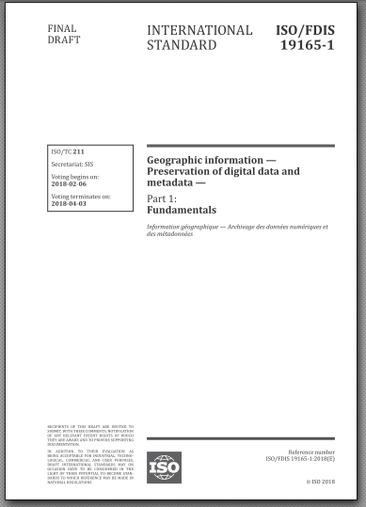
Scope
This standard sets the rules for the long-term preservation of digital geospatial data.
  These data include metadata and other ancillary data that are necessary to fully understand and rebuild the archived digital environment.
Geospatial data are preserved as a geospatial archival information package.
  This standard defines its details.
  A geospatial archival information package will be fully self-explanatory and will allow a future reconstruction of the dataset without external documentation.

Slide 5
Preservation Principles of the ISO 19165 (section 6)
ISO 14721 is the base document and the ISO 19165 defines the details and principles that go beyond and are focussing on geospatial content.
  6.1 Prioritization
  6.2 Structure
  6.2.1 Data formats
  6.2.2 Data structures
  6.2.3 Software and algorithms
  6.2.4 Properties of geospatial data
  6.2.5 Gold copy
  6.3 Rights and licensing
  6.4 Time

Slide 6
6.1 Prioritization
The exponential growth of the data volume prevents a full archival of all data.
  Consequently, only a selected subset can go for a long-term archive.
  A criteria for selecting what to preserve is needed
A temporal classification may follow the proposed categories
  1 year, 10 years, and 100 years.

Slide 7
6.2.4 Properties of geospatial data
Geospatial data often have a large number of attributes of which only a few are relevant for a specific mapping product.
  E.g, a 1:100,000 map does not show most of the road details, such as traffic lights. I
n the case of a limited archival space, this observation leads to another method of data reduction:
  assumptions about the future potential use of the data.
Based on this assumption, a decision on which of the properties and which of their details will be archived and which other will be dropped is needed.
  As a result, not all properties of the geospatial data are archived, but only those which are required to create one of the assumed products.

Slide 8
6.2.5 Gold copy
The totality of all methods can never guarantee a full recovery of the data after a very long period of time.
In order to increase reliability, a separate copy version of the 100 year data preservation should be established in an open format, file based repositories, avoiding databases, or other complex environments.
  Often, this copy if called a gold copy.

Slide 9
6.3 Rights
Authoritative geospatial data often possess legal restrictions.
Geospatial dataset licences need to include special clauses the ensure preservation and transfer of rights to the archive together with the dataset, and their regards should be guaranteed by the archive.

Slide 10
6.4 Time
According to an archiving rule the incoming data should have lost their relevance for the governmental work.
However, many geospatial data are never obsolete or are continuously updated such as cadastral data.
  These kinds of geospatial datasets never become mature for archiving.
The ISO 19165 defines a number of methods to overcome this problem.

Slide 11
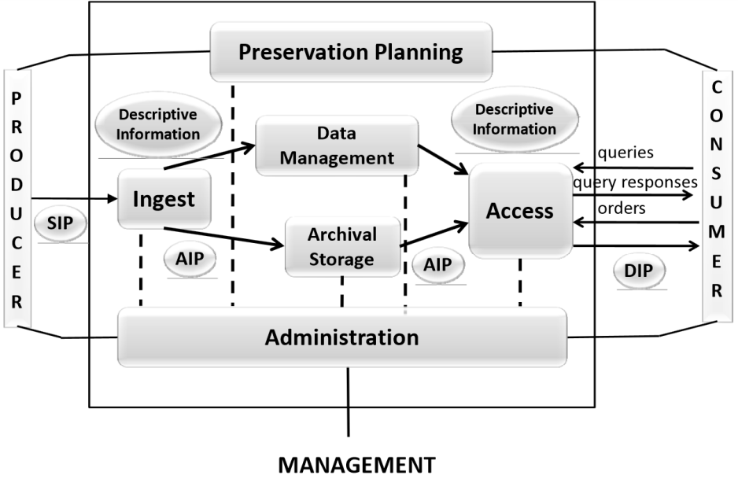
Section 7: Based on ISO 14721
An open archival information standard (OAIS) is an archive, consisting of an organization (which may be part of a larger organization) people and systems that has accepted the responsibility to preserve information and make it available for a designated community.
The Information package (IP) is central to the OAIS. The standard distinguishes further between:
  the input, the Submission Information Package (SIP);
  the storage Archival Information Package (AIP);
  the output, the Dissemination Information Package (DIP)
It does not provide any implementation or format for the IP.

Slide 12
3.3 Summary of the ISO 14721
A number of responsibilities of the organization that operates an OAIS archive:
  A sufficient control of the information needed to ensure long-term preservation,
  copyright implications, intellectual property and other legal restrictions.
Every archive needs a designated community which is able to understand the archived information without needing special resources.
Need to migrate much of its holding to different media.
  Digital migration is defined to be the transfer of digital information, while intending to preserve it.
Three major motivators are seen to drive digital migration of AIPs within an OAIS. These are
  Improved cost-effectiveness: The rapid pace of hardware and software evolution provides greatly increasing storage capacities and transfer bandwidths at reducing costs
  New consumer-service requirements
  Media decay

Slide 13
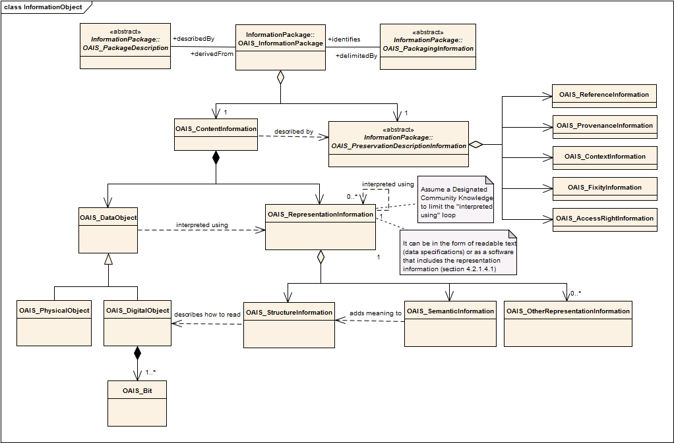
Info Packages for designated communities

Slide 14
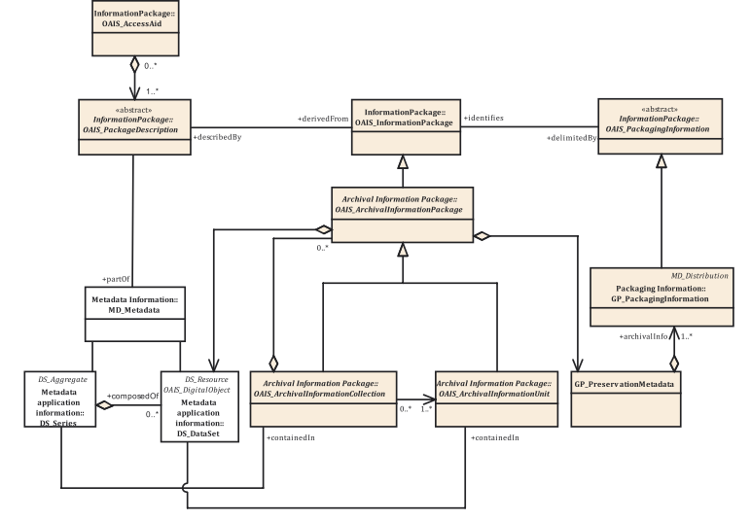
ISO19165 in the context of OAIS

Slide 15
Model design rule: Do not reinvent
Preser-vation model
ISO 19115
OAIS
PREMIS
GeoMAPP
PAAD
...
If it exists previously in the ISO19115-1 it is adopted
  If possible, we just give recommendations
  Recycling of classes, e.g. DistributionInfo is used to describe the ArchivalInfo.
  Drawback: The preservation information is "scattered" into the ISO 19115 model
    The information is re-centralized in the preservation package part
It extends ISO 19115-1 with preservation concepts
Notes:
Technical documents published by the ICGC (specifications, models etc.) are taken as they are and linked to the model.
without the need to transcribe them to a new structure

Slide 16
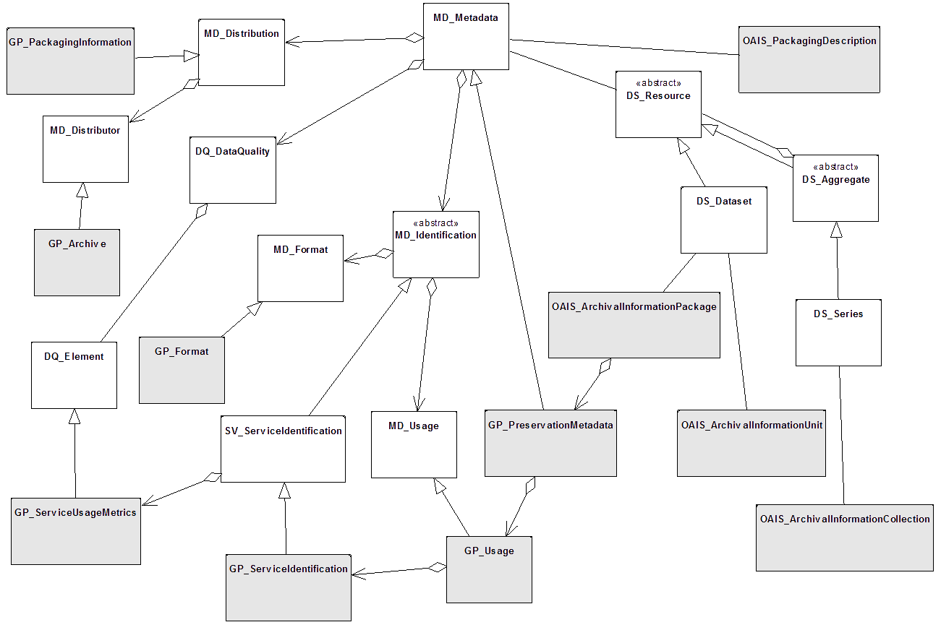
ISO 19115 was extended

Slide 17
Section 7.3
Metadata

Slide 18
Metadata
A geospatial dataset is always linked to a set of metadata.
  The metadata should be archived in a way that allows an undoubtedly reference to data
ISO 19165 will build upon the ISO 19115-1 metadata model and
  Clarifies about how to deal with data and metadata identifiers
  Add links to technical specifications, mission concepts, mission definition, data mode, etc.
  Adds:
    preservation actions,
      processes that were done by the curators and not by the original responsible parties of the dataset with the objective of preserving the data
    value, use and justification,
      documenting the administrative, legal, evidentiary, research, historical recognized value of the resource and the justification for preserving it . It also includes geospatial services usage statistics based on the data as another means of justifying its importance.
    relations to other resources,
      reuses MD_AssociatedResources and include a PREMIS relation taxonomy
    preservation package description
      lists all the parts (files and documents) that together form the AIP
    acquisition..
      how, when and with what legal constraints the dataset was given to a preservation body.
Preser-vation
Preservation actions
Preservation package
Relations between resources
Value, use and justification
Acquisition

Slide 19
GP_PreservationMetadata
Preser-vation
Preservation actions
Preservation package
Relations between resources
Value, use and justification
Acquisition

Slide 20
GP_ContextInformation
Preser-vation
Preservation actions
Preservation package
Relations between resources
Value, use and justification
Acquisition
Connection to other datasets

Slide 21

Value and strategy
Preser-vation
Preservation actions
Preservation package
Relations between resources
Value, use and justification
Acquisition
To document criteria for selecting what to preserve

Slide 22

Value of
geoservices

Slide 23
GP_PackageInformation
Preser-vation
Preservation actions
Preservation package
Relations between resources
Value, use and justification
Acquisition
What parts the package contains

Slide 24
Section 7.4
Open Packaging Conventions (OPC)

Slide 25
Open Packaging Convention (OPC)
By integrating the needs of the modern Internet environment, the OPC standard can be considered a modern version of the TAR format:
  it combines a ZIP compression of the parts composing the package (respecting a directory structure) with
  XML documents that describe the package content (that can be used to store the OAIS descriptive information),
  the web media types present in the package,
  the relations between the parts composing the package (or to external ones) and
  a quicklook of the data inside.
  optional data encryption system to guarantee both data integrity and respect the predefined access rights.
An OPC package can contain several files (the “parts”).
  allow for the interoperability of some basic data maintenance, such as the extraction of some parts of the package, thus guaranteeing that all the related resources can be extracted without the need to understand the actual encoding of the individual parts included in the package.

Slide 26

Open Packaging Convention (OPC)
OPC can be used without any modification for encapsulating geospatial data and metadata by mapping the OAIS concepts and the ones defined by this standard into the OPC concepts.
  OAIS data object (the geospatial dataset) is mapped to one or more “parts” of the OPC package.
  OAIS representation information is mapped to ISO 19115-1 metadata, symbolization information, data specification description documents, etc.; all for them are also “parts” of the OPC package.
  Then PDI is added, using the extensions of ISO 19115-1 proposed in previous sections of this document, as “parts” of the OPC.
  OPC includes its own additional parts such as a quicklook of the data.
  The OAIS packaging information in mapped to the internal ZIP headers.
  Finally, the OAIS packaging description Information is mapped to OPC core metadata stored in the core.xml “part”
This is NOT the OGC GeoPackage
  That is a SQLite and requires a transformation of the original data.
OPC

Slide 27
Mapping OPC core.xml and ISO 19115-1
OPC core metadata | ISO 19115-1 Metadata – Part 1: Fundamentals
category | MD_DataIdentification/topicCategory
contentStatus | MD_Identification/status
created | MD_Identification/citation/CI_Citation.date[CI_Date/dateType=creation]/CI_Date/dateType
creator | MD_Identification/pointOfContact[CI_Responsibility/role=resourceProvider]/CI_Responsability/party/CI_Party/name
description | MD_DataIdentification/supplementalInformation
identifier | MD_Identification/citation/CI_Citation/identifier/MD_identifier/code
keywords | MD_Identification/descriptiveKeywords
language | MD_DataIdentification/language
lastModifiedBy | MD_Identification/pointOfContact[CI_Responsibility/role=processor]/CI_Responsibility/party/CI_Party/name|MD_DataIdentification/environmentDescription
lastPrinted | MD_Identification/citation/CI_Citation.date[CI_Date/dateType=publication]/CI_Date/dateType
modified | MD_Identification/citation/CI_Citation.date[CI_Date/dateType=revision]/CI_Date/dateType
revision
subject | MD_Identification/abstract
title | MD_Identification/citation/CI_Citation/title
version | MD_Identification/citation/CI_Citation/identifier/MD_identifier/version

Slide 28
Going into practice

Slide 29








Creation of XML Schemas
Shape
Change
ISO UML
UML
preservació
Preservation XMLSchemas
Preservation
HTML
Schemas
ISO 19115-1
ISO 19115
example
115 → 115-1
ISO 19115-1
example
Preservation
example
→ HTML

Slide 30
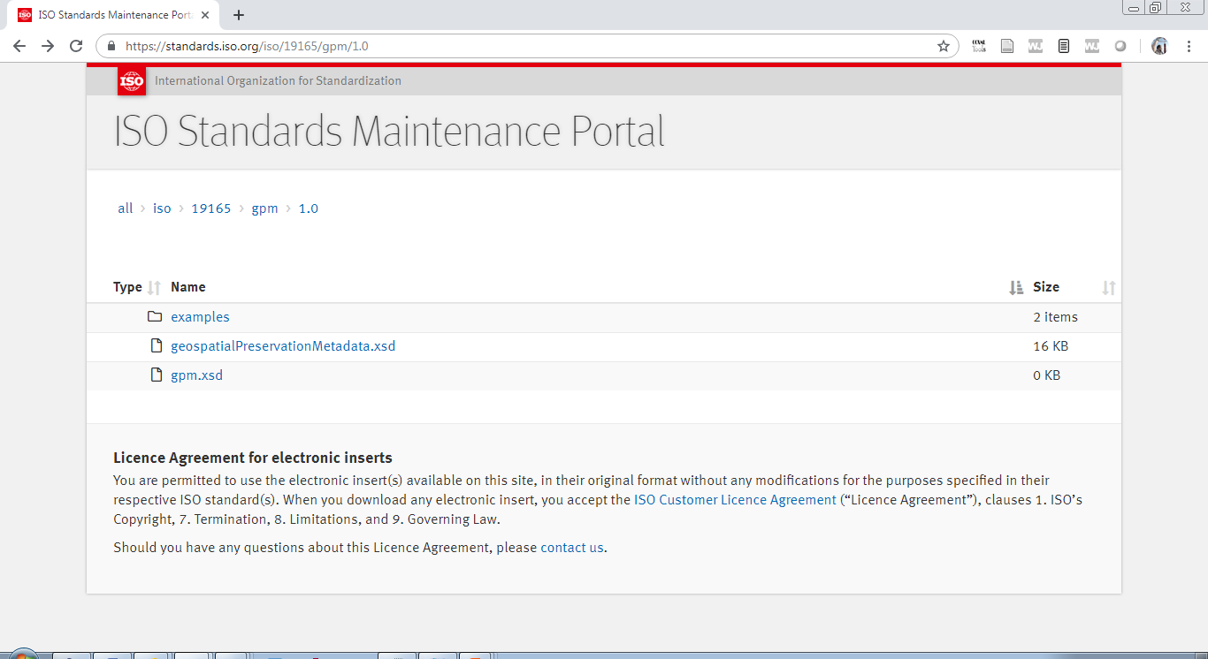
XML schemas are available

Slide 31
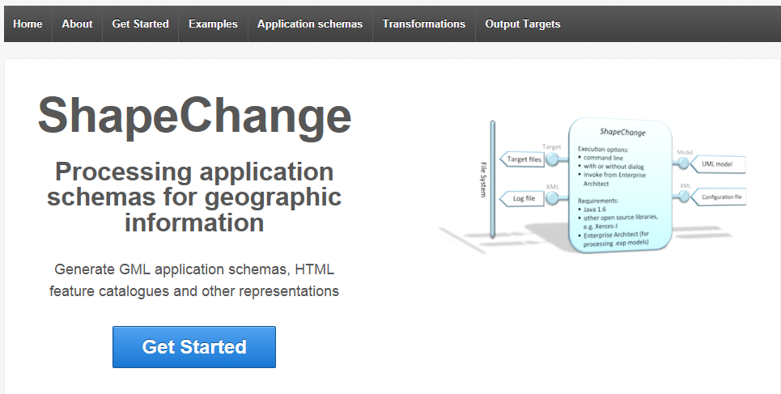
Transformation of the model to XSD
If the UML is generated following certain rules, it is possible to make an "automatic” transformation.
Program developed by the company of Interactive Instruments and that has been used to generate
  The XSD of the INSPIRE
  model GML
  The XSD of the ISO 191115-1
  (that will be called 19115-3)

Slide 32
How to start with ISO 19115-1
Thanks to the relationship with Ted Habermann (current Chair of the XML group of TC211) we obtained:
  Access to the draft of the XSD schemas of the 19115-3
    It has a modular design that requires the definition of many different interrelated namespaces
  Access to an XSL that allows the automatic transformation of XML document s from 19115 (19139) to 19115-1 (19115-3)
We created a new namespace "gpm" (Geospatial preservation metadata) with the provisional large name http: // www.opengis.uab.cat/preservation

Slide 33
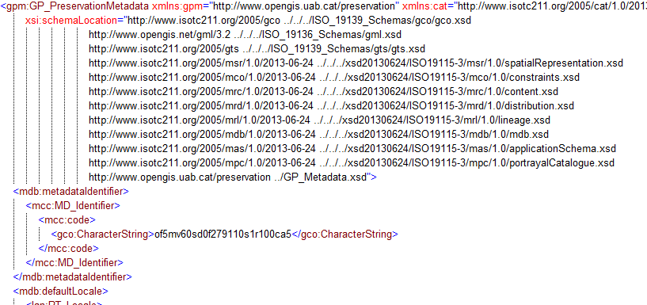
XML document: preservation parts

Slide 34
Identifiers
Reference information
Identifier: GPM_of5mv60sd0f279110s1r100ca5
Description: storage code
Responsible organization: IT department
Responsible person: J. Fuentes
Position: Head of the IT department
Phone: +34935671500

Slide 35
Technical documentation
Attached documentation
Title: TECHNICAL SPECIFICATIONS for the Ortofoto de Catalunya 1:5000 (OF-5M) v6.1
Date: 2012-12-31T00:00:00
Data type: revision 1.0
Edition: 6.1
Related organization: Institut Cartogràfic de Catalunya
Role: creator
Title: MrSID FORMAT SPECIFICATIONS for the Ortofoto de Catalunya 1:5000 (OF-5M) v6.1
Date: 2011-06-30T00:00:00
Data type: revision 1
Edition: Format implementation 1
Related organization: Institut Cartogràfic de Catalunya
Role: creator

Slide 36
Packed information
Package information
Package identifier: GPM_of5mv60sd0f279110s1r100ca5
Responsible organization for the identification: ICGC-Map Library
Responsible person for the identifcation: Carme Montaner
Position: Head of the Map Library
Contact phone: +34935671500
Description: This is the preservation package for the orthophoto of5mv60sd0f279110s1r100ca5
Responsible person for the preservation: J. Fuentes
Position: Head of the IT department
Role: Storage responsible
Contact phone: +34935671500
Date: 2019-12-31T00:00:00
Data type: Limit for preservation
Storage formats
Package components
File name: of5mv60sd0f279110s1r100ca5.xml
File size: 0.006MB
Information type: metadata
Usage restrictions: Intellectual property rights

Slide 37
Context information
Context information
Resource name: Base topogràfica de Catalunya 1:5000 – Full “Monistrolet” (279110)
Identifier: bt5mv20mm1f279110c1r040
Identifier description: Resource identifier
Association type: Reference
Initiative type: campaign
Metadata document title: Metadata for the Full “Monistrolet” (279110)
Metadata document identifier: bt5mv20mm1f279110c1r040ca5
Identifier description:

Slide 38
Preservation actions
Preservation actions
Action description: File transformed to the new datum ETRS89

Slide 39
Value, justification and use
Value and justification
Value type: administrative
…

Slide 40

MMZx. An implementation of the OPC

Slide 41
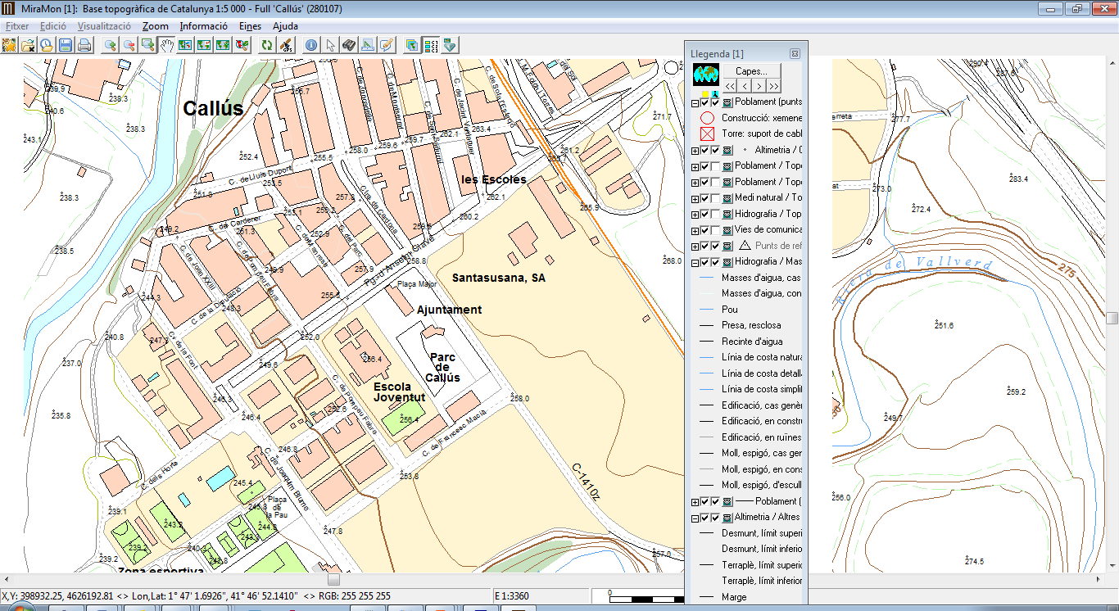
A topographic example
Home

Slide 42
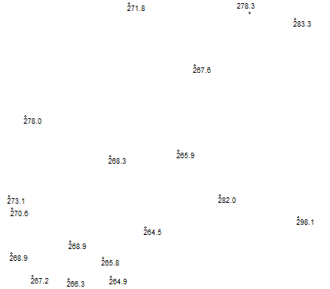
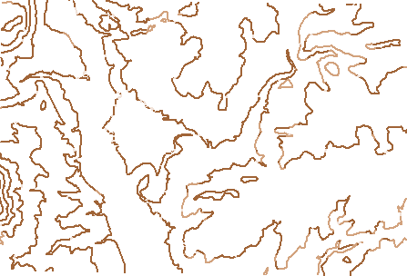

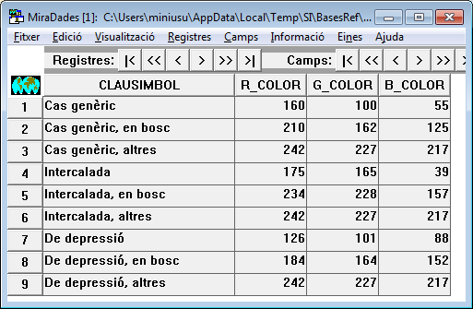
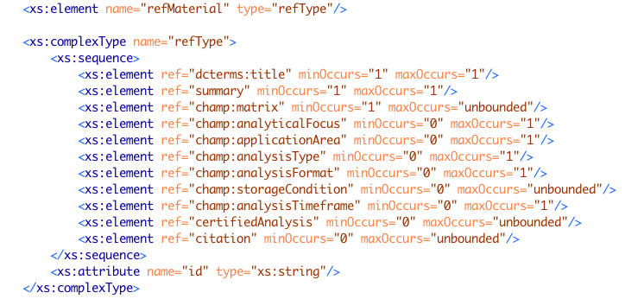
A topographic composition
539 files in 8 folders
  9 point files
  21 line files
  21 node files
  11 polygon files
  116 tables
  10 color and symbol tables
  3 vector icons
  153 metadata and data model files
  156 certification files
  38 maps
  1 entry point to all data

Slide 43
How to collect all elements?
Parts are connected by implicit links and explicit links in maps and metadata
It is possible to automatically discover the links
It is possible to store all parts in a single file ensuring that the links are preserved and all elements are there.
The resulting document can be archived, shared and easily opened.
And we called MMZ

Slide 44
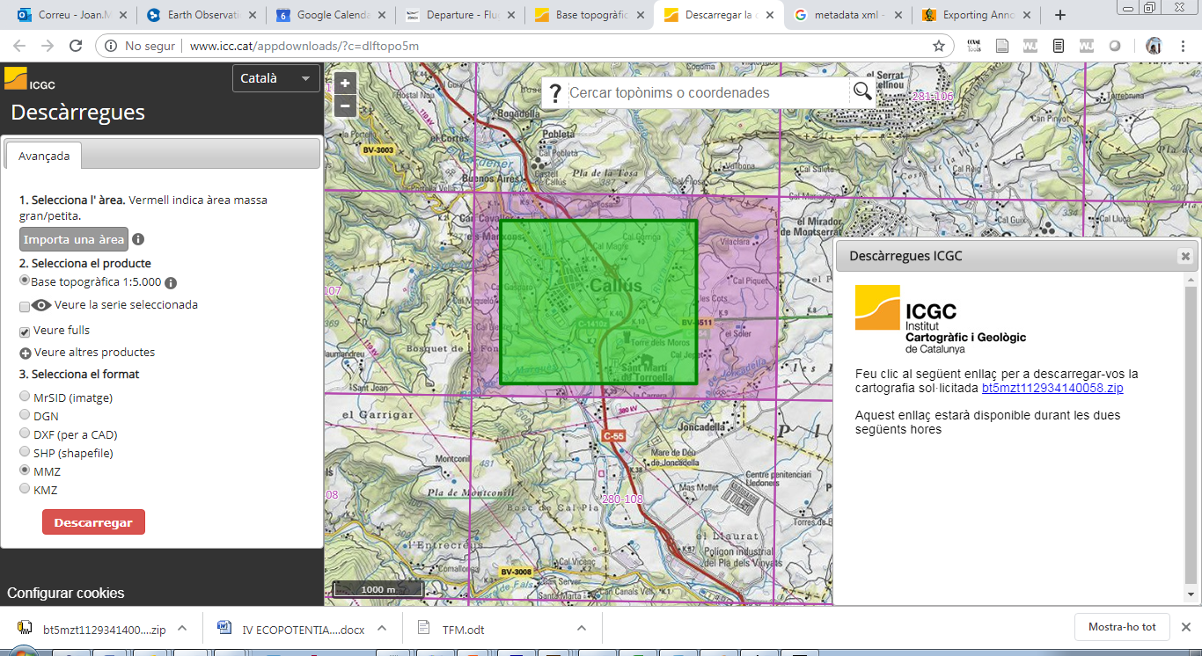
An the Catalan Carto. Inst. Uses it
It worked but it was not an standard

Slide 45
The alternative of OPC
OPC integrates elements of the ZIP compression, XML documents, and the web MIME types into an open standard that makes it easier to organize, store, and transport application data. It was defined by Microsoft and submitted to ISO and approved as ISO 29500-2 and ECMA-376.
It is used by Office 12 and above versions of Word (.docx), Excel (.xlsx), and PowerPoint (.pptx), along with XPS (.xps), Autodesk AutoCAD (.dwfx), etc.
An OPC package can contain several files with a directory structure in it. Each file is called a part and all OPC package part names have to follow the URI restrictions and conventions.
OPC specifies how to explicitly relate different parts using .rels files. These files are simple XML files that have the same name that a source part adding “.rels” and placed in a rels.
  Each of these files lists the target parts related to each source and the semantics of this relation.

Slide 46
Packaging geospatial information
The MiraMon GIS software developed by CREAF implements it.
  It is called the MMZx
The implementation consists on an automatic ZIP compression tool that collects all the elements necessary to reproduce the data in another computer:
  Data
  Metadata
  Symbology including printing configuration
  Context...
MiraMon GIS software is able to open an show the package without explicit decompression by the user.
It has now two applications
  Distribute geospatial information easily on the Internet as a single file easy to open with MiraMon
  Preserve data and metadata following ISO 19165 section 7.4

Slide 47
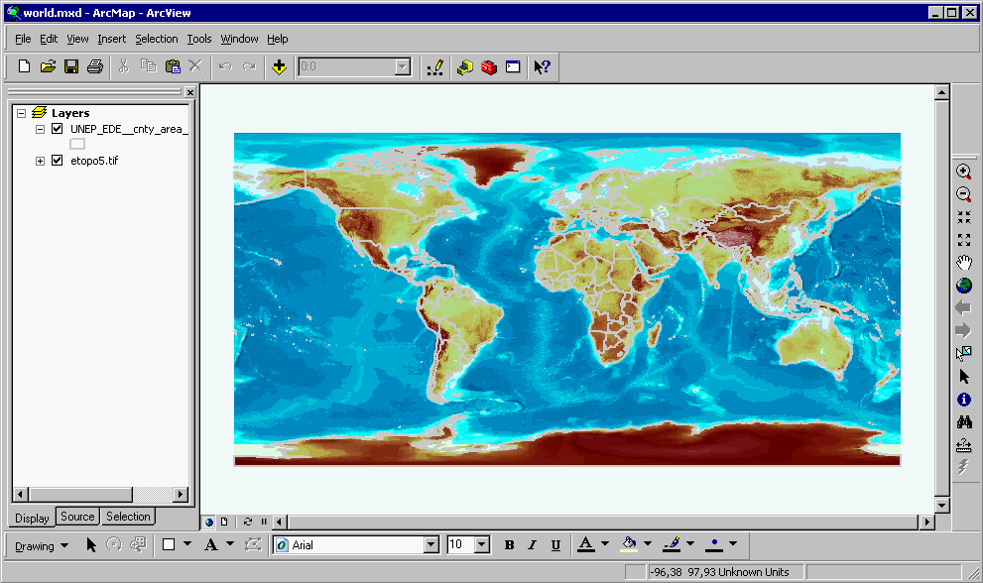
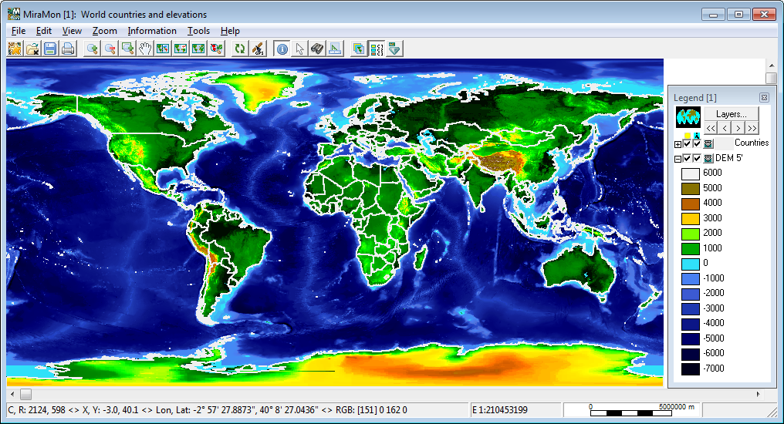
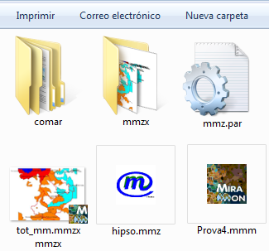
In use as preservation package.
It has been adopted by the Catalan Government as preservation tool
  It user the capability of having more that one entry point and redundancy:
    It compresses the original MiraMon format
    It replicates raster in GeoTIFF format and vector in GML format to ensure preservation.
  Since it is a ZIP file it will always decompress even if MiraMon software is discontinued
    Support to >4Gb with ZIP64.
  GeoTIFF and GML will always be readably by any vendor respecting the standard

Slide 48
Final comments
The metadata model (in section 7.3) is fairly complete but and tools to bring it into practice are needed.
  Catalan Cartographic and Geologic institute is considering to use it in its Cartographic Library
Standards are not written in stone and are reviewed and improved every 5 years
  E-ARK4ALL needs and lessons learnt can be added to next ISO 19165 as new aspects.
  There is also a ISO 19165-2 initiative for Remote Sensing that is in very draft status now
  Or… the E-ARK4ALL standards/solutions could be moved to ISO 19165-3
Offering OGC has a Data Preservation working group (no very access recently) that we could use to connect EU activities with other continents.
  Next OGC meeting in June in Leuven?

Slide 49
Thanks
Joan.Maso@uab.cat
Notes:
Falta el logo de MiraMon 20 anys.

