Slide 1
eArchiving Geopreservation Conference
The overview of
EC INSPIRE Directive
Mateja Urbančič | mag. Matej Sotlar
6 May 2019

Slide 2
INSPIRE ???
Infrastructure for Spatial Information in the European Community

Slide 3
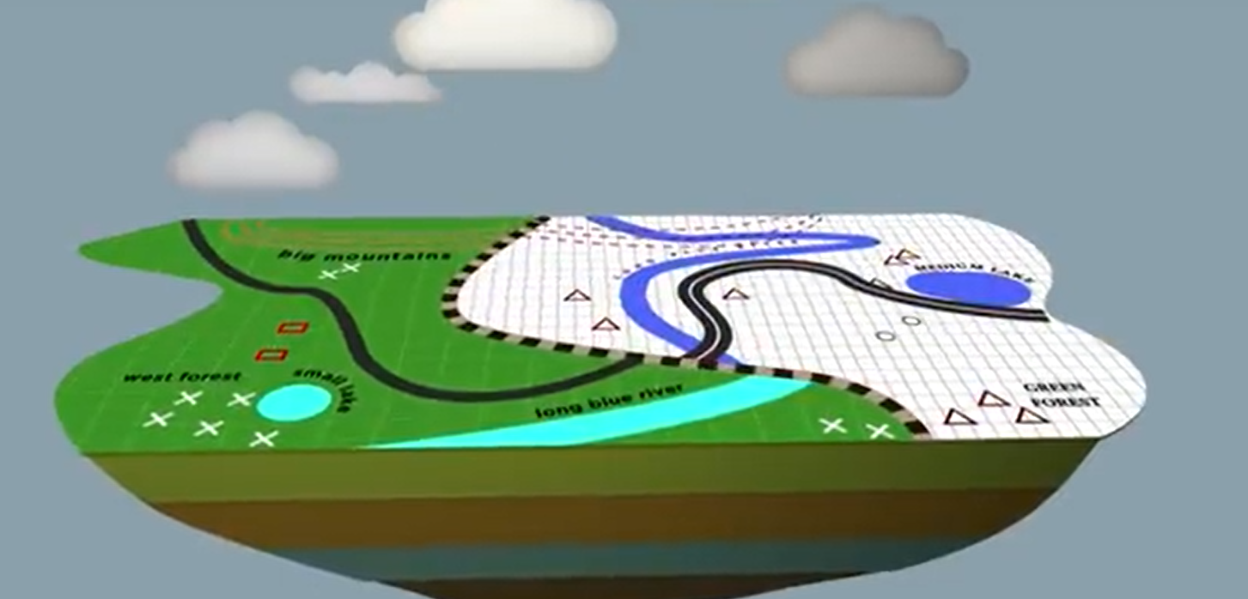
Why INSPIRE
Each country has a specific way to describe data
Data are not always available
Different standards
COMMON STANDARDS TO DESCRIBE AND SHARE DATA
Notes:
Why INSPIRE
each county has its own way to describe data. We know, that rivers, roads don’t end with the border. Governments and Local authorities need to have data to predict the impact to their local community. Data are not always available and countries use different standards. That is why the European commission set the legislation for common standards to describe and share data.

Slide 4
DIRECTIVE INSPIRE
Came into force on 15 May 2007
Full implementation by 2021
Compatible and usable Infrastructure of MS
Implementing rules:
Metadata
Network services
Interoperability
Spatial data sets and services
Notes:
The directive came into force on 15 May 2007. The implementation was formed in various stages, with the requirement to be fully implemented by 2021. The main goal is to ensure that the Infrastructure for spatial information of the Member States are compatible and usable in a Community and transboundary context. The Infrastructure, created by the Member state, should be compatible with common INSPIRE Implementing rules.
Implementing rules are legally binding and are adopted for several areas:
Metadata (metadata are created for the spatial data sets and services corresponding to the themes listed in Annexes I, II and III, and that those metadata are kept up to date ,
Network services - specify common interfaces for web servises (view, download, discover…),
Interoperability (common data models, code lists, map layers and additional metadata on the interoperability to be used when exchanging spatial datasets),
Spatial data servises (interoperability of spatial data services is characterised by the capability to communicate, execute or transfer data among them

Slide 5
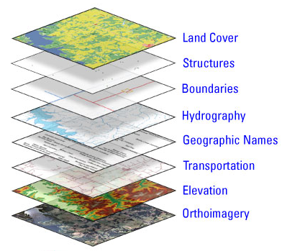
Which SPATIAL DATA
Area of the Member States
Available in electronic format
Relate to one or more themes listed in Annex I, II, III
Notes:
The Directive covers spatial data sets that relay to an area of the Member state, are available in electronic format and relate to one or more of the themes listed in Annex I, II, III. E.g. for each data set we have to add the theme (in the metadata) If we have the data sets Nature2000 we have to add the theme Protected Sites. One theme can have more data sets listed.

Slide 6
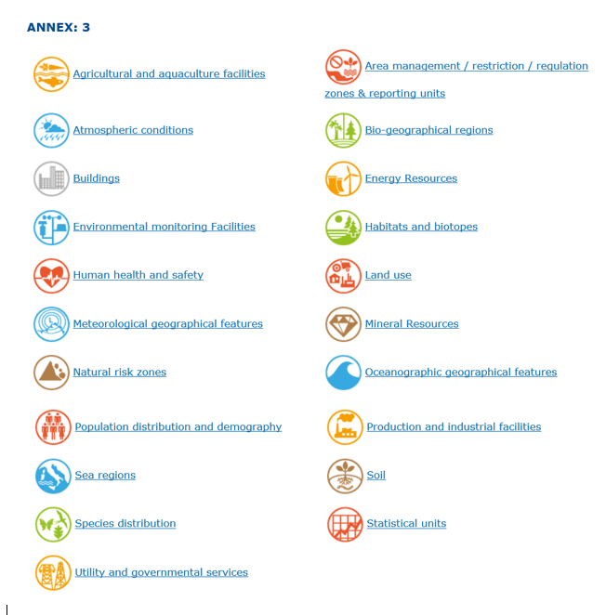
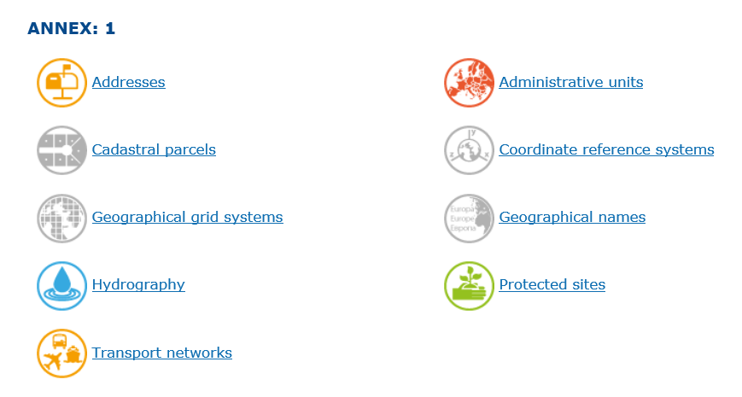

Slide 7
TECHICAL GUIDELINES
Detailed implementation aspects
Relation to existing standards
Normative References: ISO standards from 19100 series
Notes:
For each theme there are detailed implementation aspects and relations with existing standards, described in Technical Guidelines documents. These documents are non-binding and describe how legal obligations could be implemented. These are very large documents, with requirements and recommendations about application schemas, code lists, enumerations.

Slide 8
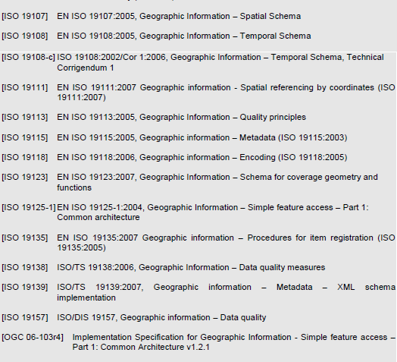

Slide 9
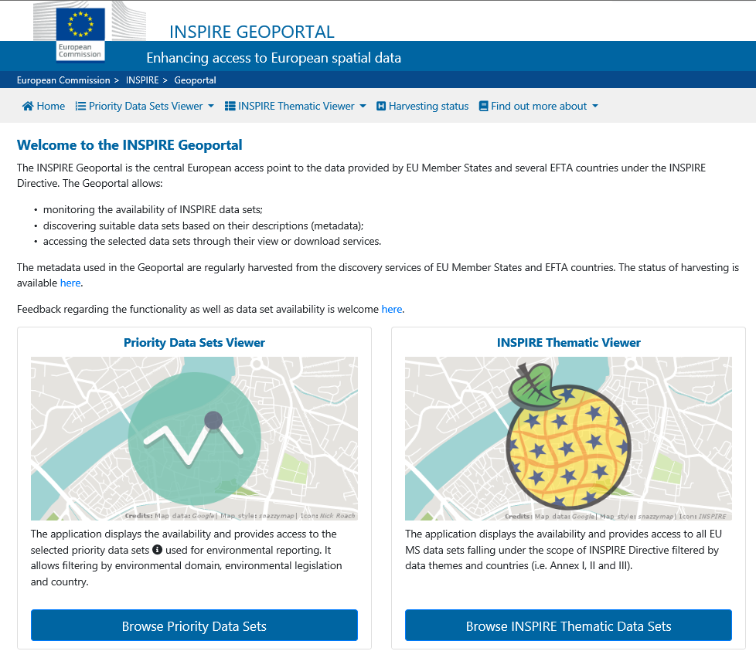
INSPIRE GEOPORTAL
Notes:
This is the geoportal, where you can access to the data. You can see which data sets are available; you can discover data sets based on the metadata, or you can access the data sets through view or download services. There are two viewers, Priority data set (data sets for environmental reporting) and the Thematic viewer

Slide 10
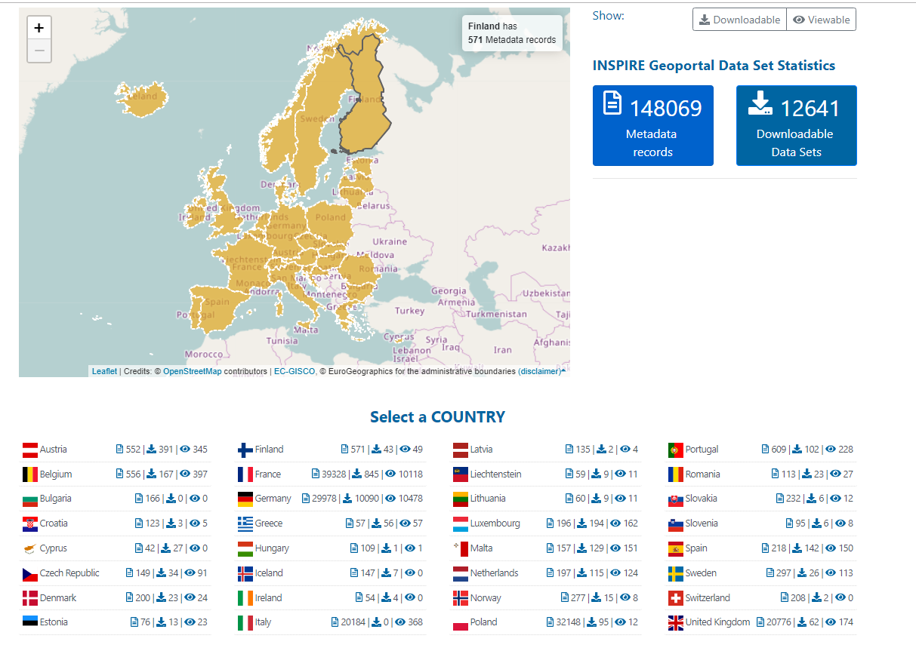

Slide 11
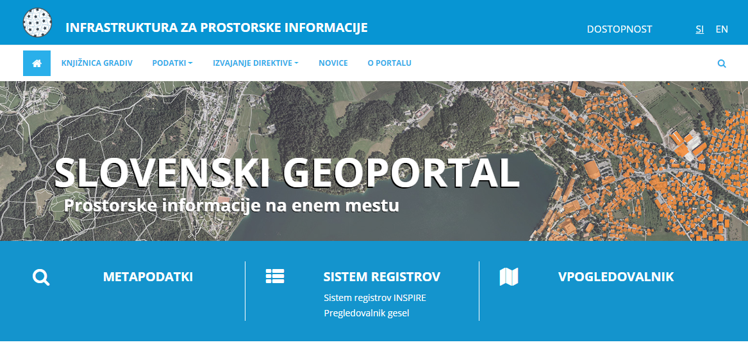
INSPIRE IN SLOVENIA
The Program of the projects eProstor

Slide 12
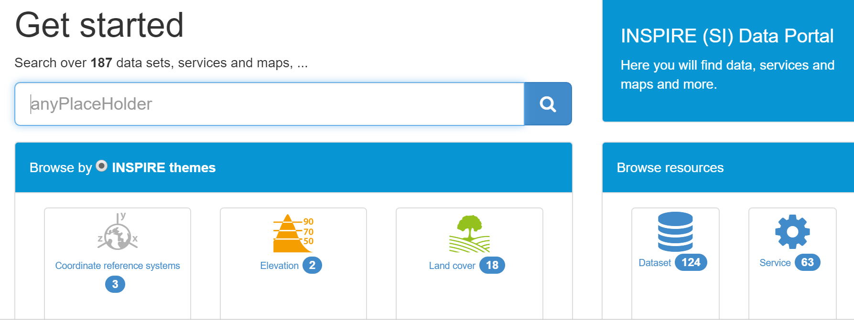
INSPIRE IN SLOVENIA
INSPIRE Metadata system

Slide 13
CONCLUSION
BEFORE
AFTER

Slide 14
Thank you for your attention.

