Slide 1
Enhancing evidentiary value of land registry records by the use of blockchain
Ph.D. Hrvoje Stančić, full professor
Department of Information and Communication Sciences
Faculty of Humanities and Social Sciences, University of Zagreb, Croatia
hstancic@ffzg.hr
Rina Milošević, Master of geography – Geographic Information System
rina.milosevic91@gmail.com

Slide 2
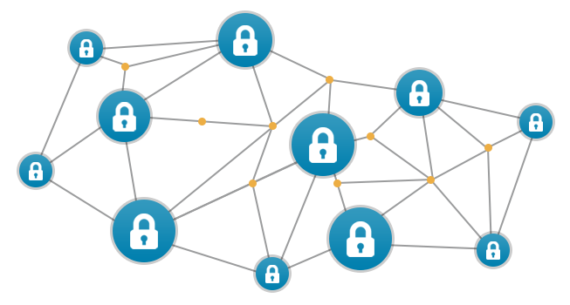
Contents
Cadastral records in Croatia
Digitization
Digital registries in Croatia
Long-term data management
Blockchain
Conclusion

Slide 3
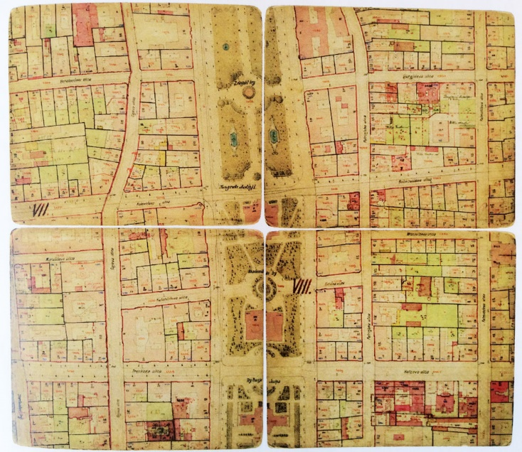
1. Cadastral records in Croatia
Registering realty properties and technical data on land – dual system
cadastre – kept by State Geodetic Administration regional cadastral offices
land registers – kept by municipal courts
Tradition from 19th Century

Slide 4
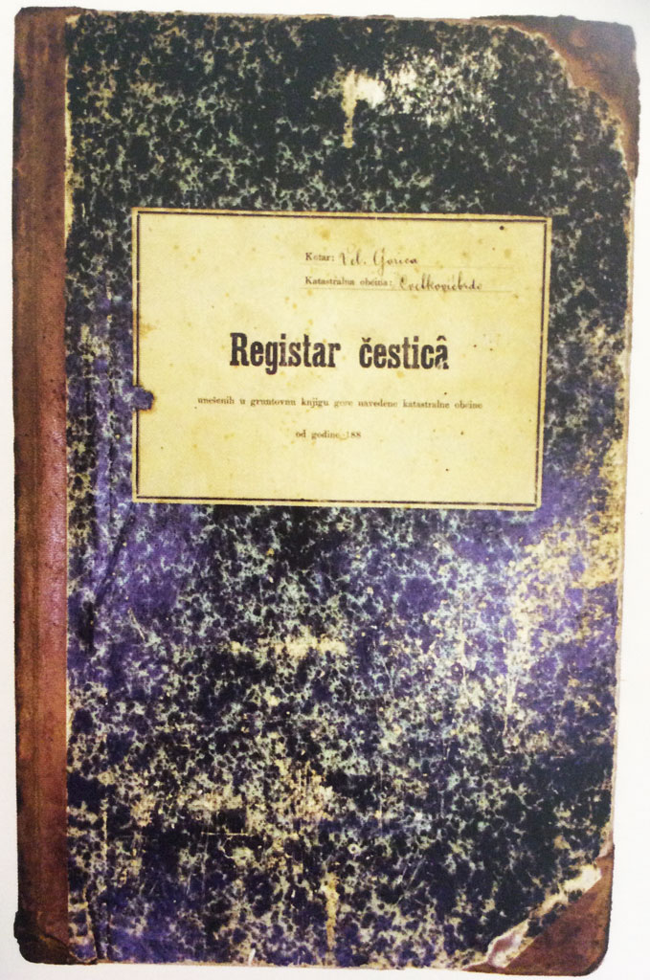
2. Digitization
Evidence of title recorded in the land registry records enable
right of ownership
land-related rights
legal transactions of ownership
Digitization
evidentiary value needs to be secured and safe from any unauthorised manipulation

Slide 5
3. Digital registries in Croatia
Digital registries
need to be cleaned from errors
some reambulation is necessary
Challenges
high costs
increase the number of officials
owners to confirm agreement with the data
harmonization of records of land registry and cadastre

Slide 6
4. Long-term data management
Digitized and harmonized data
publically available
centrally stored in a registry offering API connections
The need to
secure evidentiary value of the records
provide proof that the information is correct
Result
reduction of corruption
transparency
reliability

Slide 7
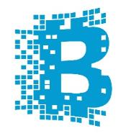
5. Blockchain
Distributed ledger technology (DLT)
Uses append-only principle
Chains blocks of hash values
Peer-to-peer consensus
Decentralization of control over truth
Immutable representation of transfer of possession available to all participants

Slide 8
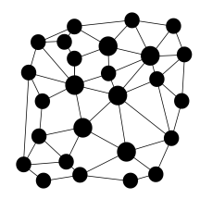
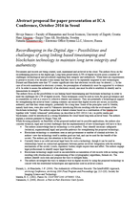
5. Blockchain …
Blocks' creation direction
Distributed
ledger
Distributed
ledger
Block n
Block n+1
Hash of the previous block
Top hash
Block hash
Hash of the previous block
Top hash
Block hash
[…]
[…]
[…]
[…]
Block documents
7d8c5b62dcb44023
3f7eaac1ec49e4c3
86b8089c37d69ab5
1bc674b8877cb032
Block documents

Slide 9
5. Blockchain …
EnigioTime – blockchain aggregator (time:beat)
Shared ledger
timestamped
block
verification
time
Blockchain aggregator
sealed block
Clock
document / record hash
receipt (chain of proof)
Digitization / digital records
Land registry
Users

Slide 10
6. Conclusion
Blockchain – true archival technology
Registering hash values of the land registry records in the blockchain
confirm integrity
existence or creation at a point in time
confirm sequence
support/enhance non-repudiation
improve validation

Slide 11
Enhancing evidentiary value of land registry records by the use of blockchain
THANK YOU!
Ph.D. Hrvoje Stančić, full professor
Department of Information and Communication Sciences
Faculty of Humanities and Social Sciences, University of Zagreb, Croatia
hstancic@ffzg.hr
Rina Milošević, Master of geography – Geographic Information System
rina.milosevic91@gmail.com

