Slide 2
References
148/212 municipalities (70%)
DARS d.d.
Ministry of infrastructure
SEL
Triglav insurance company
SiDG
GDPR data security specialist
Microsoft Gold Certified Partner
TISA member
Trusted partner for all our customers.

Slide 3
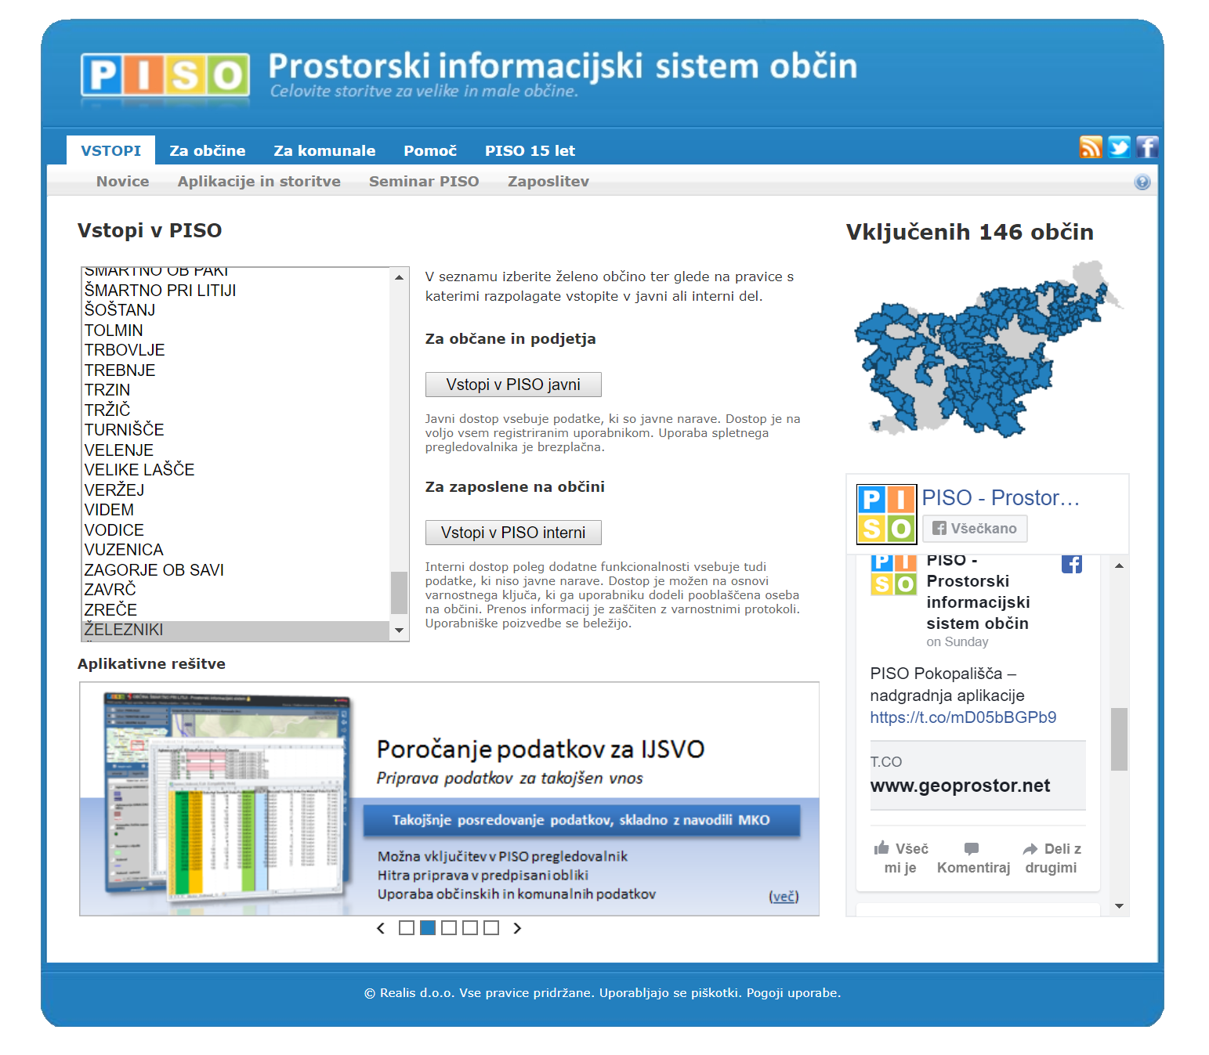
www.piso.si
Complete GIS suite for municipalities
10+ modules covering all areas of the municipality's work
Automatic data sync with state providers
Low cost solution, managed from a central location
Desktop, web & mobile
GDPR covered
18+ years in business
70% municipalities in SLO use PISO
Over 100.000 registered unique users

Slide 4
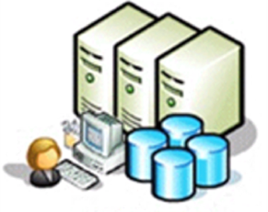
Automatic data sync with state providers - weekly
Surveying and Mapping Authority(GURS)
Slovenian Business Register
Ministry of Agriculture, Forestry and Food
Environment Agency
Water Agency
Slovenia Forest Service
Ministry of Culture
Ministry of the Environment and Spatial Planning
Zemljiški kataster
Kataster stavb
Register prost. enot
REN, GJI
DOF 050, karte…
Statistics, Geology, Electric car charging stations …
User specific DATA
Most complete collection of spatial data in Slovenia.

Slide 5
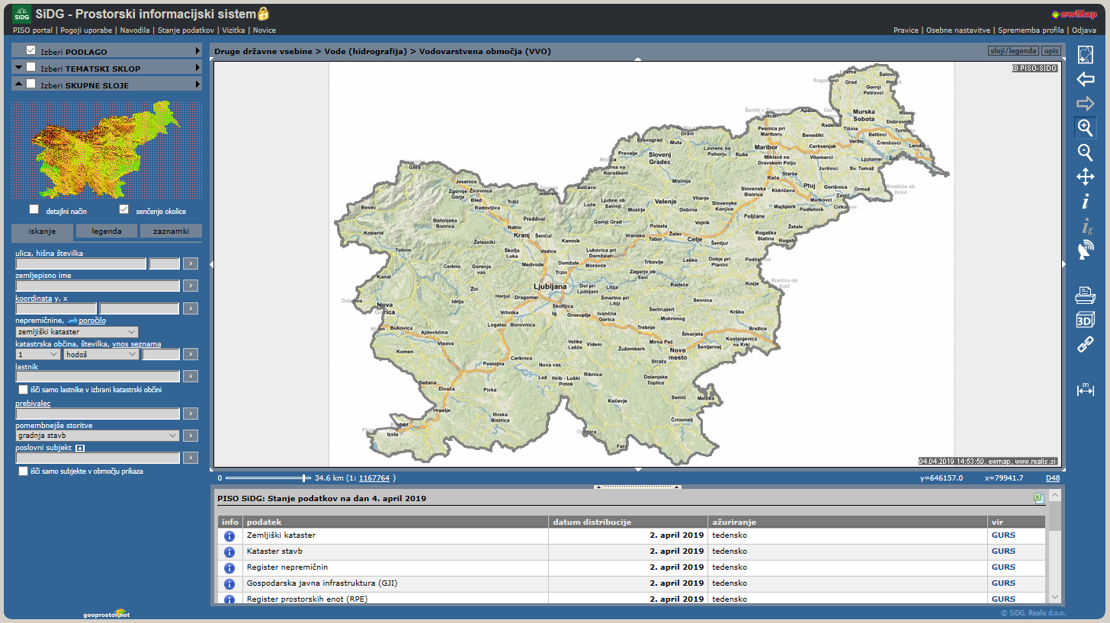
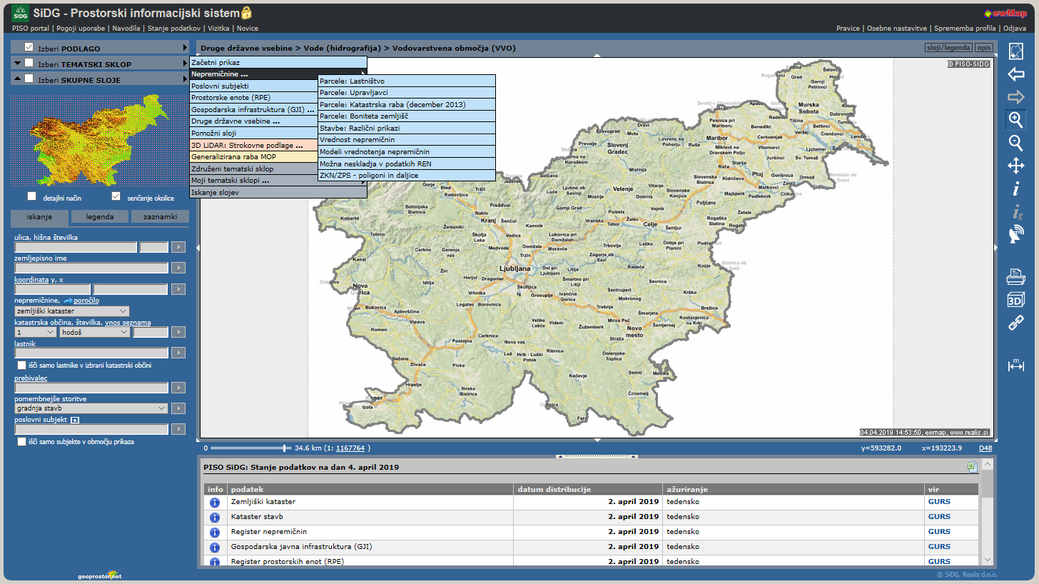
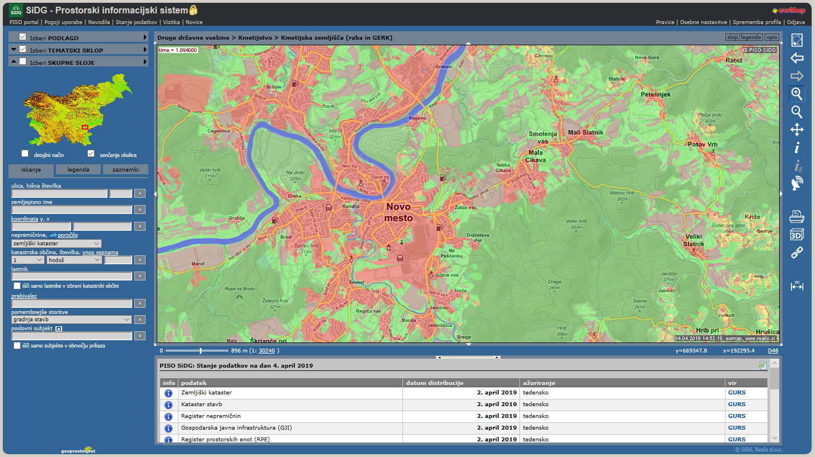
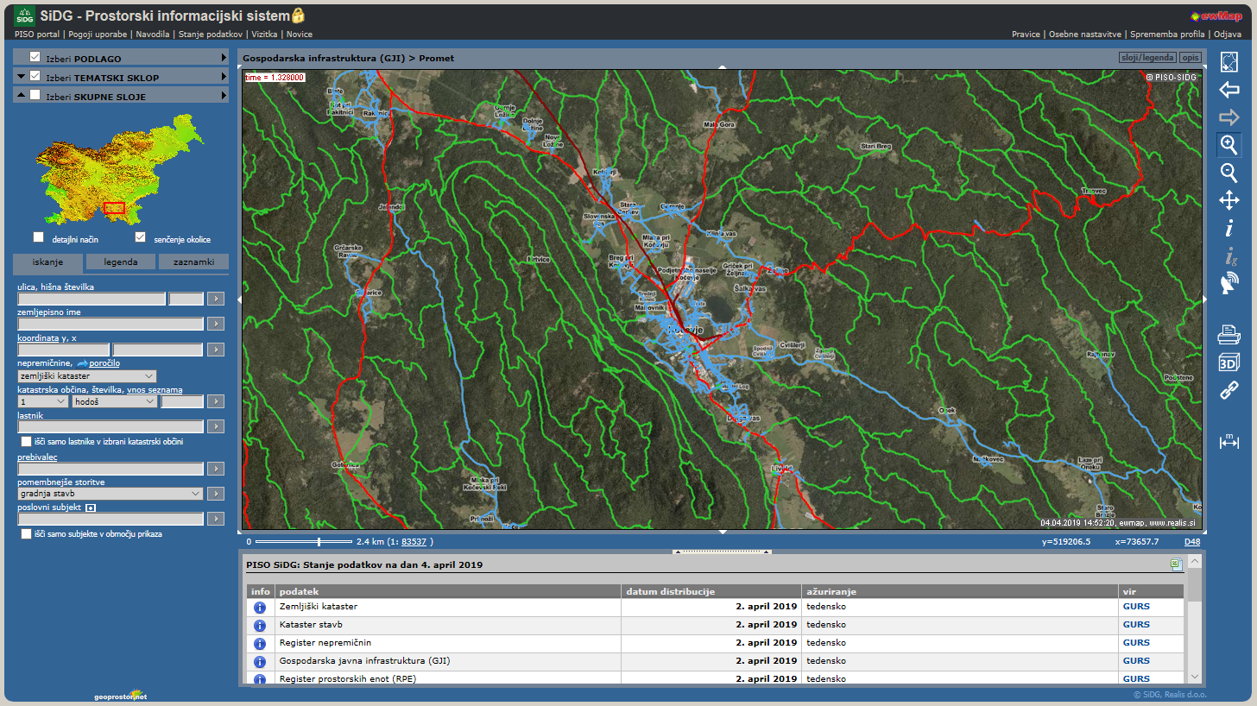
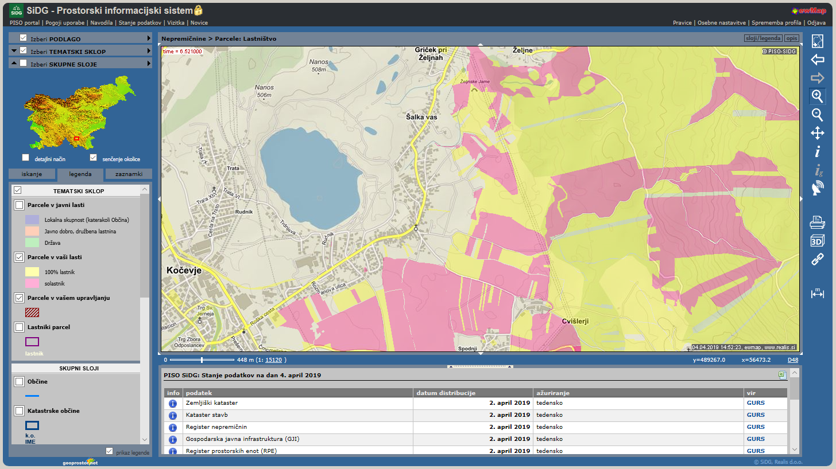
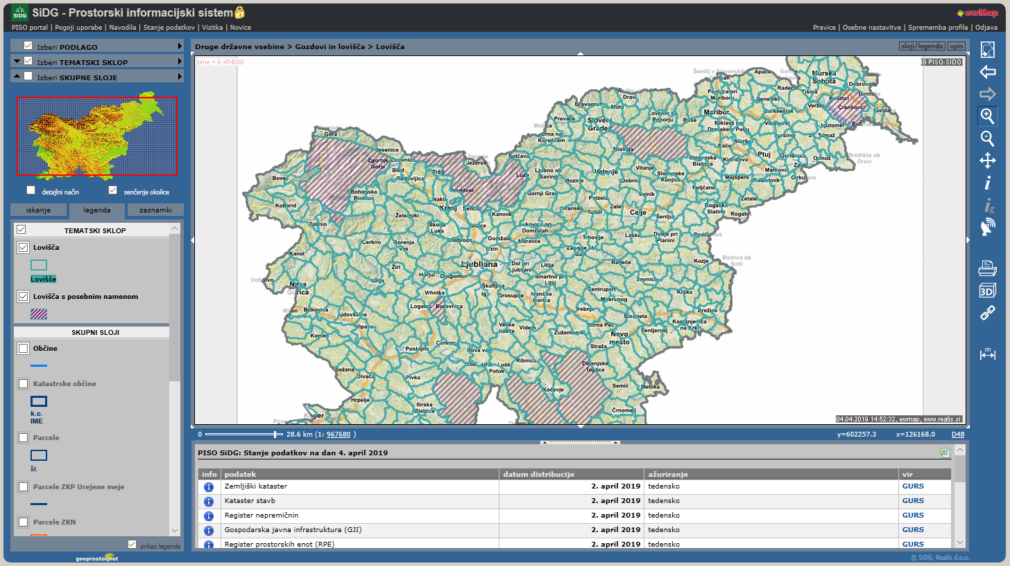
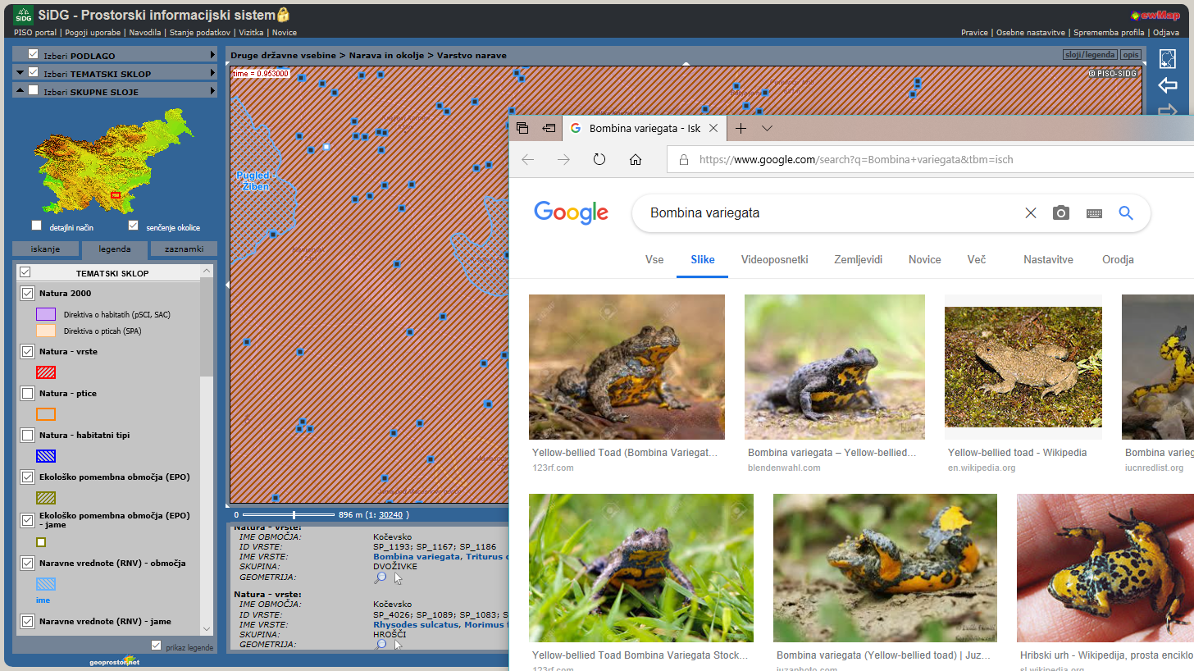
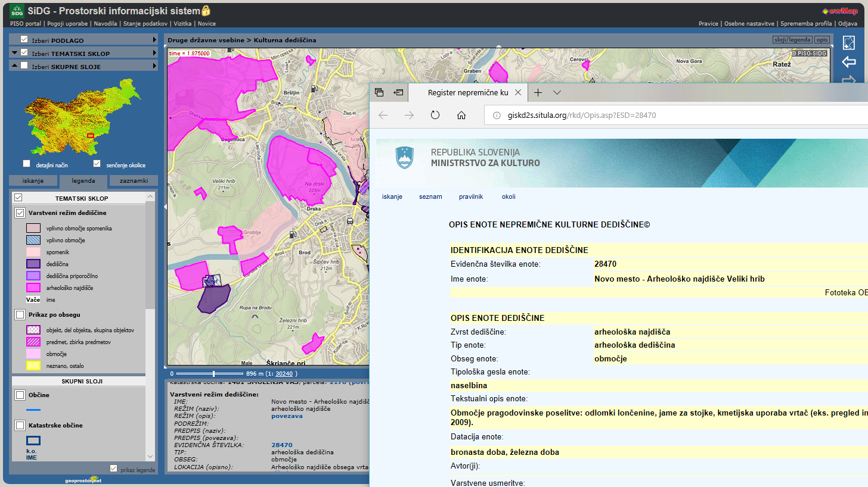
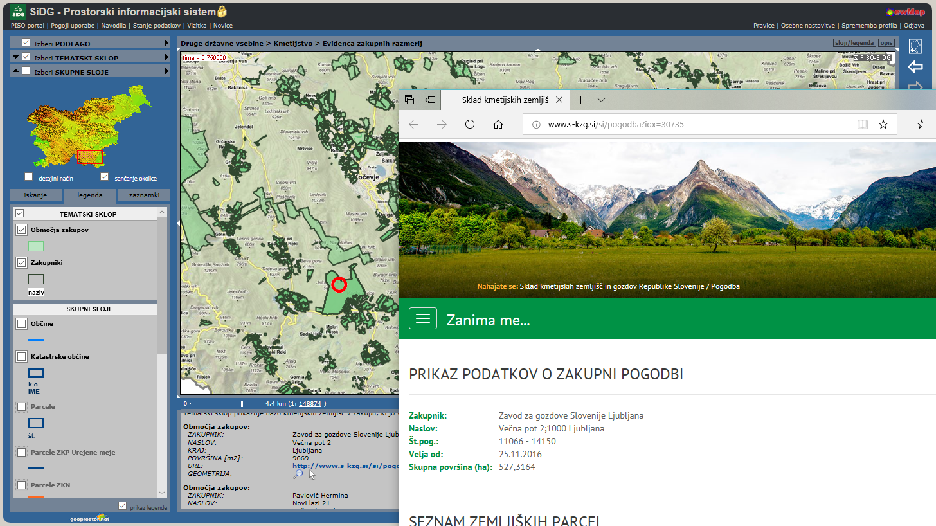
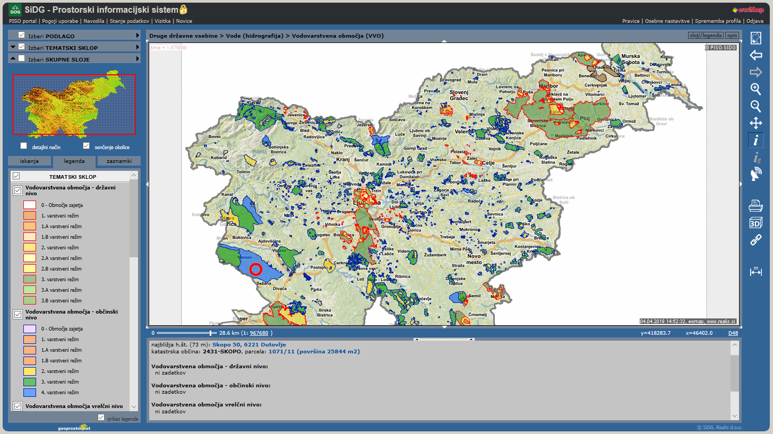
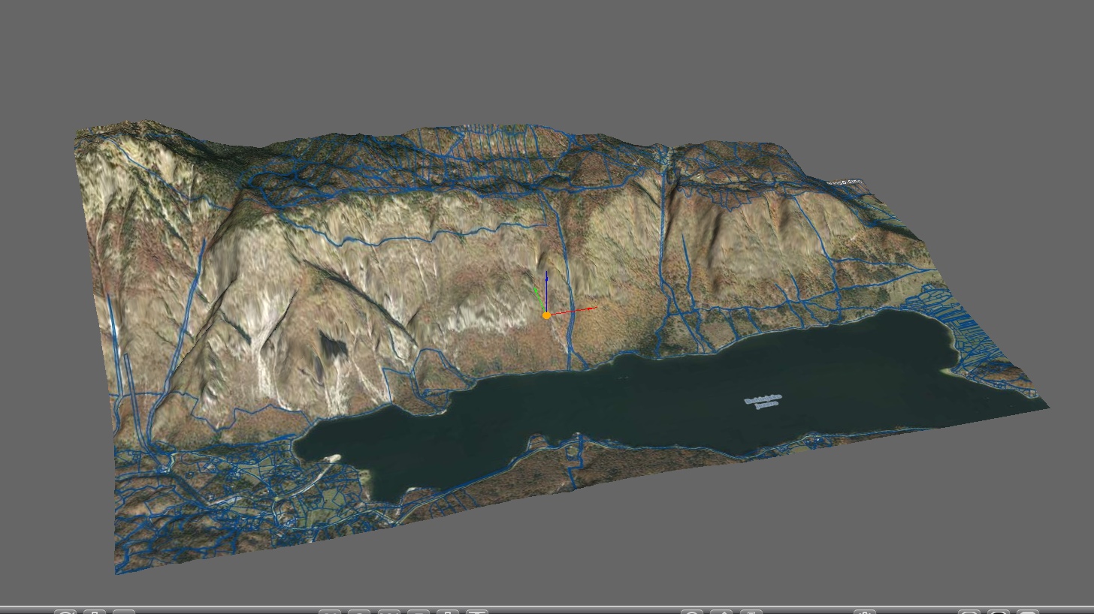
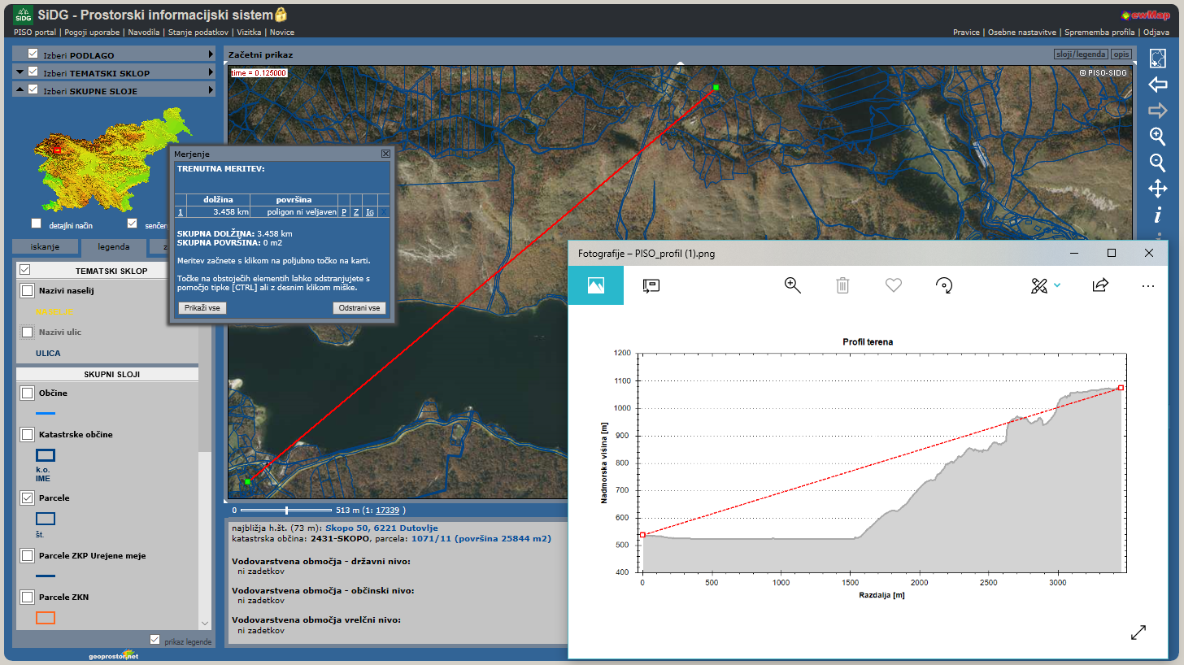
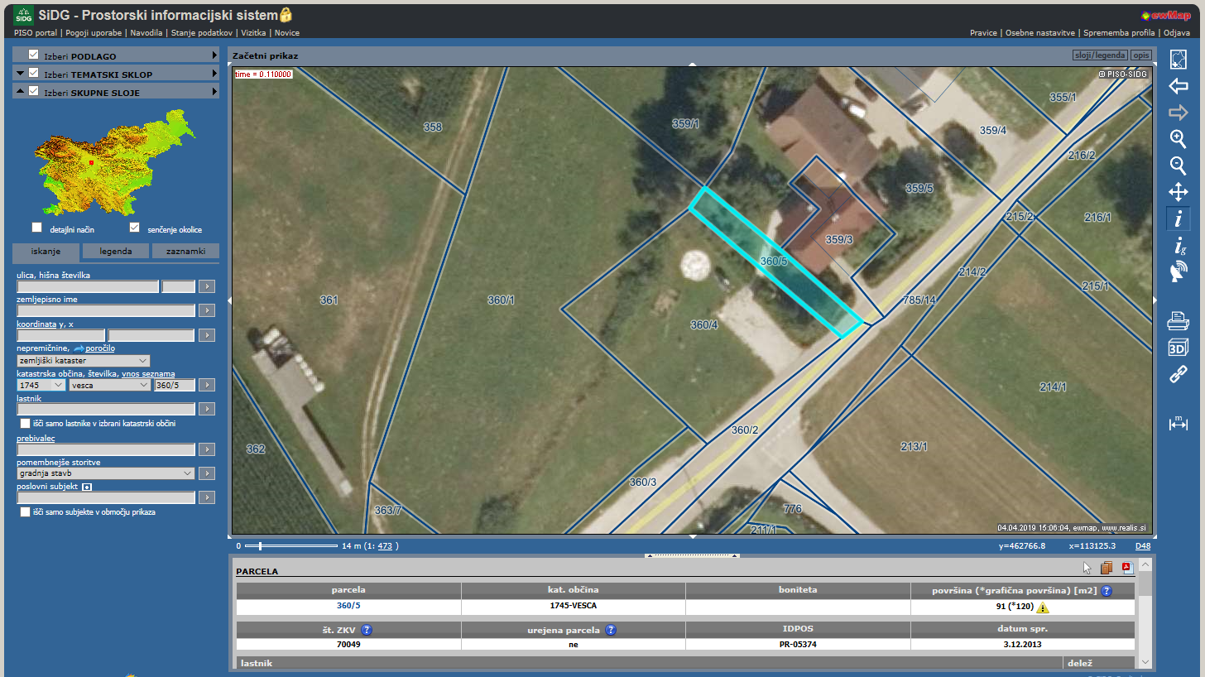

Slide 6
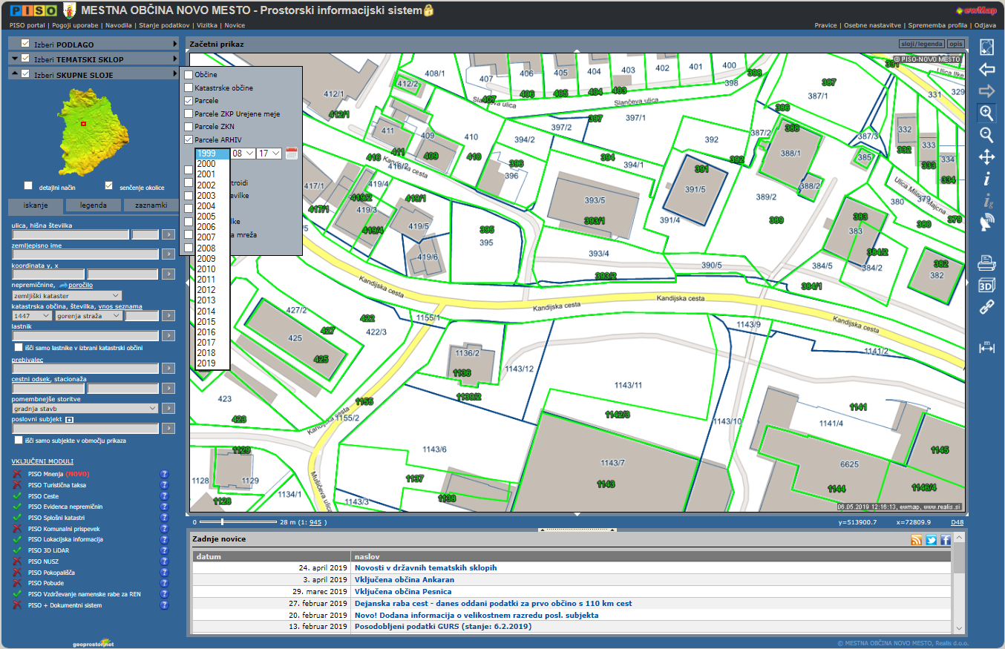

Slide 7
