Slide 1
Geodata as Instrument, Archival matter and Connector
Experiences from Belgian State Archives and National Mapping Agency
Rink W. Kruk
National Geographic Institute Belgium, State Archives of Belgium

Slide 2
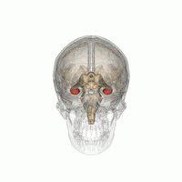
The Location of Location
Place is the referrer of memories
Central place in our brain
Very old ‘connector’
Location Reference damaged (Alzheimer)
→ Everything messed up

Slide 3
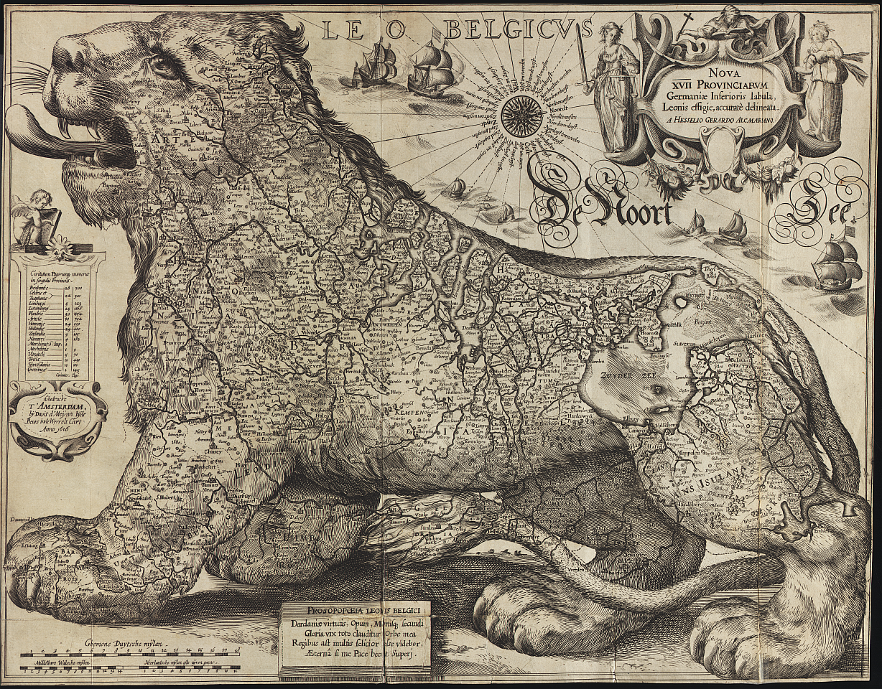
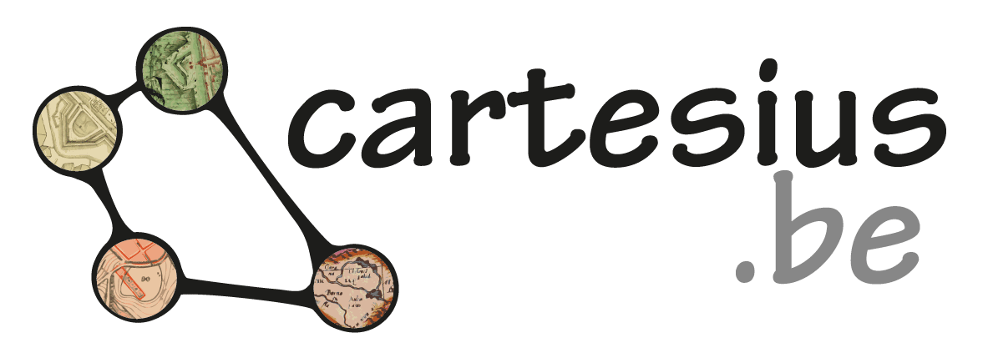
Leo Belgicus (Benelux), 1616

Slide 4
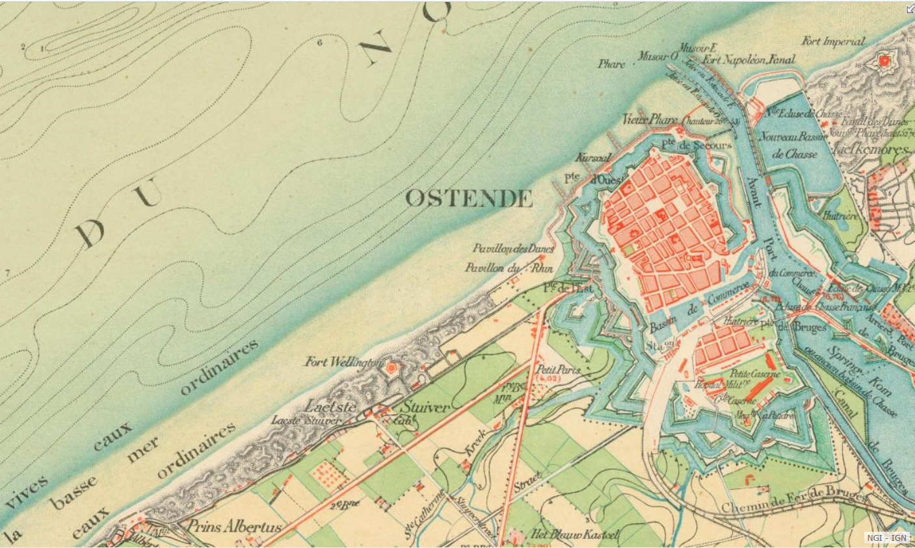
Topographic map, Oostende, 1860

Slide 5
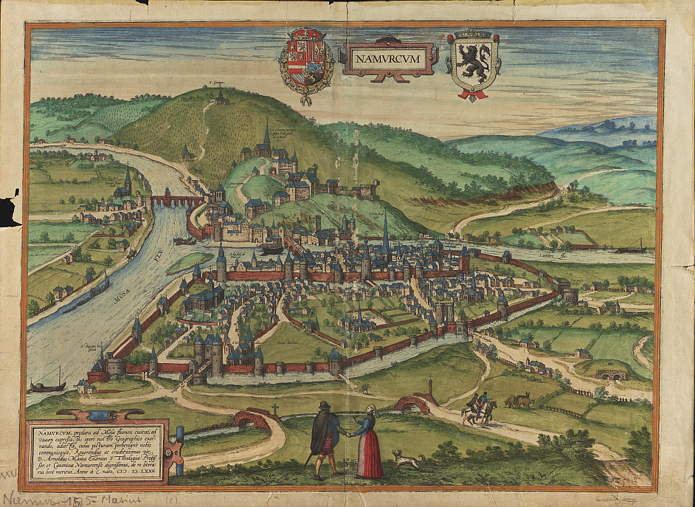
View on Namur, 1757

Slide 6
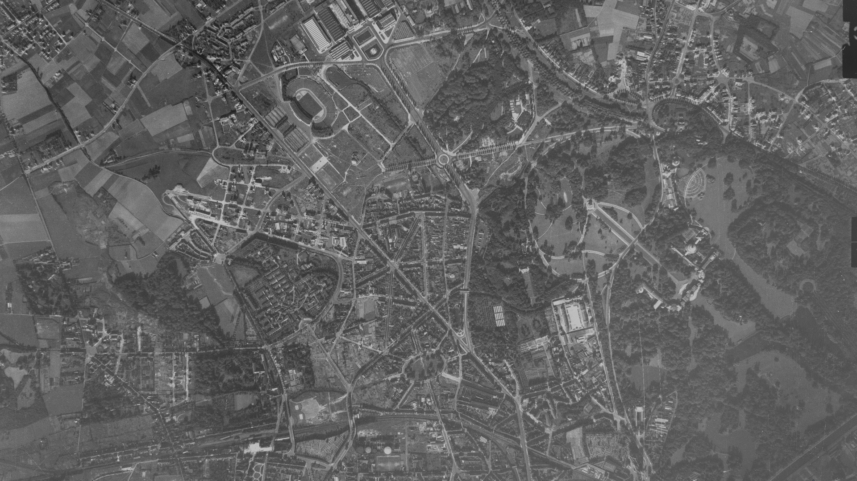
Heizel (Brussels), 1947

Slide 7
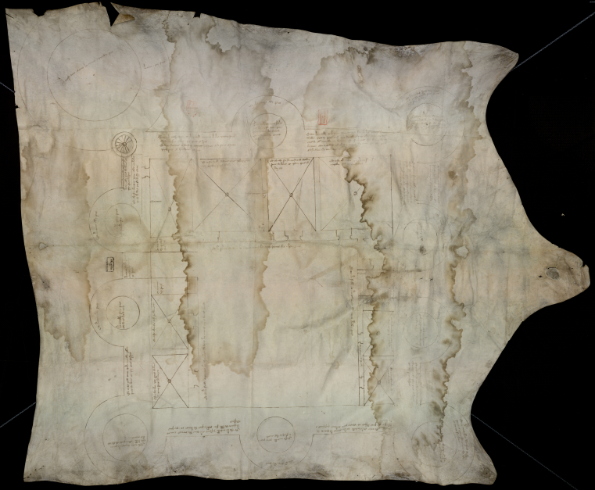
Castle Courtrai (Kortrijk), 1394

Slide 8
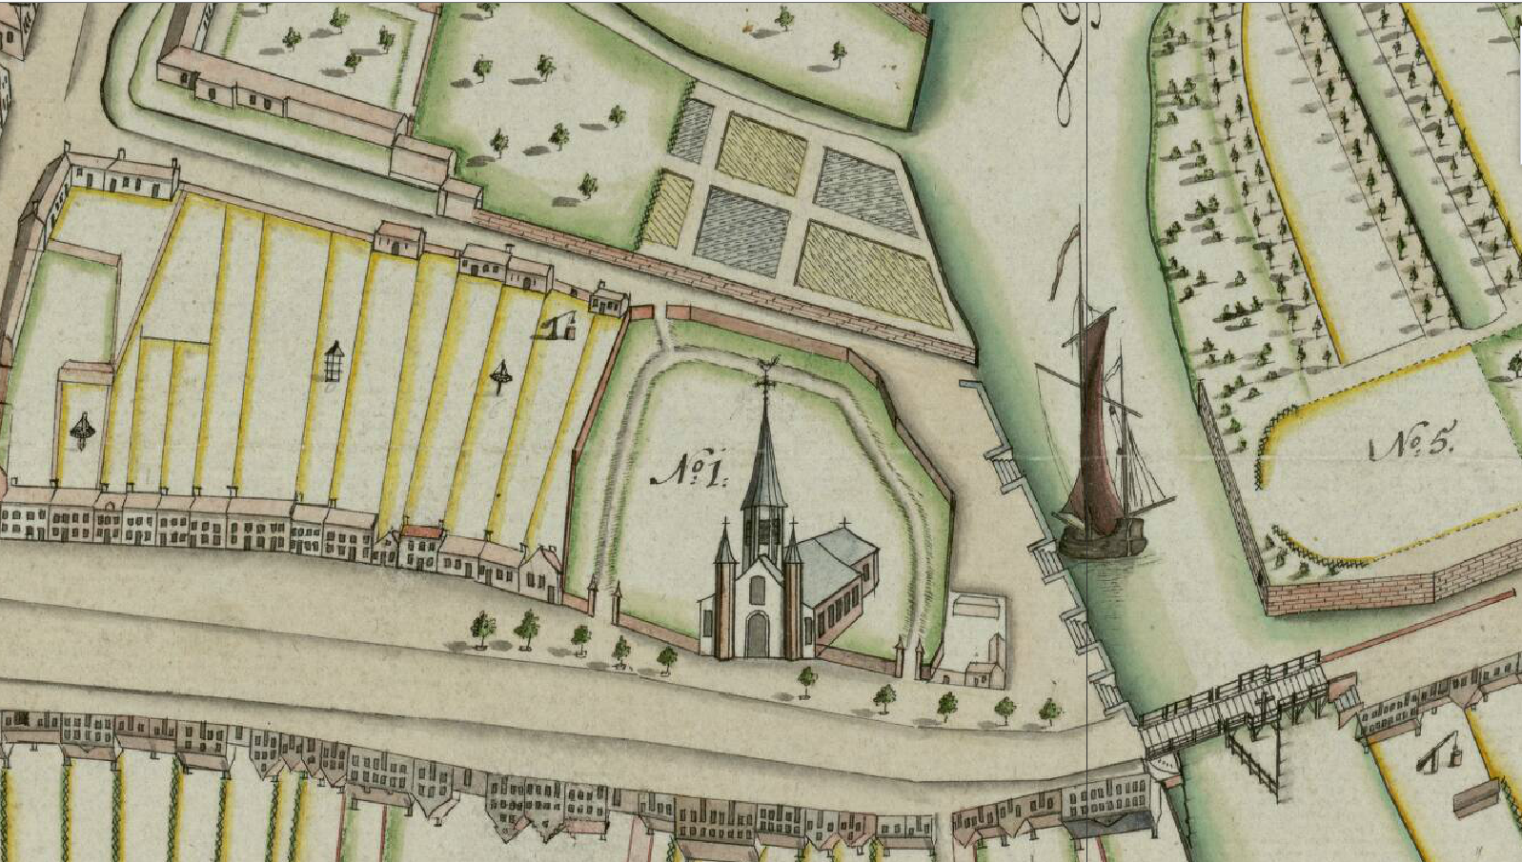
Deinze, 1786

Slide 9
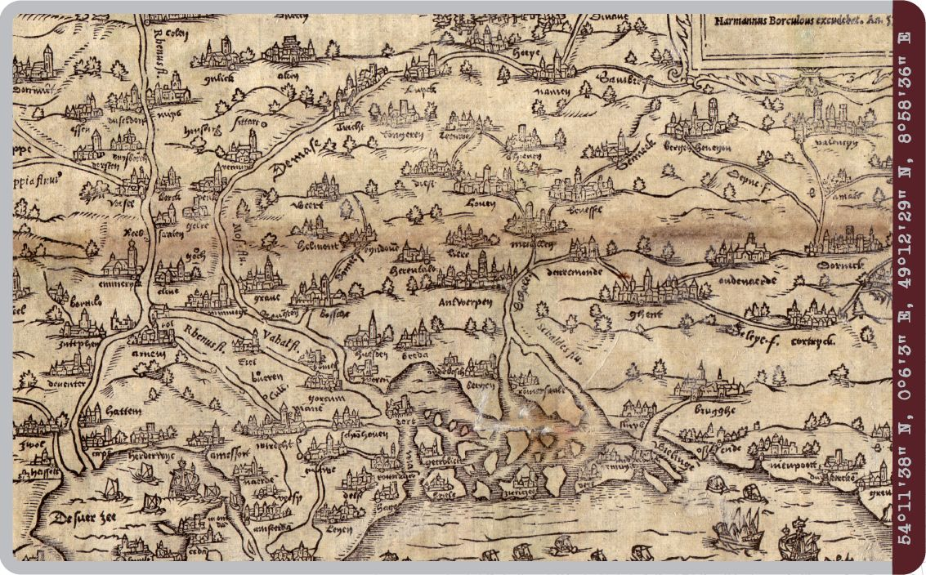
Oldest printed map of Belgium (still existing), 1557

Slide 10
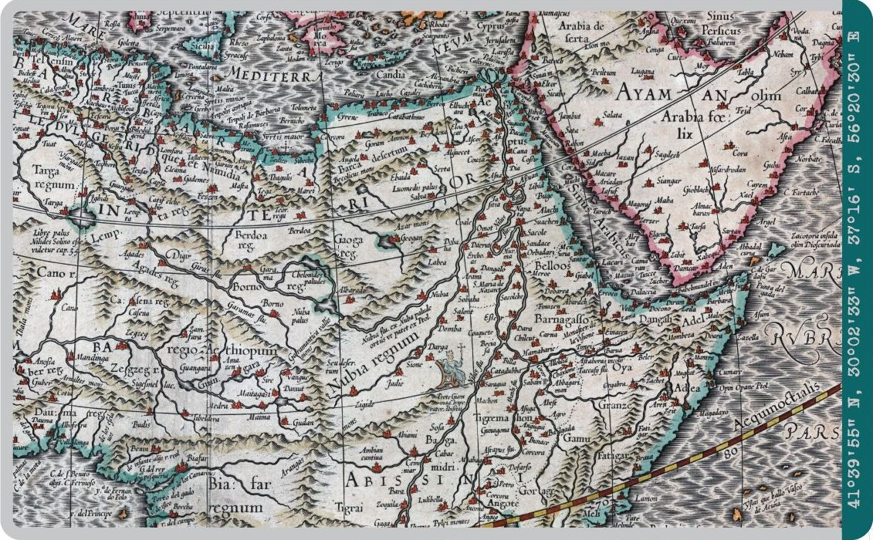
Map of Africa by Mercator, 1595

Slide 11
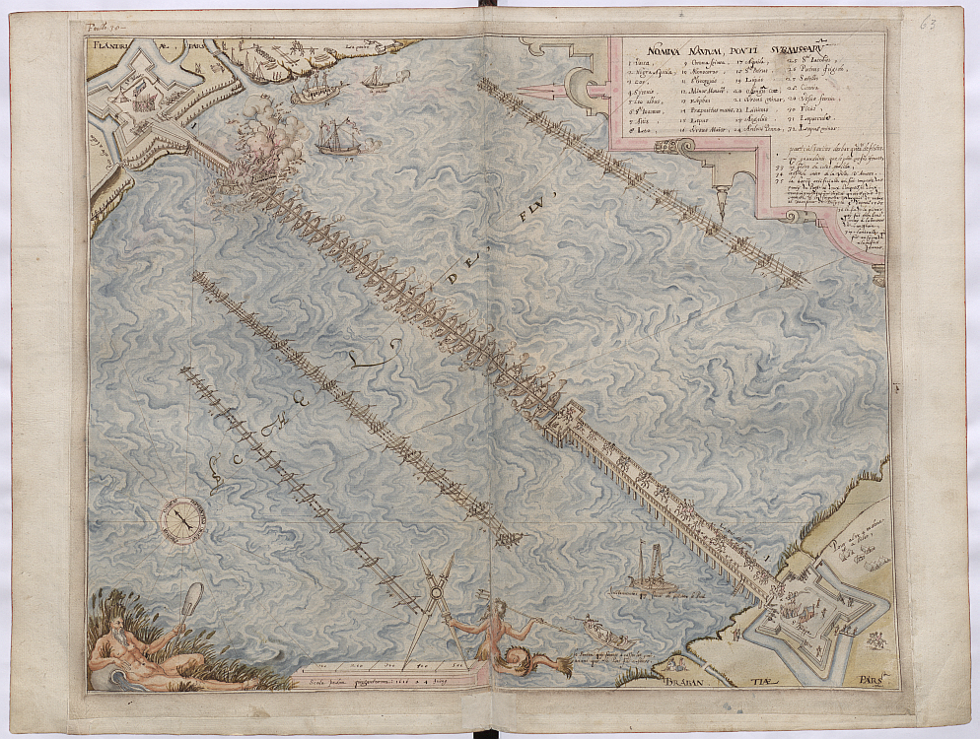
Battle at Antwerp, 1616

Slide 12
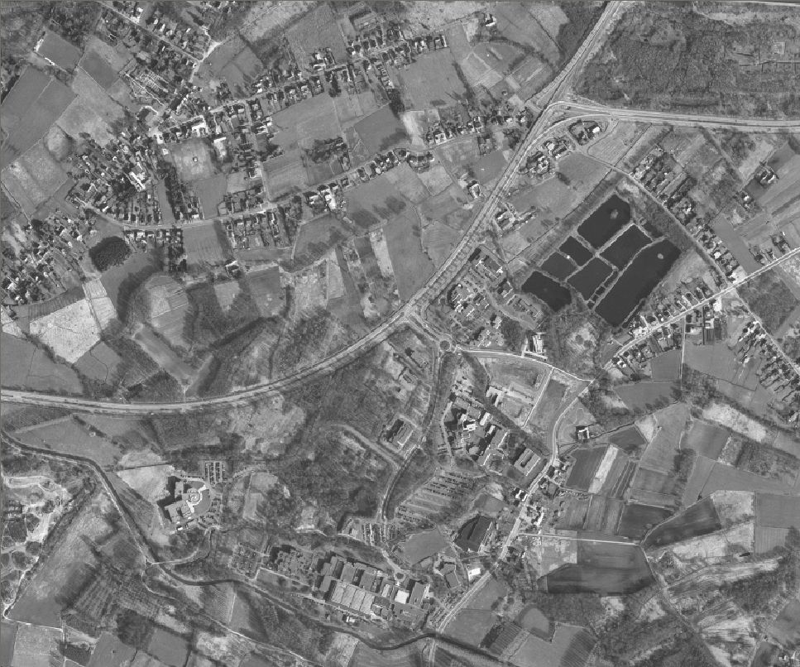
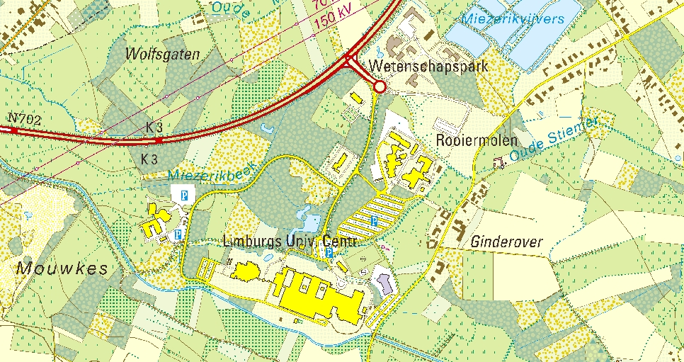
Aerial imagery . Overlay with map.

Slide 13
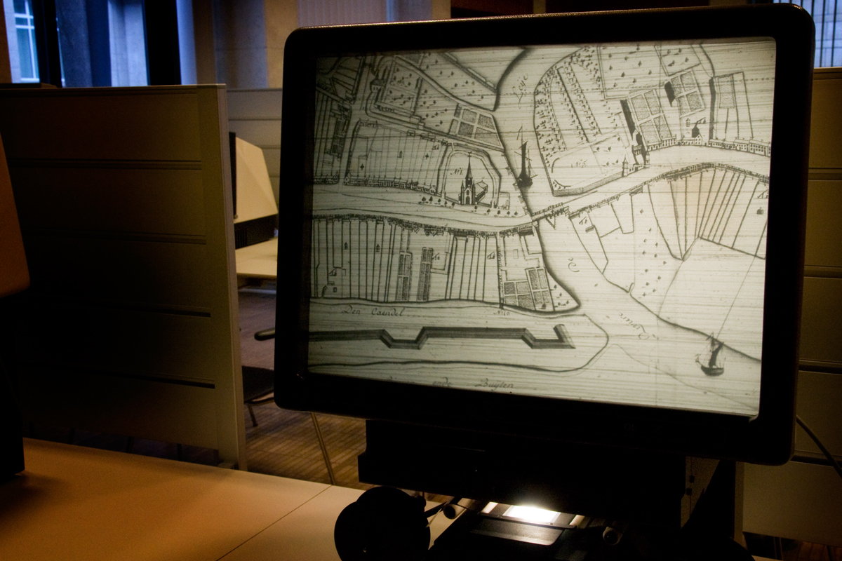
One Online Access point to everything
Avoiding work, damage and confusion
A reading room 24/24h
All the collections through one site
Accessible for everybody at great detail
Preserving the originals

Slide 14
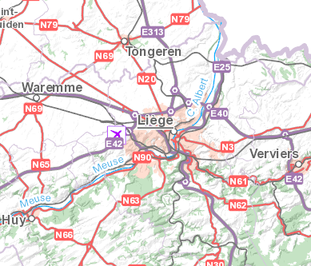
“Classical search” leads to confusion
Avoiding work, damage and confusion
Variations in the same language
Brussel, Bruocsella, Brusella, Bruxelle,..
Name in multiple languages
Liège (FR), Luik (NL), Lüttich (DE),
Lieja (ES), Liegi (ITA), Leodium (Latin), …
Difference in meaning of the same place name
Liège: ville, agglomération, province, évêché, principauté
Different places with the same name
Bergen, Nazareth, Châteauneuf

Slide 15
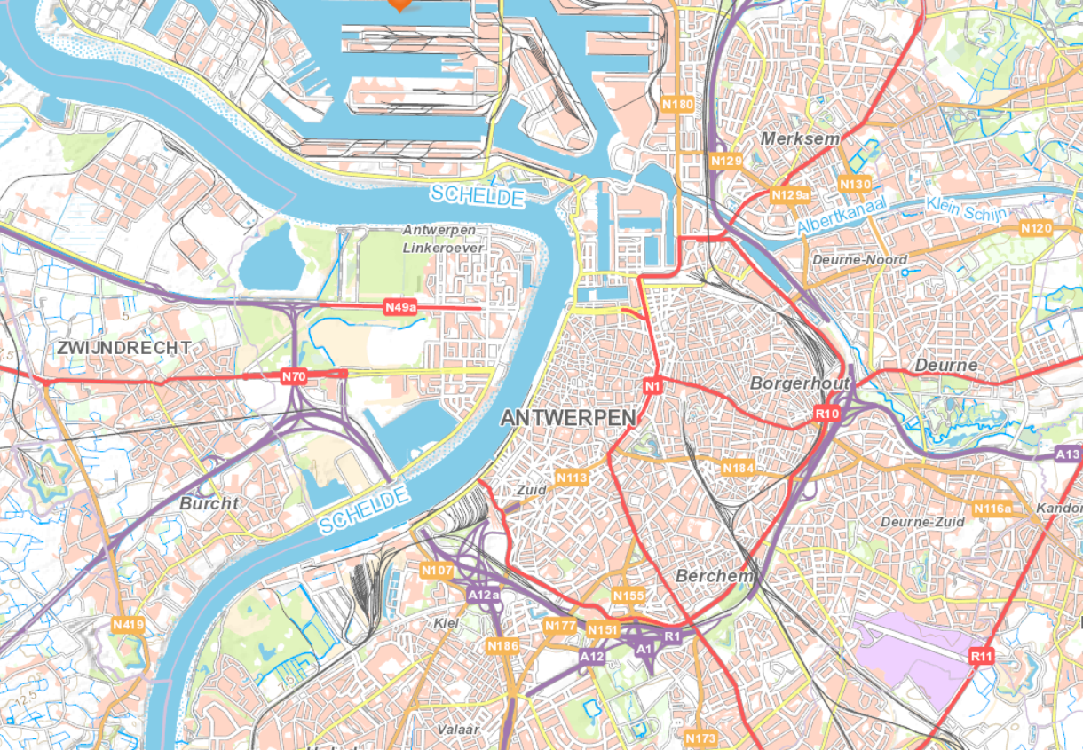
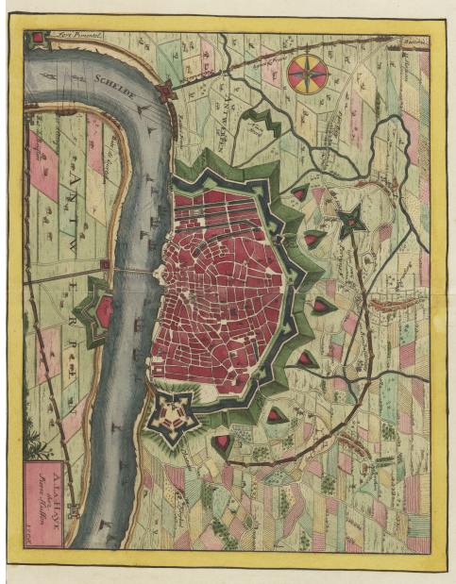
Footprint is the answer to (almost) everything
Polygon, line or point in modern coordinates = area covered by an old map

Slide 16
Searching by a modern map
Polygon vs. textual search

Slide 17
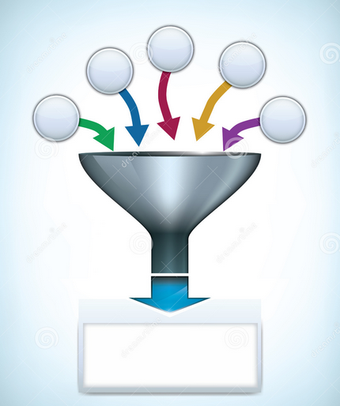
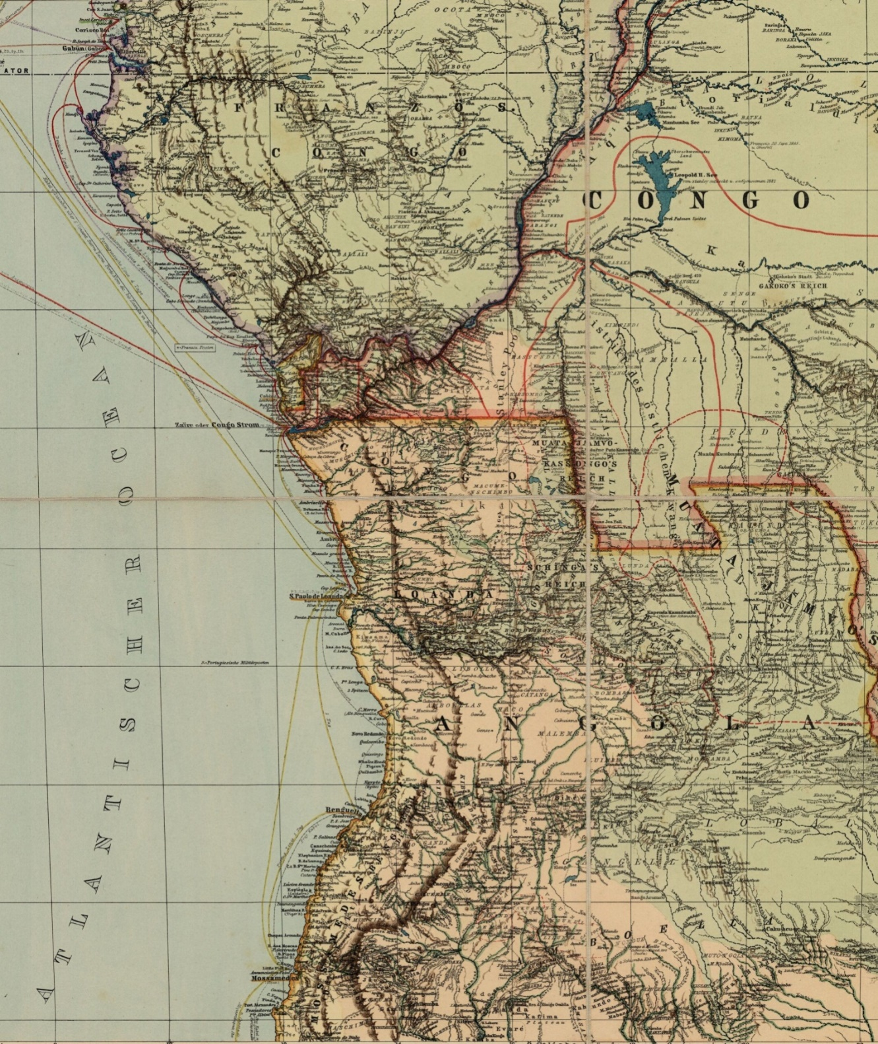
Cross breeding Metadata Standards
How to fix the mess
EAD
Ad hoc standards
INSPIRE
Dublin Core
ISBD(CM)
MARC21
ISO19115 &
INSPIRE
Cartesius Metadata Standard

Slide 18
Polygon vs. bounding box
Precise vs. false matches
Polygon – Precise matches
footprints often irregular
Bounding box – Many false matches

Slide 19
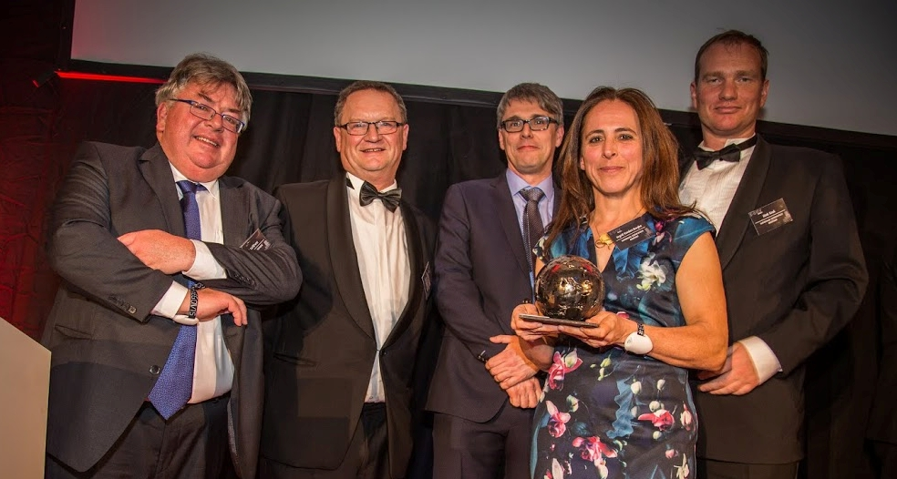
Evolution
Started in 2009 (in fact already before)
Lessons learned (vendor lock-in, open source and proprietary have costs)
Very popular, impressive quantity and quality
Most important map collections become available already by now (70.000 items)
~7500 visitors each month
Good collaboration between different types of institutions
A lot initiatives started, Cartesius.be keeps on going strong
Cartesius 3.0 analysis with public & scientific community
First step: Open-up access!
Second step: What can we do with it?

Slide 20
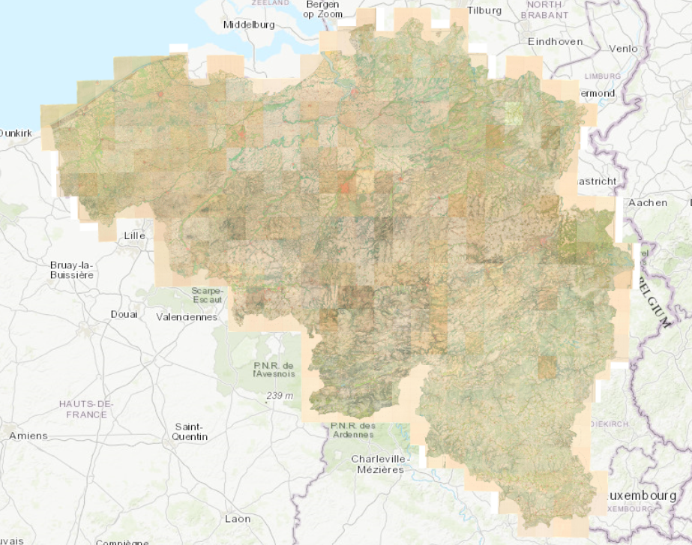
Evolution

Slide 21
Vectorisation

Slide 22
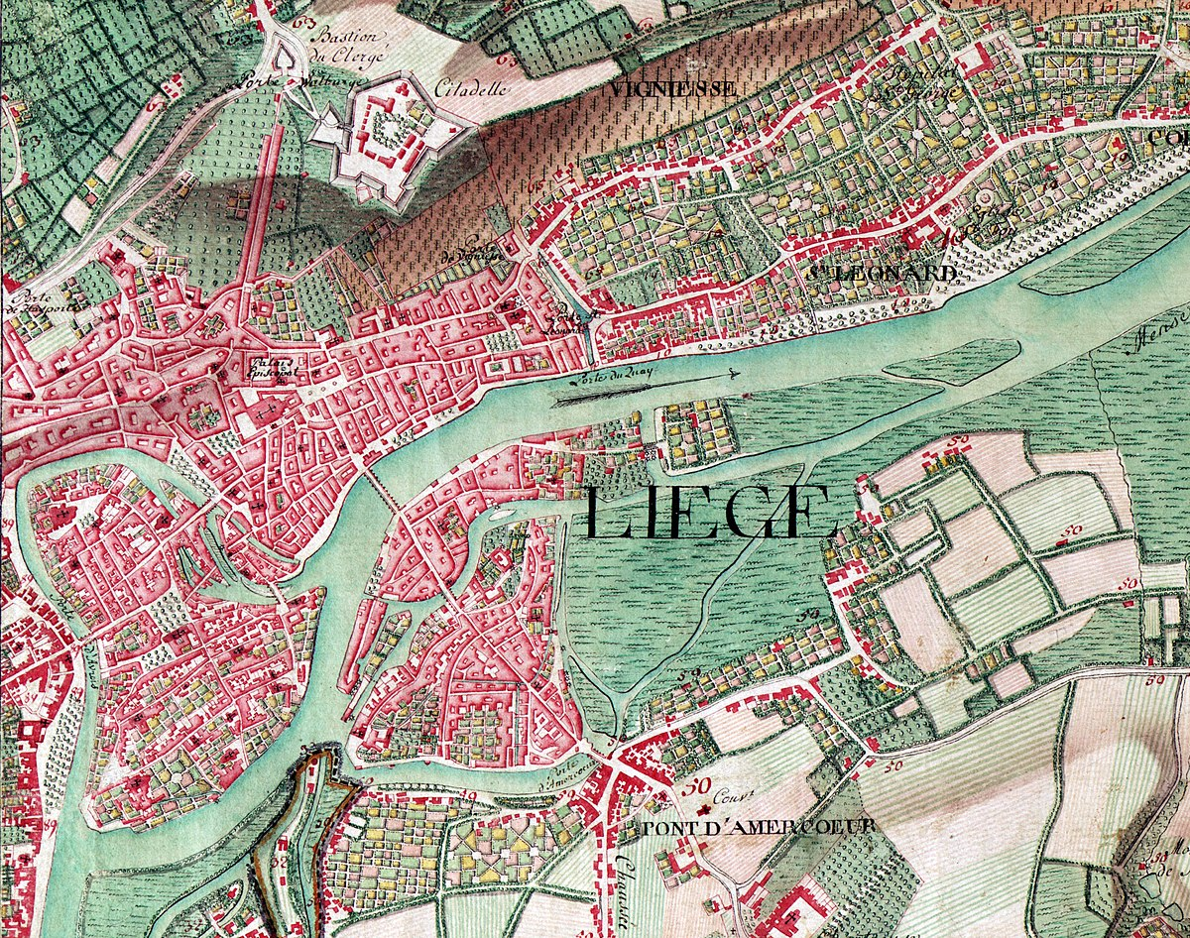
Historic gazetteers
e.g. from the time of the Austrian-Hungarian Empire
For Belgium ~ 33.000 entries
Gazetteer
Parser
…

Slide 23
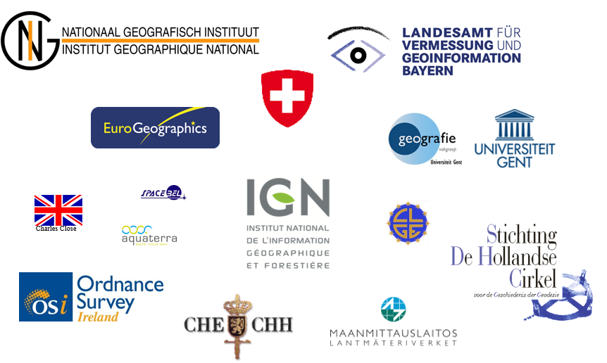
Preservation of Geographical Production Process
European Spatial Data Research Working Group
EuroSDR-Working Group 2013-2017
Essential to know what the
content on the map in fact means

Slide 24
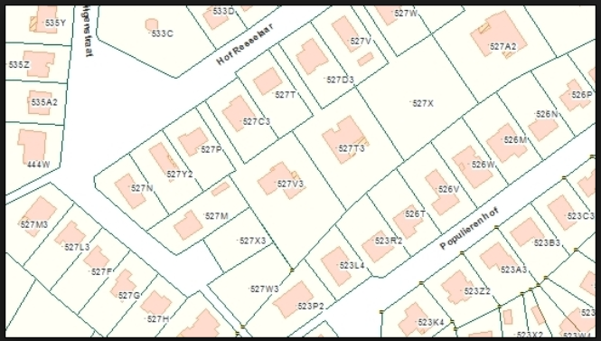
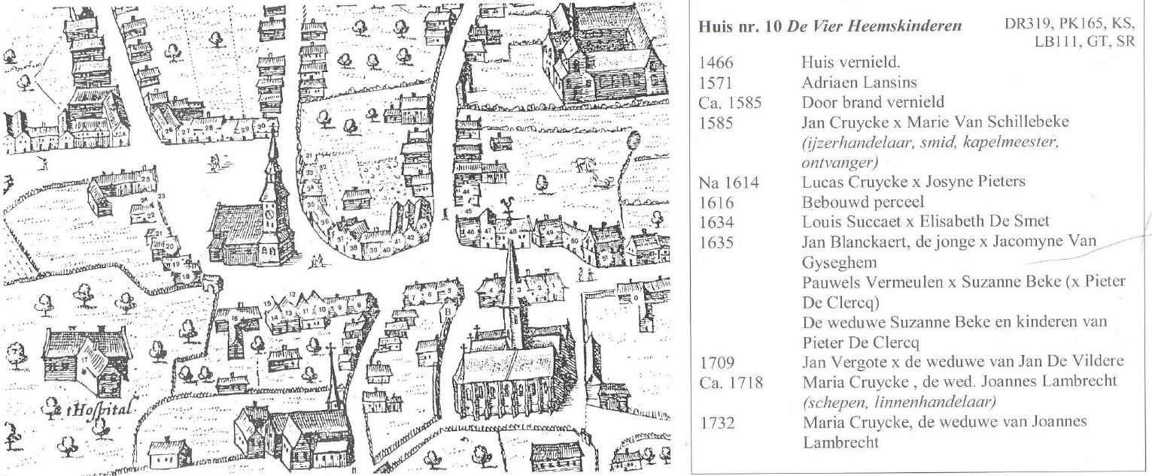
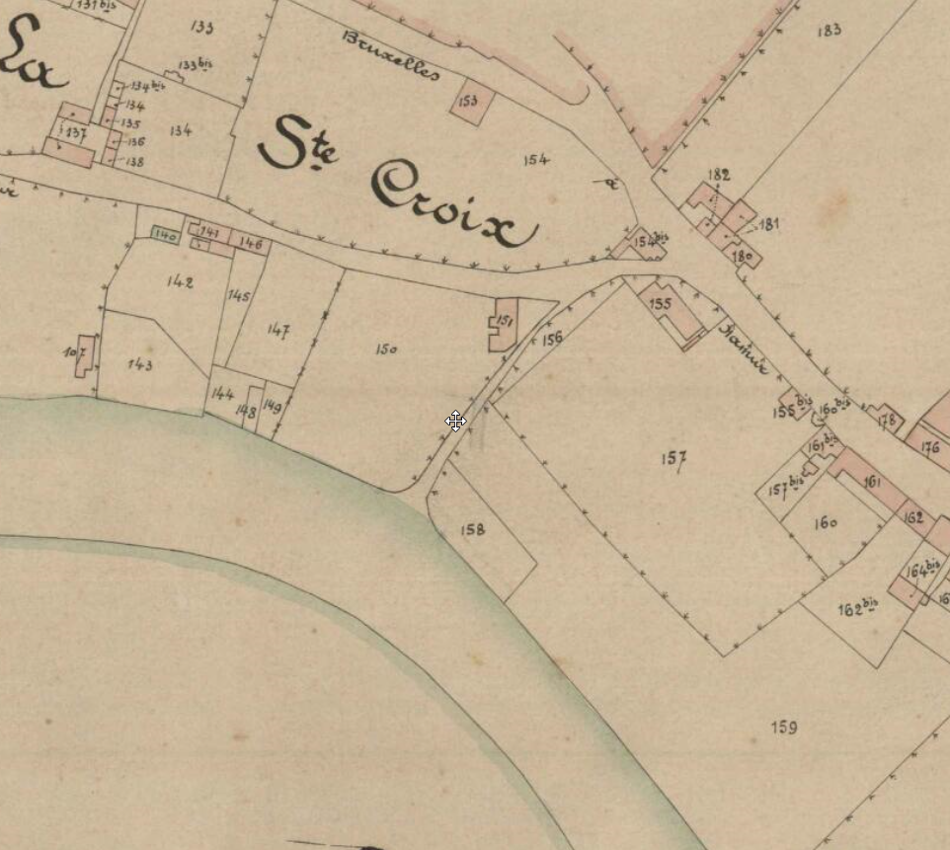
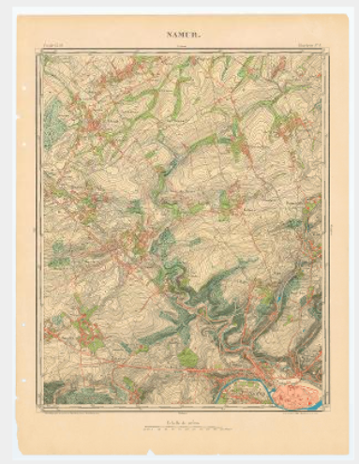
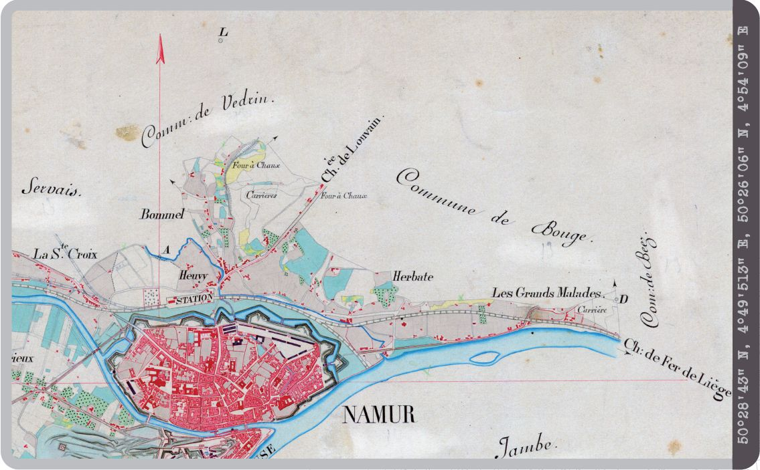

Slide 25
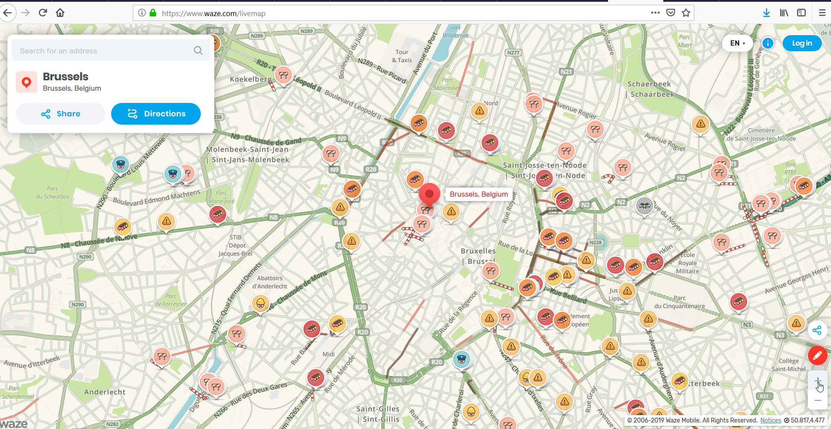
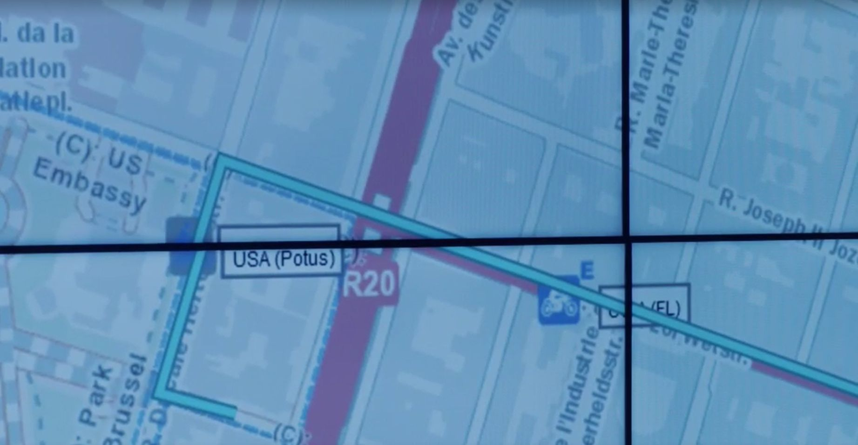
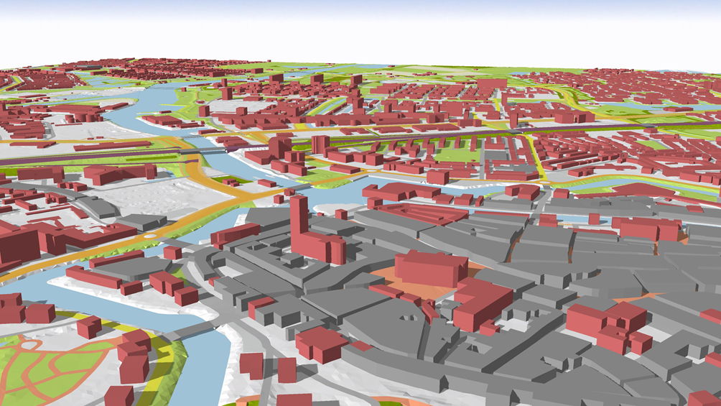
Volatile maps
How to archive them?

Slide 26
Everything happens somewhere - Initiatives
Post ICA-Conference workshop 2013 (Everything Happens Somewhere)
EuroSDR Working Group “Archiving Working Group”
GI+100: Long term preservation of digital Geographic Information — 16 fundamental principles
Collaboration of Institutions
ICA (National Archives)
EuroGeographics (National Mapping and Cadastral Agencies)
European Spatial Data Research Network (Countries, NMCA’s, Universities, …) EuroSDR
Collaboration & Understandable Communication: as Low priority & awareness …

Slide 27
We are doing it, so we can tell stories

