Slide 1
Long term preservation formats for Geodata
Gregor Završnik
www.geoarh.si
Notes:
So why is the title in two colors? We have archivists and Geodata experts (producers , solution experts)

Slide 2
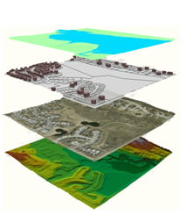




What is Geodata and what formats can we expect?
What is long term preservation and how to achieve it?
9-Track Reel
3.5" Floppy
CD-ROM
MultiMedia Card
Notes:
So in this presentation we will address the geodata formats used in GIS systems and the process of choosing the formats suitable for long term availability.

Slide 3
"Digital information lasts forever - or five years, whichever comes first."
(Jeff Rothenberg, RAND Corp., 1997)

Slide 4
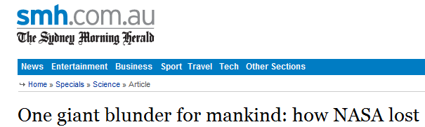
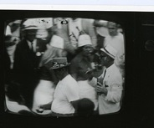
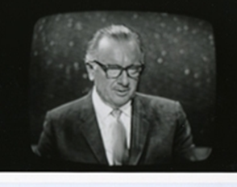

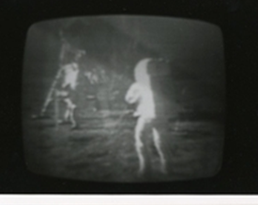
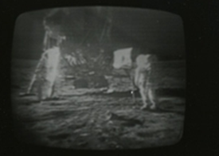
What can happen…
Copied over the Moon Landing tapes
Notes:
NASA lost the original high definition recordings of the moon landing!
What happened was that someone at NASA had the great idea in attempt to save money of recycling about 2000 old tapes thought to be unreadable because the formats were obsolete an recorded over them. Those tapes included the moon landings..
A massive loss of the records of one of the major event in the history of the human race.
Everything we see today is from lower definition copies kept by the TV broadcaster.
As a result NASA had to pay a company lots of money to have the low resolution copies processed and sharpened by a Hollywood company.
The lesson is that if NASA can mess up so spectacularly anyone can!

Slide 5
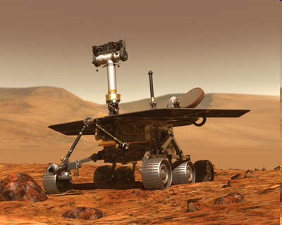
What you might need to do…
NASA sent two Viking Landers to Mars in 1975
Data recorded on magnetic tape
Climate controlled environment
In the 1990s they could not decode the formats used
Had to track down old printouts and retype everything
Photos: Courtesy NASA/JPL-Caltech
Notes:
Another example from NASA who you’d expect to know better!
in 1975 When NASA sent two Viking Landers to find out whether life might exist on Mars, it was assumed that the datasets painstakingly compiled by scientists at the time would be available for future generations of scientists to work on.
However despite their best efforts to preserve the physical media + magnetic tapes. In climate controlled, fire and flood safe environments. Just a couple of decades later, when they attempted to re-use some of the data in the late 1990s, NASA found that they could not decode the formats used.
In the end they had to track down old printouts and retype everything which as you can imaging was extremely expensive and time consuming

Slide 6

Software becomes obsolete
Software used in archaeology
Lots of formats
Become out
of date rapidly
ADS Big Data project
(formats identified more than once)
Source:
Notes:
Archaeologist use lots of different software.
This survey was carried out by the ADS in its “Big Data” project. This found a lot of different software packages being used, producing various formats.
These become out of data rapidly.

Slide 7
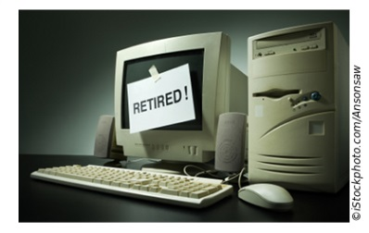
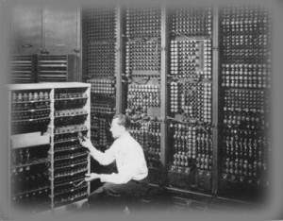
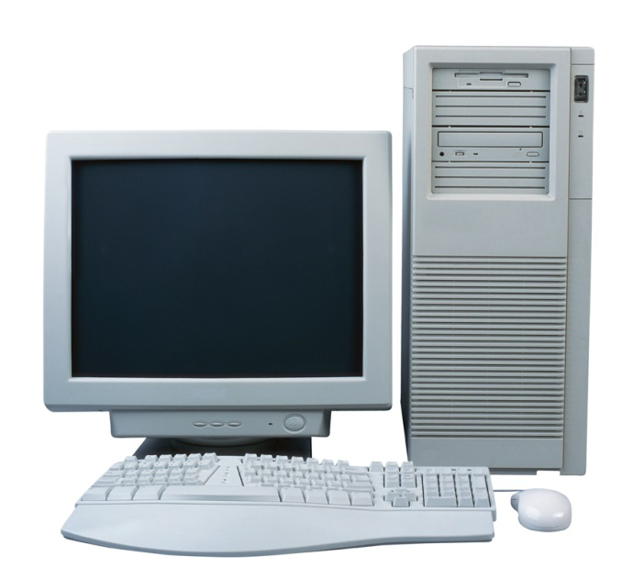

Hardware becomes obsolete
Notes:
Computers have changed almost beyond recognition since the 1940s!

Slide 8
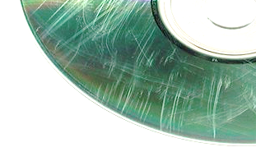
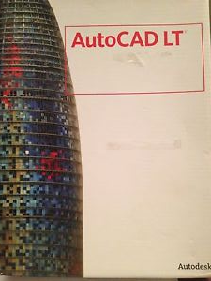


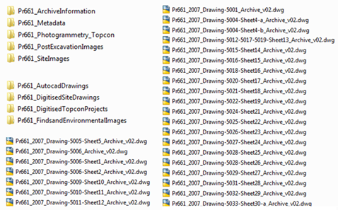
Digital data is fragile
Storage media deterioration
Storage media obsolescence
Software obsolescence
Hardware obsolescence
Poor documentation
5.25" Floppy
Notes:
The final difficulty we face when storing digital data for the long term is failure to document it properly.

Slide 9
So What is Geodata?

Slide 10
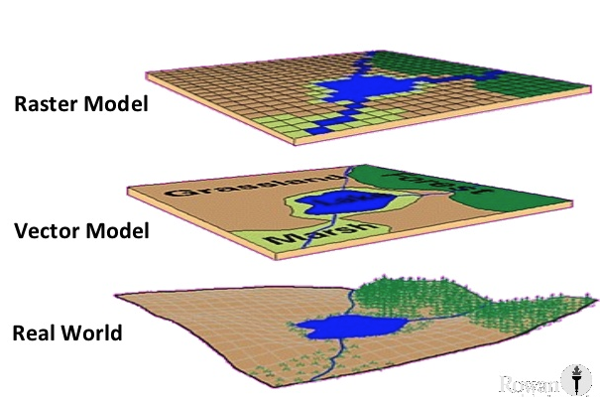
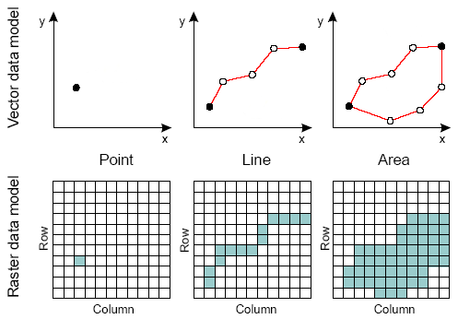
Representing reality

Slide 11
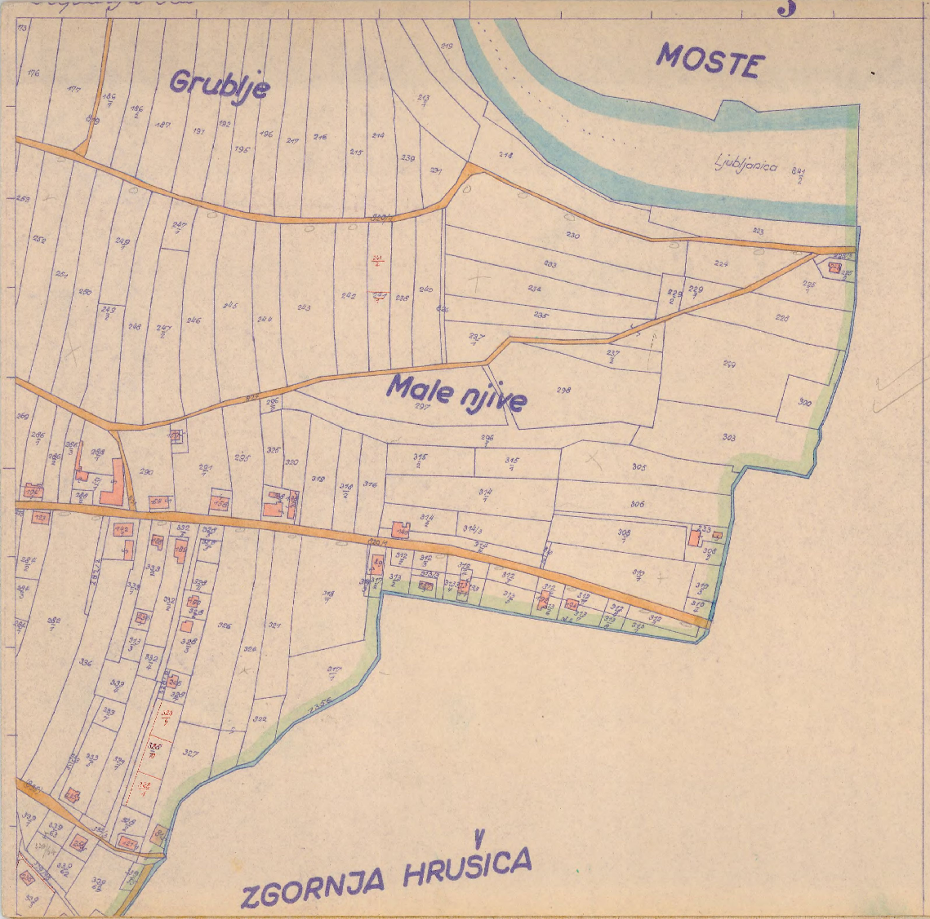
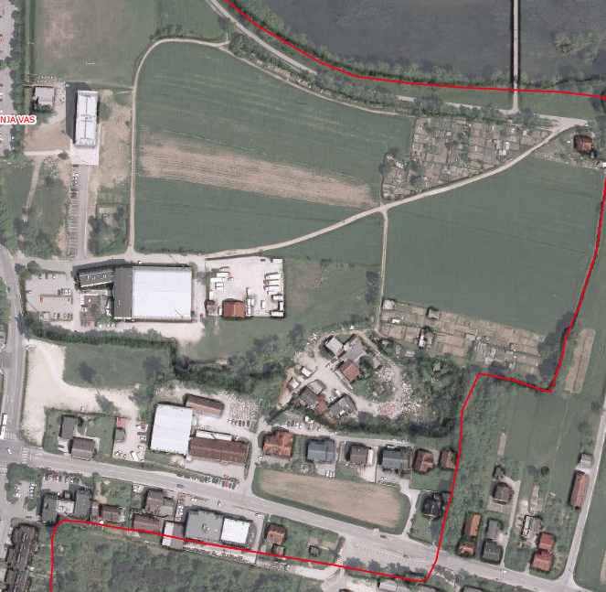
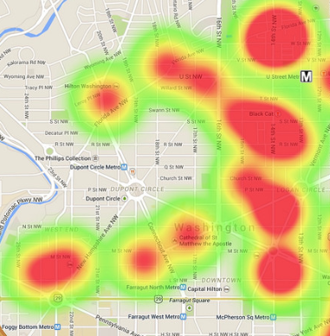
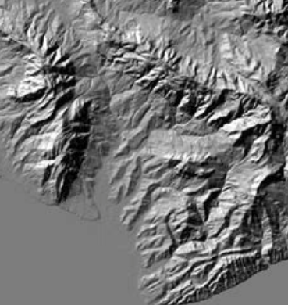
Rasters
Scanned paper maps
Imagery
Heatmaps
Terrain
Raster FORMATS
  TIFF
  GeoTIFF
  Jpeg
  Jpeg2000
  MrSID
  GRID
  ERDAS Imagine
  RST
  BIL
  PIX
  PNG
  ECW
  RLE
  ASC
  RST
  ….

Slide 12
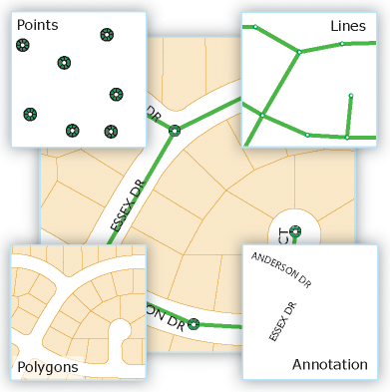
Vectors
FORMATS:
ESRI Shapefile
GML
GeoJSON
Google KML
GPS Exchange GPX
MapInfo TAB
Open-street map OSM
ArcInfo Coverage
…

Slide 13
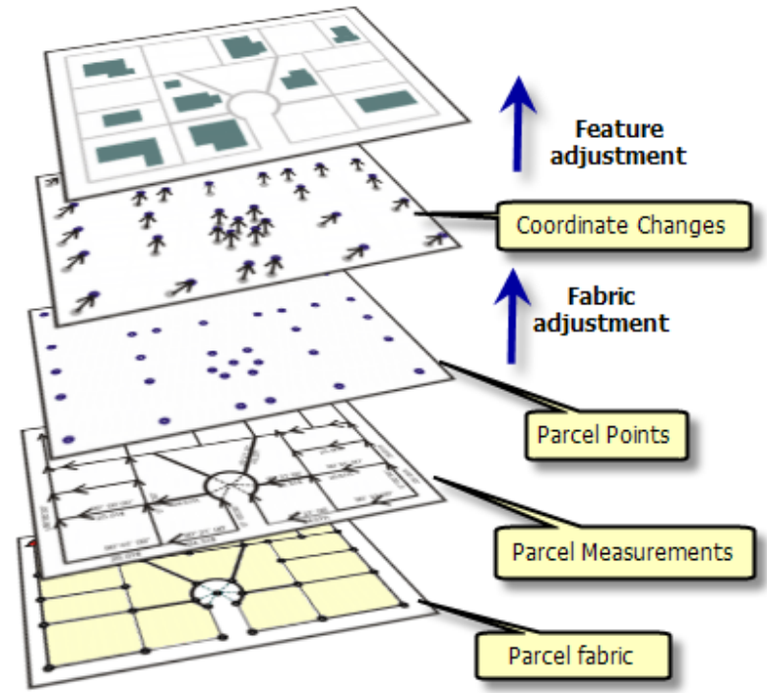
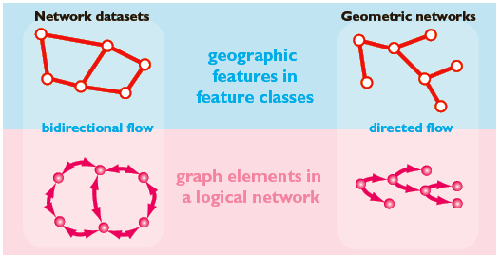
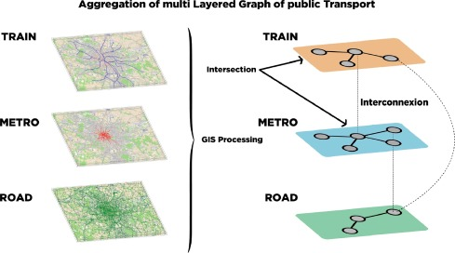
Let’s complicate it a bit…
Complex vector systems
Topologies
Complex utilities network
Transportation networks
Etc.

Slide 14
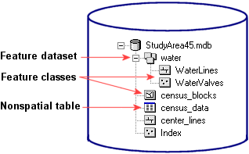
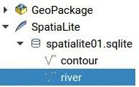
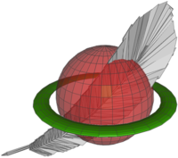


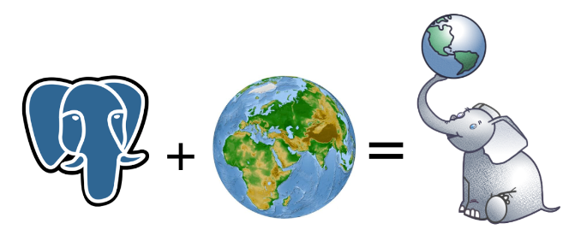
Geographic Database Formats
ESRI Geodatabase
Oracle Spatial
Postgress – PostGIS
OGC Geopackage
Mapbox MBTiles
SpatialLite
….

Slide 15
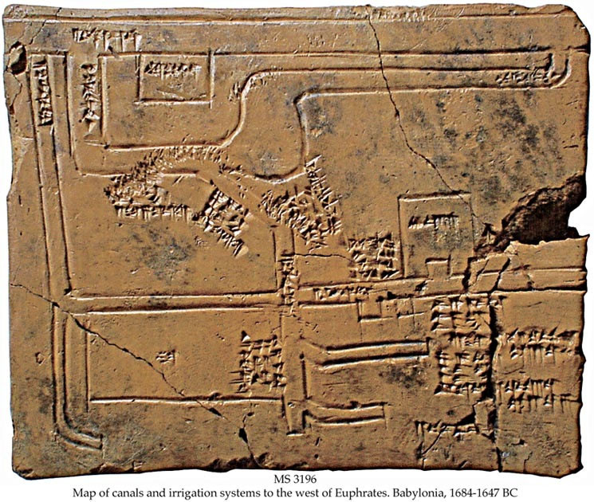
What is Long term preservation?

Slide 16
Format evaluation method for
Geodata long term preservation formats:
  Openness
  Adoption
  Complexity
  Self-Documentation
  Robustness
  Dependencies

Slide 17
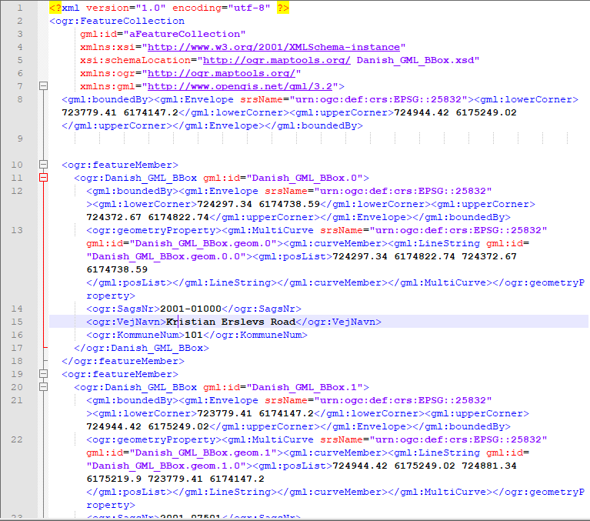
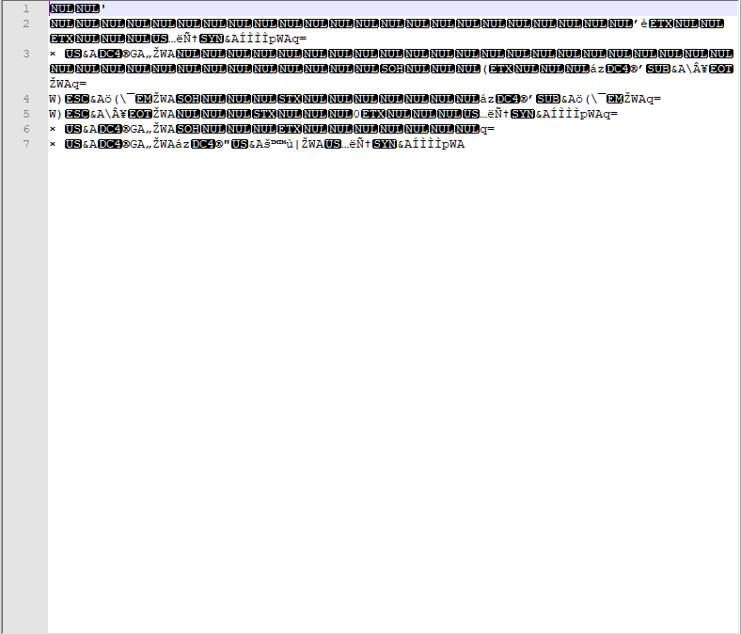
GML
SHP

Slide 18
Openness
 |  | SHP | GML
Standardisation
 | De Jure standard |  | X
 | De facto standard, available by independent organisation
 | De facto standard, specifications made by manufacturer only | X
 | De facto standard, closed specifications
 | No standard
Restriction on format interpretation
 | No restriction | X | X
 | Partially restricted
 | Heavily restricted
Reader freely available source
 | Freely available open source reader | X | X
 | Freely available reader, but not open source
 | No freely available reader

Slide 19
Adoption
 | SHP | GML
World wide usage
Widely used | X
Used on a small scale |  | X
Rarely used
Usage as archival format
Widely used | X | X
Used on a small scale
Rarely used

Slide 20
Complexity
 | SHP | GML
Human readibility
Structure and content readable |  | X
Structure readable
Not readable | X
Compression
No compression | X | X
losless compression
lossy compressed
Variety of fatures
Small variety of features | X
Some variety of features |  | X
Wide variety of features

Slide 21
Self-documentation
Format
SHP | With and additional .xml file (bounding coordinates, datum, etc.) .prj file for georefferencing information
GML | Metadata encoded following ISO/TS 19139:2007 (Geographic Information -- Metadata --XML schema implementation) can be embedded within a GML instance.

Slide 22
Robustness
 | SHP | GML
robust against single point of failure | YES | NO
Support for file corruption detection | Validator | XSD Schema
File format stability | Constant | 2.0 3.1 3.2 3.3…
Backward compatibility | / | ?

Slide 23
Dependencies
Format
SHP | Specialized GIS reader Open source readers available (with source code)
GML | None

Slide 24
Conclusion (1)
GML :
(+) is more open, human readable, robust, self-documenting
(-) Less adopted in archives and in GIS Tools
ESRI Shapefile
(+) More widely adopded, supported in readers,
(-) Less open, propriatery ownership, less robust, lacks self description

Slide 25
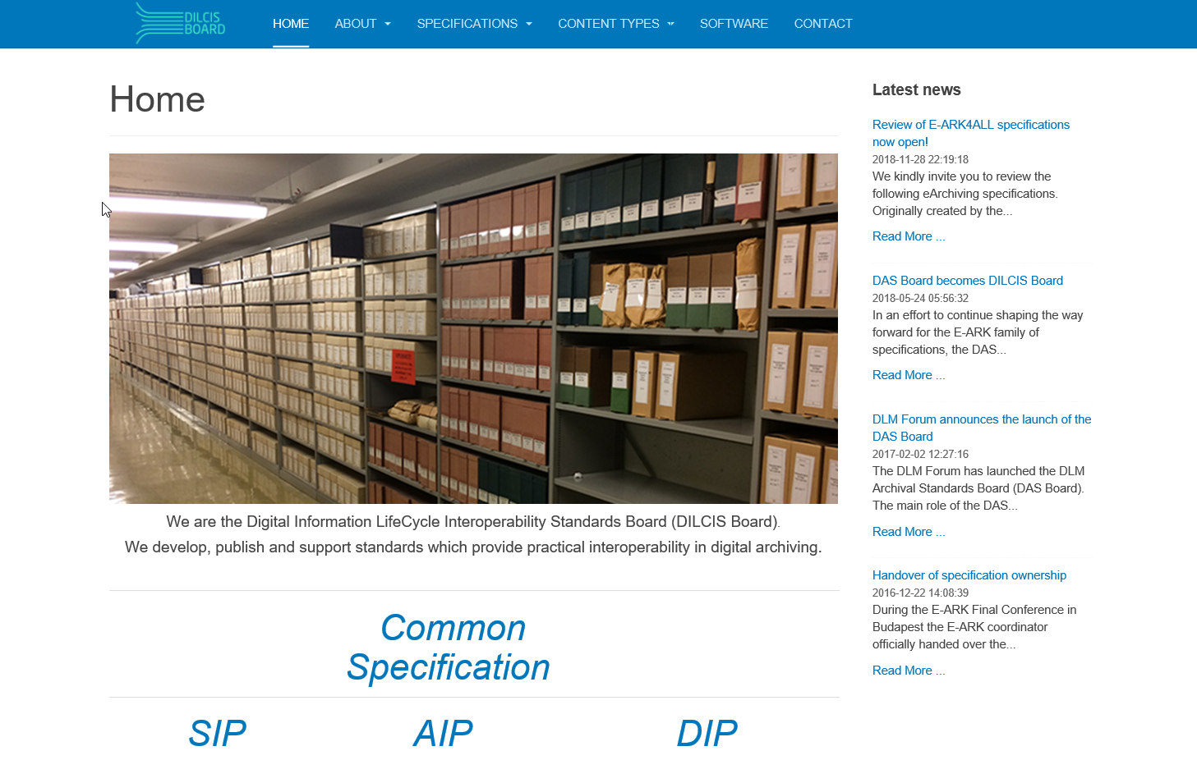
What next?
Analize more existing formats:
  (GeoJSON),
  Raster formats
  Database based formats,
HELP US!!!
Join the the DILCIS Board (run by DLM Forum) and help us evaluate best long term preservation formats for you.
www.dilcis.eu

Slide 26

Resources:
www.Geopreservation.org
E-ARK PROJECT
Paper: Evaluating File formats for Long-Term Preservation
Caroline van Wijk

Slide 27
Questions?
Gregor Završnik
Gregor@geoarh.si

