Slide 1
Preserving Federal Geodata at NARA
CEF eArchiving Building Block
Geopreservation Conference
May 2019
Rebeccah Baker
Electronic Records Division
(301) 837-0949
Rebeccah.Baker@nara.gov
Notes:
Hello, my name is Rebeccah Baker and I am an archivist within the Electronic Records Division at the National Archives located in College Park, Maryland, USA.
The National Archives:
Provides direction, guidance, and assistance to all Federal agencies in managing their records throughout their lifecycle.
Preserves electronic records with “enduring” value in non-proprietary formats
Provides access to these records
I will discuss how the Electronic Records Division at the National Archives processes and preserves federal archival geodata.

Slide 2
Electronic Records Division
Responsible for Federal records scheduled for permanent retention in the National Archives
Accessions & processes
Arranges for preservation
Describes & provides access
Program dates to 1969
Processing Branch, Reference Branch, and Digital Preservation Services Staff
29 staff
Processing &
Verification
Reference / Access
Transfer & Accessioning
Validation
Preservation
Description
Notes:
Electronic Records Division (RDE for short) accessions, processes, preserves, describes and provides access to permanent Federal electronic agency records (born digital records)
The Program dates back to the 1960’s, however, some of the records date to the World War II era and cover time periods as far back as the 1800s.
Subject areas represented in the holdings include agriculture, social and economic data, and military and environmental data.
The holdings include various record types including textual records, such as electronic telegrams, email, word processing documents, digital images, geospatial records, web records and raw data.
RDE has three branches: A Processing Branch, a Reference Branch, and a Digital Preservation Services Branch
Currently, NARA has legal custody of approximately 800 Terabytes and 10 million files of Federal electronic records preserved in the Electronic Records Archives (ERA). This does not include Presidential records or records in interim storage awaiting ingest into ERA 2.0.
Transfers to RDE include direct offer/scheduled transfers from Federal agencies as well as some donated material

Slide 3
Geospatial Holdings
Digital Cartographic Data Holdings: Electronic Records Reference Report
Fish & Wildlife Service: Watersheds, Critical Habitats
Bureau of the Census: Administrative Boundaries
US Coast Guard: Iceberg Charts
Bureau of Land Management: Wilderness Areas
National Park Service: Maps of National Parks
US Geological Survey: Digital Orthophoto Quarter Quadrangles
Federal Railroad Administration: Railroad Network
Oceanic and Atmospheric Administration: Marine Ecosystems Shape Files
National Aeronautics and Space Administration: Flight Operations
Notes:
These holdings consist of Shapefiles, KML, GML, TIGER/Line geospatial enabled PDF files, geoTIFF, and JPEG images.

Slide 4
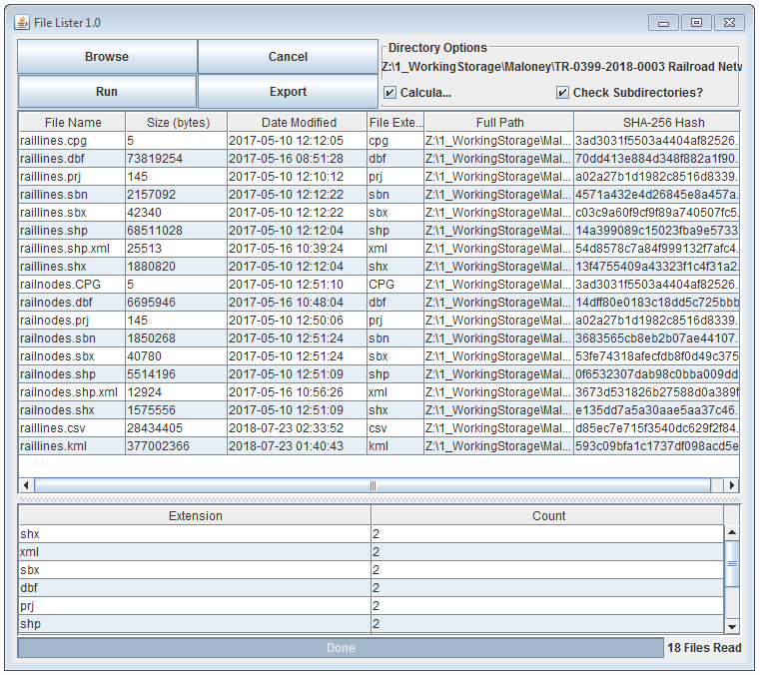
Validation of Electronic Transfers
Validation: Process to ensure that the digital files in the accession meet acceptable transfer criteria
Establish Physical & Intellectual Control of the Transfer
Register Accession
Validate records received match records schedule item description
Virus Scan
NARA FileLister tool
Processing &
Verification
Reference / Access
Transfer & Accessioning
Validation
Preservation
Description
Notes:
Agencies make transfer copies of records ready for disposition and then send the records to the Archives via removable media such as optical media or external hard drives.
Once the transfer is received RDE registers the transfer shipment as an accession.
Then RDE follows a Standard Operative Procedure (SOP) document which Brett Abrams and I have developed.
The first task is to perform Validation activities which:
Make sure things are as expected
The record content should match what is described in the schedule
The Validation process includes:
Virus scan
Metadata review
Reviewing Documentation and Data
Data Dictionary/Database Schema; code lists and record layout, etc.
Examine the file formats to ensure they meet the requirements, per the Transfer Formats Guidance
Note any software dependent/proprietary formats
Whether any files are encrypted or password protected
RDE has developed a number of tools in-house that allow Archivists to perform validation tasks such as
FileLister tool
provides an HTML or CSV export of all files within a specific directory path
File Name
Byte Count
Date Modified
File Extension
Full Path
SHA-256 Hash

Slide 5
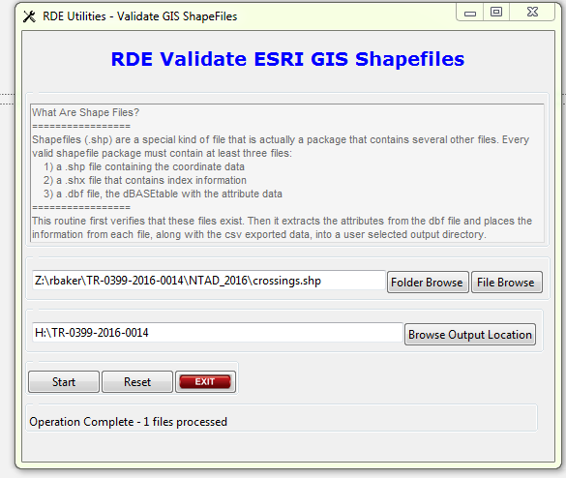
Validation of Geospatial Transfers
Notes:
RDE has developed a number of tools in-house that allow Archivists to perform validation tasks specific for geospatial records such as the Validate GIS Shapefiles tool which ensures that Shapefile clusters contain
1) a .shp file containing the coordinate data
2) a .shx file that contains index information
3) a .dbf file, the dBASEtable with the attribute data
If transferred files do not meet the format requirements, the archivist needs to make a judgement call: whether they will convert the records to a preferred or acceptable format, for example: Geodatabase to Shapefiles or GML
Archivist may request the agency send replacement copies in an appropriate format, provide replacement copies for corrupted files, ID and select only permanent files for retention.
In these and other cases, having a good relationship with the agency records officer and RM team can help ease communication and receive responses in a timely manner.

Slide 6
Processing & Verification of Geospatial Transfers
Processing and Verification: Systematic series of actions to prepare the electronic records in an accession for preservation and access
Includes comparing the content of the electronic records to the anticipated content based on the records disposition schedule and agency documentation
Use NARA-created or Commercial tools to verify content and structure
Originally used USGS Digital Data Viewer: dlgv32 Pro
DLGV32 Pro is now Global Mapper
Microsoft Excel creates preservation copy of .dbf file in .csv format
Processing &
Verification
Reference / Access
Transfer & Accessioning
Validation
Preservation
Description
Notes:
We want to make sure the data is well-formed, and that it makes sense, weed out any duplicate or nonpermanent record material
RDE relies on tools to help automate processing and enhance efficiency
RDE has the support of an IT Specialist for technology needs
The format of the records defines the verification path
Vector (.shp, .gml, .kml) and Geographic database (.gdb) files would be processed using Global Mapper
Raster (geospatial enabled PDF files, geoTIFF, and JPEG images) would be processed using Adobe viewers such as Acrobat Pro, Photoshop, or Illustrator
Performing Verification ensures the records’ authenticity, accessibility and sustainability
Added bonus: Processing and Verification helps with the Description process. The archivist may glean why or how researchers may wish to access the records in the future.

Slide 7
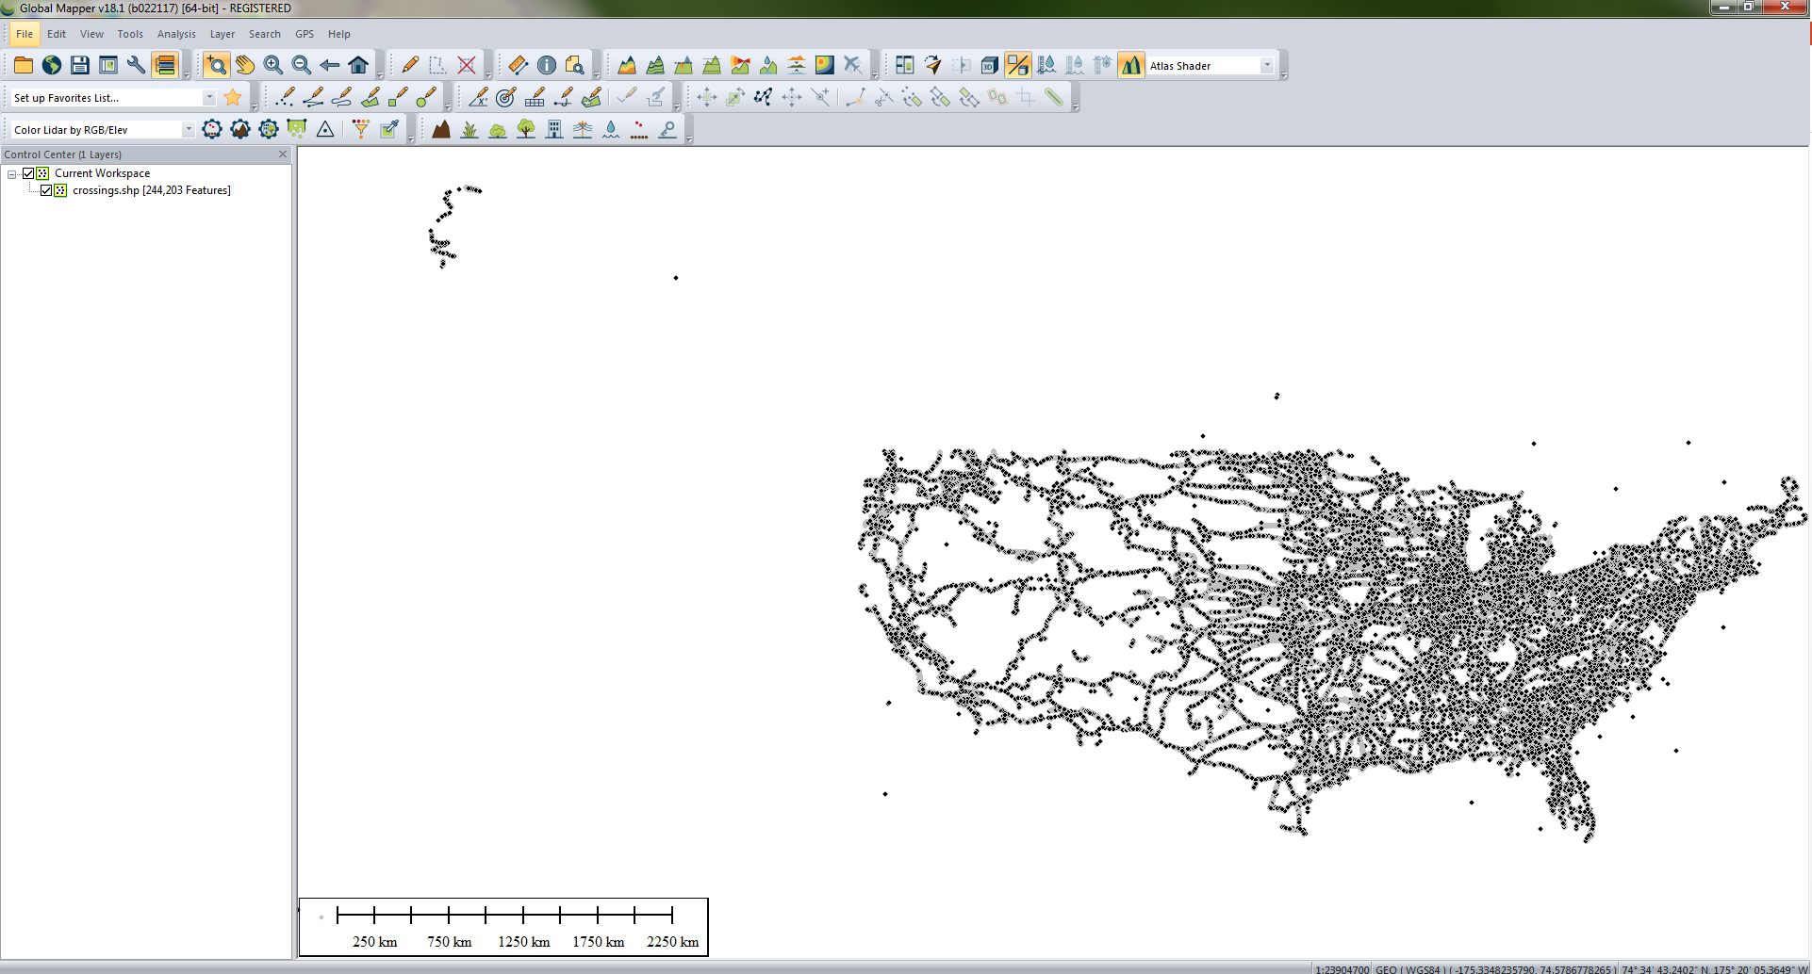
Processing and Verification: Viewing
Ensure records:
Authenticity
Accessibility
Sustainability
Notes:
Global Mapper is the verification tool currently used by RDE to view the ERSI Shapefiles, GML, and KML files received in a geospatial accession. By viewing the .shp file, archivists confirm that the file is able to open and has not been corrupted through the transfer process. Generally, NARA staff in the electronic records custodial unit verifies records on a data file level. However, this approach does not seem appropriate when individual files are not interpretable but instead work in conjunction with other files to create a single Shape file that depicts this railroad network system. Therefore, staff verify the single Shape file rather than the individual files within the cluster of Shapefiles.

Slide 8
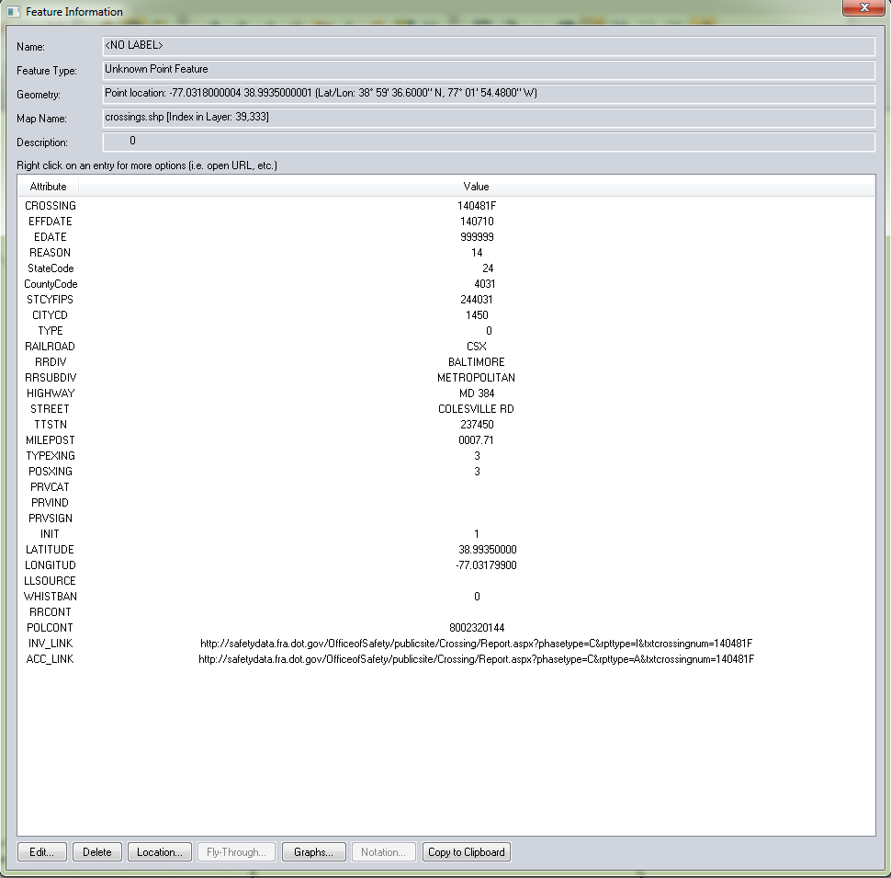
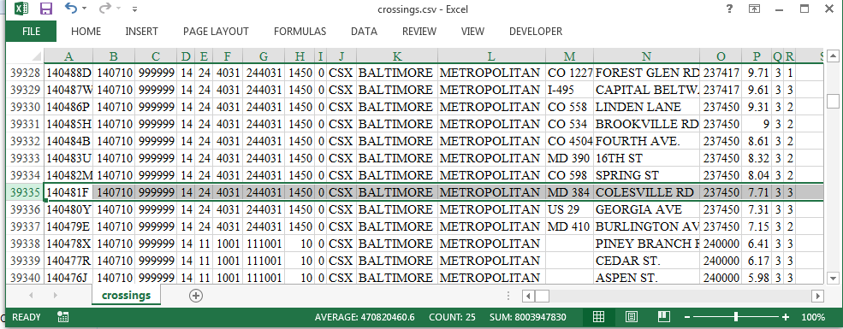
Processing and Verification: Feature Information
Using Global Mapper Feature Information tool
Verify file is legible and producing expected content
Verify geographic coordinates
Compare geographic area to:
Transfer document / schedule
Metadata file
Notes:
Once RDE has established that the Shapefile is able to be viewed verification of feature information begins. Archivists confirm whether they are able to see the associated attributes used to describe the distinct locations and the location of the lines and points on the file fell within the coordinate range noted on the technical documentation.

Slide 9
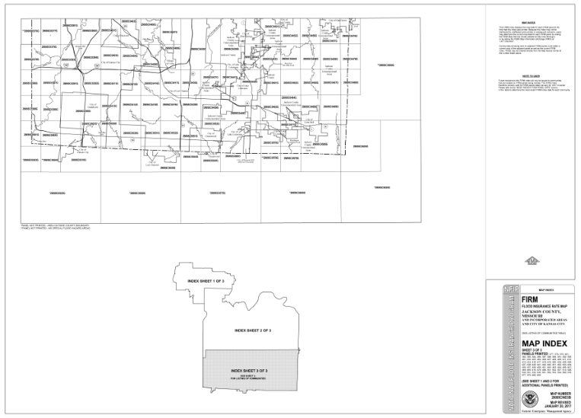
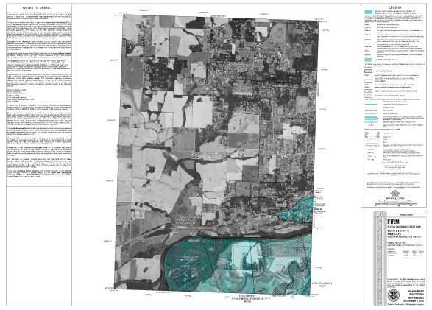
Processing and Verification
Notes:
These are examples of raster geospatial holdings at NARA. Both are products of the Federal Emergency Management Agency (FEMA) Flood Insurance Rate Map. The map on the left is a GeoTIFF while the map on the right was transferred in PNG format. Both products were transferred with companion .PGW and .TFW world files that provide raster geolocation.
In order to verify these files archivist use Adobe viewers such as Acrobat Pro, Photoshop, or Illustrator.

Slide 10
Preservation
Preservation: Process to copy an accession’s digital files to NARA’s digital repository, the Electronic Records Archives (ERA).
Records are packaged into ZIP containers and transferred via FTP
Processing &
Verification
Reference / Access
Transfer & Accessioning
Validation
Preservation
Description
Notes:
Once processing is complete, RDE moves on to preservation where the records are sent to NARA’s digital repository ERA.

Slide 11
Description, Reference / Access
Description: National Archives Catalog provides public access to descriptions about NARA’s holdings
Reference / Access: Understand, interpret, and convey the technical characteristics of the records
Unless records are available online, researchers can only access electronic records by obtaining reproductions of them
Researchers can review paper documentation on-site
Processing &
Verification
Reference / Access
Transfer & Accessioning
Validation
Preservation
Description
Notes:
When records have been successfully ingested into the repository RDE creates descriptions for the series and file units within the accession.
The National Archives Catalog provides public access to descriptions about NARA’s holdings.
RDE Reference staff often provide information about the records by interpreting the documentation and metadata maintained in NARA systems.
Unless records are available online, researchers can only access electronic records by obtaining reproductions of them.

Slide 12
National Archives Catalog: Geospatial Holdings
Processing &
Verification
Reference / Access
Transfer & Accessioning
Validation
Preservation
Description
Notes:
Oregon and Washington Wilderness Areas Characteristics Data Files
https://catalog.archives.gov/id/6158833
This is an example of a National Archives Catalog entry belonging to a geospatial accession from the Bureau of Land Management that is being retained by the National Archives.
The accession contains three ERSI Shapefiles, 19 Shapefile component files including the attribute data file, and 6 electronic documentation files. Recently I assisted our Reference Branch in developing a procedure for uploading geospatial records to the Catalog. Currently records are available for download in a ZIP container which contains a NARA developed read me file which describes the records and explains how each of the component files are related.
Other example - National Wildlife Refuge System Geospatial Data Files
https://catalog.archives.gov/id/1257471

Slide 13
Challenges
Limitations
Verification Capabilities
Viewing Capabilities
Conversion Capabilities
Preserving an immense volume of records (file count / byte count)
Solution: DOR_Ready interim storage until ingest to ERA 2.0
Notes:
RDE has greatly expanded our NARA processes geospatial records and many of the material covered in the previous slides has only come into practice in the last few years. There is room for continued improvement.
The Global Mapper verification capabilities are limited, for example this software is not able to confirm that all points and lines in a Shapefile are connected. We do not currently have the capability of viewing LIDAR data. Global Mapper has limited conversion capabilities, for example this software does not support the conversion of ESRI Shapefiles into GML format.
Many of the geospatial accessions NARA receives have an immense volume of records (National Atlas contains over 1 Million files/ 57GB and Disaster Planning Atlas contains ~550,00 files / 784 GB). RDE has stored these records on a server until the files can be ingested in NARA’s new cloud based repository ERA 2.0.

Slide 14
FME Evaluation
FME Desktop Tool provides an automated workflow environment capable of validating over 300 geospatial file formats.
Can convert files into in-guidance formats in an automated and repeatable process
Advanced verification capabilities
Automatically generated log of verification and conversion tasks
Notes:
During calendar year 2018, a subgroup within RDE performed a 12 month evaluation of FME Desktop. During the evaluation the subgroup identified numerous ways that this software could improve RDE processing capabilities for geospatial, design, web, and structured data records. The group submitted a recommendation to acquire the product for the division and are currently awaiting funding to procure it.

Slide 15
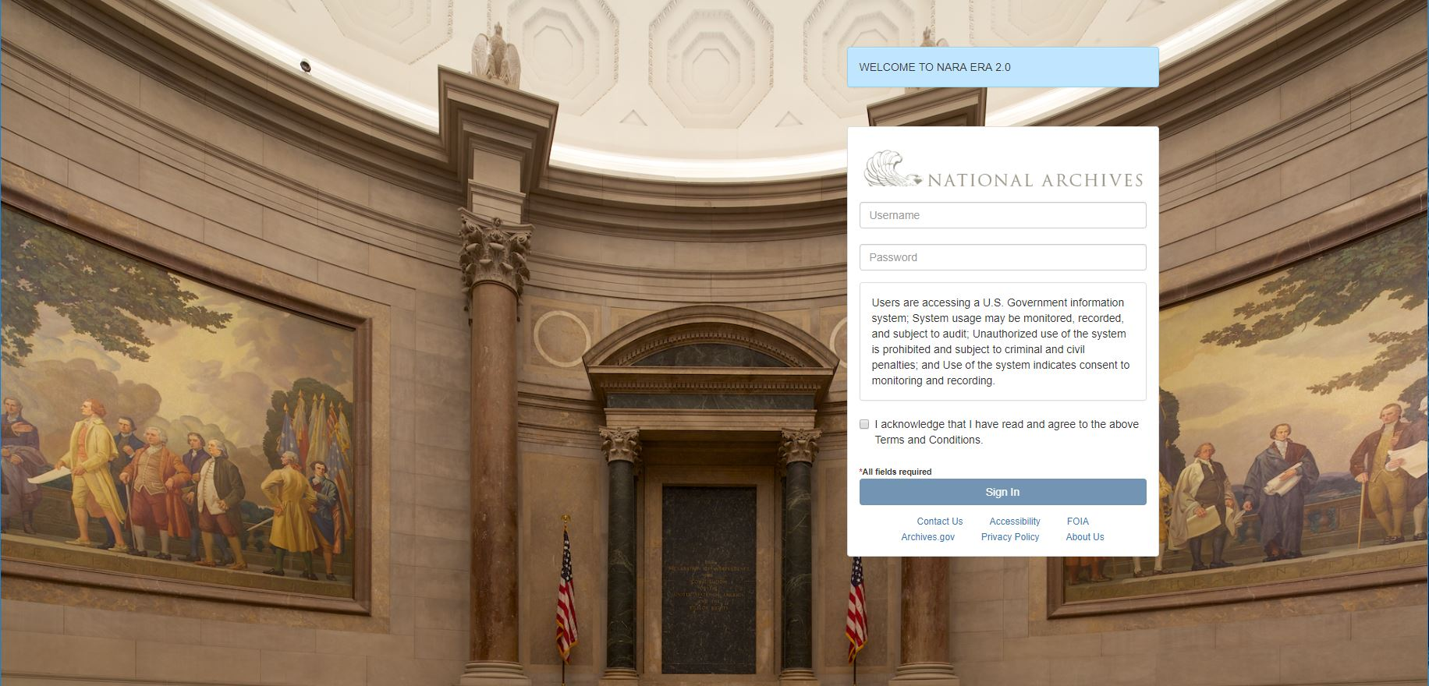
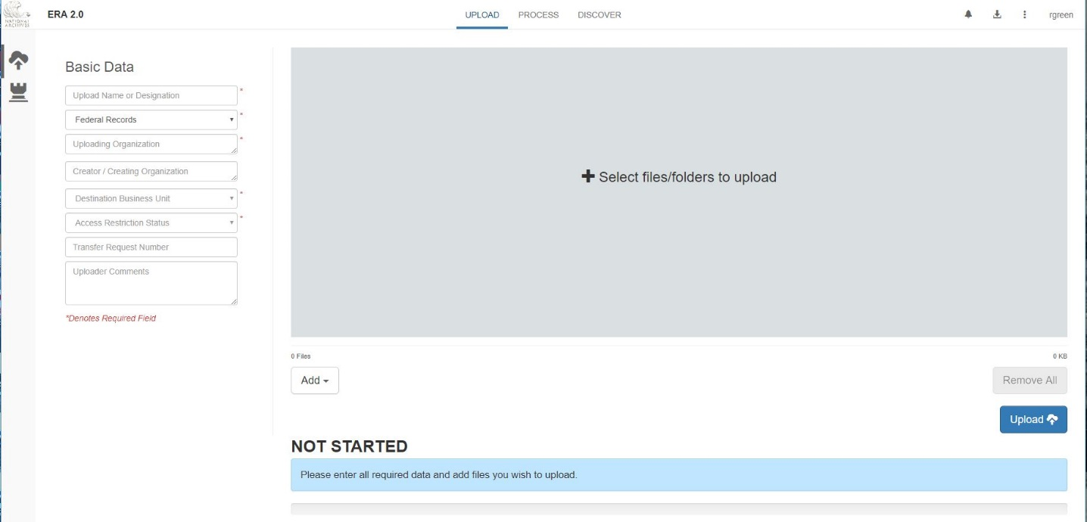
ERA 2.0
The Electronic Records Archives 2.0 System is an Amazon Cloud based repository that allows NARA to upload, process, and discover electronic records and archives at scale.
Solves current challenge for accessions containing an immense volume of records
Notes:
ERA 2.0 is a cloud based repository that allows the National Archives to upload, process, and discover electronic records at scale. ERA 2.0 can handle large accessions as well as zip container files.

Slide 16
Questions?
Thank you for inviting me to be a part of this conference. Please feel free to contact me.
Rebeccah Baker
Electronic Records Division
(301) 837-0949
Rebeccah.Baker@nara.gov

