Slide 1


Jakob Eiby – Archiving geodata
What should we archive?
Which experiences have we gained?
How have they shaped appraisal strategies?
First a little something about me…

Slide 2

What should we archive?
Danish Archives Act
Public Administrative Authorities
Notification, appraisal, approval
”System” – database, record, dataset?
So… is it just straight-forward from there?

Slide 3

Which experiences have the DNA gained?
Geodata Agency
Castrastral Map – GML 3v3.DK (old format)
Nature Agency
PROTEUS – Forest management GIS
Business Authority
Plandata – Physical planning
DNEP (subsidiary of EPA)
DAI – nature and environmental data

Slide 4
Which experiences have the DNA gained?
Data modeling
Grunddataprogrammet (Basic Data Program)
Spatiotemporal data?
Data integration
Data flow > redundancy
Data owner /= system owner (e.g. DNEP)
Central distribution <> contextual preservation
Strategies of appraisal?

Slide 5
Contextual preservation?
Fredningsregistret – land preservation (one ”system” > one SIP)
Documents (PDF)
Polygons (geodata files > spatial DB)
List of preservation decisions (Excel sheet)
Case management system (DB)
Now (two SIPs & unstructured web archive)
Central distribution of polygons (DAI > no context)
Netarkivet (web crawler – PDF, findable?)
Corporate EDRMS (classification system – PDF?)

Slide 6
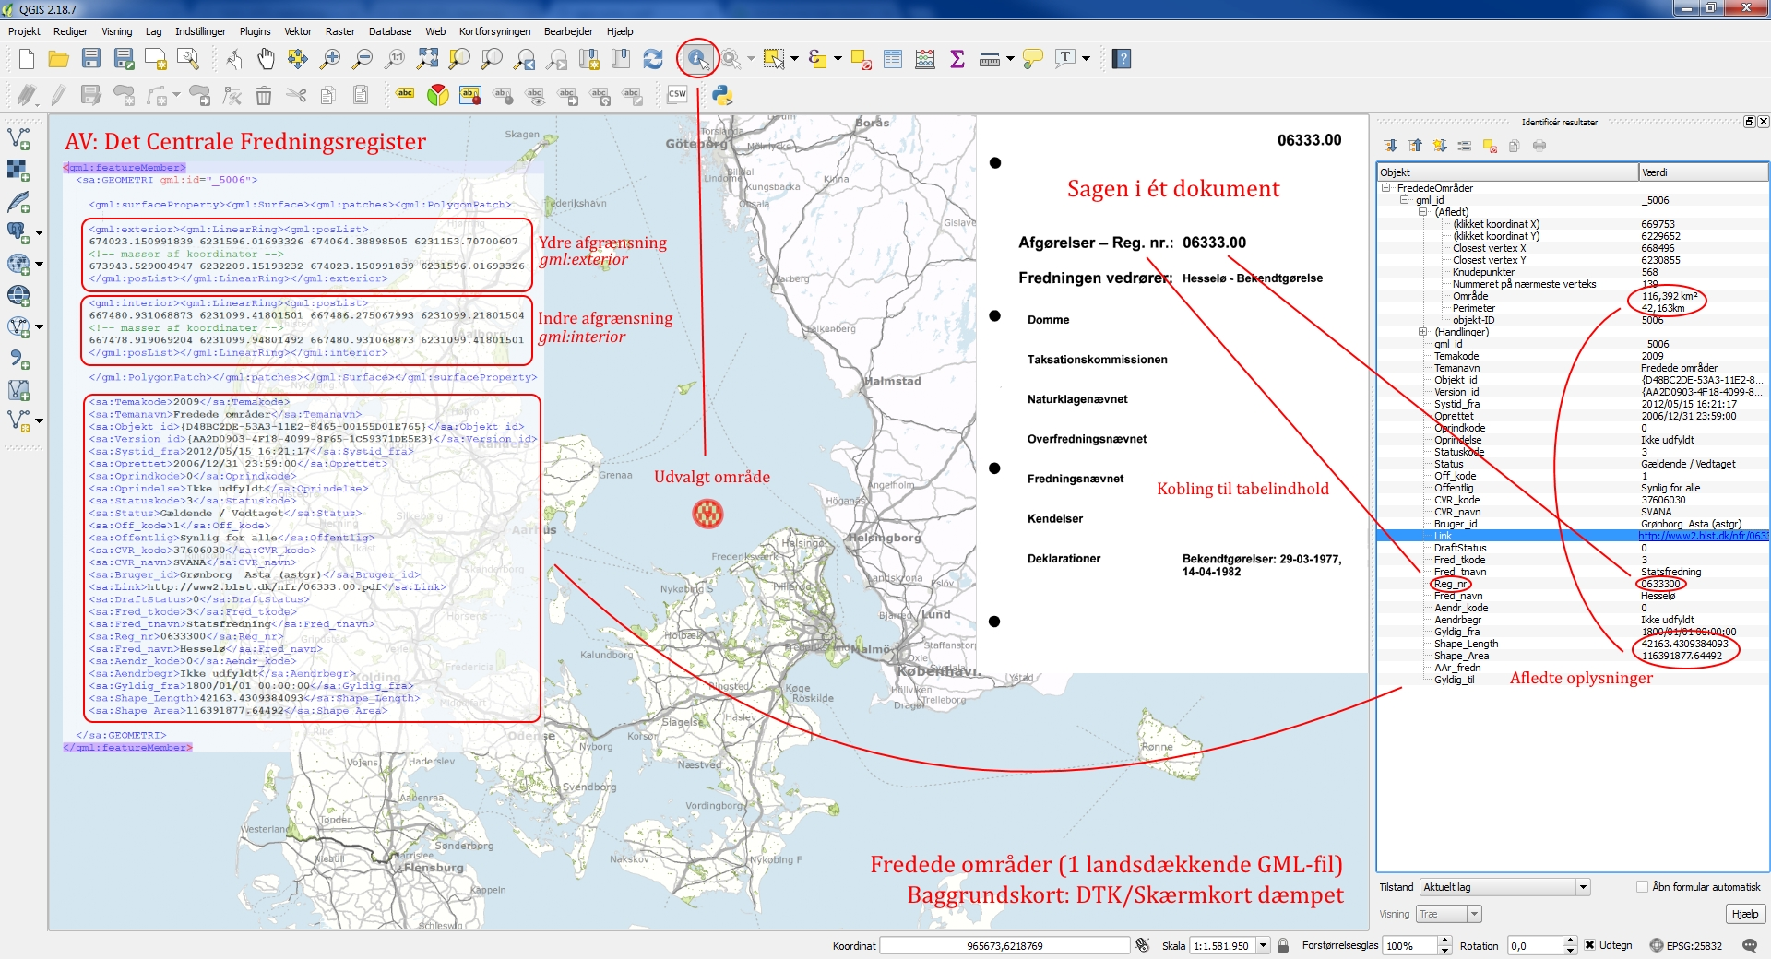

Slide 7
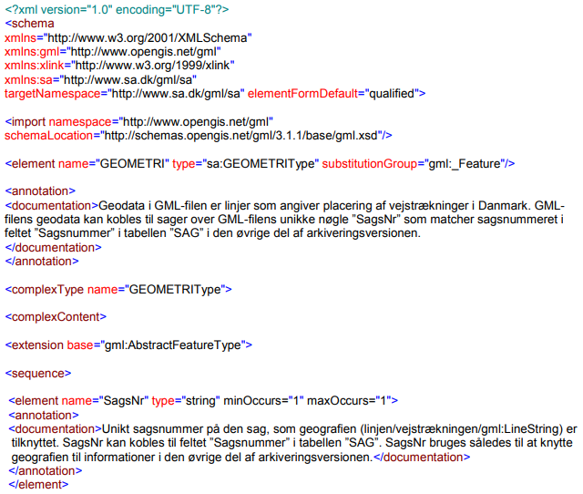
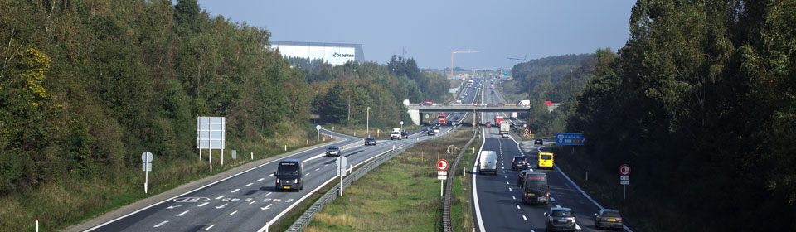
Geodata formats in EDRMS
e.g. The Danish Road Directorate
Shapefiles (SHP, SHX, DBF…)
MapInfo TAB (TAB, DAT, ID, MAP…)
Local schemas describe structure

Slide 8

Strategies of appraisal
Central distribution – how to appraise?
EnvironmentGIS (EPA)
Contextual preservation – manage?
Danish Area Information (DNEP)
Central preservation – contextualize?
Local GIS
All-purpose ArcGIS platforms
Data ownership, departmental/contextual usage

Slide 9
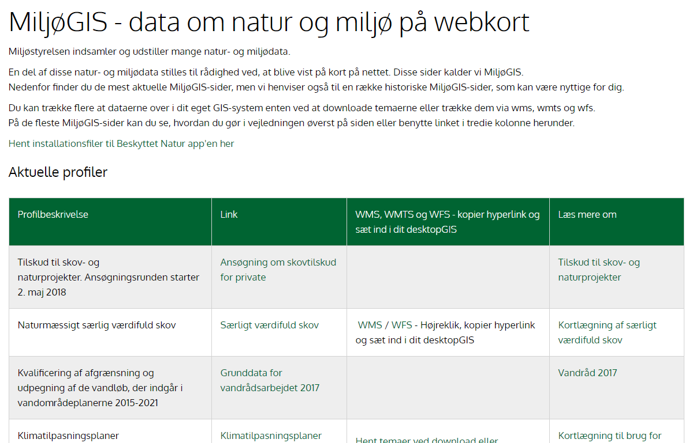

Slide 10
Summary
What relies on legislation, knowledge and experience
Experience shapes appraisal strategies
Contextual preservation depends on user needs
Questions unanswered
We do not have an instruction on archiving raster geodata
Spatiotemporal data?

Slide 11

Questions?
Jakob Eiby, IT archivist
je@sa.dk, +45 41717370
https://www.sa.dk/en/
https://digitalbevaring.dk/om-sitet/about-us/

