Slide 1

Linking Archival Records, Geodata and Other Maps in Environmental History Analyses:
With an Emphasis on 16th- to 18th-Century Data
e-Archiving Geopreservation Conference
Ljubljana, 6 May 2019
Žiga Zwitter
University of Ljubljana, Faculty of Arts
Department of History
Ziga.Zwitter@ff.uni-lj.si

Slide 2

Structure:
Introduction to the ‚historical-critical method‘

Slide 3
Structure:
Introduction to the ‚historical-critical method‘
Uses of historical maps and geodata in environmental history:
  to understand historical legacies in present landscapes
  to better understand (environmental) history

Slide 4
Structure:
Introduction to the ‚historical-critical method‘
Uses of historical maps and geodata in environmental history:
  to understand historical legacies in present landscapes
  to better understand (environmental) history
Production of historical geodata:
  to better understand history
  to better understand to a certain degree preserved traditional landscapes
  to learn from past extreme events

Slide 5
Structure:
Introduction to the ‚historical-critical method‘
Uses of historical maps and geodata in environmental history:
  to understand historical legacies in present landscapes
  to better understand (environmental) history
Production of historical geodata:
  to better understand history
  to better understand to a certain degree preserved traditional landscapes
  to learn from past extreme events
Conclusions

Slide 6
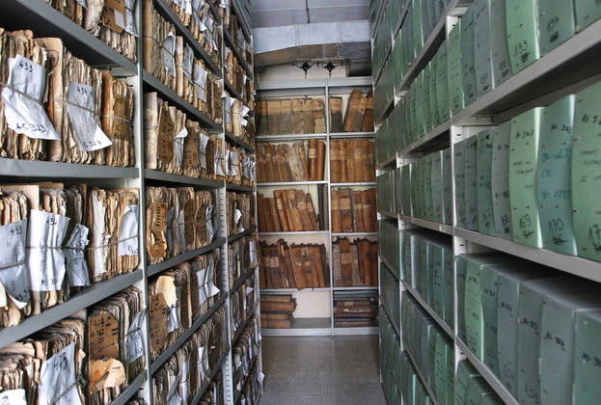

Introduction to the ‚historical-critical method‘
?

Slide 7
Fundamental questions of the
‚historical-critical method‘:
The context of production of the text:
  What was this record produced for?
  How was it produced?
  Who produced/commissioned the record?
  Where & when was the record produced?
The context of use of the text:
  - What was the record used for?
  - How was it used?
  - Who was using it?
  - When & where was it used?

Slide 8
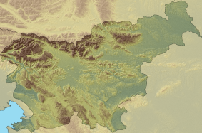
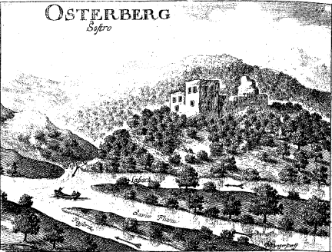
Historical-critical method from theory to practice:
river beds on 17th-centry topographical portraits
SOUTH
Valvasor, Die Ehre XI (1689), 434.
4 RIVERS
EAST
Ljubljanica
WEST
Sava
Sava
Kamniška Bistrica

Slide 9
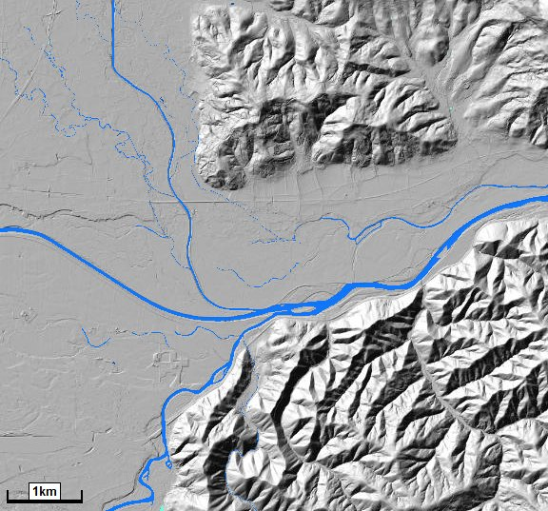
!
Environmental atlas of Slovenia.
Valvasor: Die Ehre XI, 434.

Slide 10
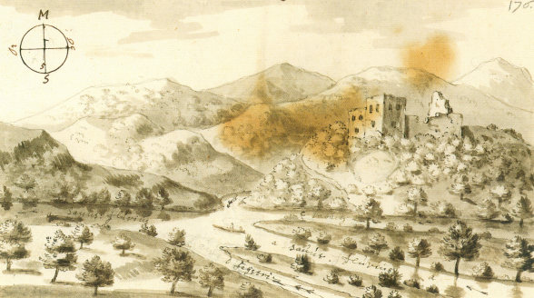
Environmental atlas of Slovenia.
Topografija Kranjske: Skicna knjiga, no. 201; Valvasor, Die Ehre XI, 434.

Slide 11
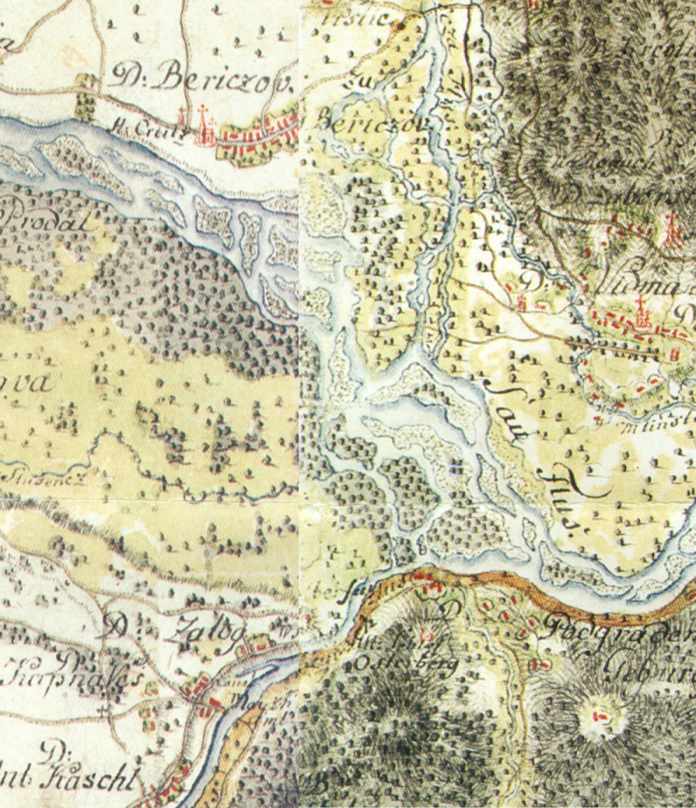
RIVER BEDS ON TOPOGRAPHICAL PORTRAITS: the Glory of the Duchy of Carniola
A century younger map:
  What was the record produced for?
To depict the castle and its surroundings :
  To document it for future generations
  To attract noblemen/ burghers:
to visit the described territories,
to buy this book because they heard that it was amusing …
Topografija Kranjske: Skicna knjiga, no. 201;
Valvasor, Die Ehre XI (1689), 434;
Slovenija na vojaškem zemljevidu 2, map sheets 190, 191.

Slide 12
RIVER BEDS ON TOPOGRAPHICAL PORTRAITS: the Glory of the Duchy of Carniola
A century younger map:
SAVA
KAMNIŠKA BISTRICA
SAVA
LJUBJANICA
Topografija Kranjske: Skicna knjiga, no. 201;
Valvasor, Die Ehre XI (1689), 434;
Slovenija na vojaškem zemljevidu 2, map sheets 190, 191.

Slide 13
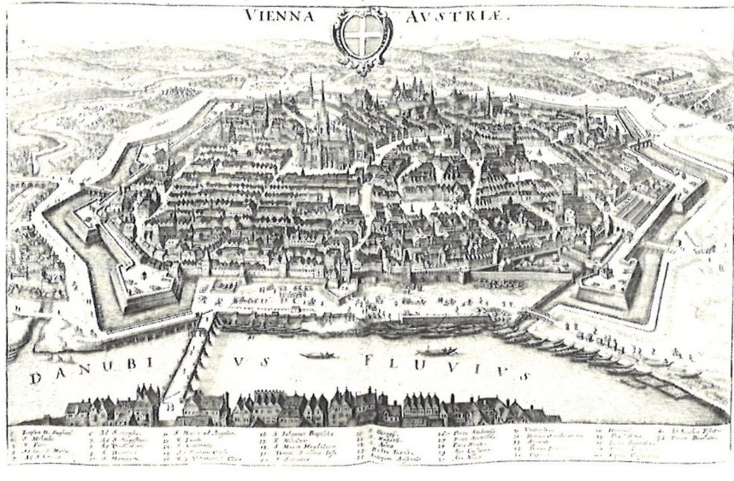
M. Merian der Ältere:
Topographia Provinciarum Austriacarum (1679): Vienna
Knoll, Die Natur der menschlichen Welt (2013), 309.
The Danube River

Slide 14
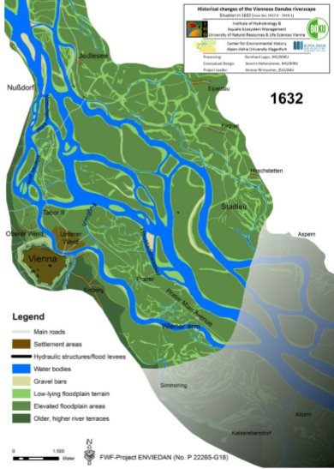
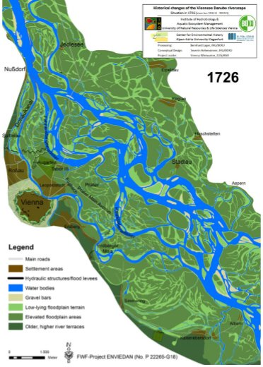
The riverscape of the Danube near Vienna in the years 1632 and 1726
1632:
1726:
Water body
Settlement area
Vienna
Hohensinner et al. (2013), Changes in water and land, 154, 157.

Slide 15
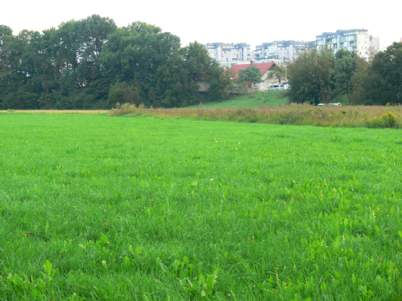
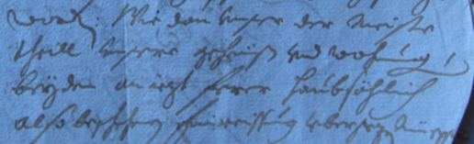
  What was this record produced for?
Correct or made-up argument in a petition for a tax relief in 1654?
Photo: Ž. Zwitter
Petition for a tax relief in 1654:
SI AS 2, The Estates of the province of Carniola, 1st registry, box 499.

Slide 16
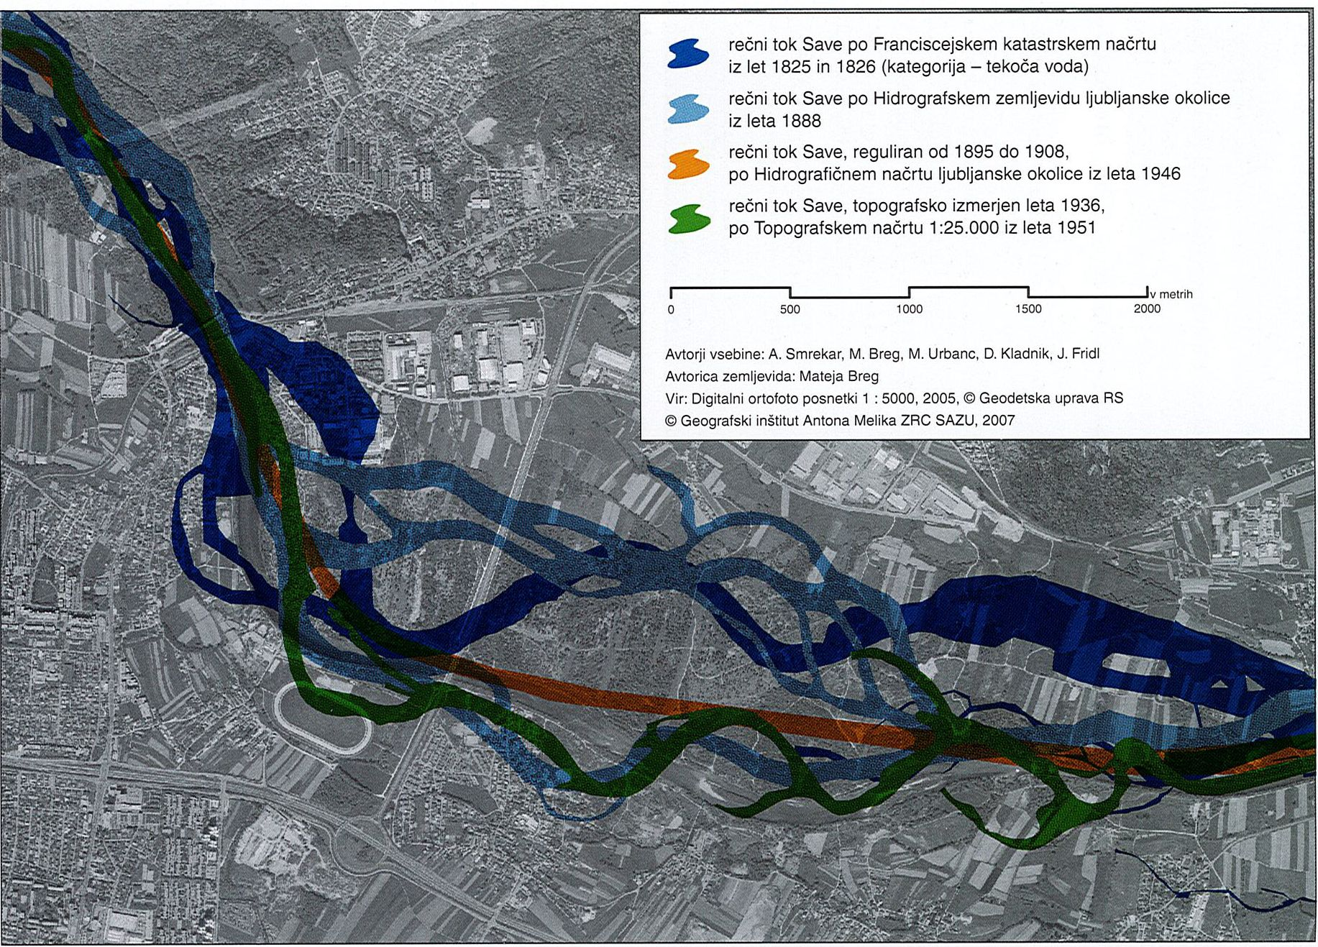
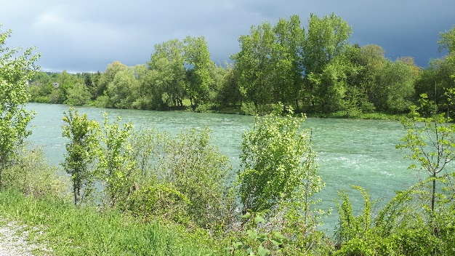
The Sava River north of Ljubljana:
mid-1820s, 1880s, about 1900, 1936 and now (grey)
years 1825, 1826
map published 1888
the result of regulations between 1895 and 1908
year 1936
metres
0 500 1000 1500 2000
Mala vas
Stožice
we are here
Smrekar, Divja odlagališča odpadkov (2007), 96.

Slide 17
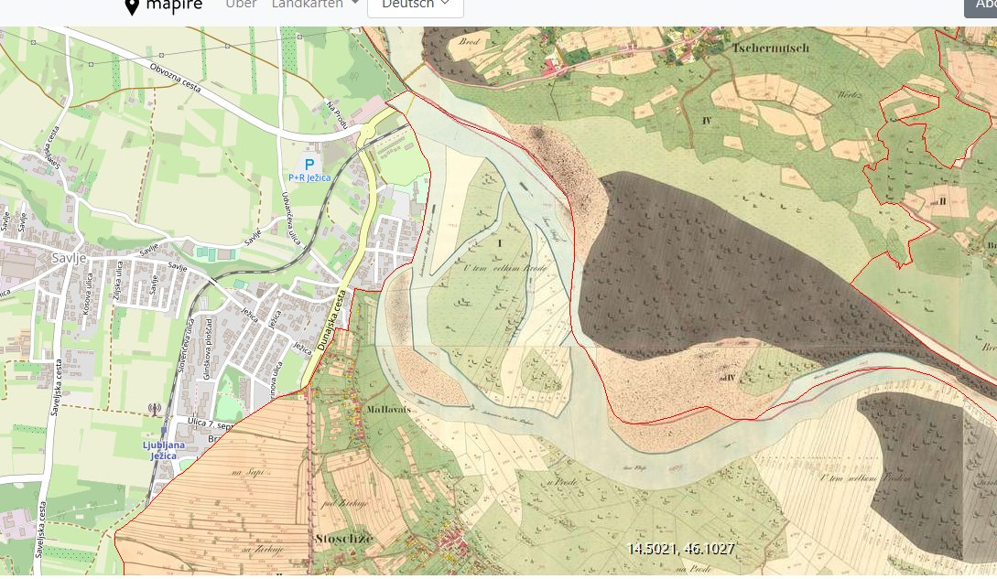
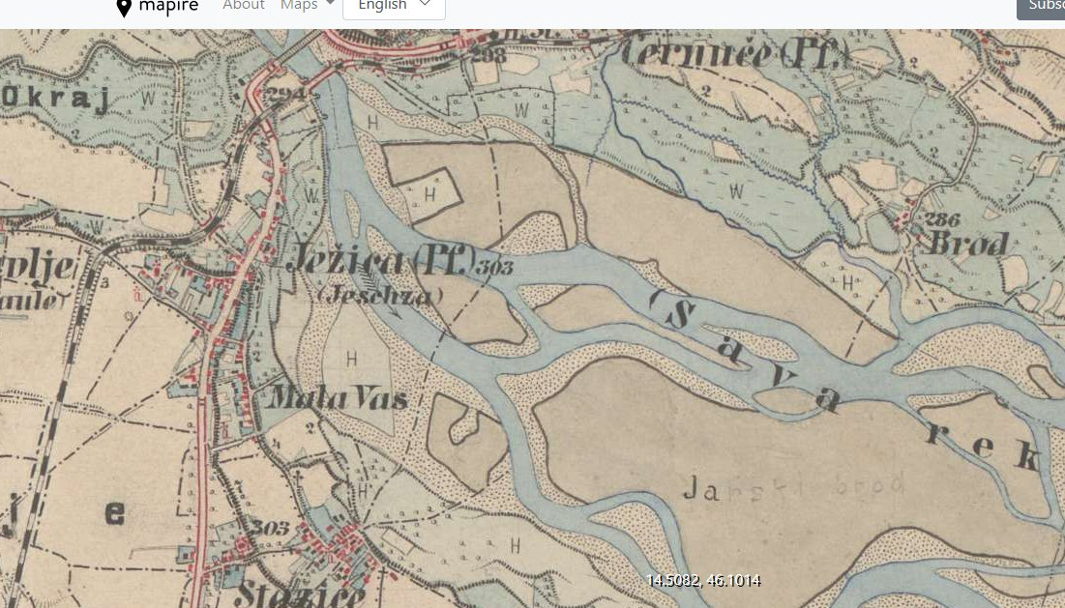
1820s:
Mapire: https://mapire.eu/de/map/cadastral/?layers=osm%2C3%2C4&bbox=1609437.6905358028%2C5790868.732598148%2C1624218.7008804488%2C5795646.046865972;
https://mapire.eu/en/map/europe-19century-thirdsurvey/?layers=osm%2C160%2C166&bbox=1615904.3825615854%2C5792958.807590321%2C1617752.0088546662%2C5793555.971873799

Slide 18
  What was this record produced for?
Correct or made-up argument in a petition for a tax relief in 1654?
Photo: Ž. Zwitter
Petition for a tax relief in 1654:
SI AS 2, The Estates of the province of Carniola, 1st registry, box 499.

Slide 19

2. The use of historical maps and geodata in environmental history:
2. 1. to understand historical legacies in present landscapes
The Sava River below Mala vas today
Photo: Ž. Zwitter.

Slide 20
Photo: Ž. Zwitter.

Slide 21
Terrace 1
Photo: Ž. Zwitter.

Slide 22
Terrace 2
Terrace 1
Photo: Ž. Zwitter.

Slide 23
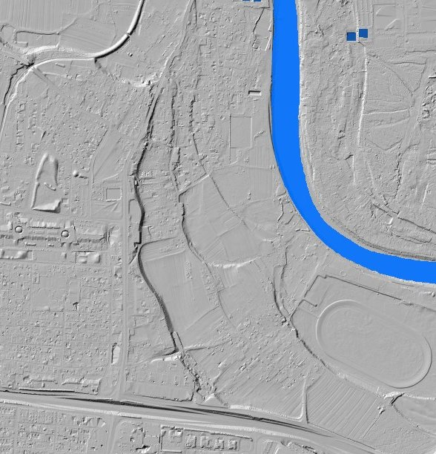
The Sava River

Slide 24
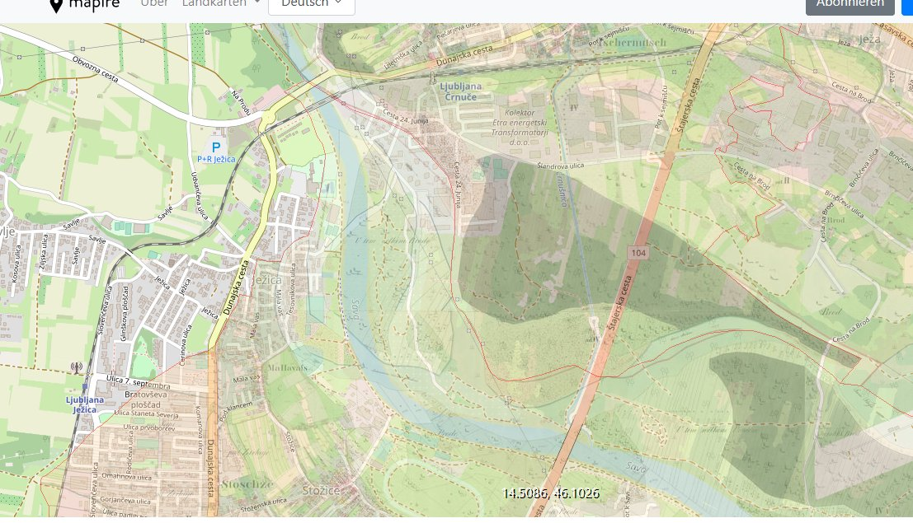
The Sava River
Mapire: https://mapire.eu/de/map/cadastral/?layers=osm%2C3%2C4&bbox=1609437.6905358028%2C5790868.732598148%2C1624218.7008804488%2C5795646.046865972
Atlas okolja:
http://gis.arso.gov.si/atlasokolja/profile.aspx?id=Atlas_Okolja_AXL@Arso
we are here

Slide 25
The Sava River
Mapire: https://mapire.eu/de/map/cadastral/?layers=osm%2C3%2C4&bbox=1609437.6905358028%2C5790868.732598148%2C1624218.7008804488%2C5795646.046865972
Atlas okolja:
http://gis.arso.gov.si/atlasokolja/profile.aspx?id=Atlas_Okolja_AXL@Arso
we are here

Slide 26
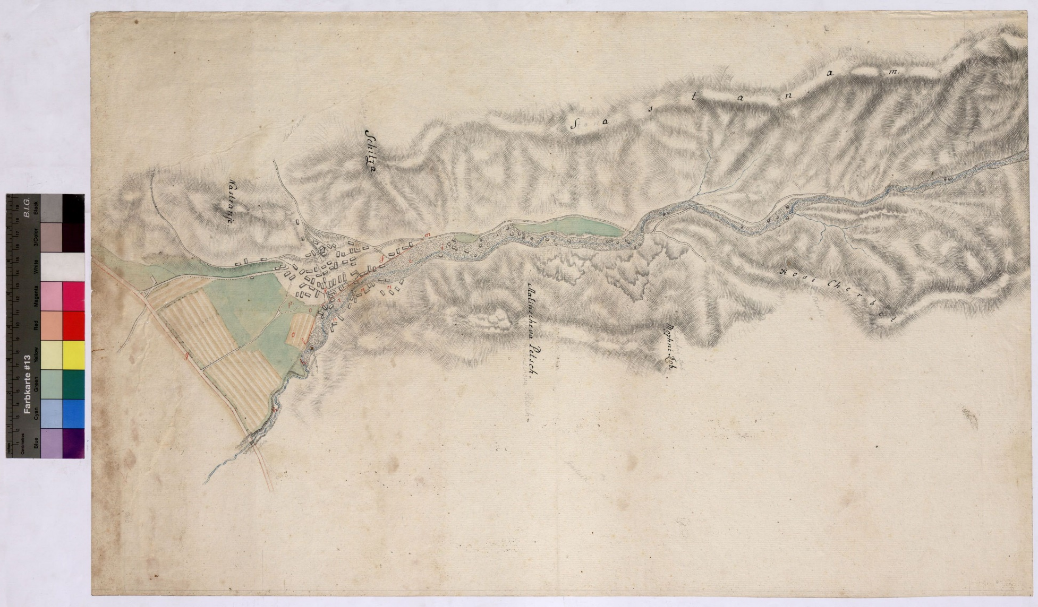
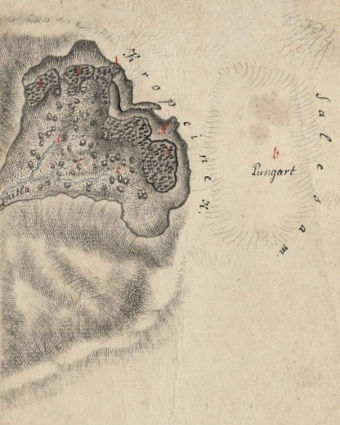
2. The use of historical maps and geodata in environmental history:
2. 1. to understand historical legacies in present landscapes
A debris-flow devastating the village Koroška Bela in 1789
SI AS 1068, 1_043, 1_044.

Slide 27
A debris-flow devastating the village Koroška Bela in 1789
SI AS 1068, 1_043, 1_044.

Slide 28
A debris-flow devastating the village Koroška Bela in 1789
SI AS 1068, 1_043, 1_044.

Slide 29
A debris-flow devastating the village Koroška Bela in 1789
SI AS 1068, 1_043, 1_044.

Slide 30
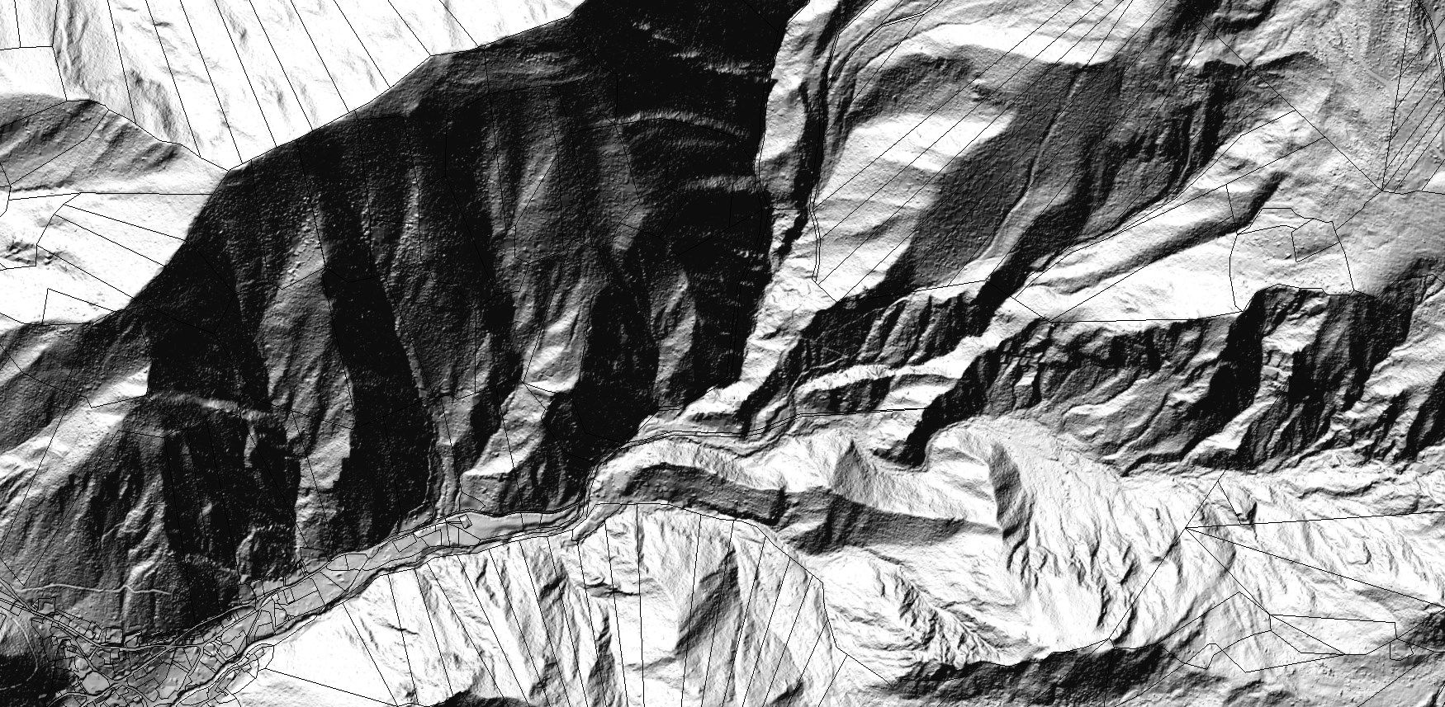
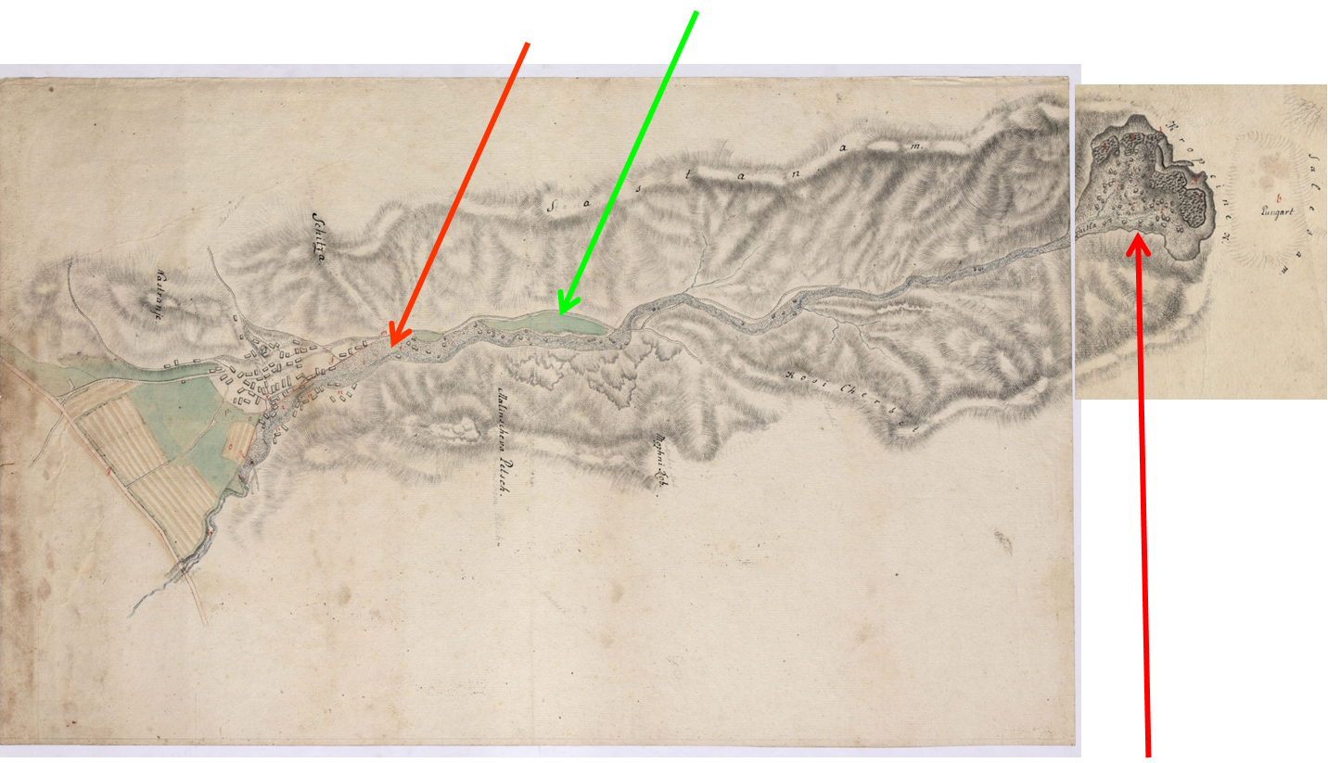
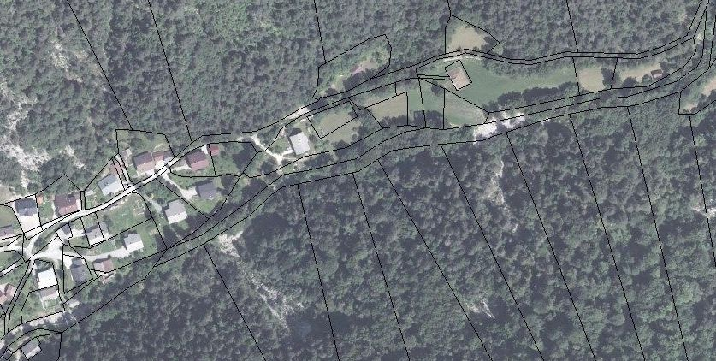
Atlas okolja.
SI AS 1068, 1_043, 1_044.

Slide 31
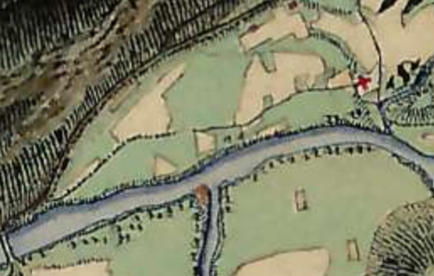


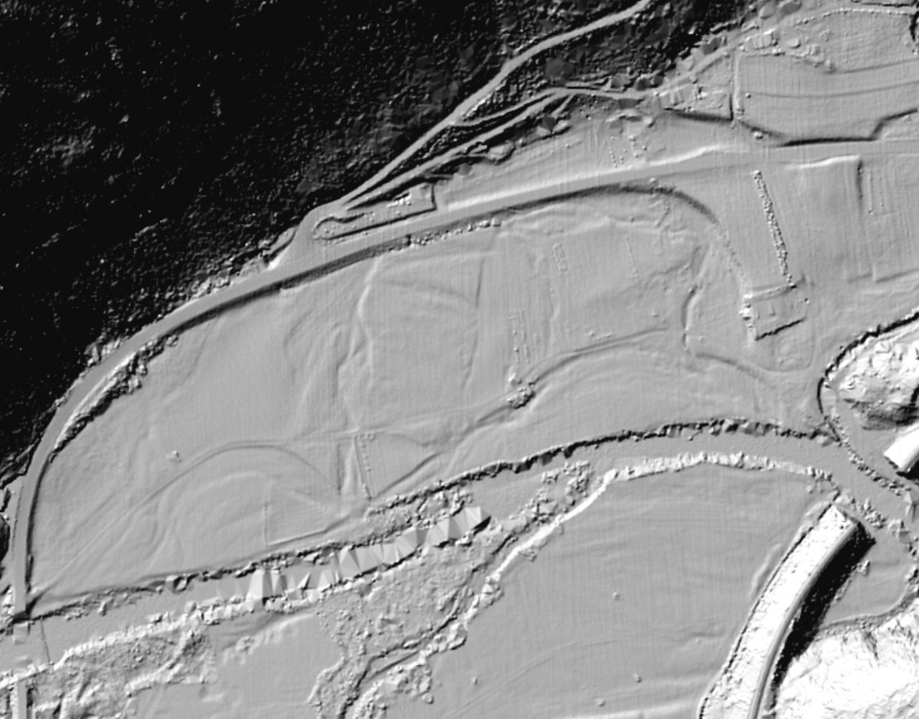
CHURCH
Legend (to the map on the left, early 19th century):
= meadow
= field
BRIDGE???
= water
CHURCH
2. The use of historical maps and geodata in environmental history:
2. 2. to better understand (environmental) history:
example:
site characteristics, 17th c.
1606: „Vmlaze“
1607: „V logu“
Environmental Atlas of Slovenia; Mapire: Franziszeische Landesaufnahme.

Slide 32
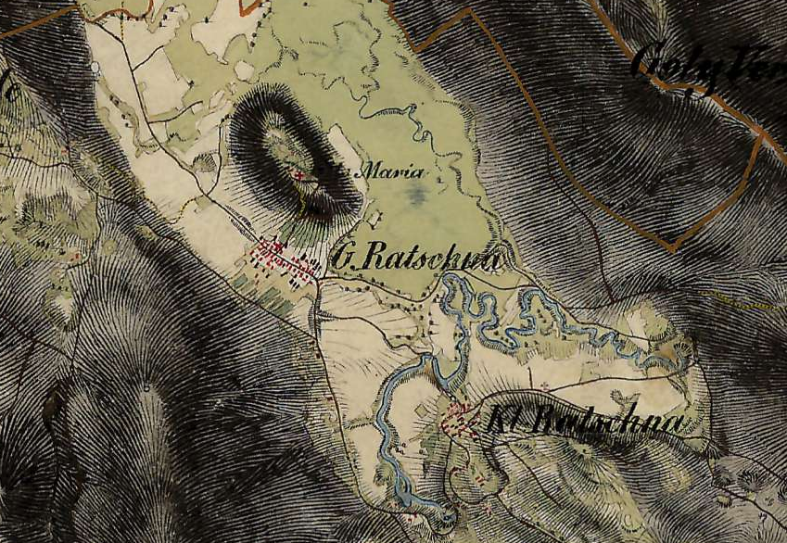
19th-century land use
Gams, Kras v Sloveniji v prostoru in času (2004), 391.
fields
Mapire.
village Velika Račna
2. The use of historical maps and geodata in environmental history:
2. 2. to better understand (environmental) history:
example:
general long-term lack of adaptation to flood hazard

Slide 33
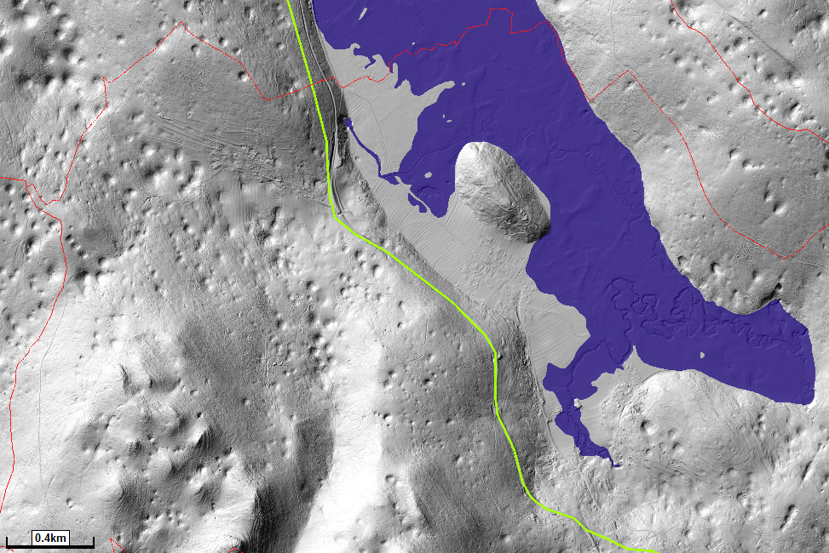
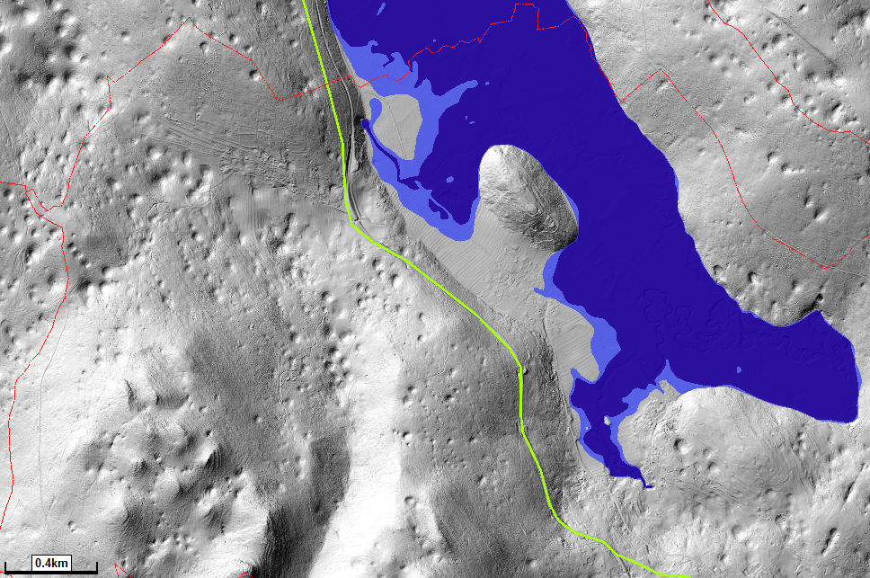
19th-century land use
1568 description: floods cause severe damage to cereal fields
Ca. 1750: severe flood hazard, also in fields, in spring & autumn
fields
Zwitter, forthcoming.
10-year flood:
100-year flood:
Atlas okolja; Mapire.
400 m

Slide 34
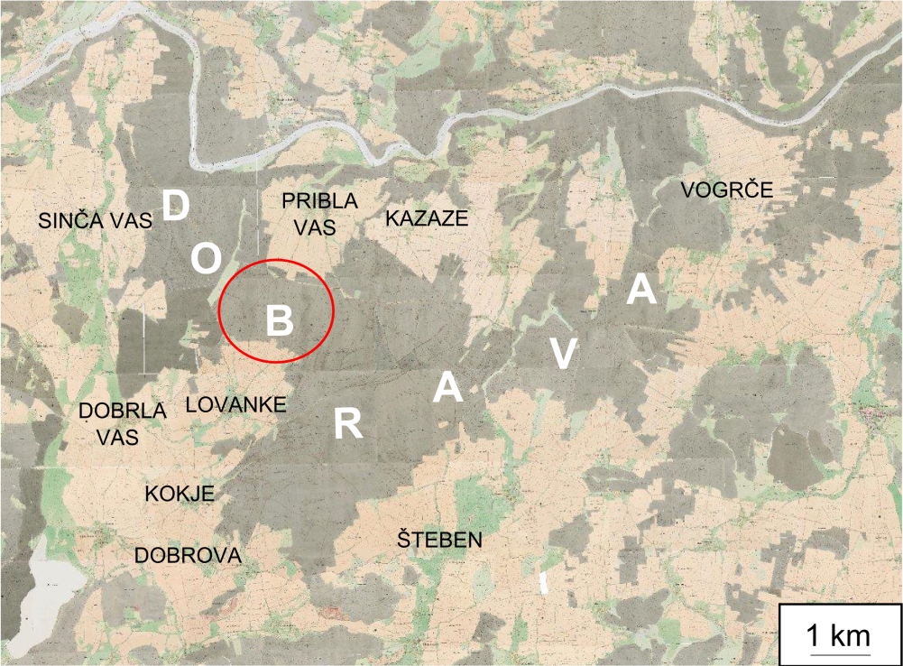
DOBRAWA/DOBRAVA forest in central Jauntal/Podjuna
HU
AT
Land-use about 1820:
HR
IT
PRIBELSDORF
RINKENBERG
KÜHNSDORF
EDLING
LEGEND:
: forest
: field
EBERNDORF
GABLERN
: meadow
KÖCKING
ST. STEFAN
: water
HART
Kärnten Atlas: https://gis.ktn.gv.at/atlas/(S(btrio41r10hdvpwdzfyetjwv))/init.aspx?karte=atlas_basiskarten&ks=kaernten_atlas

Slide 35
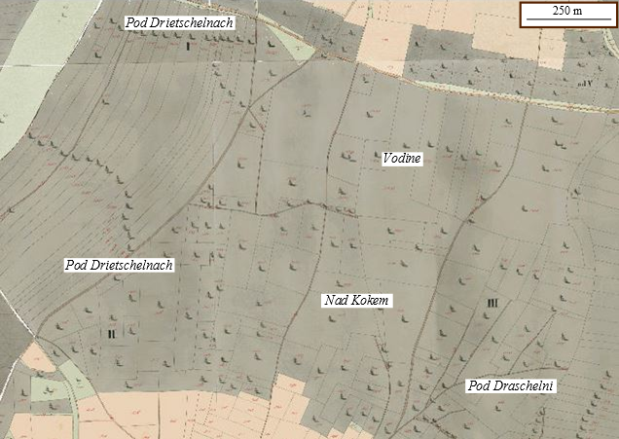
Anton Melik (1954):
»The spatiousness of the area still occupied by Dobrava, the tightly closed forest covering well-nigh a half of the entire Podjuna/Jaunal plain, is surprising«
(Slovenski alpski svet, 506).
250 m
Kärnten Atlas: https://gis.ktn.gv.at/atlas/(S(btrio41r10hdvpwdzfyetjwv))/init.aspx?karte=atlas_basiskarten&ks=kaernten_atlas.

Slide 36
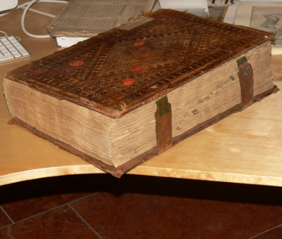

AT StiAStP, Eberndorf, Buch 4, 197.
Description of tenants‘ holdings, 1664-1665:

Slide 37
AT StiAStP, Eberndorf, Buch 4, 192, 197.
Description of tenants‘ holdings, 1664-1665:

Slide 38
Anton Melik (1954):
»The spatiousness of the area still occupied by Dobrava, the tightly closed forest covering well-nigh a half of the entire Podjuna/Jaunal plain, is surprising«
(Slovenski alpski svet, 506).
250 m
1664/65: Pod Rietschini …
1664/65: Na Ladinach
1664/65: Na Coku
Kärnten Atlas: https://gis.ktn.gv.at/atlas/(S(btrio41r10hdvpwdzfyetjwv))/init.aspx?karte=atlas_basiskarten&ks=kaernten_atlas.

Slide 39
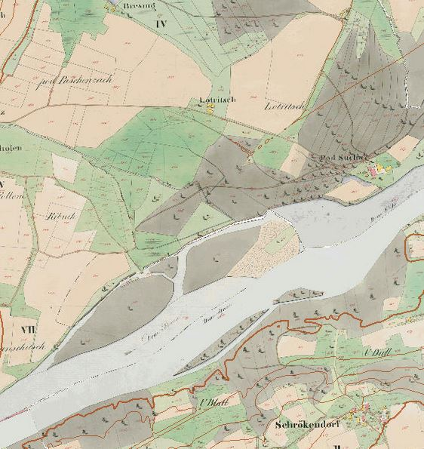
3. Production of historical geodata:
3. 1. to better understand history
HU
AT
HR
IT
LEGEND:
: forest
: field
: meadow
Ca. 1820:
!
: water
Kärnten Atlas http://gis.ktn.gv.at/atlas/(S(wiozymjl3zbsn2t5xvyqbhbo))/init.aspx?karte=atlas_basiskarten

Slide 40
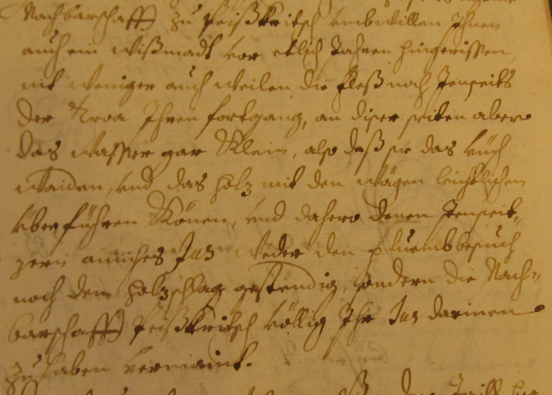
3. Production of historical geodata:
3. 1. to better understand history
Long-term changes in morphology of river beds: 17th & 19-century:
Island in the Drava/Drau River below Piskertschach/Piskče, Carinthia, 1662:
HU
AT
IT
HR
AT StiAStP, Eberndorf, Buch 181, 29.

Slide 41
THE DRAU/DRAVA RIVER BELOW PISKERTSCHACH/PISKRČE, EARLY 19th C.
LEGEND:
!
: forest
: field
: meadow
!
: water
Kärnten Atlas http://gis.ktn.gv.at/atlas/(S(wiozymjl3zbsn2t5xvyqbhbo))/init.aspx?karte=atlas_basiskarten

Slide 42
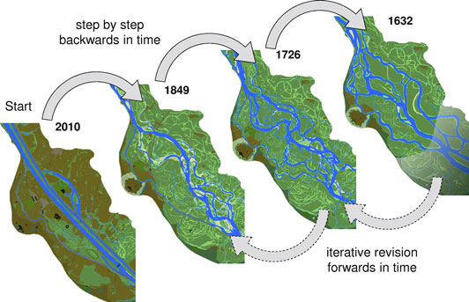
Reconstruction of the Danube at Vienna using regressive-iterative approach
Hohensinner et al. (2013), Two steps back, one step forward, 136.

Slide 43
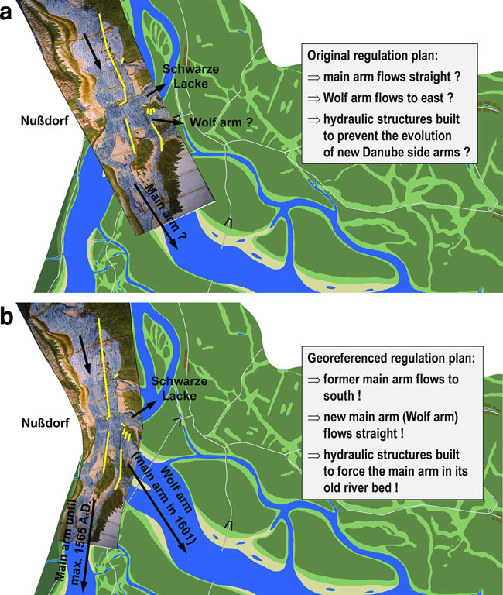
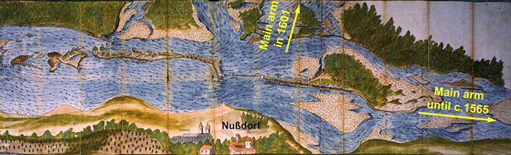
River engineering plan of the Danube at Nußdorf, upstream from Vienna, 1601:
Hohensinner et al. (2013), Two steps back, one step forward, 127–128.

Slide 44
River engineering plan of the Danube at Nußdorf, upstream from Vienna, 1601, without considering the topography:
… considering the topography :
Hohensinner et al. (2013), Two steps back, one step forward, 128.

Slide 45
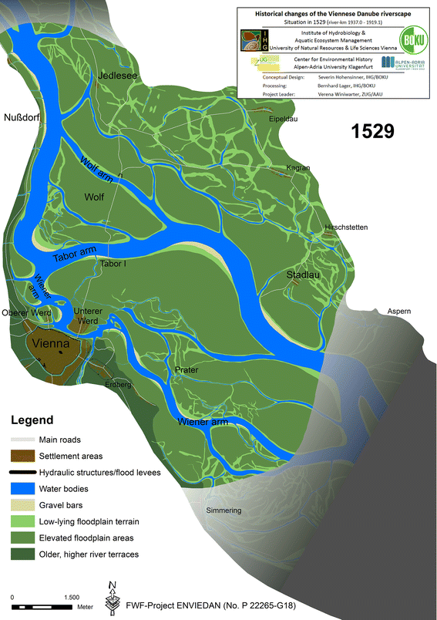
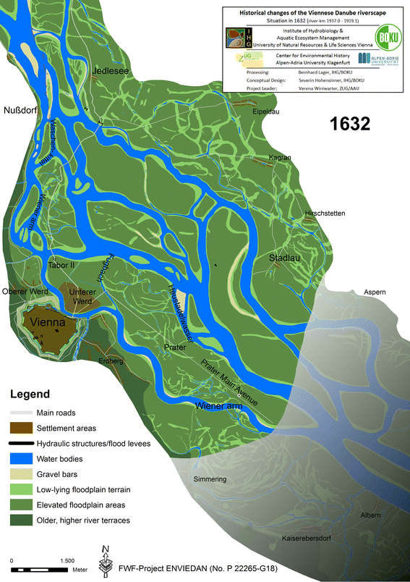
1632
Hohensinner et al. (2013), Changes in water and land, 149, 154.

Slide 46
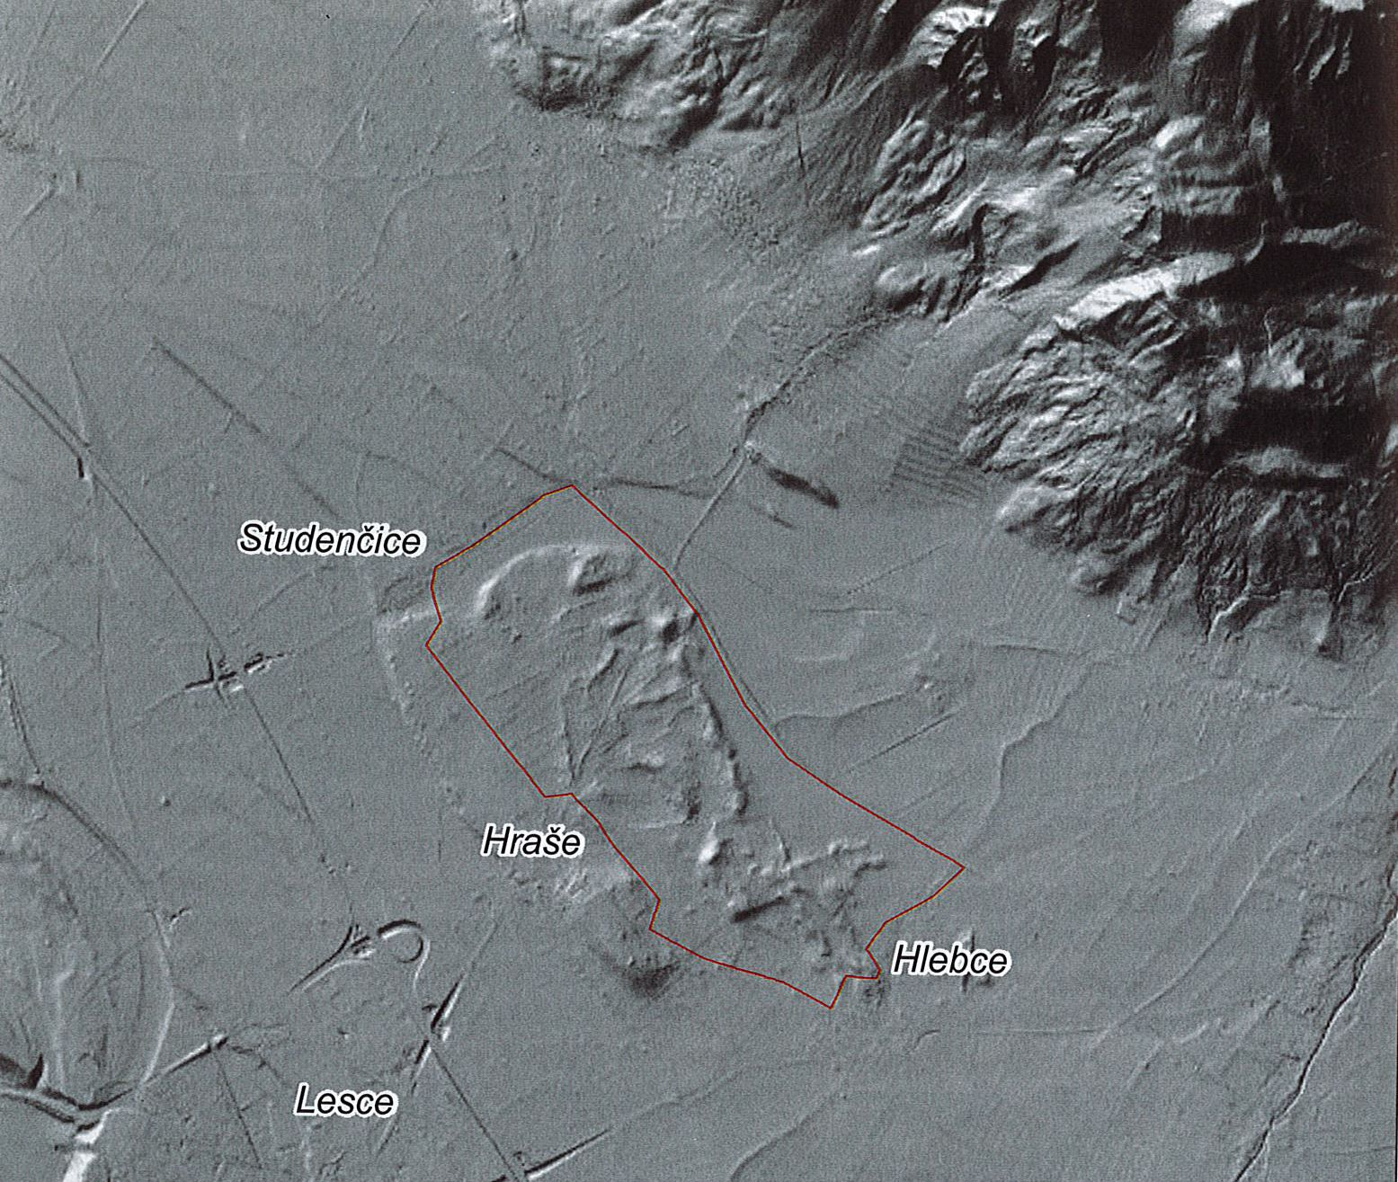
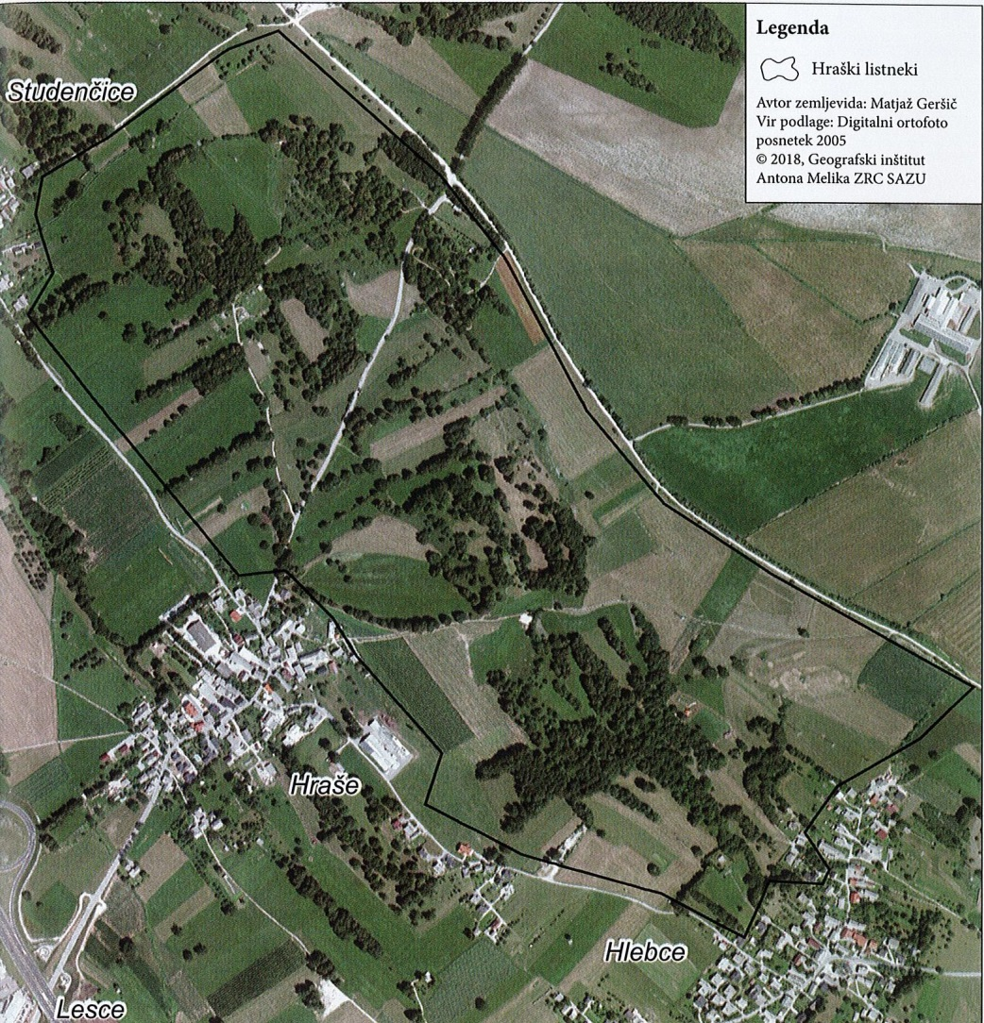
  3. Production of historical geodata:
  3. 2. to better understand to a certain degree preserved traditional landscapes:
  an example of a „traditional“ agricultural landscape
Geršič, Gabrovec, Zwitter, Primerjava kulturne pokrajine Hraških listnekov (2018), 63–64.

Slide 47
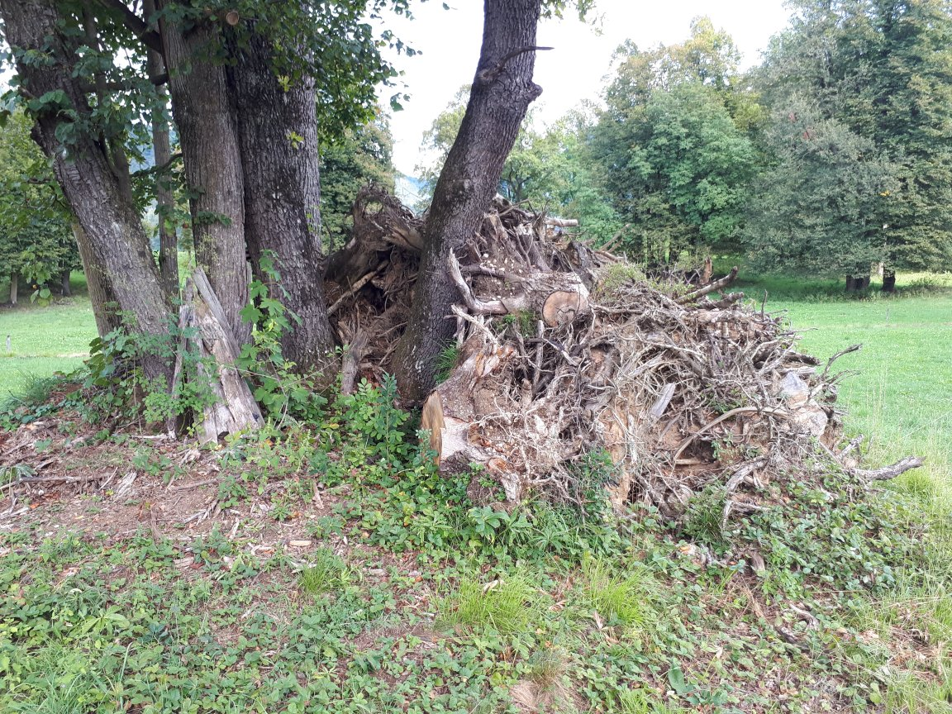
Photo: Ž. Zwitter.

Slide 48
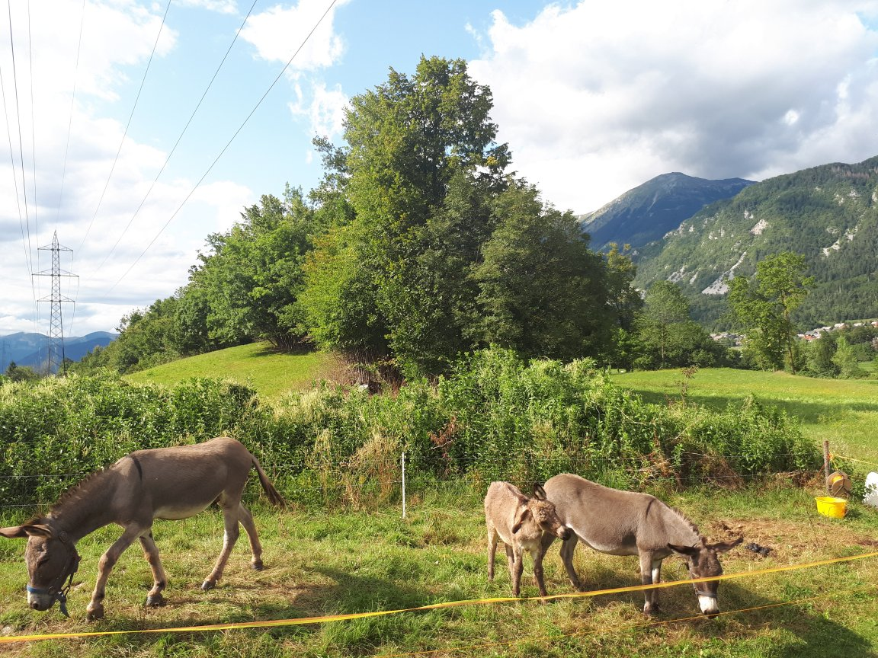
Photo: Ž. Zwitter.

Slide 49
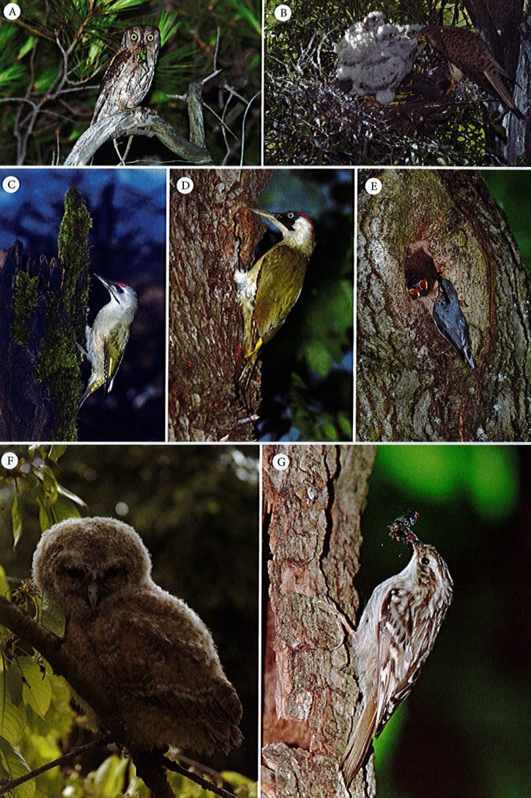
A: Otus scops,
Eurasian scops owl
B: Falco tinnunculus,
common kestrel
C: Picus canus,
grey-headed woodpecker
D: Picus viridis,
European green woodpecker
E:Sitta europaea,
Eurasian nuthatch
F: Strix aluco, tawny owl
G: Certhia brachydactyla,
short-toed treecreeper
Photo: Boris Kozinc
Geršič, Gabrovec, Zwitter, Primerjava kulturne pokrajine Hraških listnekov (2018), 68–69.

Slide 50
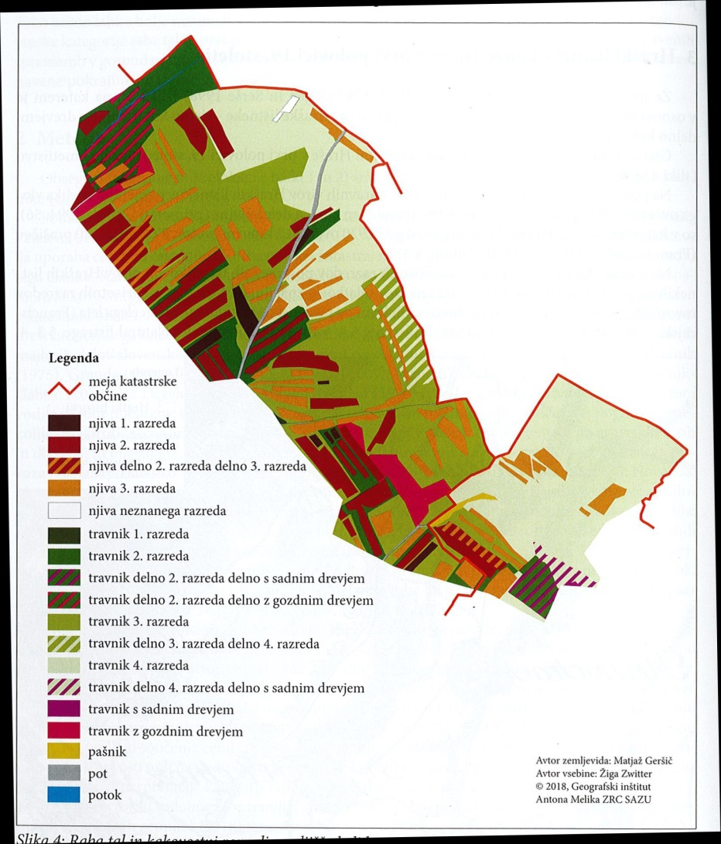
Land use, ca. 1830:
border of the cadastral municipality
arable land, 1st class
arable land, 2nd class
arable land, partly 2nd, partly 3rd class
arable land, 3rd class
arable land, class not recorded
meadow, 1st class
meadow, 2nd class
meadow, partly 2nd class, partly with fruit trees
meadow, partly 2nd class, partly with wild trees
meadow, 3rd class
meadow, partly 3rd, partly 4th class
meadow, 4th class
meadow, partly 4th class, partly with fruit trees
meadow with fruit trees
meadow with wild trees
Geršič, Gabrovec, Zwitter, Primerjava kulturne pokrajine Hraških listnekov (2018), 68–69.
pasture
path

Slide 51
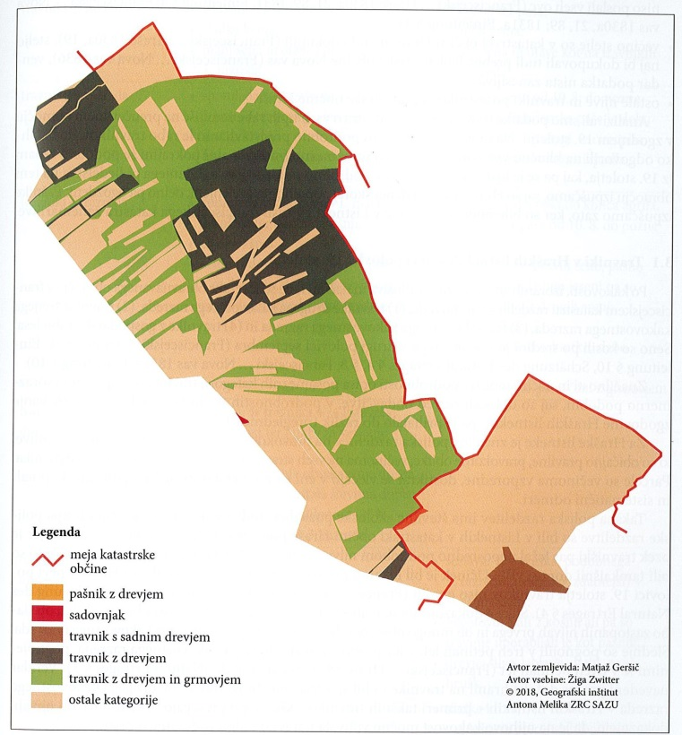

wooded pasture
Land use, ca. 1830:
orchard
meadow with fruit trees
wooded meadow
the same & with bush
other land-use cathegories
Land use, 1827
border of the cadastral municipality
arable land, 1st class
arable land, 2nd class
arable land, partly 2nd, partly 3rd class
arable land, 3rd class
arable land, class not recorded
meadow, 1st class
meadow, 2nd class
meadow, partly 2nd class, partly with fruit trees
meadow, partly 2nd class, partly with wild trees
meadow, 3rd class
meadow, partly 3rd, partly 4th class
meadow, 4th class
meadow, partly 4th class, partly with fruit trees
meadow with fruit trees
meadow with wild trees
Geršič, Gabrovec, Zwitter, Primerjava kulturne pokrajine Hraških listnekov (2018), 68–69.
pasture
path

Slide 52
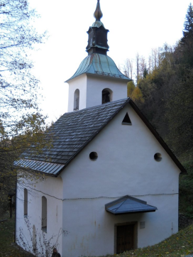
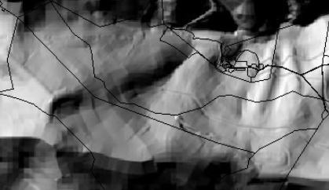
3. Production of historical geodata:
3. 3. to learn from past extreme events
example: avalanches
929 m a.s.l.
Photo: R. Dovjak.
Environmental Atlas of Slovenia.

Slide 53
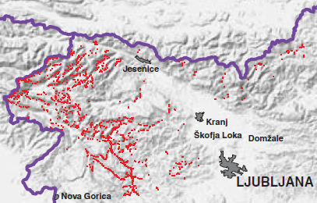
3. Production of historical geodata:
3. 3. to learn from past extreme events
example: avalanches
929 m a.s.l.
Photo: R. Dovjak.
Pavšek, Snežni plazovi v Sloveniji (2002), 30.
Environmental Atlas of Slovenia.

Slide 54
3. Production of historical geodata:
3. 3. to learn from past extreme events
example: avalanches
!
929 m a.s.l.
Photo: R. Dovjak.
Pavšek, Snežni plazovi v Sloveniji (2002), 30.
Environmental Atlas of Slovenia.

Slide 55
4. Conclusions
Environmental historians use and produce spatial environment-related data, among them geodata.

Slide 56
4. Conclusions
Environmental historians use and produce spatial environment-related data, among them geodata.
Geodata (and other maps) often improve our understanding of environmental history, in certain cases also of past legacies in present landscapes.

