Slide 1

EARK Pilot Experiences in archiving Natura 2000
Primož Kogovšek
eArchiving Building Block Geopreservation Conference 6-7 May 2019, Ljubljana

Slide 2
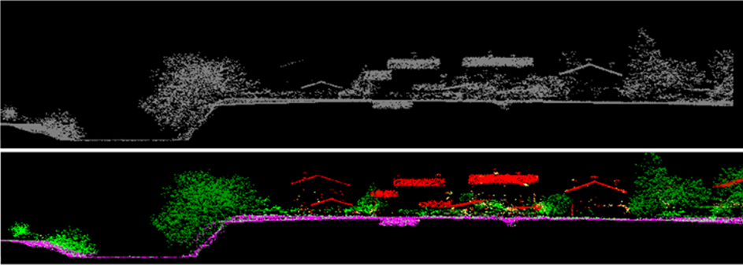
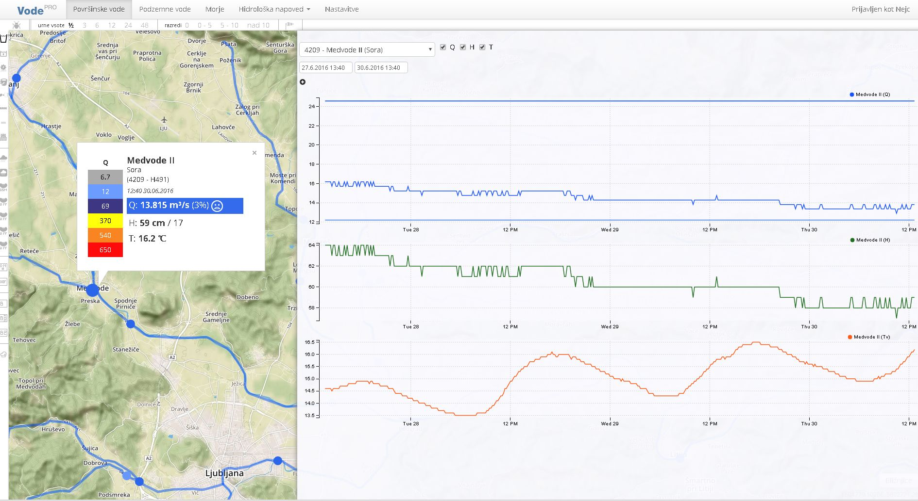
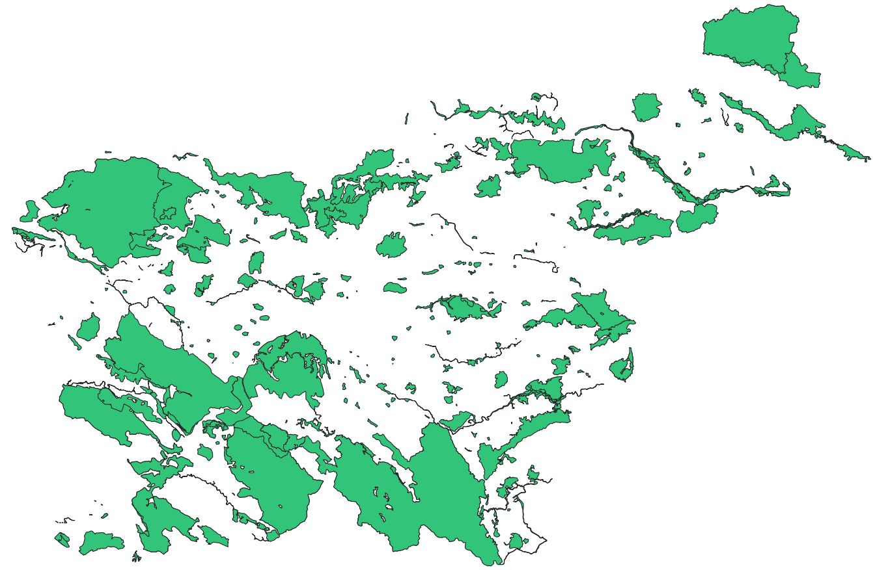
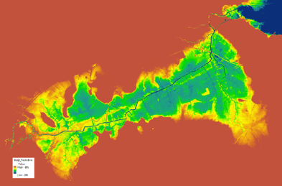
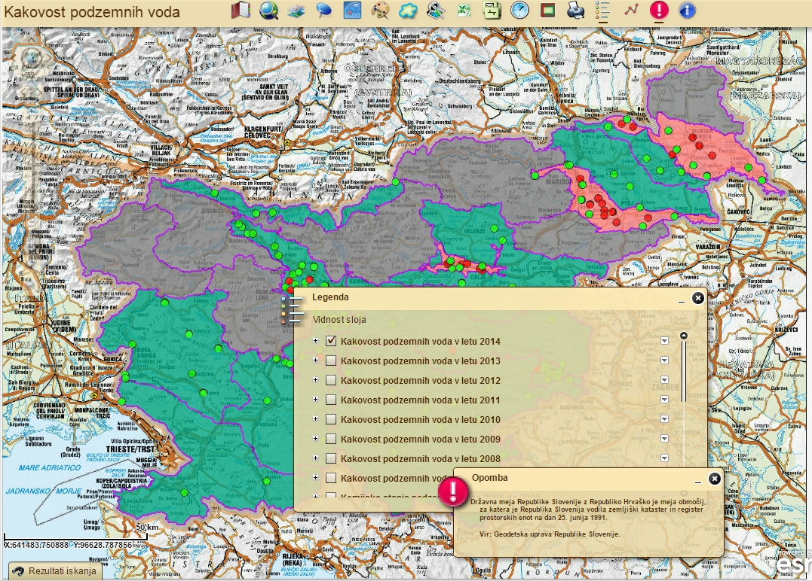
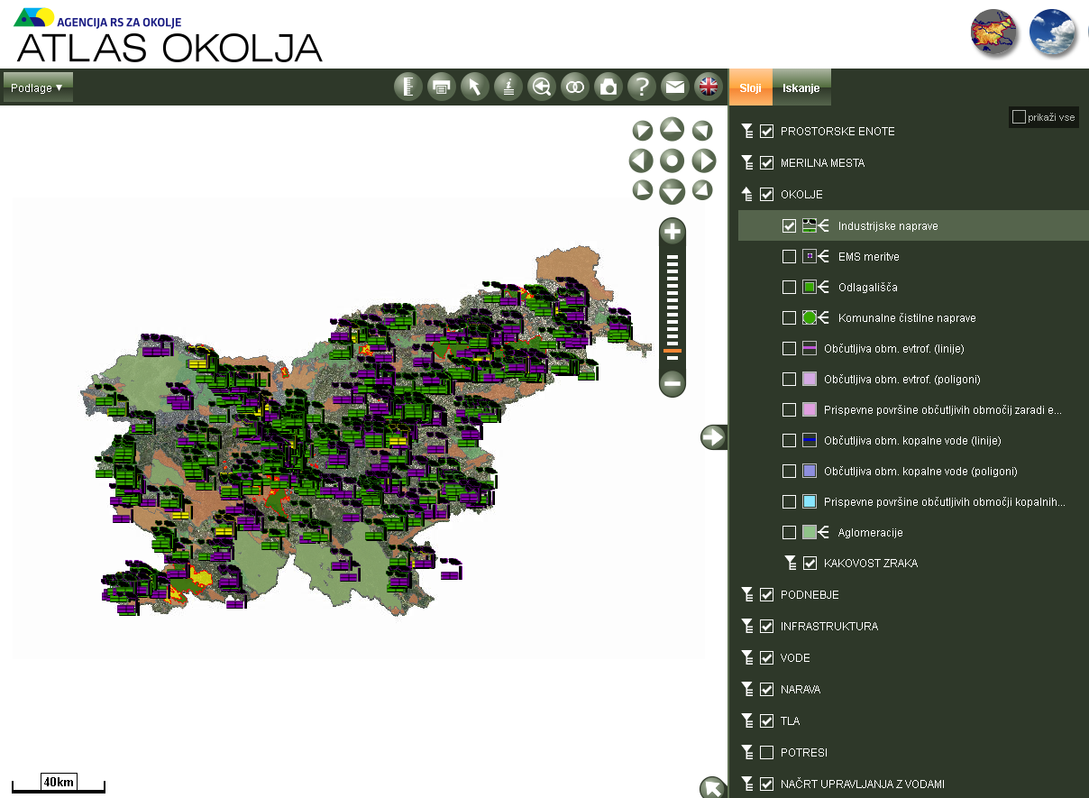
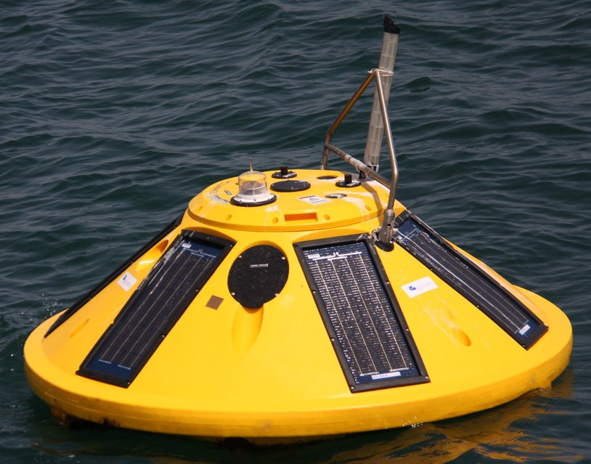
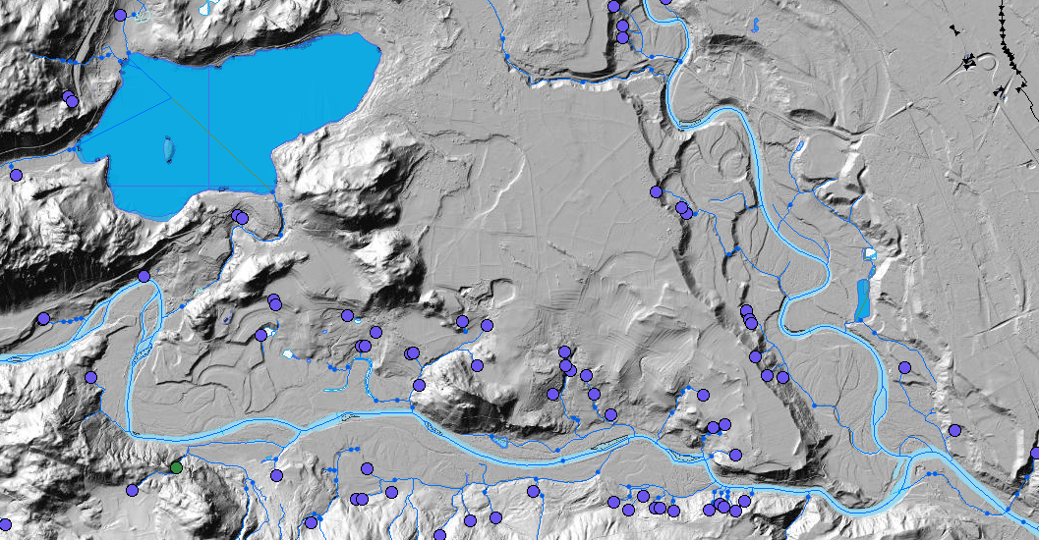
We produce, mange, use and share geodata
Meteorology
Hydrology
Seismology
Air quality
Soil
Protected sites
IED permits
Emissions

Slide 3

Why?
Providing information on state of envirnoment
Reporting to differnt EU institutions
Protecting/Permiting
Providing relevant data to Public sector and general public

Slide 4
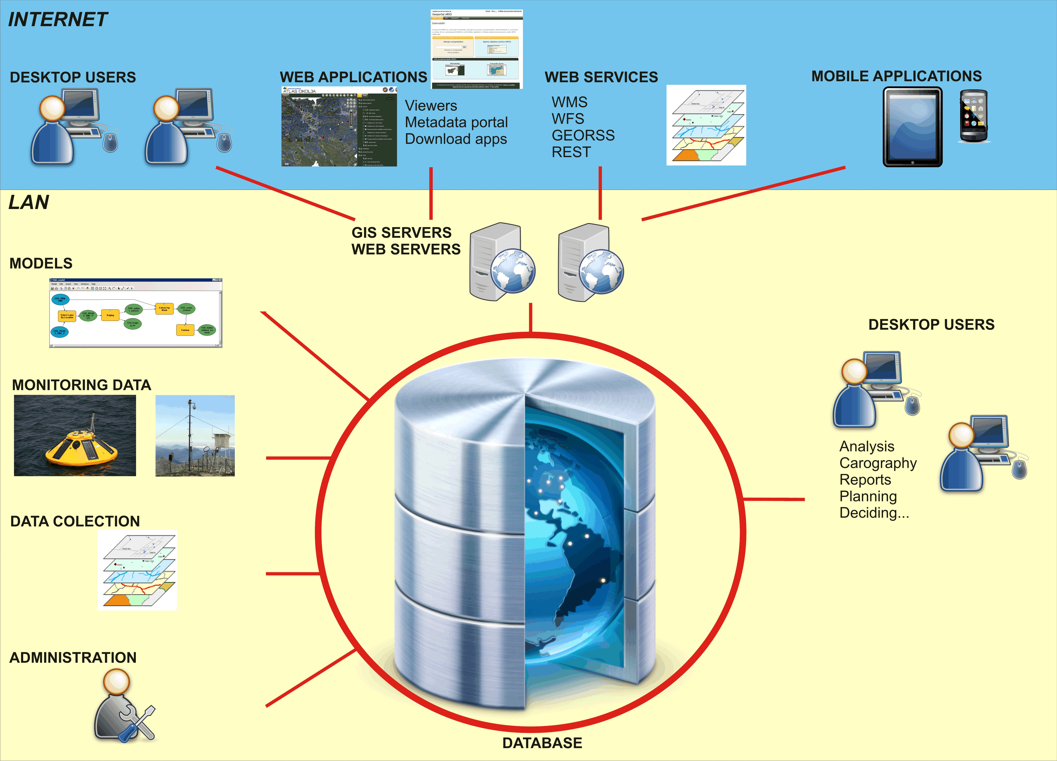
With help of our spatial data infrastrucvture

Slide 5
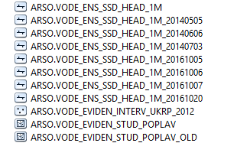
But, what about archiving?
Whose responsibility is Archiving?
Backup, versioning, archiving,…
Diverse data types, working processes
No existing procedures to support spatial data archiving.
Reasons for this situation are very diverse, from lack of awareness, human resources to poor regulation and legislation.

Slide 6

EARK Project
Invatation from Slovenian National Archives
Intruduction, Intervieves
Dataset idenification

Slide 7
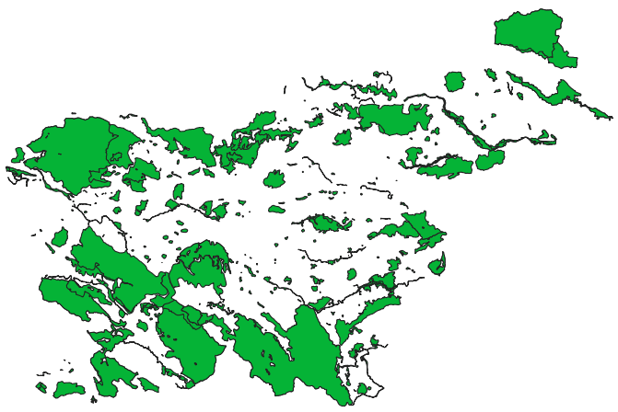
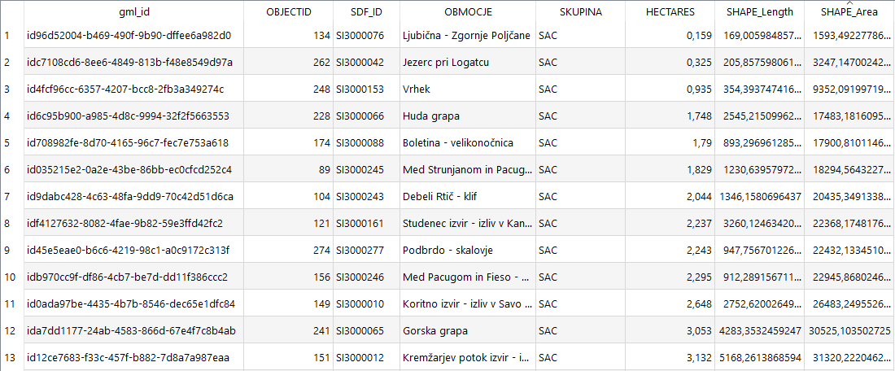
Pilot dataset Natura 2000
EC Directive
A network of nature protection areas in the territory of the European Union
Estabilshed in 2004
Changes in 2009 and 2016
Used in permitting

Slide 8
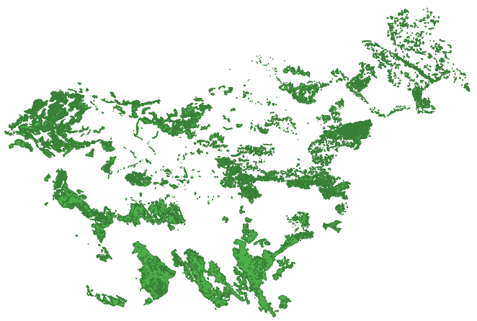

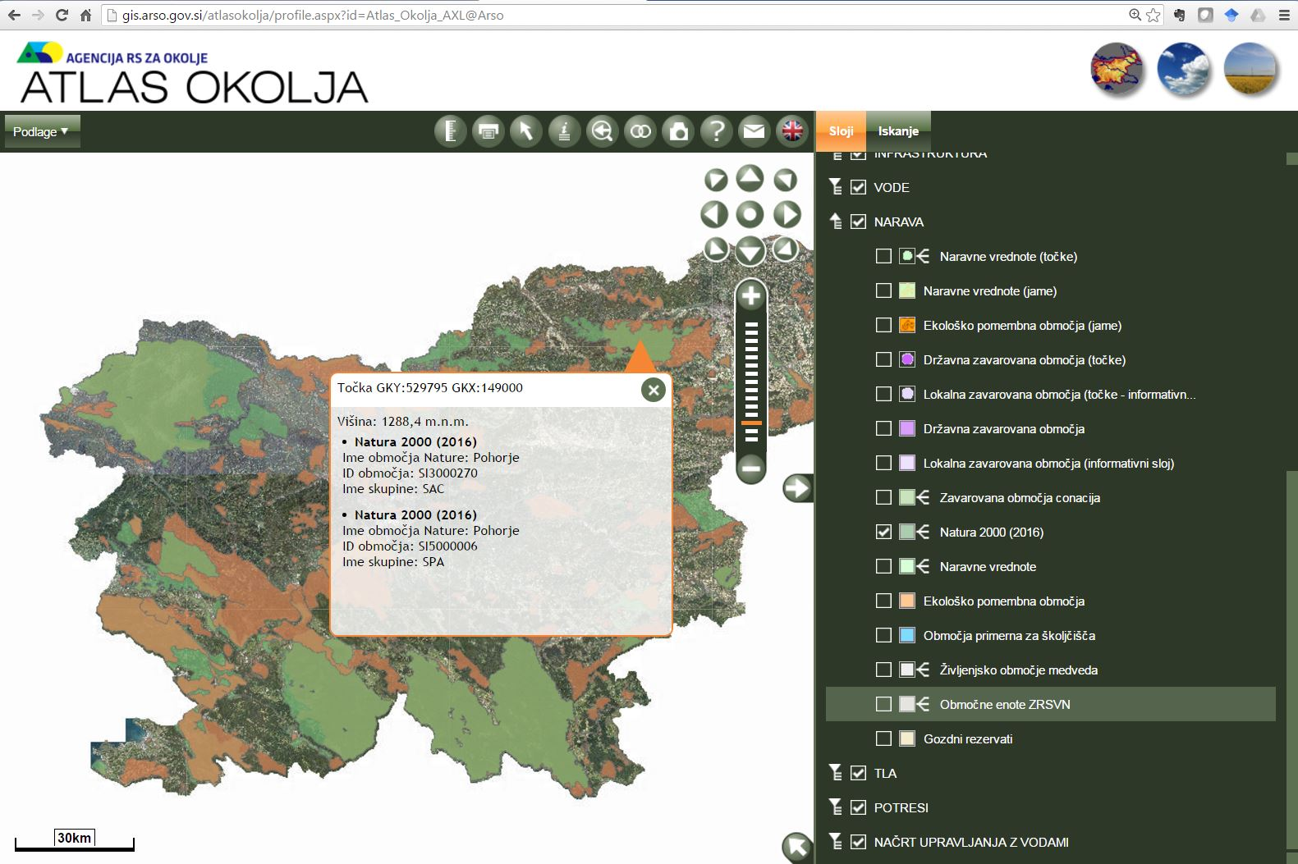
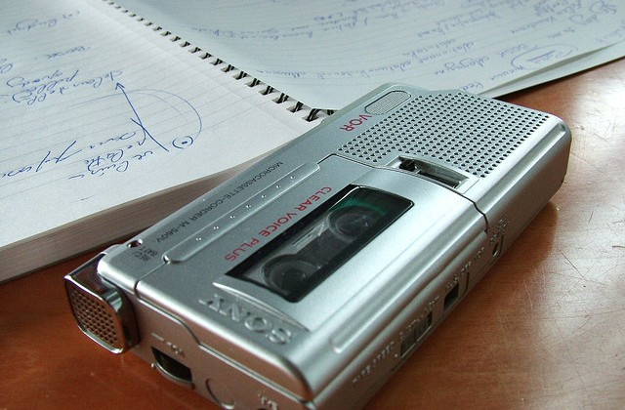
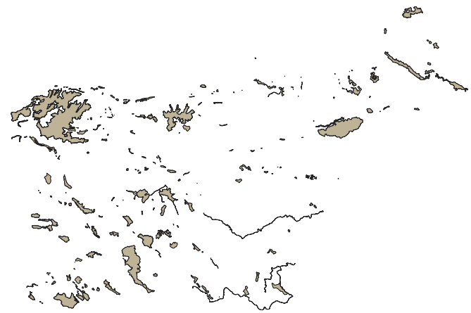
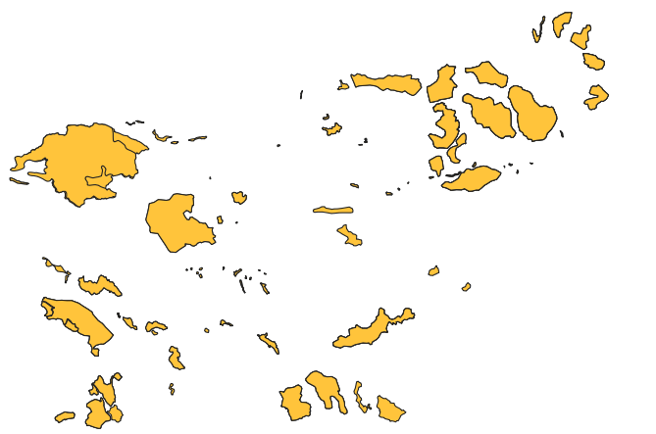
What have we done?
“Trainer led lessons”
Find source data and files
Exporting from our system
Preparing metadata and technical documentation
Record an interview

Slide 9
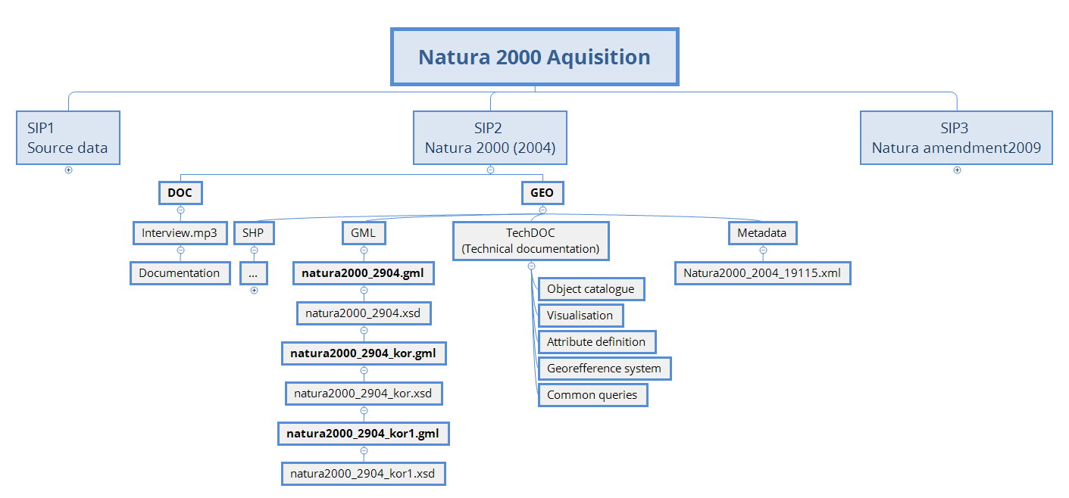
Implementing EARK specifications

Slide 10
Lessons learned
Awareness
Exporting from our system
  Unspecified export settings – GML guidelines
  Capturing the whole story (context)
Prevent data loss
  Teach us how to prepare old geodata sets
  Adjust existing and future systems to automate arciving

Slide 11
Future challenges (SEA)
Start discussions on geodata archiving in our agency
Define datasets for archiving
Raster formats, multidemnisional raster formats (grib, netcdf)
Implement archaving requirements at the begining of spatial data lifecycle

Slide 12
Future challenges - general
Learn from implementing similar workflows (INSPIRE)
“Not reinveting the weel”
Good coordination
Build knowledge base
Tools
Continiue with small steps

