Slide 1


The CEF eArchiving Building Block
Janet Anderson
E-ARK4ALL Project

Slide 2
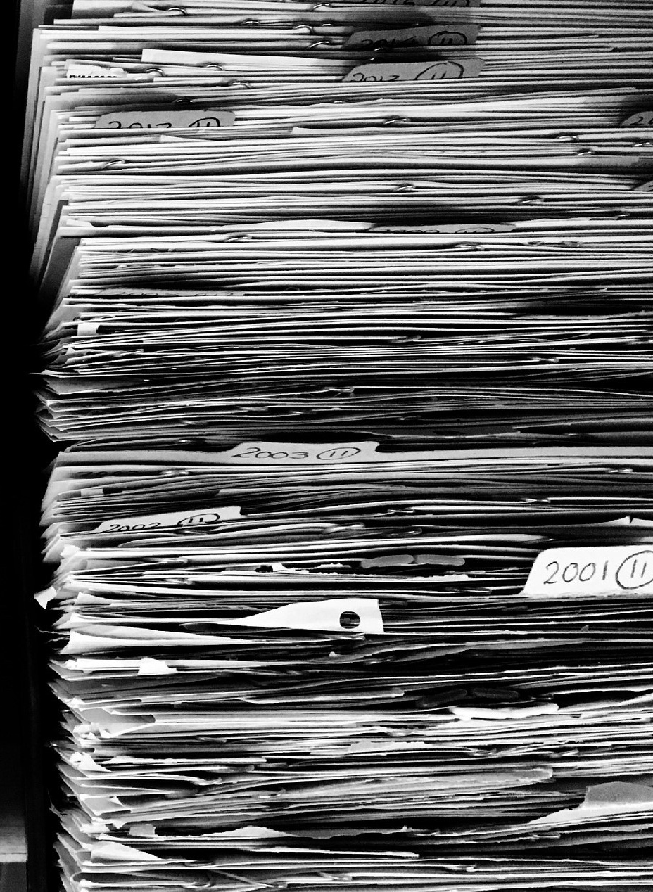


Standardising digital archiving in Europe with eArchiving
Vision:
All digital preservation systems receive, store and provide access to information regardless of its size, type or format according to a set of agreed principles which allow systems to identify, verify and validate the information in a uniform way

Slide 3
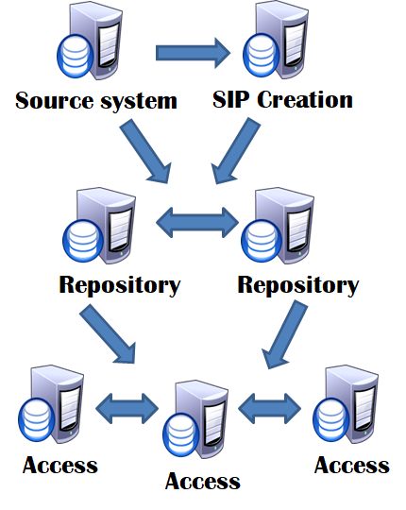
Standardising digital archiving in Europe with eArchiving
Goal:
Interoperability between data sources, archives and reuse environments is improved to a point where digital preservation tools can be reused across borders and institutions
All achieved with the same high degree of archival quality as with analogue archiving, so authenticity, provenance etc. guaranteed

Slide 4


Brief History: Nine years of effort and ongoing..
2010 - 2011: DLM Forum interoperability discussions
2013: European Commission e-Archiving call
February 2014 – January 2017: the E-ARK project (FP7 PSP CIP pilot B)
February 2017: DILCIS Board created to maintain the specifications

Slide 5


E-ARK outcomes
Specifications for
Common Specification for Information Packages, ingest, archiving, access
relational database, electronic records and geodata archiving
Sample tools
to check if the specifications work
to demonstrate to everyone that the specifications work
Pilots
to implement the specifications and tools in operational environments
Knowledge Centre
E-ARK Maturity Model and Assessment Tool
E-ARK General Model for visualisation
* all available at http://eark-project.com/

Slide 6
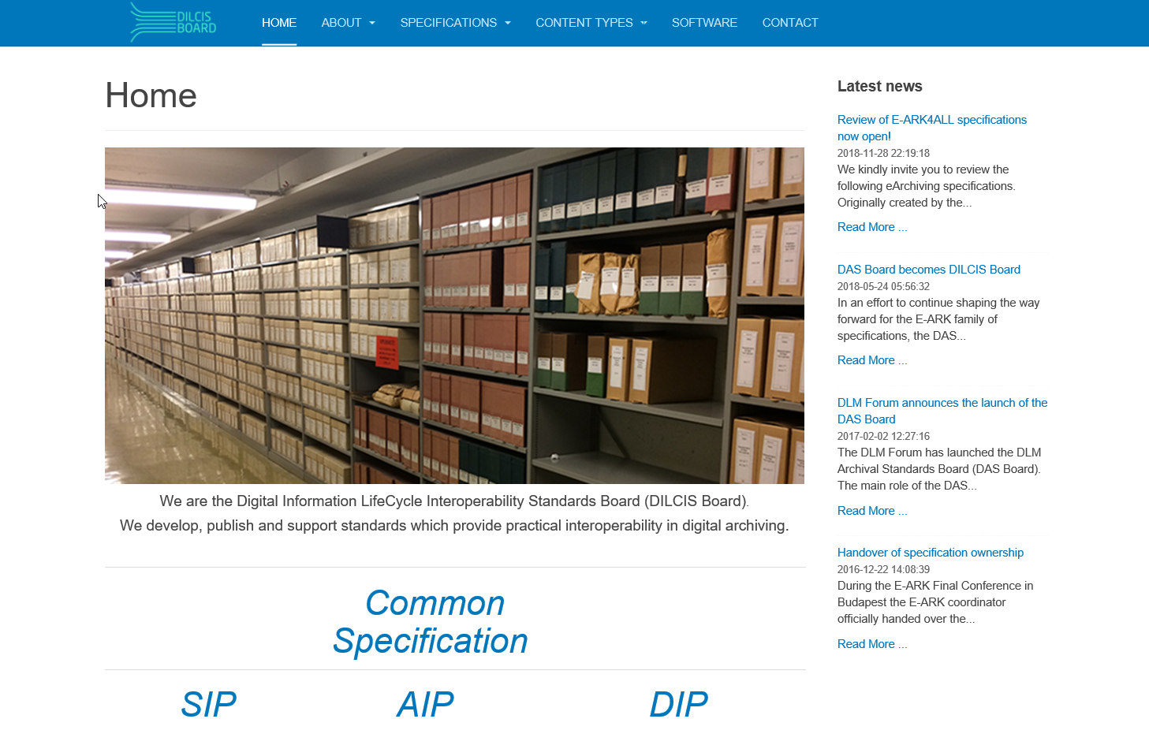
DILCIS Board
Specifications are the core of E-ARK
DILCIS Board established to guarantee the further maintenance of E-ARK specifications
DILCIS: Digital Information LifeCycle Interoperability Standards
More information available at www.dilcis.eu

Slide 7
The CEF building blocks are a collection of specifications, software and services structured in a service offering that can be reused in any European project to facilitate the delivery of digital public services across borders
IDENTIFY with
eID
SIGN with
eSignature
EXCHANGE with
eDelivery
INVOICE with
eInvoicing
TRANSLATE with
eTranslation
7

Slide 8

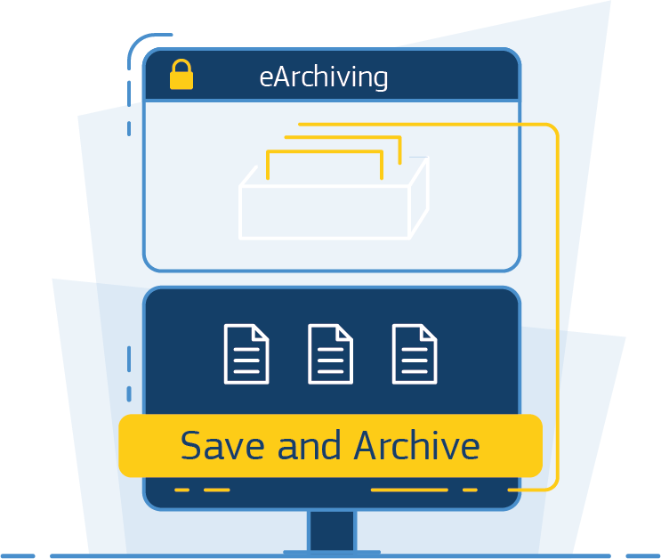
Brief History: Nine years of effort and ongoing..
2010 - 2011: DLM Forum discussions
2013: European Commission e-Archiving call
February 2014 – January 2017: the E-ARK project (FP7 PSP CIP pilot B)
February 2017: DILCIS Board created to maintain the specifications
2016 - 2017: proposing E-ARK outcomes to become a CEF Building Block
June 2018 – May 2019: the E-ARK4ALL project launched to create the eArchiving Building Block
December 2018: eArchiving Building Block officially launched in Brussels

Slide 9
eArchiving Building Block
Business Owner European Commission
DG CNECT
Expert Group European Archives Group
Solution Provider E-ARK4ALL
Solution Provider European Commission DIGIT

Slide 10
E-ARK4ALL Consortium
The Danish National Archives (Coordinator)
The Swedish National Archives
The DLM Forum MTÜ
Austrian Institute of Technology (AIT)
Keep Solutions
DLM Project Members:
National Archives of Estonia, Norway, Slovenia; Federal Archives of Germany, Switzerland
OPF, ES Solutions; Geoarh, Gregor Zavrsnik, s.p.; Easy Lean OÜ; Poliphon; Mikkeli University of Applied Sciences; Instituto de Engenharia de Sistemas e Computadores (INESC-ID); Highbury Associates IVS; Gabinete UMBUS SL

Slide 11








eArchiving Building Block Objectives
Experts in national archiving setting out with a common purpose
Collaboration
The services offered are a result of strong collaboration between numerous Member State national archives.
From information
Facilitate research
Through the use of common standards, exchanging information on topics of choice can empower researches, law and order…
Promote cross-border adoption
By offering out of the box tools, technical support, training and testing services.
To organised repositories
Broaden areas of application
eArchiving aims to be used in sectors such as healthcare, environment, finance, safety-critical systems, etc.

Slide 12
eArchiving Building Block Goals
Reduced cost of implementation
The services provided by CEF Digital are open source.
Long-term solution
Common set of specifications for packaging digital information, supported by the main European digital archives.
Interoperability
Cross-border collaboration on data analysis, including big data analysis.
Guidance on legal landscape
Numerous individual legislations at Member State level can confuse the citizens; we can help them navigate through these legislations.

Slide 13
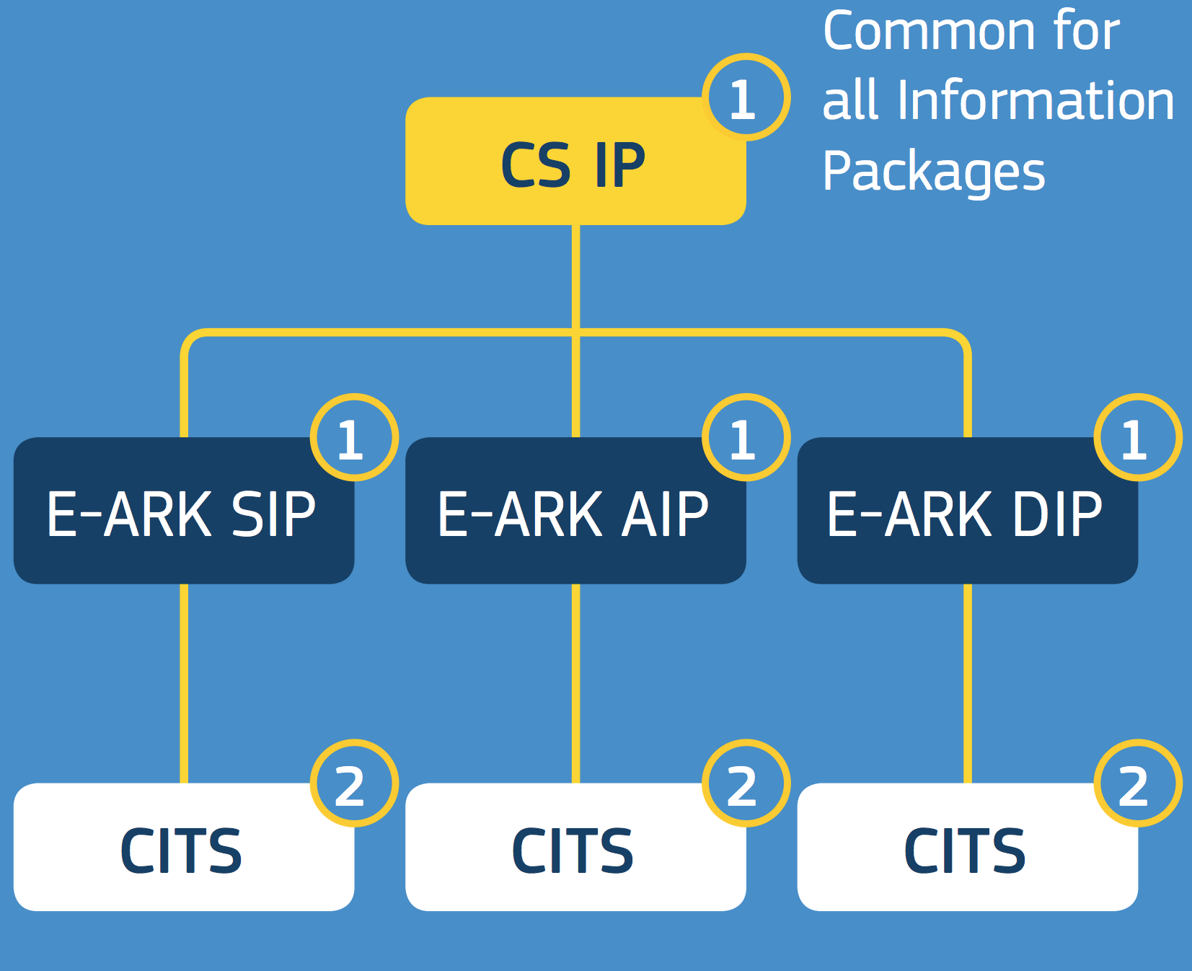
Standards are the core of the Building Block

Slide 14

eArchiving Sample Software
Purpose, To:
Be example on how to implement E-ARK specifications
Show that tools with different background, regional coverage and user base can all implement
E-ARK specifications (and be interoperable with each other)
  Multiple tools for the same task
  Modular based – mix and match
  End-to-end systems
Be primary implementers voice within the specification development activity
Be primary implementation testbed for specifications
Provide and maintain the most crucial components as open-source libraries

Slide 15







eArchiving Sample Software
eArchiving Building Block currently features
Pre-Ingest
Storage
Access
View
eArchiving
Ingest
RODA-In
Database Preservation toolkit
ESSArch Tools for Archive
RODA
E-ARK Web
ESS Preservation Platform
RODA
E-ARK Web
Search and Display GUI
Order Management Tool
IP Viewer
Database Visualisation toolkit
A solution for
natural persons

Slide 16
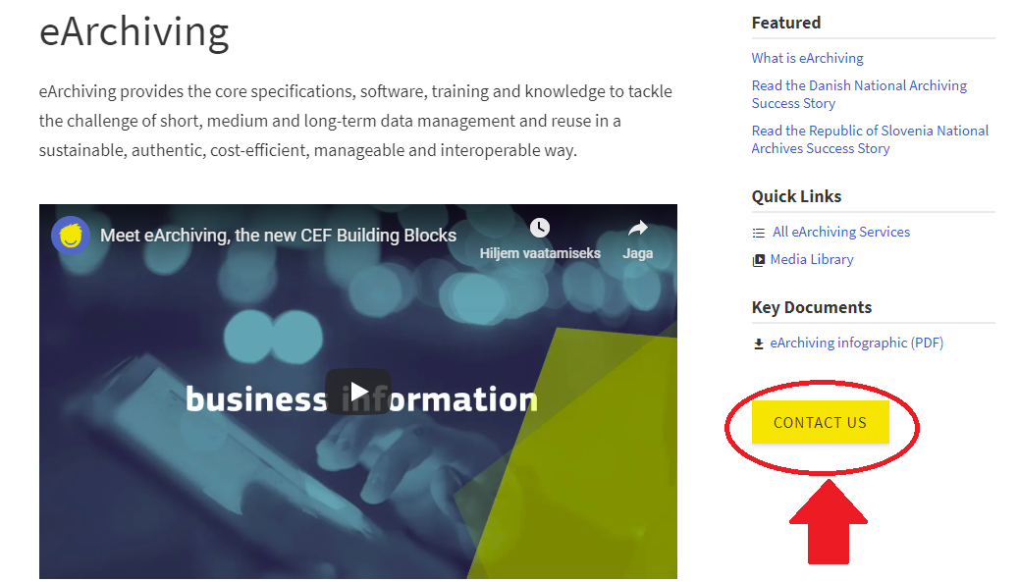
eArchiving Service Desk
Helps you to:
Get an overview of,
learn about,
implement,
participate in…
In regard to:
E-ARK specifications,
sample software,
training offering,
community

Slide 17

eArchiving Training
Comprehensive Training Needs Analysis undertaken
Masterclasses planned
Some training available
Bespoke training envisaged by arrangement
Further Training per specification, tool etc.

Slide 18
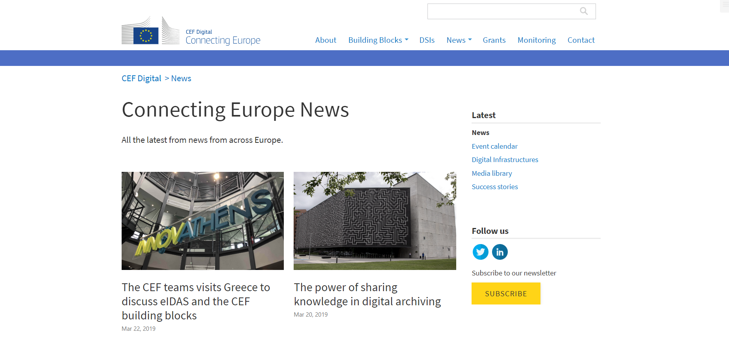
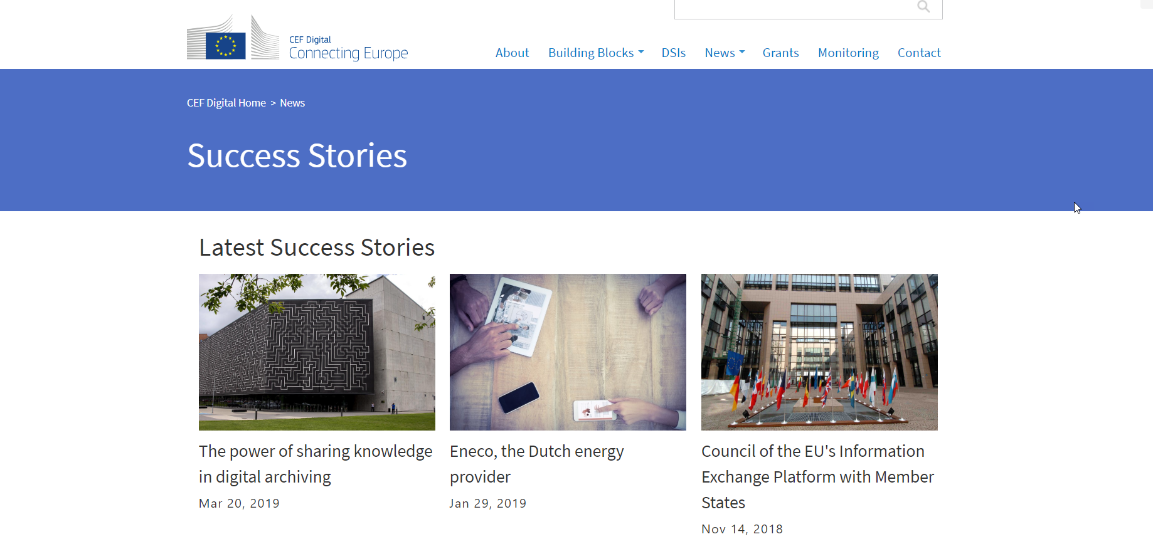
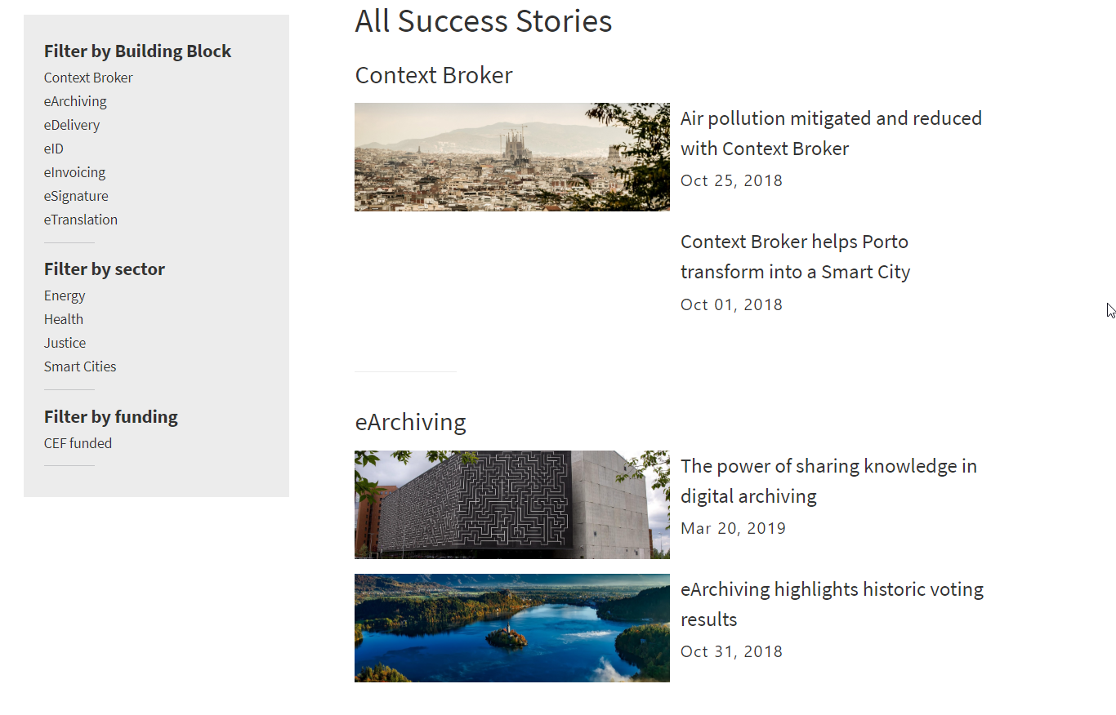
Connect with eArchiving and E-ARK
www.ec.europa.eu/cefdigital
www.e-ark4all.eu
https://www.linkedin.com/groups/8343650/
@EARKProject
#ConnectingEurope
#earchiving
Notes:
What can you do?
Review the specifications:
http://e-ark4all.eu/activities/activity%202/
Contact us to take up the eArchiving Building Block
Use the Service Desk for training, discussing the specifications, help with implementation
Visit the websites
https://ec.europa.eu/cefdigital/wiki/display/CEFDIGITAL/eArchiving
http://e-ark4all.eu/
Join the LinkedIn Group
https://www.linkedin.com/groups/8343650/
Follow us on twitter
@EARKProject
Qué puedes hacer?
Examinar las especificaciones:
http://e-ark4all.eu/activities/activity%202/
Contactar con nosotros para implantar el eArchiving Building Block
Utilizar los Servicios de Atención para temas de formación, aclarar cuestiones sobre especificaciones, ayuda con la implementación
Visitar las paginas web https://ec.europa.eu/cefdigital/wiki/display/CEFDIGITAL/eArchiving
http://e-ark4all.eu/
Unirte al Grupo en LinkedIn
https://www.linkedin.com/groups/8343650/
Seguirnos en twitter
@EARKProject

Slide 19

eArchiving highlights historic voting results in Slovenia

Slide 20


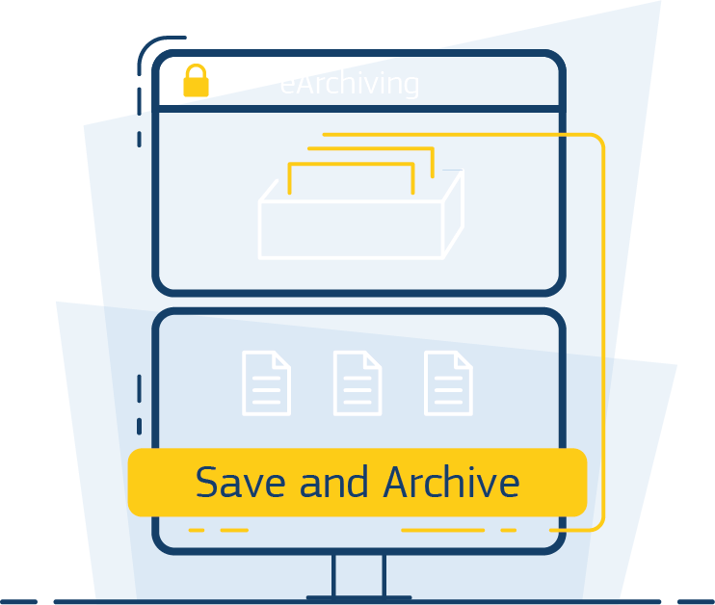



Is eArchiving for me?
Yes, if you need to guarantee access to your information in the future.
What we can help you achieve
Tackle the challenge of short, medium and long-term data management
Transfer data to dedicated long-term repositories
Migrate data between generations of information systems
Preserve and access data over extended periods of time

Slide 21

Ready to get started?
Reach out to us to learn more!
Or visit our website www.ec.europa.eu/cefdigital
Notes:
What are we doing next?
CEF and the eArchiving Building Block will continue at least until 2021
eArchiving BB to focus on
Continuous maintenance of the specifications
Implementing E-ARK specifications in preservation software (and beyond)
Growing the E-ARK community - come and join us!
Qué vamos a hacer proximamente?
CEF and el eArchiving Building Block continuará por lo menos hasta el 2021
El eArchiving Building Block se centrará en:
El mantenimiento continuo de las especificaciones
La implementación de las especificaciones del proyecto E-ARK en software de preservación (y sucesivos)
La expansión de la comunidad E-ARK – conócenos y únete

Slide 22
Questions
Please share your thoughts with us!

