Slide 1
E – ARK4ALL – Solutions for archiving geodata
Gregor Završnik
www.geoarh.si

Slide 2
Overview
The E-ARK Project
Geo CITS Specifications
Tools for Archiving Geospatial records / Systems
Training and Consulting services
How we can work together

Slide 3
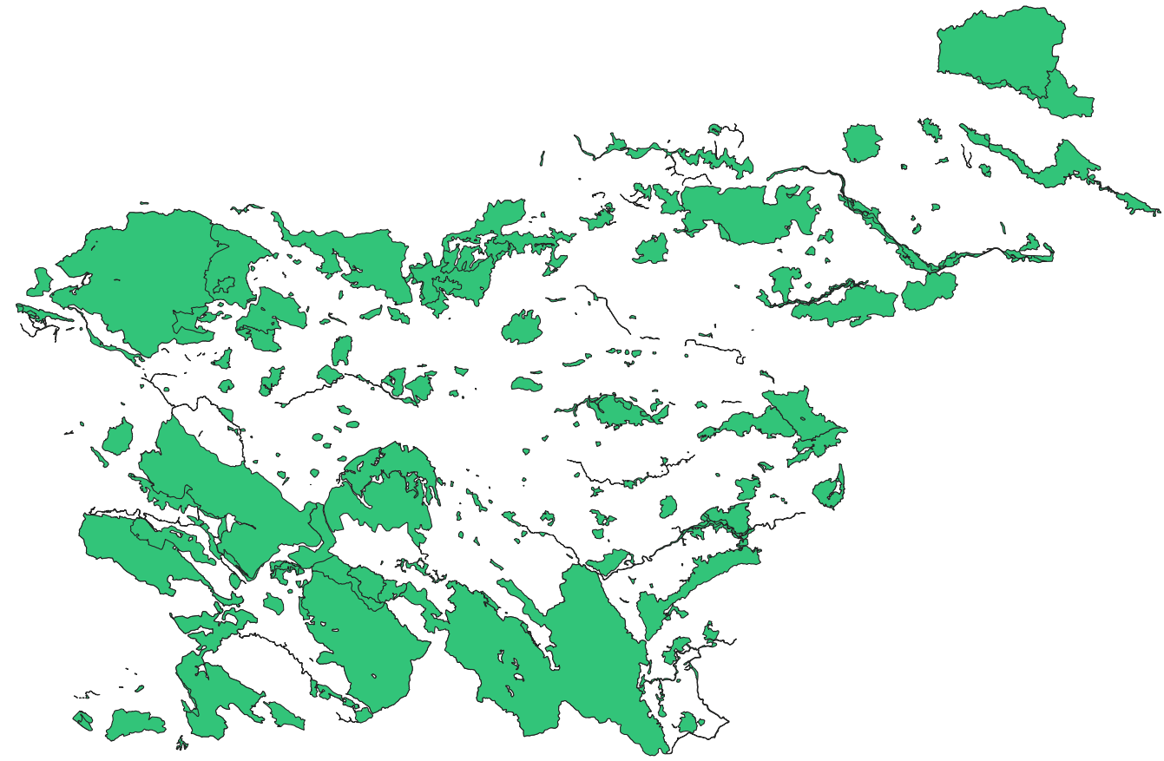
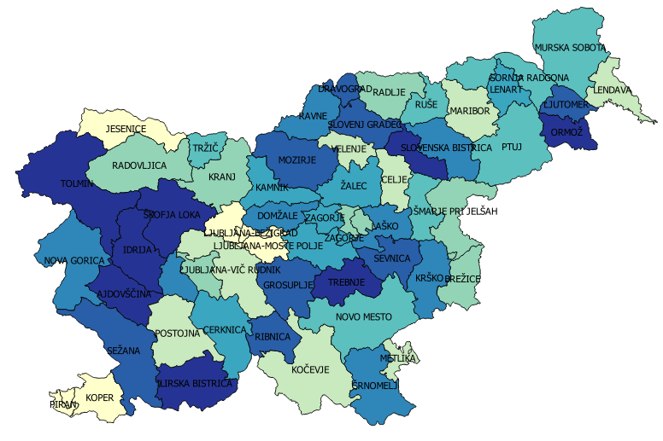
The E-ARK Project results for Geodata
Specifications
SIP – Geodata guidelines
AIP – Geodata guidelines
DIP – Geodata guidelines
Sample tools test
Archival tools
OGC tools
Pilot acquisitions
Natura 2000 (Slovenian EPA)
Old borders of Municipalities (Slovenian Mapping And Surveying Authority)
www.e-ark-project.com

Slide 4
Geo Content Information Type Specifications (GeoCITS)

Slide 5
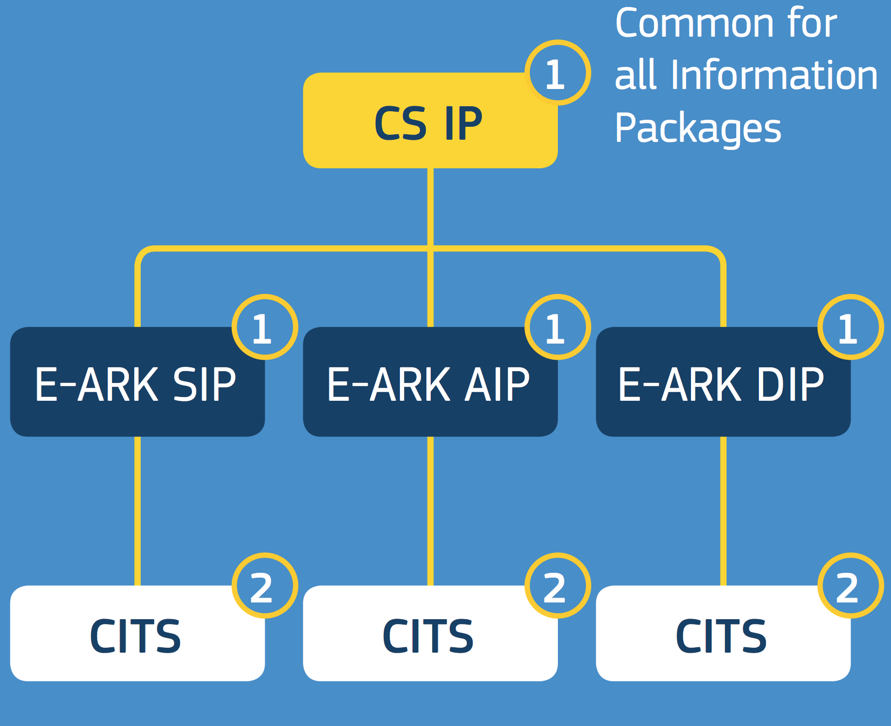
GeoCITS
URL: Bit.ly/GeoCITS

Slide 6
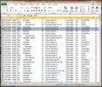
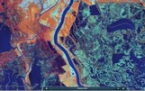
Geodata lives in a GIS System
GIS
Tools
Symbology, geoprocessing, exports
Organisation, Queries, Cartographic projections, transformations…
Vector data
Raster data
Database
Lists, codepages
Models

Slide 7
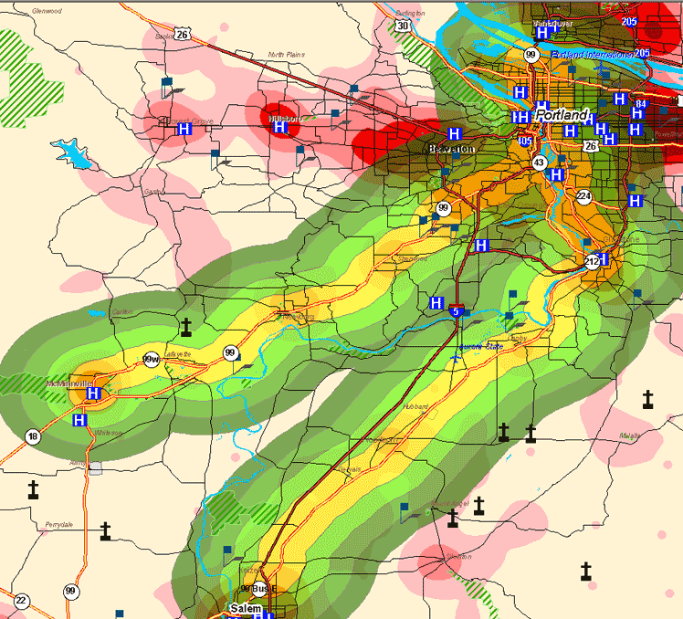
Results are often based on complex formulas

Slide 8
Results often come from complex systems (of GIS Systems)
Minstry of culture Cultural heritage
Ministry of environment
Urban plans
Ministry of defense
Surveying & Mapping Authority
Cadastre maps
Environmental agency
Environmental restrictions
Ministry of Agriculture
Landuse
Building permit

Slide 9
So what should an archival package contain?

Slide 10
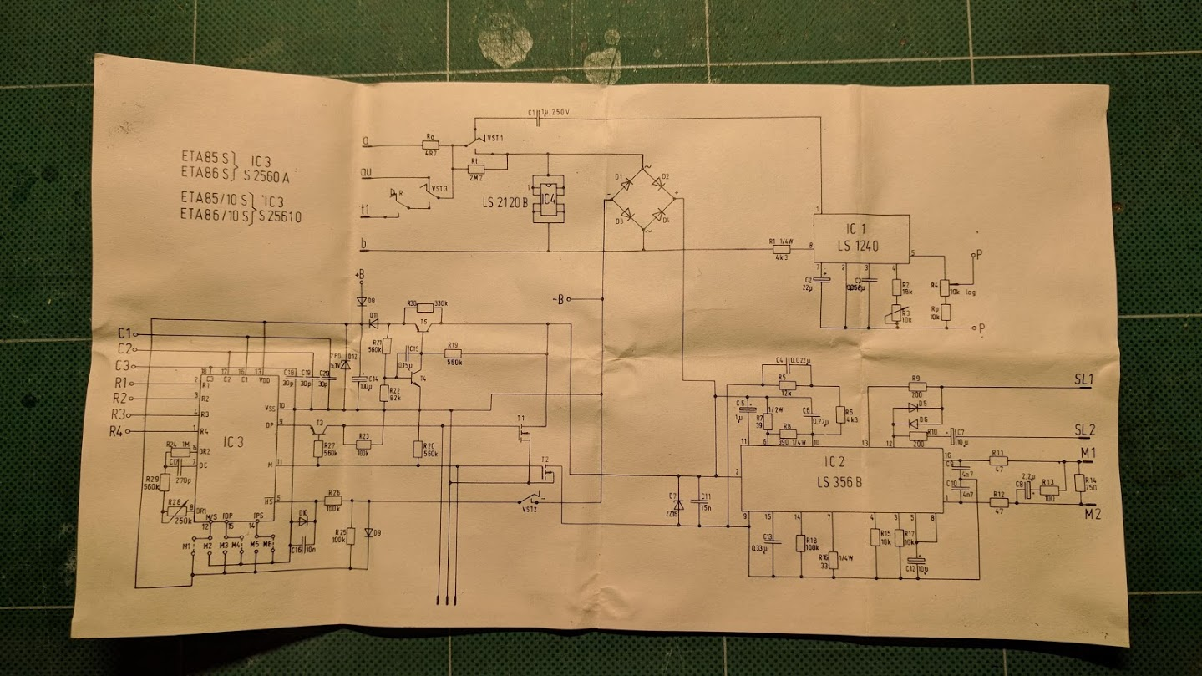
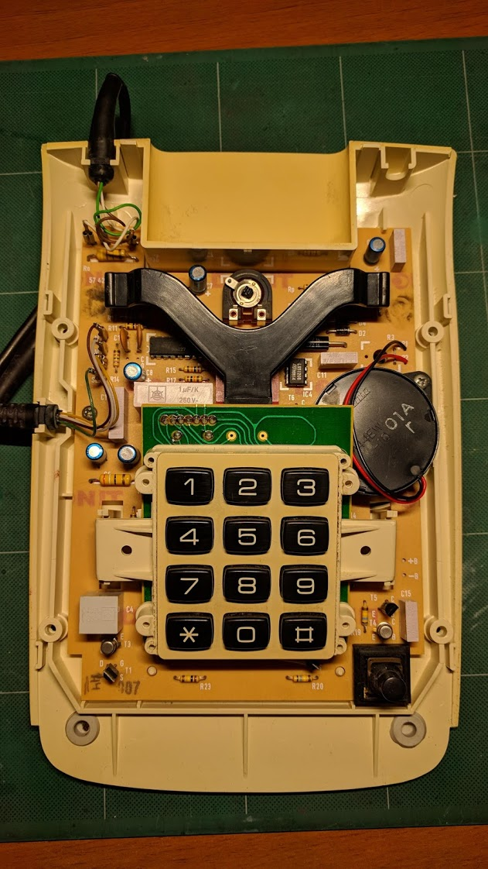
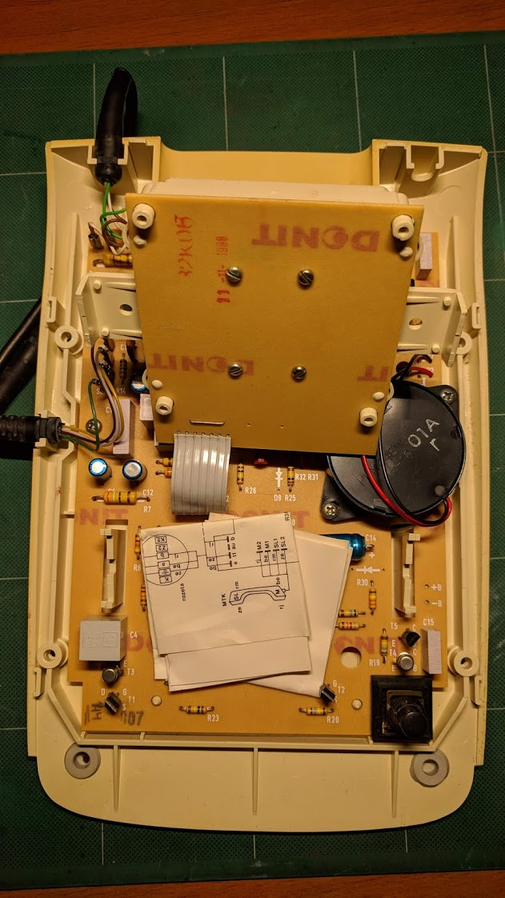
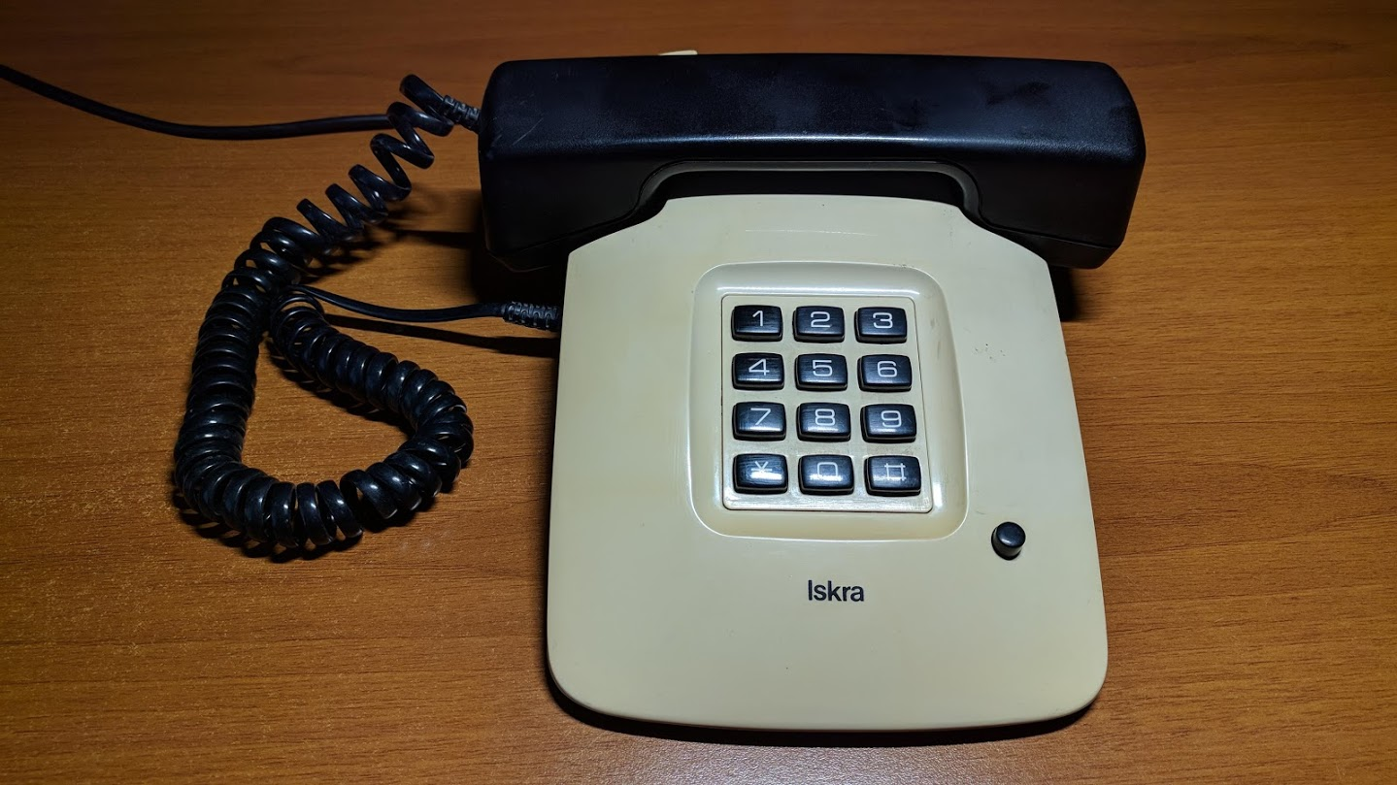
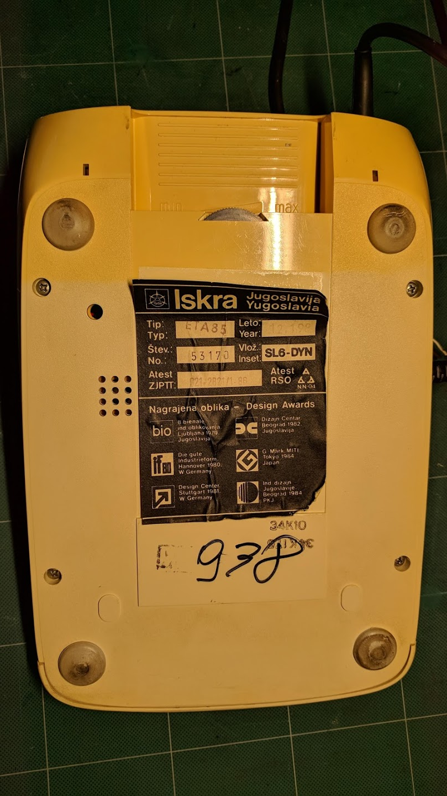
Rebuilding an old landline phone
Geo CITS

Slide 11
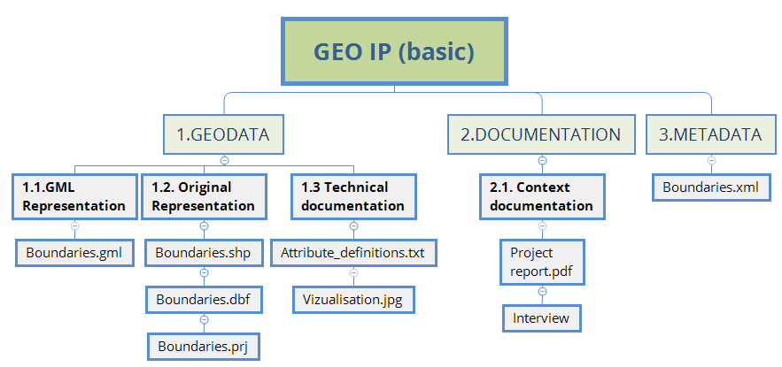
Geo Information package example
Longterm preservation formats
Geographic coordinate system
URL: Bit.ly/GeoCITS

Slide 12
Longterm preservation formats Examples
GRID, jpg, TIFF, MrSID…
GeoTIFF
TIFF +Metadata
Shp, dxf, mif, xyz
GML 3.2.1
RDBMS, tables
csv, SIARD 2.0
URL: Bit.ly/GeoCITS

Slide 13
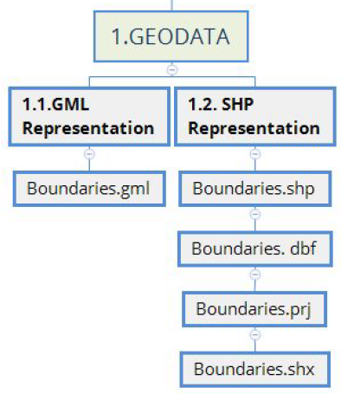
Multiple representations of data
Golden Copy
Long term preservation format
URL: Bit.ly/GeoCITS

Slide 14
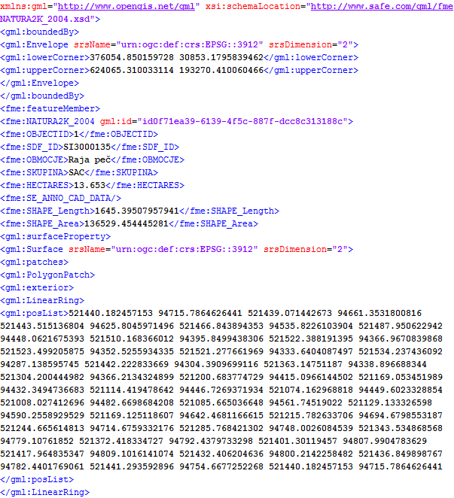
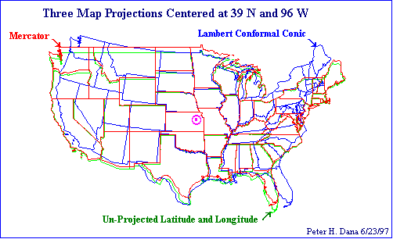
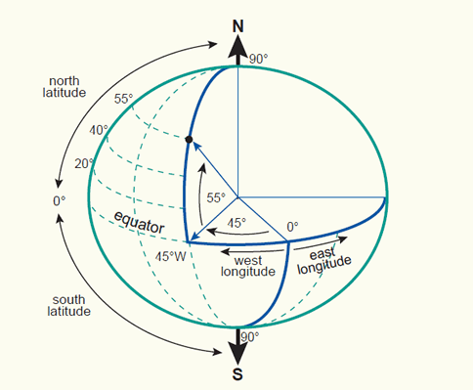
Coordinate system definitions
URL: Bit.ly/GeoCITS

Slide 15
Geo Archival Information package
URL: Bit.ly/GeoCITS

Slide 16
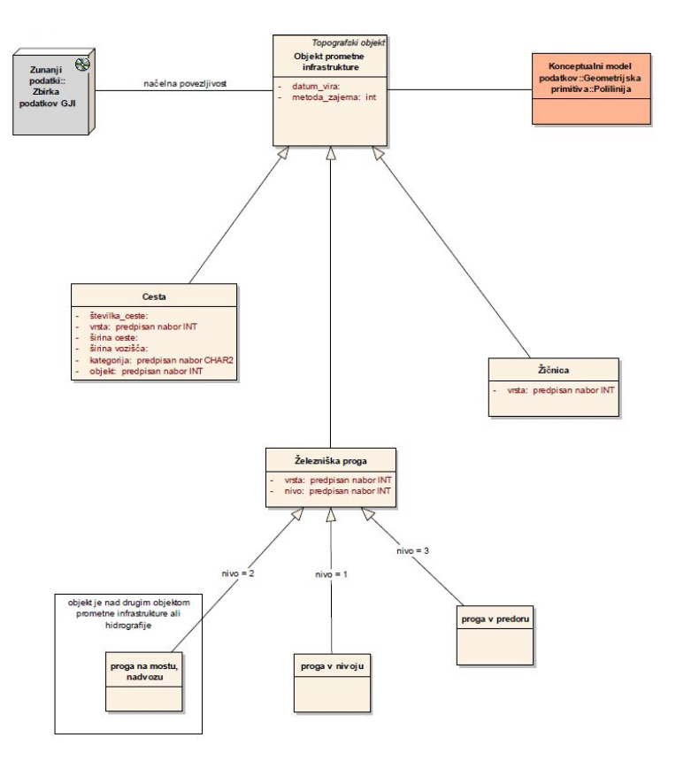
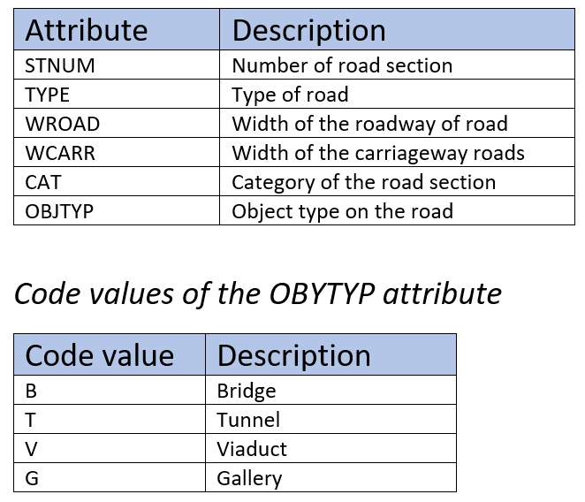
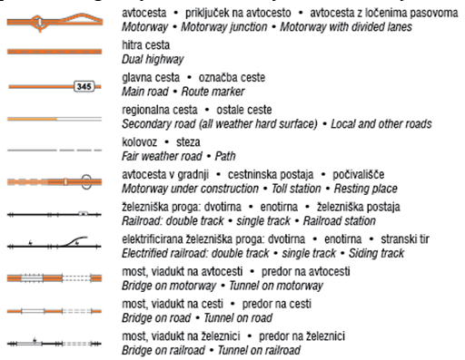
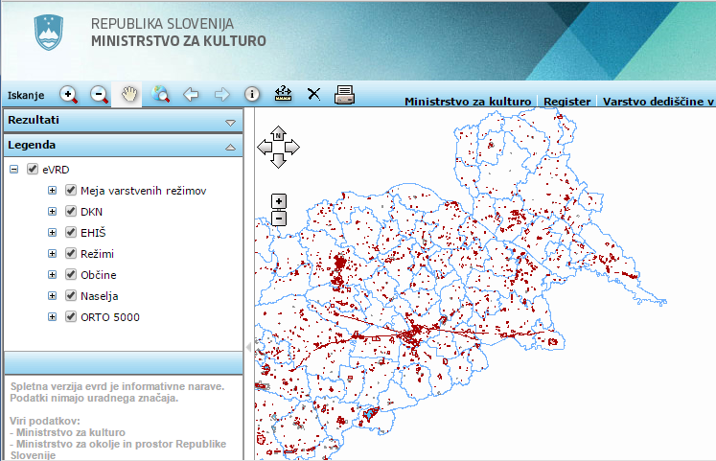
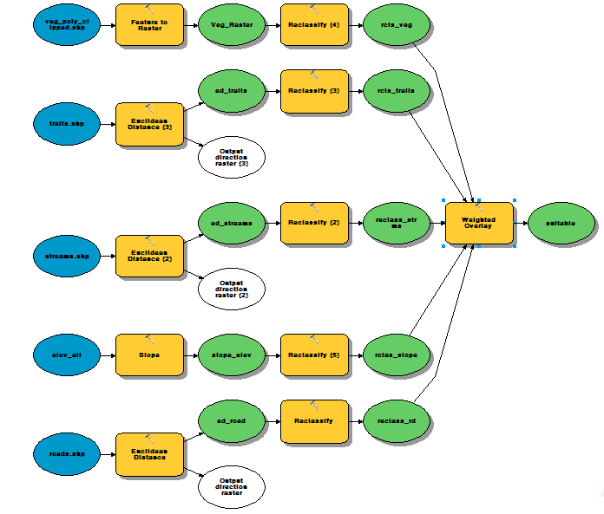
2.1. Technical documentation
Attribute definitions
Feature catalogue
Logical structure
Visualisation (cartography)
Common queries
Geoprocessing workflows

Slide 17
Geo Archival Information package
URL: Bit.ly/GeoCITS

Slide 18
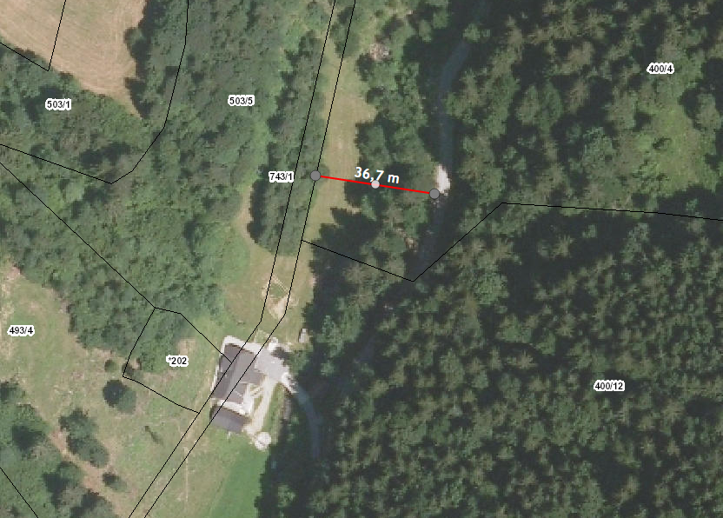
Geodata needs context
URL: Bit.ly/GeoCITS

Slide 19
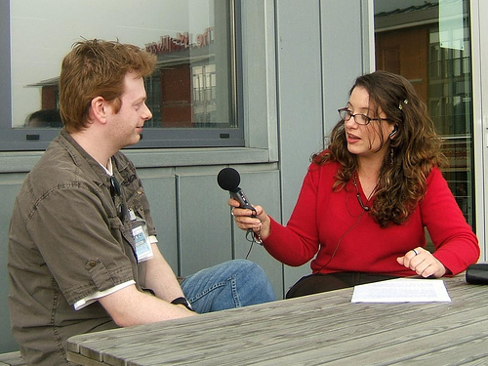
General - Contextual documentation
Project documentation
Legal background
Lineage (methodology)
Temporal accuracy
Interviews
Etc.
URL: Bit.ly/GeoCITS

Slide 20
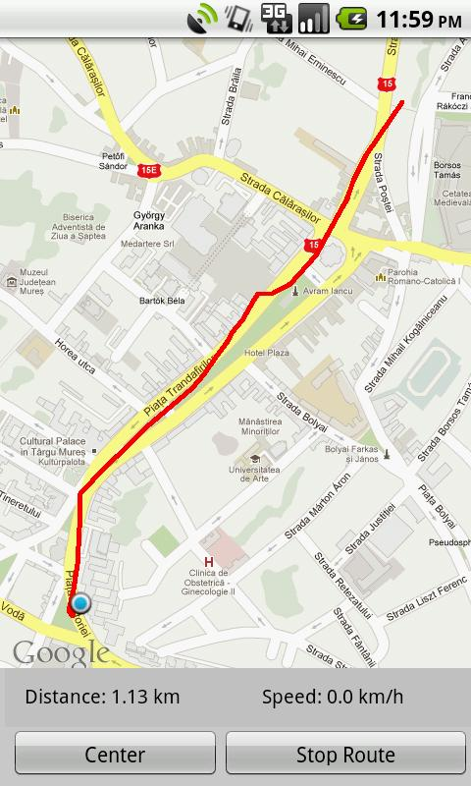
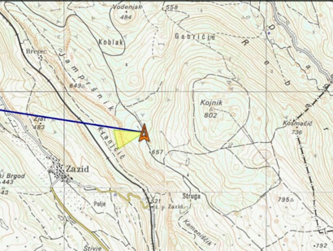
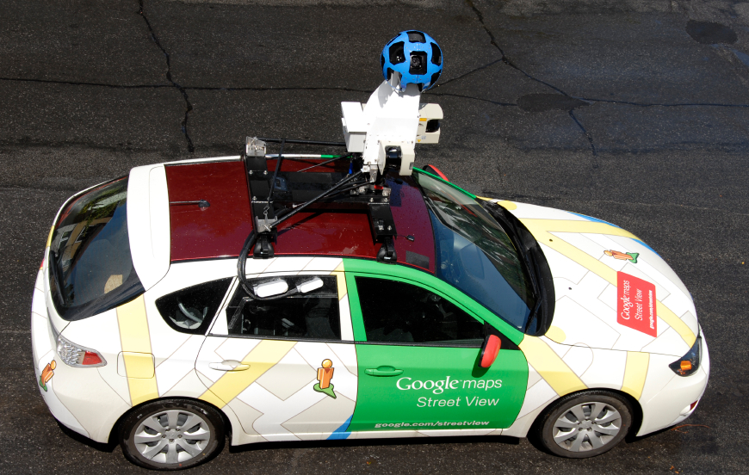
Importance of Lineage (methodology)
Digitising from a scanned map scale = 1:50.000
1mm on map = 50m accuracy
GPS capture
~ 2-5m acuracy
URL: Bit.ly/GeoCITS

Slide 21
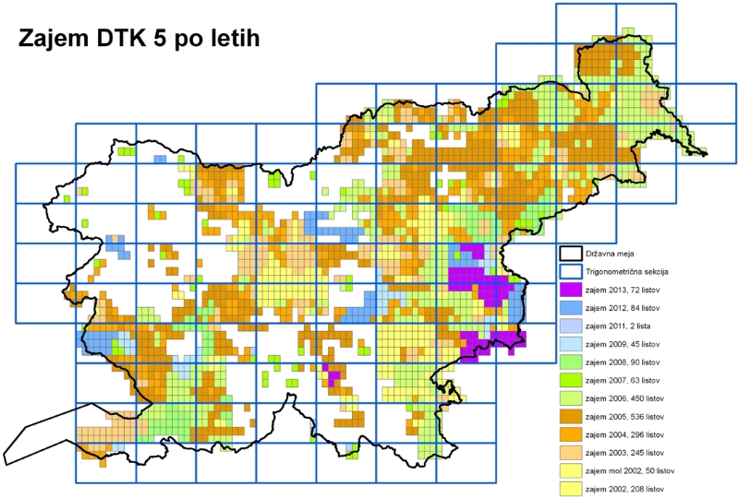
Geodata Temporal accuracy
URL: Bit.ly/GeoCITS
Notes:
Naslov in tekst v dveh stolpcih

Slide 22
3. Metadata
Use existing geo metadata based on:
ISO 19115;ISO 19119
INSPIRE (if existant)
National standard
Store it as documentation
Describe content using archival metadata
Use suggested elements (based on INSPIRE mandatory 22 elements)
Harvest existing geo metadata
URL: Bit.ly/GeoCITS

Slide 23
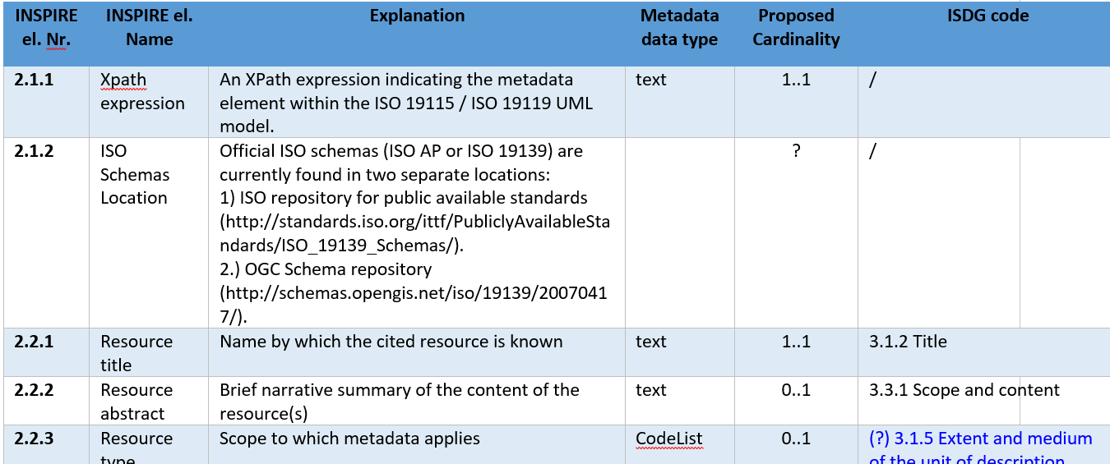
Proposed metadata elements
URL: Bit.ly/GeoCITS

Slide 24
What is next ?
Archiving GIS Systems
Archiving Geo workflows / Transformations
Archiving Symbology
Here we need your input !!!
URL: Bit.ly/GeoCITS

Slide 25
How should we Implement the specifications?

Slide 26
Two main areas
Proactive preservation in new / exiting systems
Archiving existing systems

Slide 27
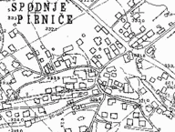
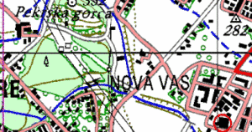
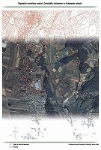
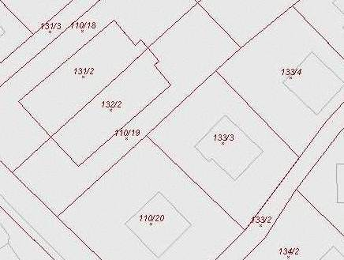
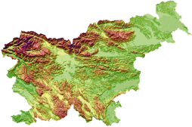
Archiving existing systems
Identify archival data
Start with the basemaps
Conversion to longterm preservation format
Gather documentation

Slide 28
New and existing systems
Data Life Cycle Management
Data capture/ creation
Conversion to long term preservation format
Copy to a longterm medium
Secure storage
Metadata and documentation
Export to archival repository
Data reuse
Processing
Distrubute
Analysis
Archival step

Slide 29
E-ARK Sample tools
Preingest
Ingest
Data Management
Search
Access
Roda In
Roda
DBPTK
ESSArch Preservation Platform
OGC Tools
ogr2ogr
QGIS;
ogr2ogr
Geonetwork
Geoserver
QGIS

Slide 30
EARK4ALL Training / Consulting
For Archivists
Introduction to Geospatial records
Implementing Geo CITS Specifications
Coordinate Systems basics
Introduction to OGC Tools for Archiving
Apraising Geospatial records
For Producers
Introduction to Archiving principles
Adding archiving data flow practices
Pilot implementations
Consulting services for Solution providers

Slide 31
How can you contribute ?
DLM Forum Geo Sub Group
DILCIS Board Contributor
Present your solutions and experiences
URL: Bit.ly/GeoCITS

Slide 32
Questions?
Gregor Završnik
Gregor@geoarh.si

