Slide 1
The increasing value of Geodata – and why preserving it is important
Anne-Sofie Jensen
Director General
National Archives of Denmark eArchiving Geopreservation Conference
6th May 2019, Ljubljana
Notes:
Thank you very much for the invitation. Pleasure to be here. And in the lovely city of Ljubljana. Been here some years ago giving a presentation on how the Danish parliament is organised around the whole EU policy area and how the european committee of the Danish Parliament works.
Not quiet the same today – but still in an EU context. And today on a specific area of european cooperation – the archiving business. A pleasure to
I am fairly new in the business. Only been on my present post for 4 months. But have been working with data and digitization for some years now – and it is precisely the data and digitization mindset that I hope to bring into my present job.
As all other national archives we have a lot to offer when it comes to data and digitisation and as a contributor to a datadriven and efficient public sector. Since it is our job to continuoudly document and collect data on the development of society, we have huge amounts of data that are highly relevant to society as a whole of course but increasingly also when it comes to a modern and datadriven public sector. Our data is relevant for public administration and regulation, for policy development and policy making. And as part of more digital public sector. As we all know data is the new oil and the fuel for further digitisation of the public sector.

Slide 2

The world’s most valuable resource is no longer oil, but data
Notes:
I am sure you are all familiar with this. The famous front page of the Economist. Data – not oil - is the worlds most valuable ressource. As National Archives that should make you quiet happy. If the Economist guys are right we are literally sitting on gold – and a lot of it. But in my perspecitive it also puts a huge task and a huge obligation on our shoulders. Beacause our task is increasingly to put that gold to use. To make it easily available to society.
Most people might think, that national archives are all about old papers contained in boxes and put on shelves in basements. We know that this is not the truth – and it is our job to tell them otherwise and to continously strive to make our data easy to find and easy to use – and keep communicating good examples on how our data can be used and for what purposes.

Slide 3
Agenda
National Archives of Denmark – part of public sector digital infrastructure
The increasing value of geodata
The case for preserving – and how to do it
Questions?
Notes:
But before I go to deep into that – let me just put on the agenda for the next 30 minutes or so:
I will start by saying a little bit about the role I envision for the danish national archives as part of the public sector digital infrastructure as this is part of the reason why geodata is an increasingly important type of data – also when it comes to preserving it.
Then I will adress the increased importance of geodata in Denmark – not least due the to fact that geodata was made free and open back in 2012. That has spurred a growing use of geodata in both private and public sector.
That will lead to the 3rd point on my agenda – the preservation of geodata
And finally we should have time for a few questions.

Slide 4
Agenda
National Archives of Denmark – part of public sector digital infrastructure
The increasing value of geodata
The case for preserving – and how to do it?
Questions?

Slide 5
New strategy…
Strategic goals
Main focus areas
We document society for both the present and the future
We activate our data to create value
We make the public sector more efficient
We must secure the documentation of society as a whole
It has to be easy to both find and use our data
We must be an integrated part of the public digital infrastructure
We preserve our data securely
We must distribute and use our data in new ways
It should be easy for public institutions to both give and access data
Notes:
But let me just start by saying a bit about the role I envision for the Danish national Archive – bearing in mind the frontpage of the Economist.
We have just finalised our new strategi – with data at the center of it. And fousing on collecting data, making use of it again and helping to make the public sector more efficient. More specifically its about securing an adequate documentation and making sure that we take good care of the data we collect bearing in mind an increasing focus on privacy and the whole GDPR legislation. Focusing on making data available again in an easy and straightforward manner – not just opening the doors to our data but also actively pushing data out. And focusing on being part of the digital infrastructure and making it easy for public sector institutions to reuse their data.

Slide 6
Agenda
National Archives of Denmark – part of public sector digital infrastructure
The increasing value of geodata
The case for preserving – and how to do it?
Questions?
Notes:
Let me turn to geodata and the development it has undergone in the recent years in Denmark. From being data used by usual suspects and usual sectors and their dataspecialist to being data used widely across sectors for a number of purposes and not only by GIS specialists.

Slide 7
The relevance of geodata in eGovernment
Geodata are well positioned to become an integral part of eGovernment and the digital economy:
Part of a national digital infrastructure that also contains non-spatial data sets
Value to society as a whole and often key to combining discrete data sets and unlocking value
Notes:
As I have indicated a couple of times already – the importance of geodata is growing.
Public geodata was made open in 2012 – meaning that you can get it and use it without having to pay for it. That is one thing.
And of course you also have to take the development of new technology into consideration. The technology revolution has had a huge impact as e.g. the computing power and new algorithms has made it possible to process huge amounts of data, has made it a lot more easy to access, use and combine data giving whole new insights and ways of utilising data in both public and private sector.
But it is also due to the nature of geodata. We have this saying that everyting that happens happens somewhere – at a spceific place or spot. And that is why geodata is important – it has the ability to connect and combine other data in a meaningful way. In its nature it is excellent at combining various data – because the place is the key that combine things.
And then geodata is an integrated part of the continuous development of our national digital infrastructure with ambition of making easy access to high quality public data of various kinds – not just spatial data.

Slide 8
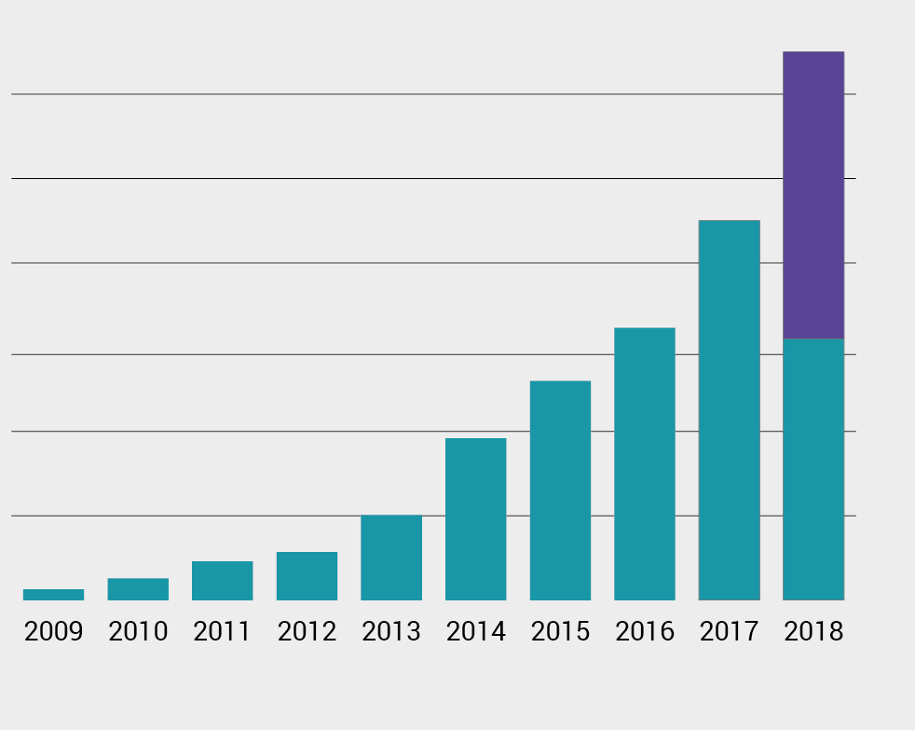
Development in Geodata Usage
Billion
6
Changes from 2012 to 2016
No. of users | + 75 times
Data usage | + 4 times
Value of geodata | + 2 times
5
4
3
2
1
0
Data Distribution
Development over Time
Notes:
Looking at the figures it is quiet easy to see this development. And as you can see the use of geodata has been steadily increased over the last years. The number of users has increased 75 times – the amount of data used has increased four times and the value of geodata to society has been doubled. And as you can see there has been almost 6 billion hits on the geodata distribution site.
Together it tells the story about the growing importance of geodata to society.

Slide 9
Economic Value from Geodata
Efficiency improvements: Cost savings from the use of open geodata
60% of public organisations experience greater efficiency. Up from 12% in 2012
Production improvements: Production and services based on open geodata
Over 50% expect that geodata will improve their innovation. Up from 25% in 2012
Notes:
But what kind of value from the increased use of geodata is unleashed. What lies behind the term ”value to society”. It boils down to two kinds of value so to speak.
One is about increased efficiency - both public and private sectors. The use of geodata often reduces the manpower you otherwise have to use when e.g. making inspections on site. An example being the The Danish tax administration – they are using geodata in determining taxes on property with a consideable cut in manpower used to physically inspect properties. And financial institutions use geodata to get an overview of specific types of businesses in a specific area when deciding on the loan policies.
And then it is about production improvements – as companys develop new services base on open geodata and creating whole new products. New maintanance systems developed to the utilities sector or new and imporved services in the real estate sector giving buyers a lot of new information about the property they wish to purchase – what is the risk of my property being flooded with a more extreme weather situations in the future, will it be possible and profitable to put solar panels on the roof etc. etc.
Just to give you some idea about the new value that comes from increased use of geodata.

Slide 10
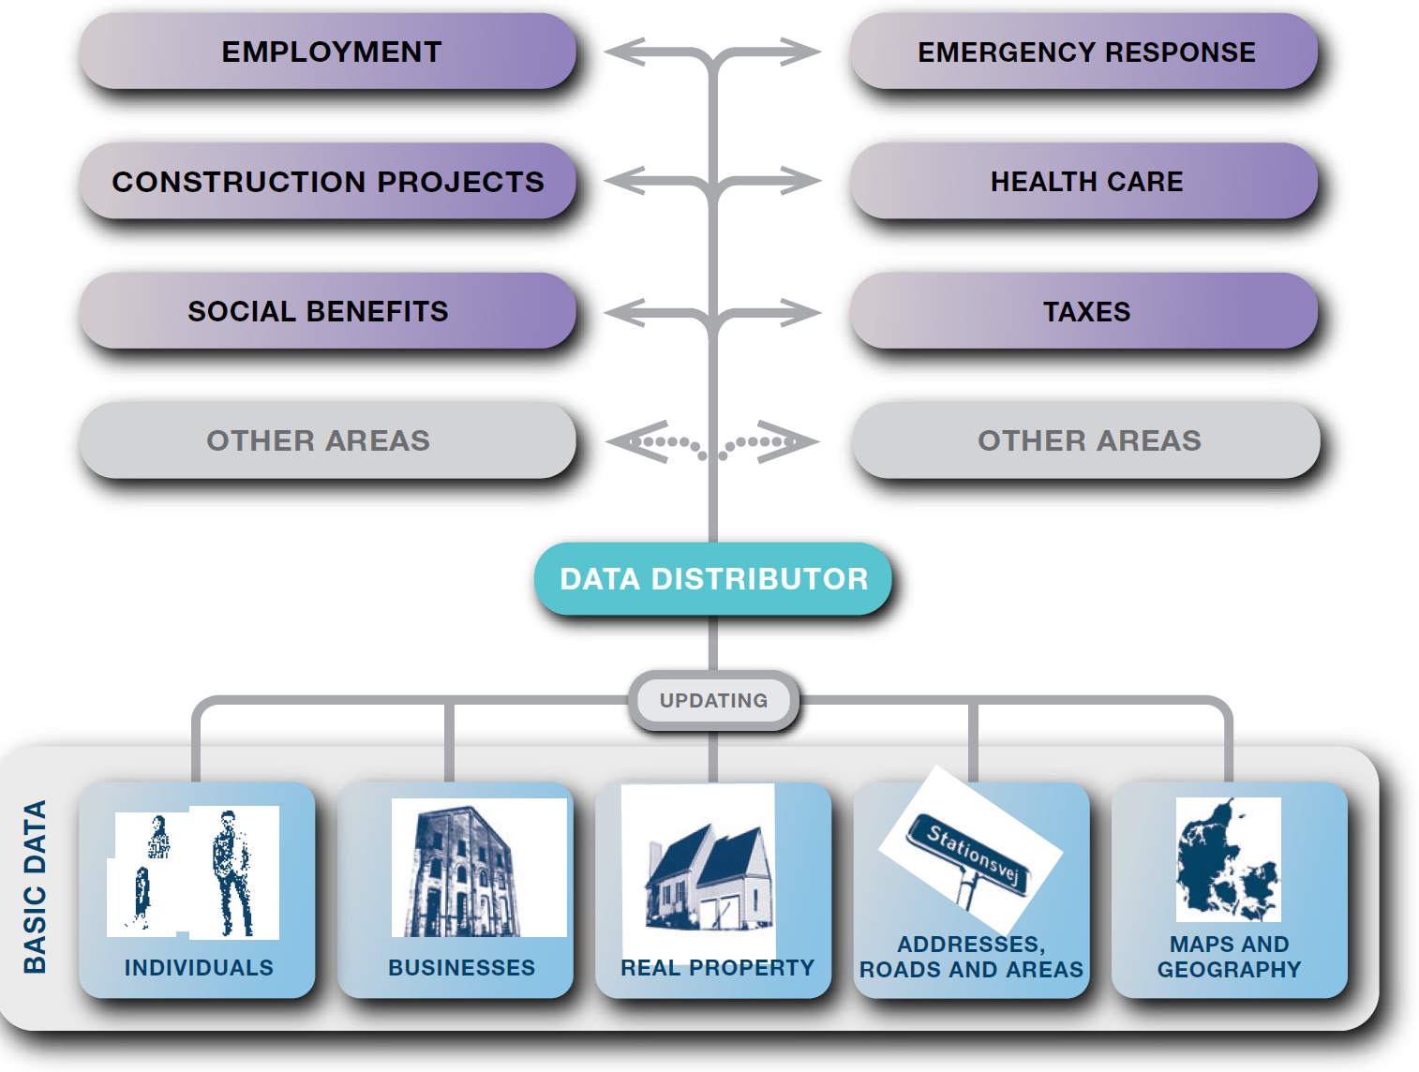
eGovernment – Basic Data Programme
(Geo)data
Notes:
Tuning in on the national digital infrastructure and the role geodata plays in this, I will focus on the Danish basic data programme that you might have heard of as it plays an important part in the continuous development of eGovernment. Let me just say a few words about it.
Basic Data Programme:
In Denmark we have - and have had for many years – a variety of public registers. These are registers containing data on individuals, on companies and enterprises, on property, and various geodata such as adresses, data on roads, areas and geography such as a hight model and data on rivers, streams and lakes and various maps.
All these basic data are the data used every day across the public sector in all kinds of administrative processes in various areas such as health care, social benefits, taxes construction project, environment al regulation etc..
As part of the basic data programme as a first step all these public registers have been modelled so that they can easily be combined and quality in general has been improved.
Secondly a new data distribution platform has been developed meaning that you can find all basic data at the same place – at the data distributor. It means that you do not have to collect data from e.g. eight different data platforms – but are able to find all basic data at the same place. As you can see – geodata is a considerable part of the basic data programme.
The fact that data quality has been improved, that data has a common data model and that data can be collected at the same place is is expected to further increase the use of data including geodata. And the business case behind the basic data programme is solid.

Slide 11
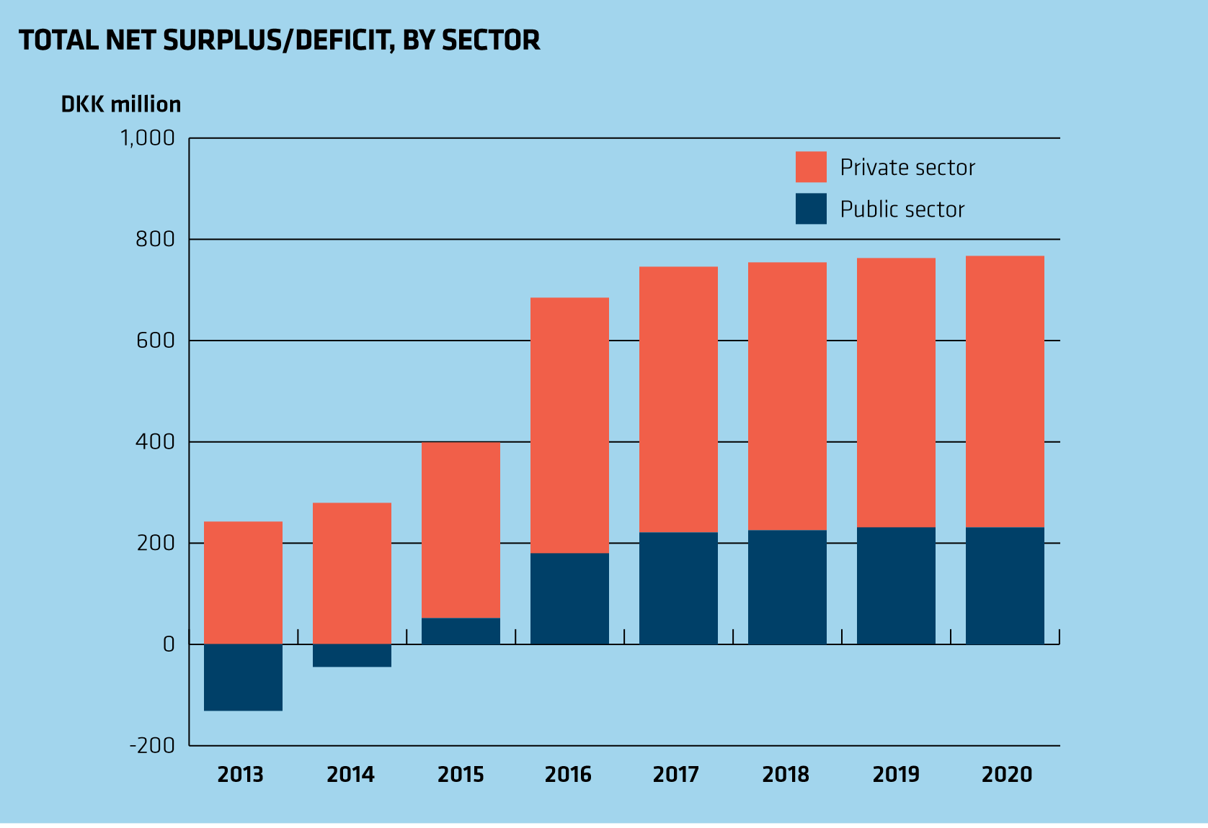
eGovernment – Good Basic Data for Everyone
Notes:
As you can see when fully operational the basic data programme has a net surplus of 750 million DKK (100 million euros) each year 250 million of that being in the public sector. Now the basic data progamme is being finalised this year – the last data is on its way to the common data distributor. And it will indeed be interesting to see if the expected value will be released.
So just to sum up – geodata is increasingly important in Denmark and plays an important role in a datadriven and digitalised public sector. Taking that into consideration – geodata is also increasingly important to us as a national achive.

Slide 12
Agenda
National Archives of Denmark – part of public sector digital infrastructure
The increasing value of geodata
The case for preserving – and how to do it
Questions?

Slide 13
Important to preserve
Because of its value to society – both public and private sector
Important source when documenting the development of society
Notes:
But let me just repeat
1. Increasing value to society in general
2. Important for our core business as national archive – it becomes an incresingly important source when documenting the development of society.

Slide 14
But not that easy…
New domain – different kind of data
Comes in numerous formats – that we do not know very well
Takes more time to test and validate
How do we make them available – search and access tools etc.
Notes:
Unfortunately – preserving geodata is not that easy.
And I am certainly or unfortunately not able to tell you excatly how to do it.
geodata are difficult and somewhat different from normal achiving business. Other kind of data, other formats etc. Simply a new domain for all of us. And when something is difficult it often a good idea to call your freinds and do it together. Thats what we are doing today and tomorrow in lubljana.

Slide 15
And that is why…
…we should do it together
Common task for EU member states
Pull our resources together
  common standards
  common tools
  Share knowledge and pool competencies
Notes:
So – do it together. Not just because it is difficult – but also so that we do not do in 10 different ways. It is simply much wiser to develop common standards, common tools and share our knowledge and pool our competencies.

Slide 16
Agenda
National Archives of Denmark – part of public sector digital infrastructure
The increasing value of geodata
The case for preserving – and how to do it
Questions?

