Slide 1

FME – a leading technology for spatial data transformation
Želimir Župljanin

Slide 2
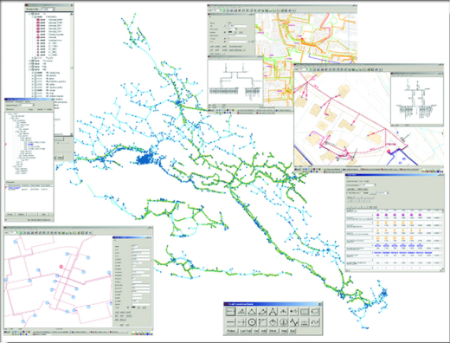
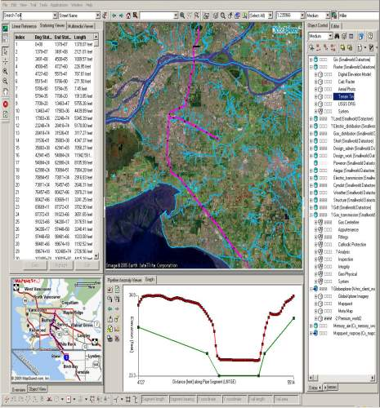
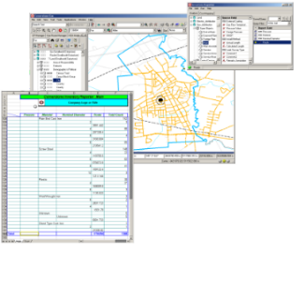
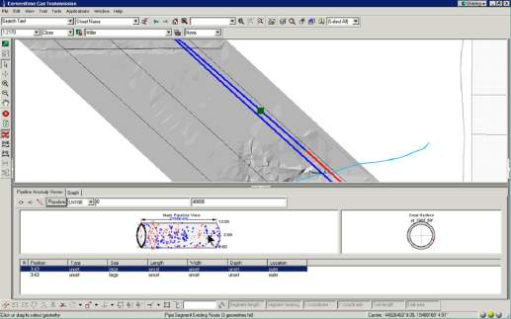



About us
Based in Zagreb, Croatia
Integration of IT systems
Functional Geoinformatics Systems (GIS)
Experts in field of IT system integration and spatial technologies, in industry of energy, telecom, civil and utility services
Notes:
We are supplier and integrator of spatial IT solutions for effective planing, management i control of network, asset, resources and operability in utility industry
Our goal is to develop and implement universal IT solutions based on renowned softwares, giving our users real business suitability. And we’re doing this through permanent growth of competence in IT and other key industries (such as energy, telecomunications, civil service)

Slide 3
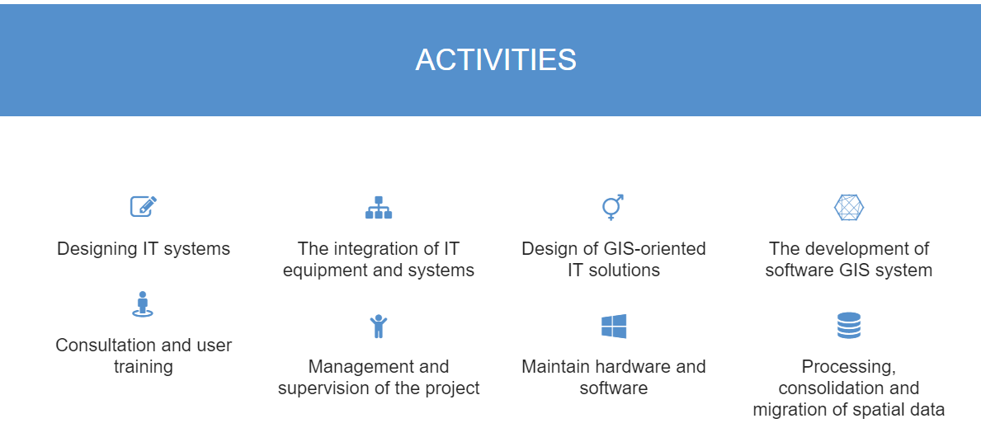

Slide 4

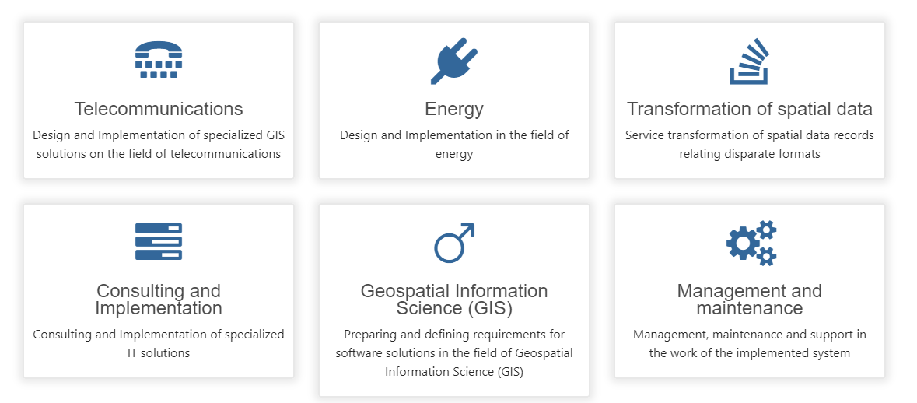

Slide 5
Multisoft – Top products
Electrical Power: DeGIS - a information system designed for documenting, planning, management and maintenance of the
EE network.
Telecommunications: DDS – a system which includes spatial and technical data of the telecommunications network and
telecommunications facilities.
Local administration: VodGIS - a geographic information system for the management of spatial and technical data of the cadastre of Zagreb’s infrastructure.
FME…

Slide 6

About FME
Leading technology for spatial data transformation
Support for 300+ data formats
500+ tools for manipulating data, extensive library of coordinate systems and built-in automation
Complete ETL (Extract-Transform-Load) solution for your spatial data
Used by more than 20,000 companies and organizations in the world for:
  Data conversion
  Transformation
  Workflow Automation (data <-> system <-> device)
  Using real-time data

Slide 7
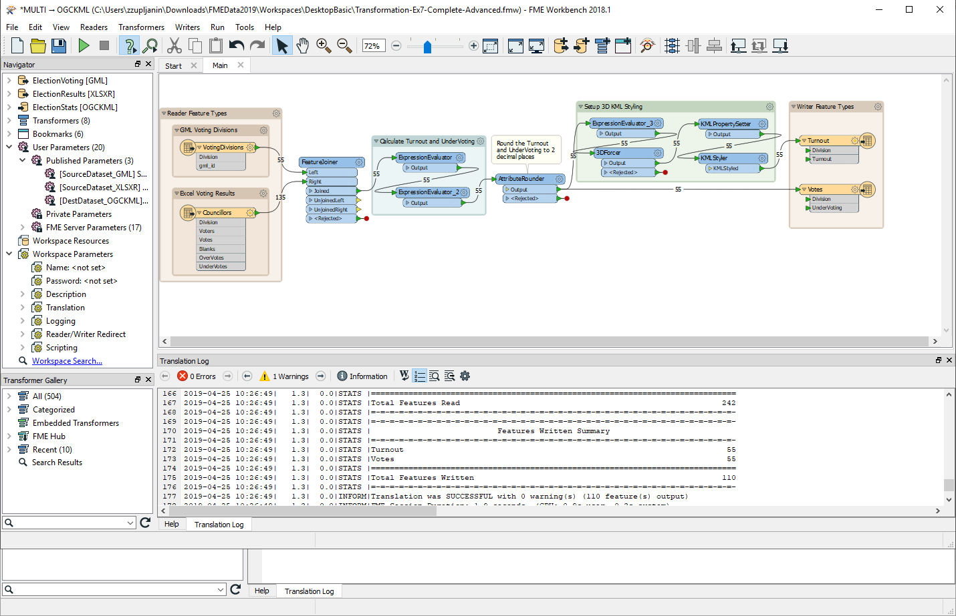
Extract, Transform, Load
Step 1. Extract: Drag’n’drop your input
Step 2. Transform: Modify your workflow
Step 3. Load: Write your data to destination

Slide 8
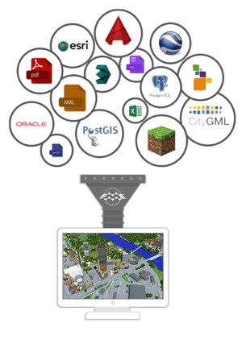






How FME works?
Data conversion
Data translation
Data integration
Data sharing
Data validation
…

Slide 9


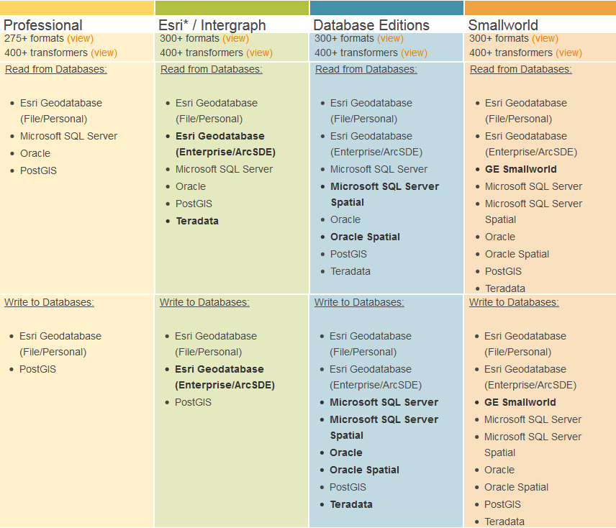
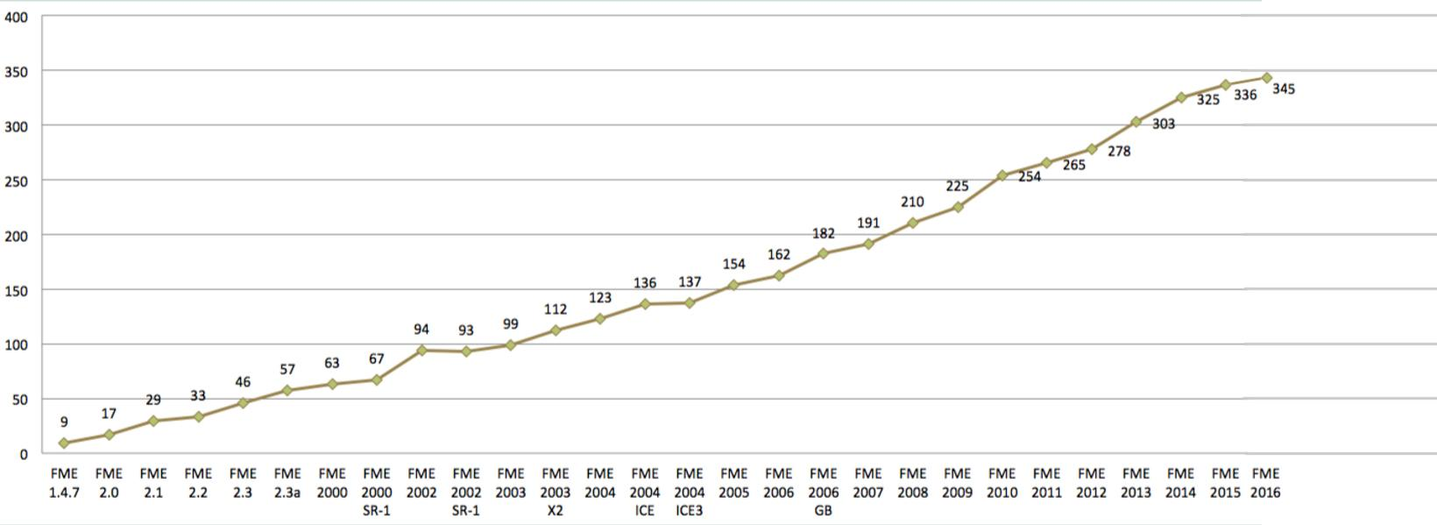
FME products
    FME Desktop
    FME Server
    FME Cloud
FME supported formats

Slide 10
User demands
  Coordinate system transformation (HDKS-HTRS96 module)
  Quality control for data migration
  Migration of data into database
  Export from database to various formats
  Production of statistical reports
  Interface customization

Slide 11
Implementations
  Web UI
  Notifications via e-mail
  Integration inside another application
  Directory watch
  Work optimization
  Adjustment of web database for statistics display

Slide 12
Real world examples

Slide 13
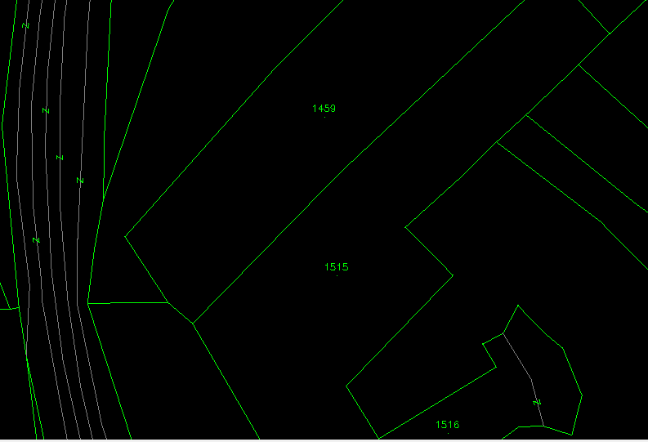
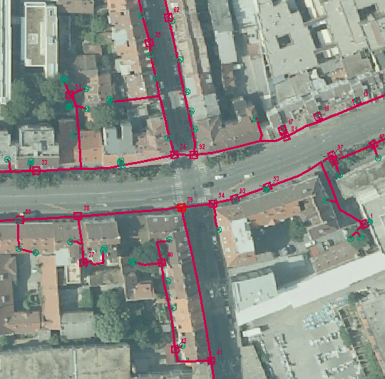


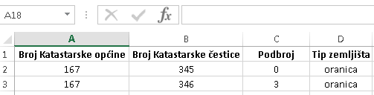
Processing data from multiple sources
  e.g. legal affairs
  Digital cadastral plan
  Utility
  Ownership data
  Official document
  Tabular land data
  e-cadastre
  e-land_registry

Slide 14
Quality control of utility planner’s drawings
AutoCAD dwg format
Definition of technical standard
Reusable for import into Smallworld database and share (export) through entire enterprise
Validation of geometry, attributes and topology
Preferably automated solution

Slide 15
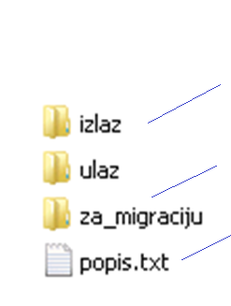
Aerial telecom utility network
„Simple” design – FME Server, Directory Watch
Invalid data, flagged errors
Input data
All ok data; prepared for import
Log file
Notes:
Uputa vanjskim izvođačima za snimanje mreže
Formalne i topološke FME kontrole
Jednostavna provjera
Ulaz: kopiranje podataka u direktorij za provjeru
Izlaz: podaci spremljeni u direktorij za migraciju ili spremljen u direktorij za vratiti na ispravak sa naznačenim pogreškama

Slide 16
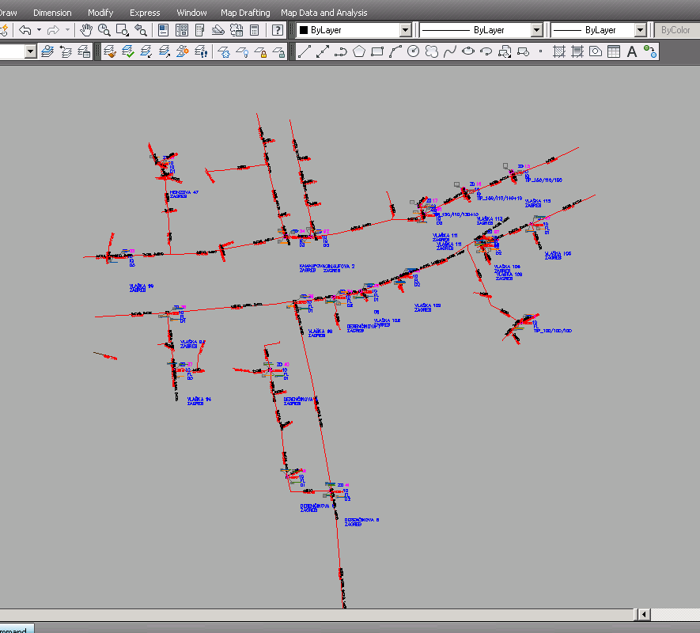
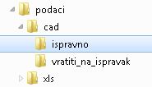
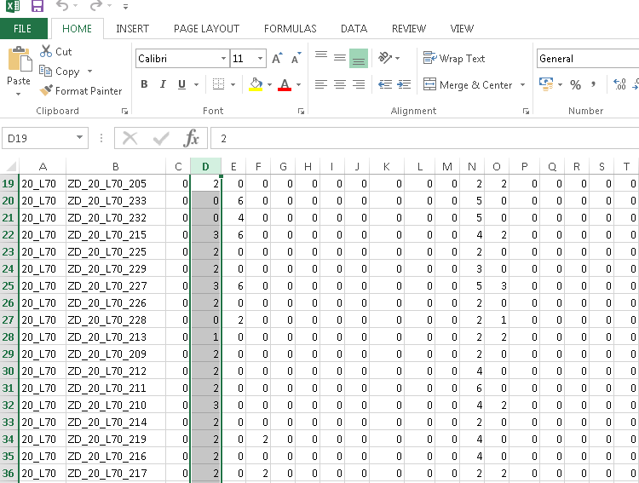
Automatic file processing
  Transformations
  Formal and logical controls
Bat script
Control checkup
Directory watch

Slide 17
Automatic data extraction from GIS
Output to various formats
Known technical standard
Extract of data based on user defined area
Integrated in desktop and web application
Fully automated solution

Slide 18
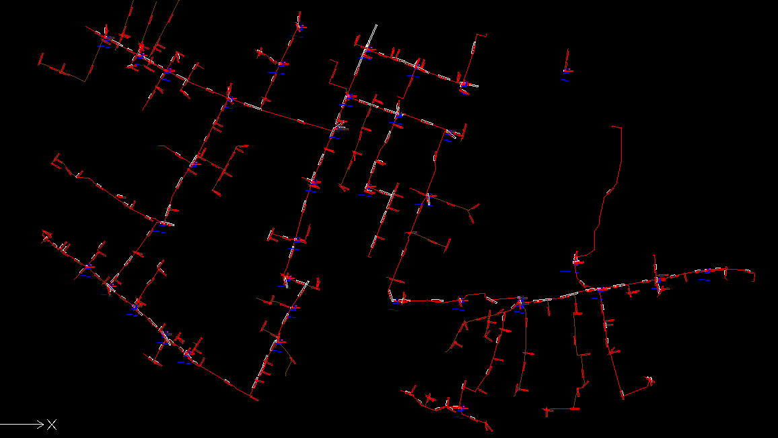
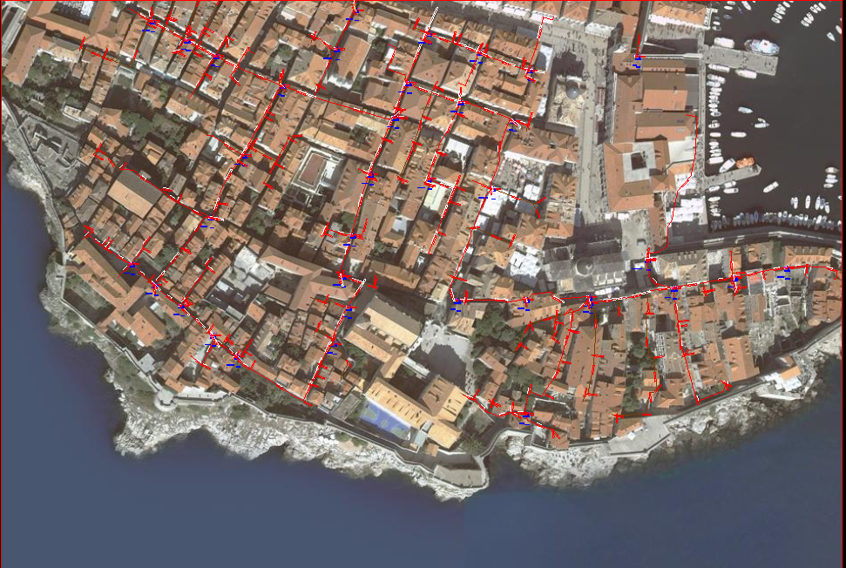
Data export from GIS to CAD
From GE Smallworld to AutoCAD drawing
User definition of layers and blocks

Slide 19





Data sharing solution for administration office
Water supply network owners
Heating system owners
Oil network owners
Electrical network owners
Gas network owners
Drainage system owners
Administration body
Telecom network owners
control + detection + import
Report and messages

Slide 20
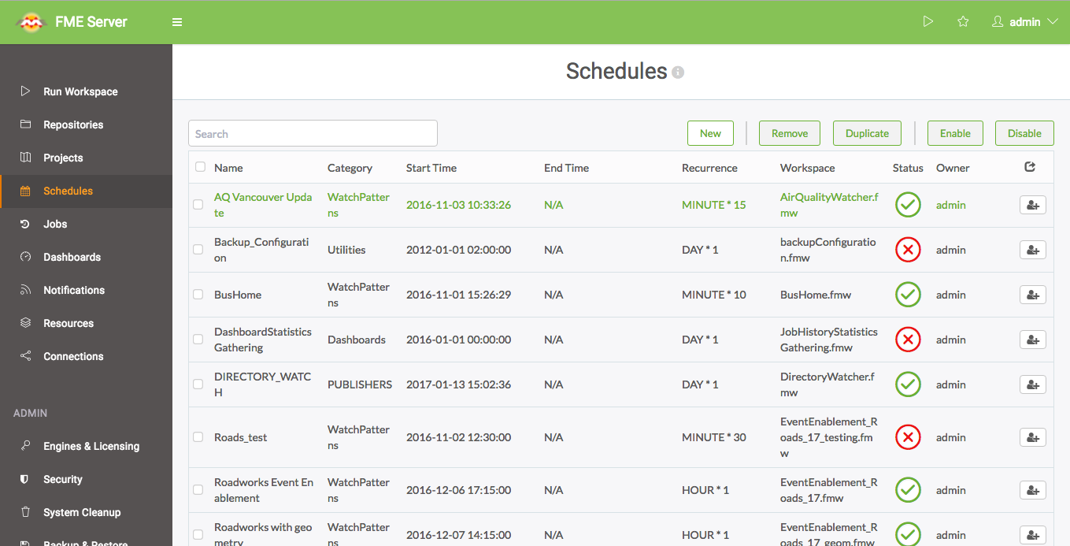
Scheduled running in FME Server
Notes:
First, step 2, the scheduling part. This is easy to set up in FME Server.
Create your workspace that reads a dataset or feed, then upload it to FME Server and put it on a schedule.
The schedule can run as often as you’d like, but you should bear in mind API restrictions, data upload frequency, engine usage, job runtime.

Slide 21
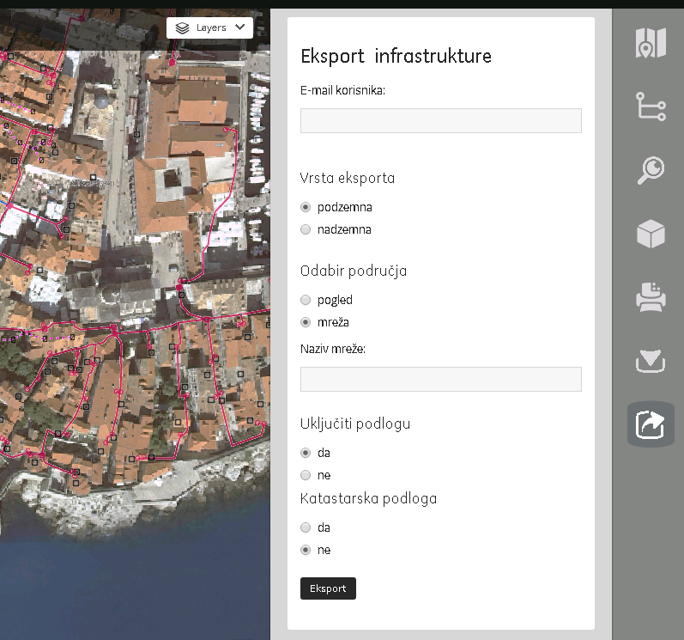
Integration with mobile/web applications
User e-mail
For authorisation
For login
Type of export
Aerial route
Underground route
Scope
From view
Explicit route name
Include basemap?
User basemap database
OpenStreetMaps
Include cadastral data?
User’s basemap dataset
Notes:
The CIP team was using Google Sheets as a database for all of their project information. As project data was updated such as the project status, a team member would update it manually in the Sheet.

Slide 22
Where does FME fit in considering archives?

Slide 23
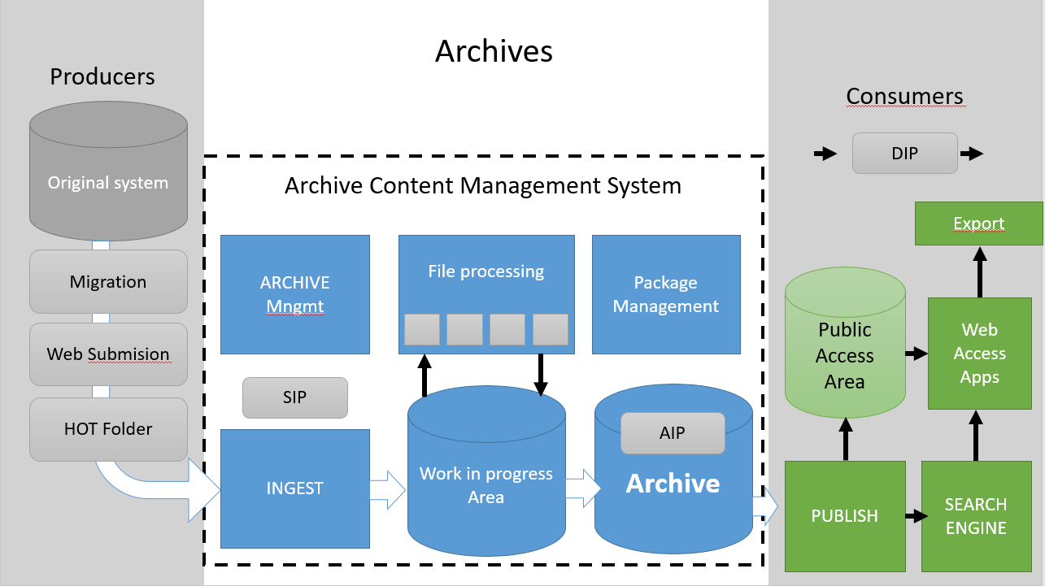


Slide 24

Historize combined data for certified and reproducible reports and analysis

Slide 25
GeoSpatial Analysis Spatial Warehouse
Enterprise wide solution for integration, analysis, reporting and distribution of asset information
Provides a secure, certified environment for mature asset management by enabling time invariant analysis and reports
Automates best practices from data warehouse for spatial data, integration and performance
Combine, (re)model, historize and distribute spatial data
Build history for data using time stamps
Detect and capture only data changes

Slide 26
Thank you for your time
zelimir.zupljanin@multisoft.hr

