Slide 1


Upravljamo s prostorom skupaj Let`s manage e-spatially together
INTEGRATING OPENSOURCE GIS SOLUTIONS INTO A FUNCTIONAL ARCHIVAL SYSTEM
Integracija odprtokodnih GIS rešitev v delujoč arhivski sistem
Tomaž Černe, Urban Jensterle: IGEA d.o.o.
Urban Berger: RTH d.o.o.
Ljubljana, 7. 5. 2019
Notes:
My name is Tomaž Černe, and I will present the paractical use of opensource GIS solutions in solving large and degradated area mangement

Slide 2
Content
System for effective use of archive data (spatial and non spatial) in the field of closed coalmine area management (degraded areas).
Case: Coalmine Trbovlje – Hrastnik (RTH) in process of gradual closure.
Chapters:
  History, present and future of Coalmine RTH
  Information system‘s aim
  Information system concept and technology
  Transformation of data, used in system
  Use case
  Further IS development plan
Notes:
I will present our experience or our example of creating a modern system that is cappable of using archive data for solving present problems in the field of closed (or closing) coal mines management (in fact all of degraded areas management)
The speciality of the presented system is also, that it includes a cappability to use non spatial archive data through spatial queries
The system was developted for coal mine Trbolvje Hrastnik case, it is current and well known in Slovenia
I will present this matter in five chapters

Slide 3
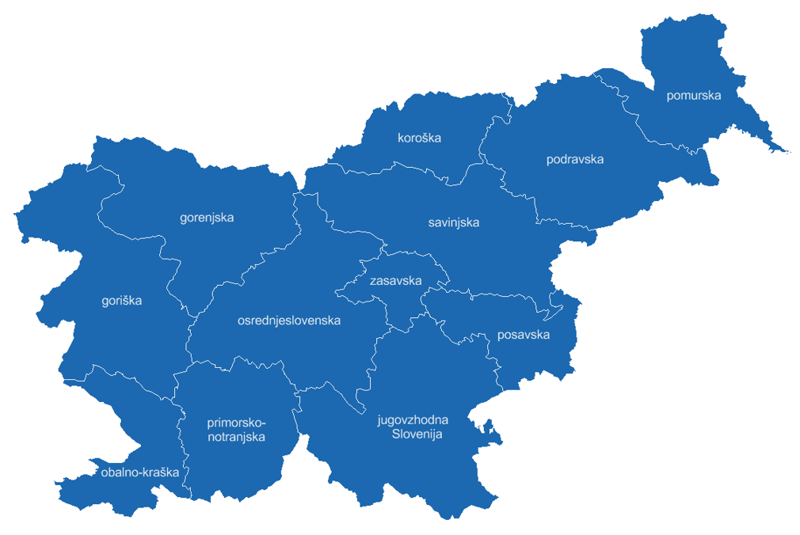
History of coal mining in Zasavje region
Zasavje region
Municipalities:
  Zagorje ob Savi
  Trbovlje
  Hrastnik
  Litija
Notes:
RTH coal mine lies in region called Zasavje
Zasavje region lies in the central Slovenia
It consist of four municipalities: Litija, Zagorje ob Savi, Trbovlje and Hrastnik

Slide 4
History od coal mining in Zasavje
1755: baron Franc Raigersfeld obtained first official permission for mining in Zagorje region.
1804: Franz Mauer established first coal mine in Trbolje.
1842: first coal mine established by state.
1873: all coal mines in Trbovlje and Zagorje were associated to the Trbovlje mining company.
Notes:
Coal mining in Zasavje dates back to 1755 when baron Franc Raigersfeld obtained first official permission for mining in Zagorje
In Trbovlje first coal mine was established by Franz Mauer in 1804
1842 first coal mine in Trbovlje (coal mine Vode) was established by state and then transfered to private firm
In 1873 all coal mines in Trbovlje and Zagorje were associated to the Trbovlje mining company

Slide 5
History od coal mining in Zasavje
1946: nationalisation of all coal mines.
1968: associaton of coal mines into Zasavje coal mine company.
1995: Zasavje coal mine company was divided into four companys (one of them Trbovlje – Hrastnik mine) (RTH)
Founder and owner of RTH mine is Republic of Slovenia
Notes:
1946, after the second world war –all coal mines in Zasavje were nationalisated
1968 – Zagorje, Trbovlje and Hrastnik coal mines were asociated in Zasavje coal mine company, 1984 coal mines Senovo, Kanižarica and Laško (not from Zasavje) were joined
In 1995 Zasavje coal mine company was divided into four companys: Trbovlje – Hrastnik mine (active) and Kanižarica, Senovo and Zagorje mine (all under Closure already in this time)
Founder and owner of RTH mine is Republic of Slovenia

Slide 6
End of coal mining in Zasavje
2000: Act Regulating the Gradual Closure of the Trbovlje-Hrastnik Mine and the Economic Development Restructuring of the Region was accepted.
The procedure for closing all rights and obligations and liquidation of RTH company will be performed until end of 2020
Notes:
In year 2000, after the national referendum for investnig in new Termoelectrical plant Trbovlje (TET 3), which was declined, the Act of Gradual Closure of the Trbovlje-Hrastnik Mine and the Economic Development Restructuring of the Region was accepted
The liquidation of RTH company will be preformed until end of 2020, together with procedure od closing all raights and obligations of RTH company

Slide 7
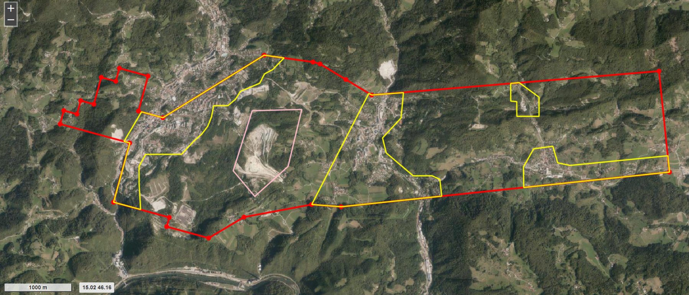
Coalmine Trbovlje Hrastnik
1400 hektars in 2 municipalitis
Dimensions: 8 km x 3 km
Notes:
The mining area of RTH measures 1400 hektares, and is located in two municipalities Trbovlje and Hrastnik. Lenght of mining area is 8 km, wide is 3 km.
Present situation:
Underground closing works has been completed
Surface remediation in final stage (mining infrastructure clearenc, drainage, new roads, forestering …)
Procedure for the erasure of mine area from the cadastre of acquisition spaces is underway
Only few employes managing all area and procedures

Slide 8
Obligations of RTH under Mining Act
Permit for the abandonment of mining works
Execution of mine closing works, surface and environment rehabilitation works
Technical overview of closing and rehabilitation works
Order on the termination of the rights and obligations
Delivery of mining documentation to the Geological Survey of Slovenia
The removal RTH from the mining register
Notes:
Important circumstance, to understand the system aim is the procedure of closing mine under mining act. Procedure is divided into 6 steps:
1. Getting a permit for the abandonment of mining works - in this permit the obligations of mining company which must pe completed is diffined
in this step, necessary documentation is: data on the present state of the mine, coal reserves ...
2. Execution of closing works and rehabilitation of the environment (in case of RTH this is long term procedure, planing, civil ingeniring works ..)
in this step necessary documents are (mining and civil) projects of planned rehabilitation below and undergraund
3. Technical overviews of the situation after the rehabilitation are taken (in case of RTH more technical overvies and procedures)
necessary documents: rehabilitation civil projects, actual situation reports
4. When the technical overwiev is passed, Order on the termination of the rights and obligations will be issued issued
Comments: prelinimary described four steps in case of RTH are performing into several repetitionts considering the size od RTH mining area
5. Mmining documentation must be delivered to the Geological Survey of Slovenia
part of the material is permanently archived in state archive
6. The final act is removal of the holder of the mining right n from the mining register
After performing this 6 steps, the former mining area is not under te authorization of mining autority.
Izdaja dovoljenja za opustitev rudarskih del – v dovoljenju navedene obveznosti glede sanacije (potrebni podatki o stanju rudnika, zaloge premoga …)
Izvajanje zapiralnih del in sanacija okolja (potrebni projekti načrtovane sanacije)
Tehnični pregled stanja po sanaciji (potrebni projekti izvedene sanacije, prikazi dejanskega stanja)
Izdaja odločbe o prenehanju pravic in obveznosti rudarske pravice za izkoriščanje
Izročitev rudarske dokumentacije Geološkemu zavodu Slovenije (del gradiva se trajno arhivira v skladu s predpisi o arhiviranju)
Izbris nosilca rudarske pravice za izkoriščanje iz rudarskega registra

Slide 9
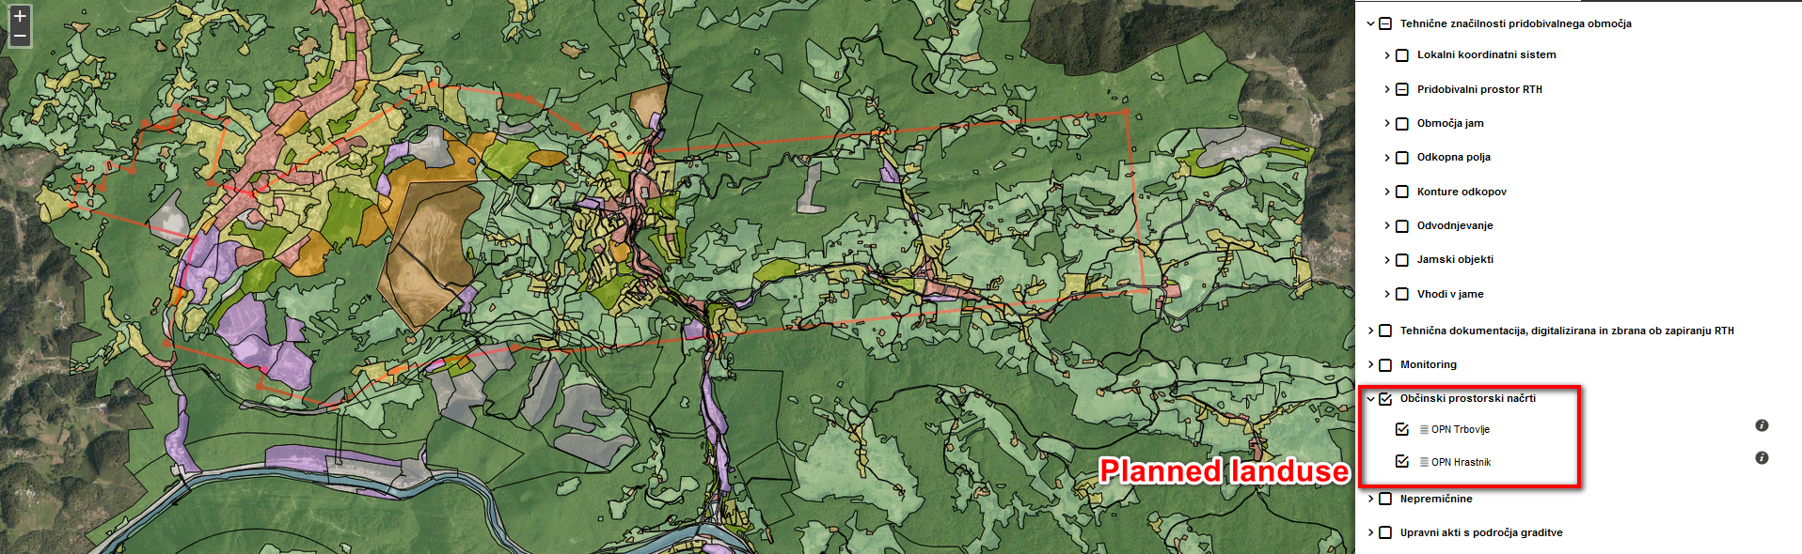
Coal mine Trbovlje Hrastnik Tomorrow
Notes:
What will hapen after the clousure …
The actual, present and planed land use of the mining area is mixed. The remediation of land into industrial zones, central functions zones, housing and sport areas is planed. So it is very important to know exactly of the technical conditons for constructing

Slide 10
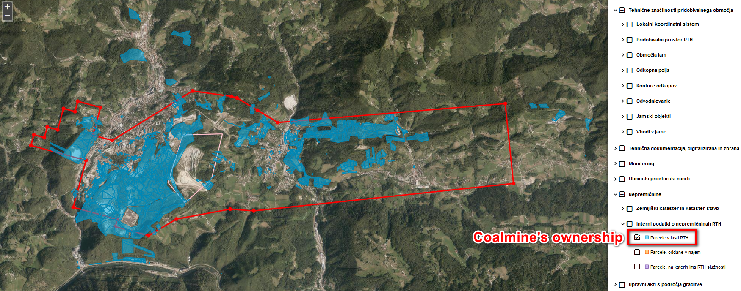
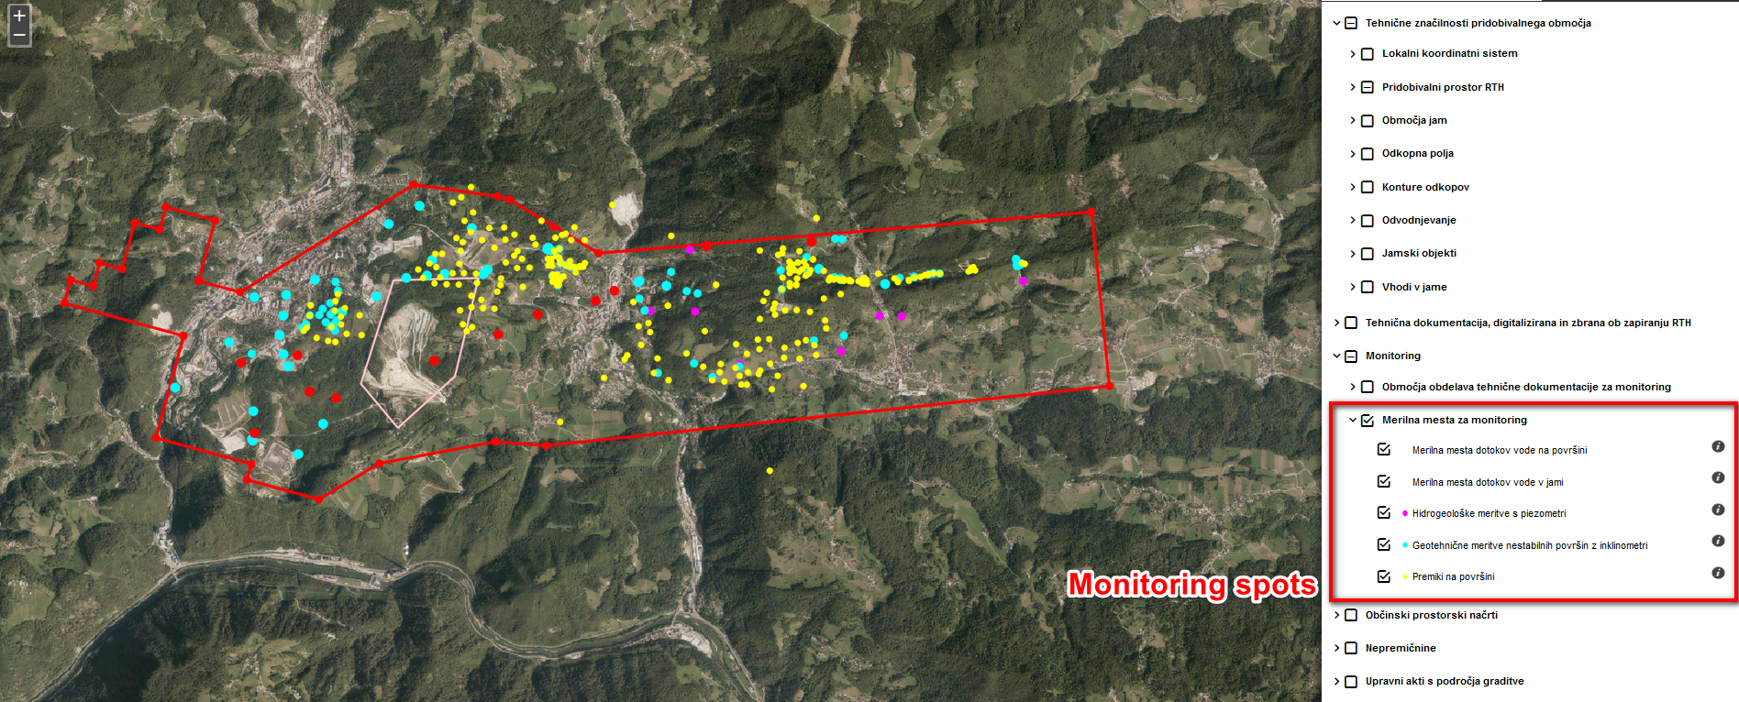
Coal mine Trbovlje Hrastnik Tomorrow
Notes:
This two maps are showing the owner ship and monitoring spots of the mining area.
On uper picture, in blue are colored all the parcels owned by RTH company, which means that Republic Slovenia will be major owner after the liquidation of RTH
On lower picture you can see monitoring spots (monitoring of inclination, movement, water quantitiy etc.). Intense monitoring of the conditons is planed in future, with aim to prevent possible damage on objects or infrastructure due to surface changes. Surface changes will appear no matter of remediation

Slide 11
Information system‘s aim
Less employees: intensive execution of closing procedures, large amount of documentation needed in procedures.
Surface maintenance (cleaning of drainage ditches, interventions ...).
Monitoring of surface movements, monitoring of water quantities ...).
Providing information on the tehnical conditions for landuse (spatial planning, building permits).
Notes:
Now i,m moving to the essence of presentation. The information system, which i,m gona to present aim is to support all the issues discribed till konow.
The infomation system aim is to support four areas of mine management:
To fill in lack of employes dealing the procedure of mine closing (less employes, more work on closing procedure)
To serve data needed for mining area maintenance (after closing of RTH company)
To serve data and to save data from monitoring (surface movements, inclinations, water quantities nad quality)
And, I think most inportant: providing reliable and complete information on the technical conditions for possible land use in future

Slide 12
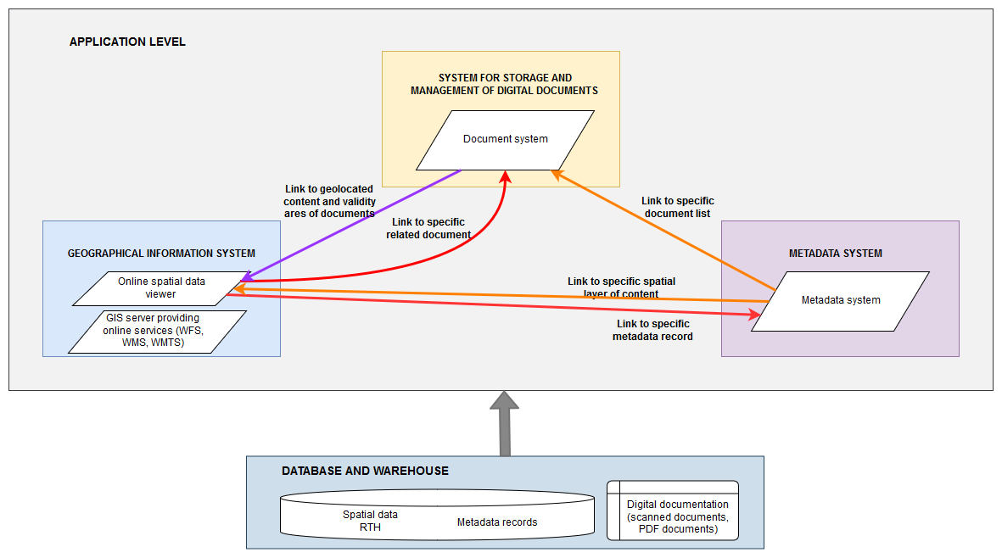
Sheme of the system
Notes:
The information system is composed out of three systems and one database:
System for manageing of digital documentation (DMS)
Spatial data system (GIS) which is composed of spatial data server and spatial data viewer. Spatial data system is used for searching and presentation of spatial data
Metadata system which is used to create and presentat metada of dosuments and spatial data
Database and warwhouse system which is used as storage of all spatial and atribute datof systema

Slide 13







System technology
APPLICATION LEVEL
The Open Geospatial Consortium (OGC) is an international not for profit organization committed to making quality open standards for the global geospatial community.
SERVICE LEVEL
DATABASE
Notes:
System components are developed by using open source solutions which are compatible to OGC standards. These components are freely available for anyone to use to improve sharing of the geospatial data.
GeoNetwork is a free and open source cataloging application for spatially referenced resources.
OpenLayers is an open-source JavaScript library for displaying map data in web browsers as slippy maps.
GeoWebCache is a Java web application used to cache map tiles coming from a variety of sources
GeoServer is an open-source server written in Java that allows users to share, process and edit geospatial data.
PostgreSQL (also referred to as Postgres) is an open-source relational database management system (RDBMS)
PostGIS is an open source software program that adds support for geographic objects to the PostgreSQL database.

Slide 14
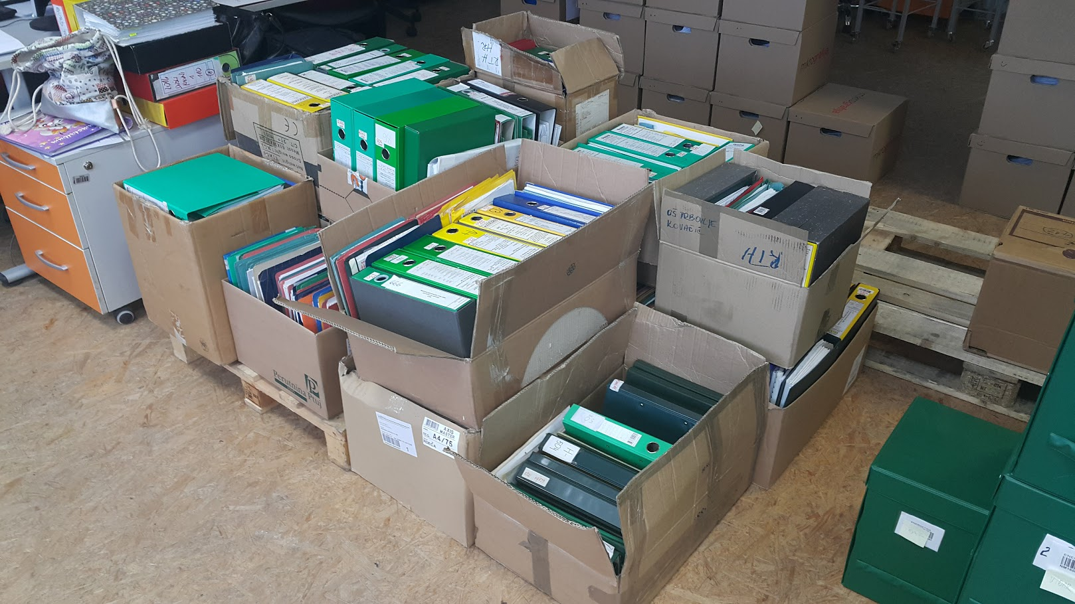
Data transformation – documents and maps
Documentation (projects, maps) mostly in analog format, stored on various locations.
Quantity: 60 000 pages A0 – A4 in 800 binders
Notes:
Some words on data digitalization and transformation.
First analogue documents and maps. The quantitiy of dosuments and maps was large, document were in diferent formats and on various locations. The picture shows a part of documents in binders or folders

Slide 15
Documents and maps - procedure
Documentation was brought together and labeled with unique signs.
Metadata list were created. Data from list is used for searching and sorting documents.
Documentation was scanned
Standard for digital archiving of documentation:
  PDF/A with OCR recognition: 300 DPI; 24 bit.
  Non compresed TIFF: 300 DPI
Notes:
Document and maps digitalizing procedure
Documnts were digitalazied using the common standard for digital arcihivig

Slide 16
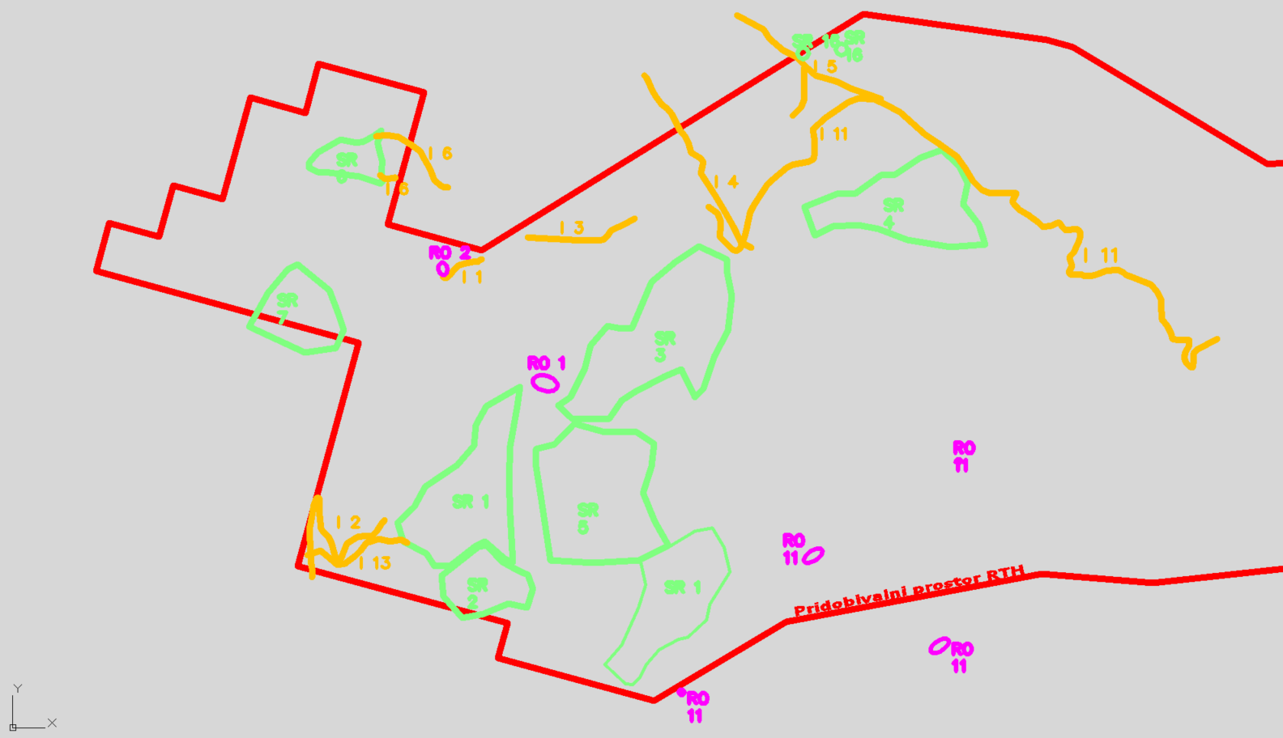
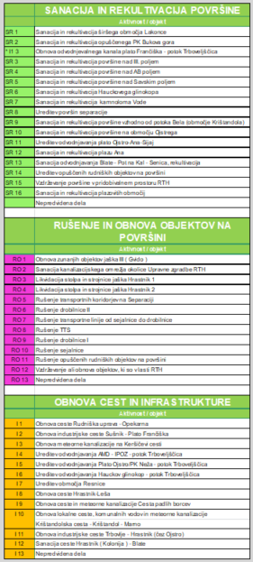
Data Transformation of CAD data into „spatial data“
geoorientation
geoorientation
Transformation of CAD data into „geospatial vector data“ (SHP) and than import in PostgreSQL and PostGIS
Notes:
A lot of data used in the system was ori8ginaly created and stored in CAD drawings on file system
Such data is suitable for individual use for civil enginering porpuses, but not for use in a information system which aim is fast and simple searching and retriving data for different purposes. In this picture you can se example of CAD drawing.
So the CAD data was transformed into structure and data format suitable for GIS systems - so caled shapefiles

Slide 17
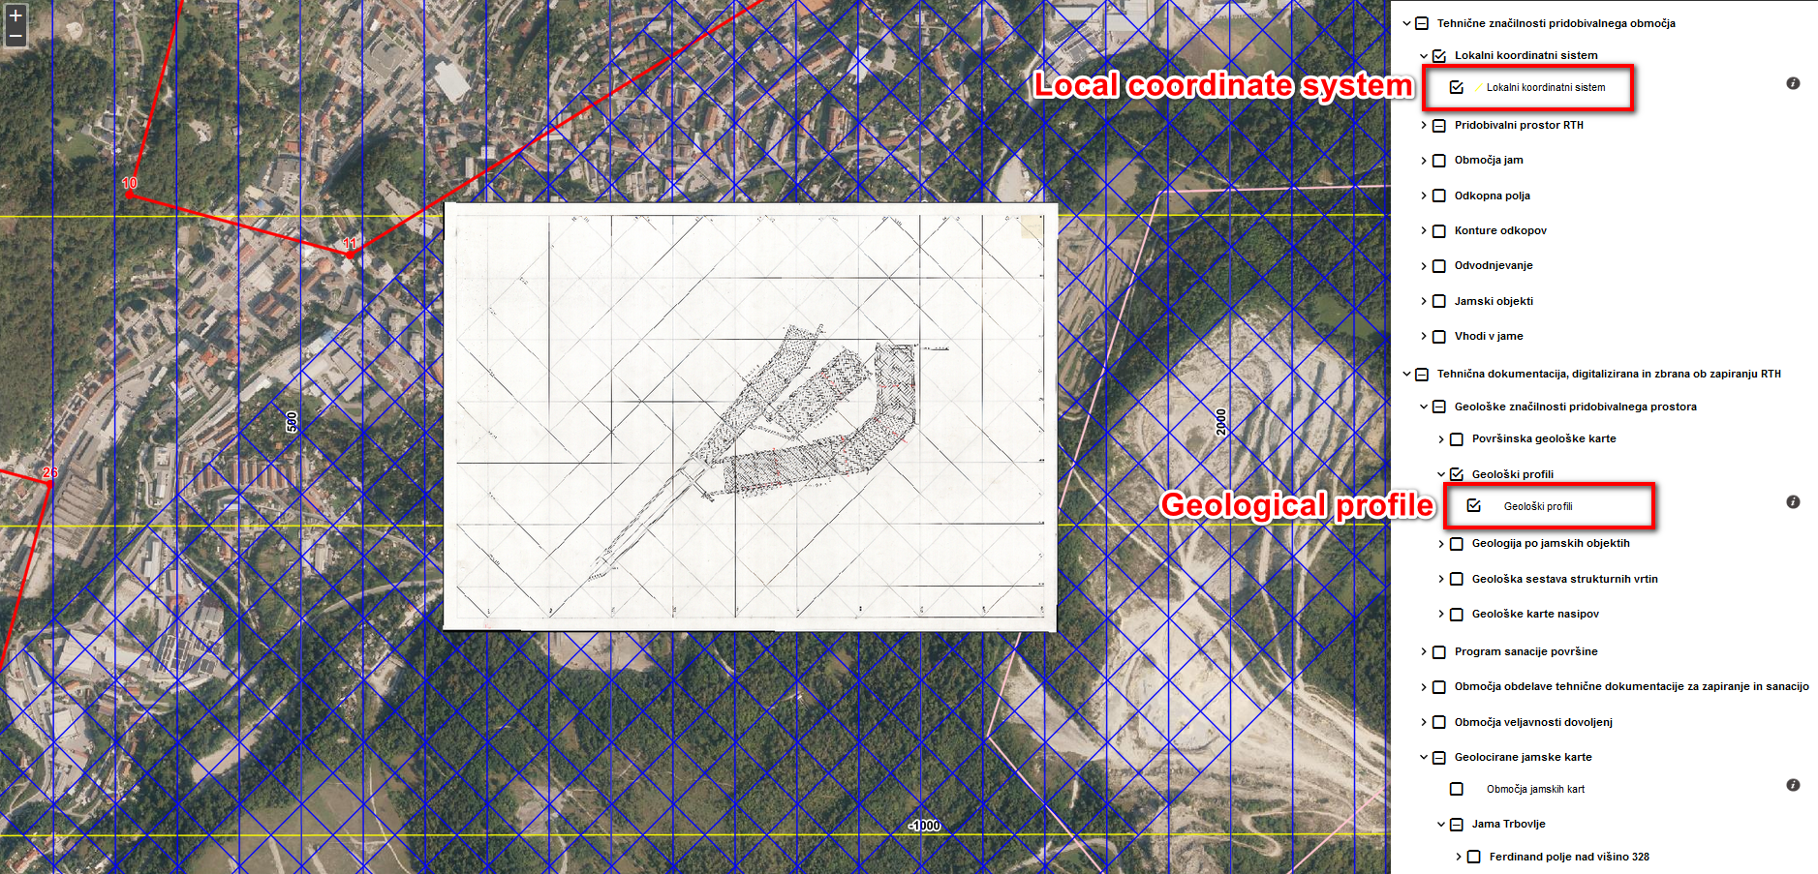
Geoorinentation of maps
Geoorientation of maps (creating world file)
Notes:
Scaned maps were geoorinetated for used in geografic information system
The example of geoorineted map you can see on this picture. Map is shown in spatial wiever on official and local (mininig) coordinate system

Slide 18
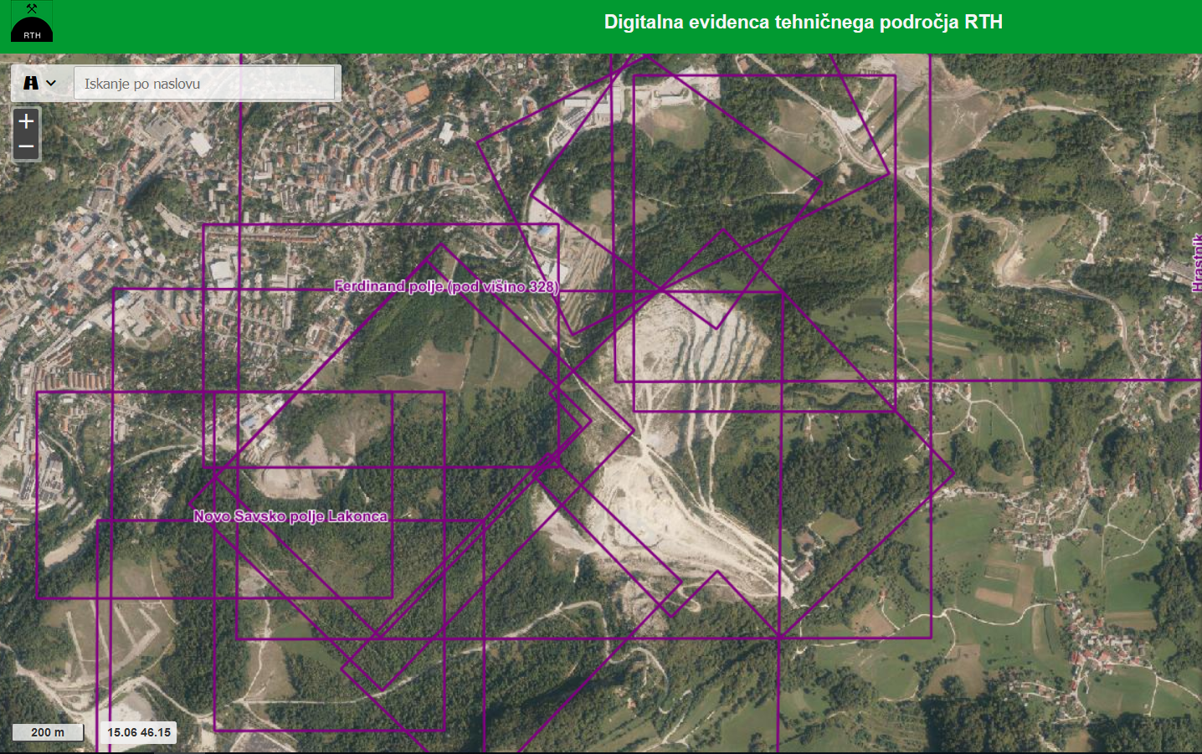
Digitalization of map frames
Digitalization of maps frames and document‘s maps frames for creating ‚validity zones‘ for document and maps
Notes:
And finnaly, the maps frames of geooriented maps and documents were digitalized
In the picture you can se example of digital map frames. Every frame has a atribute data which links frame with scaned map in document system

Slide 19
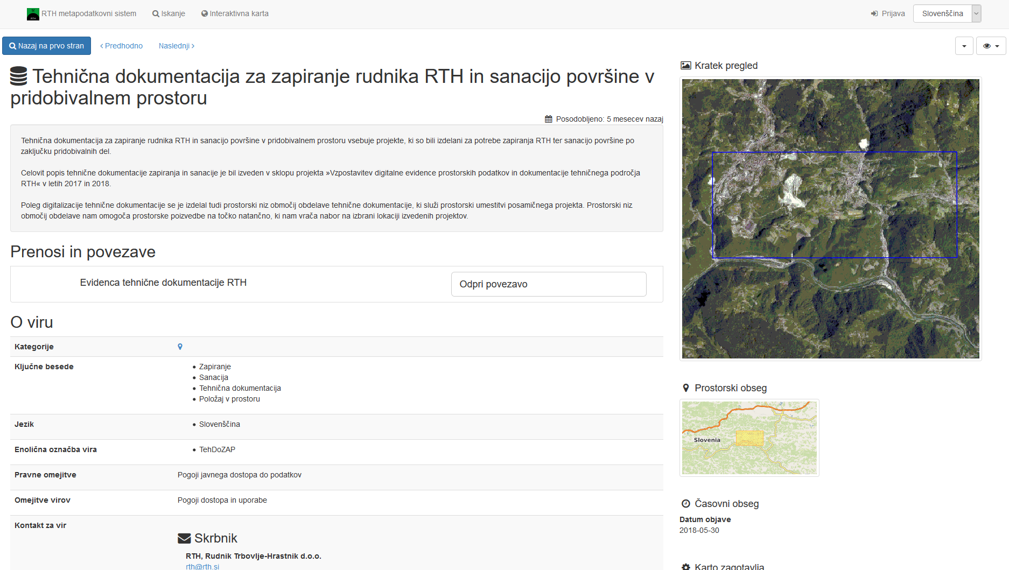
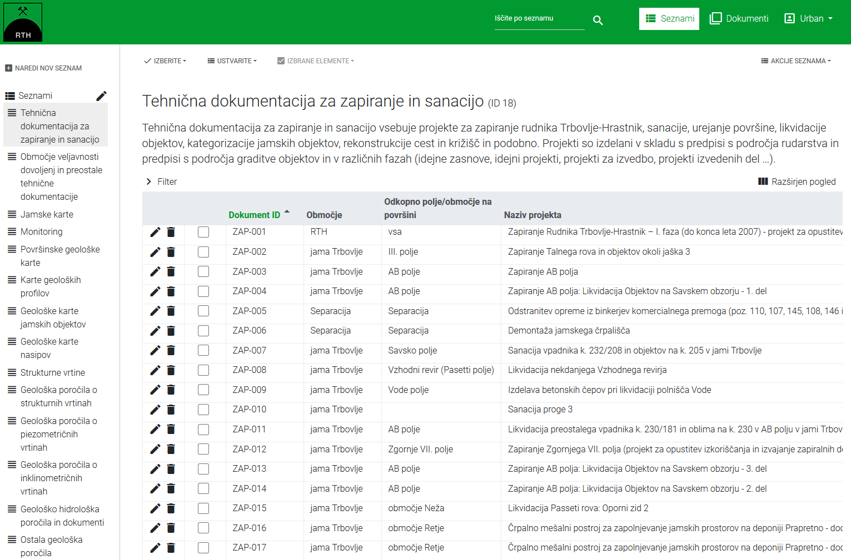
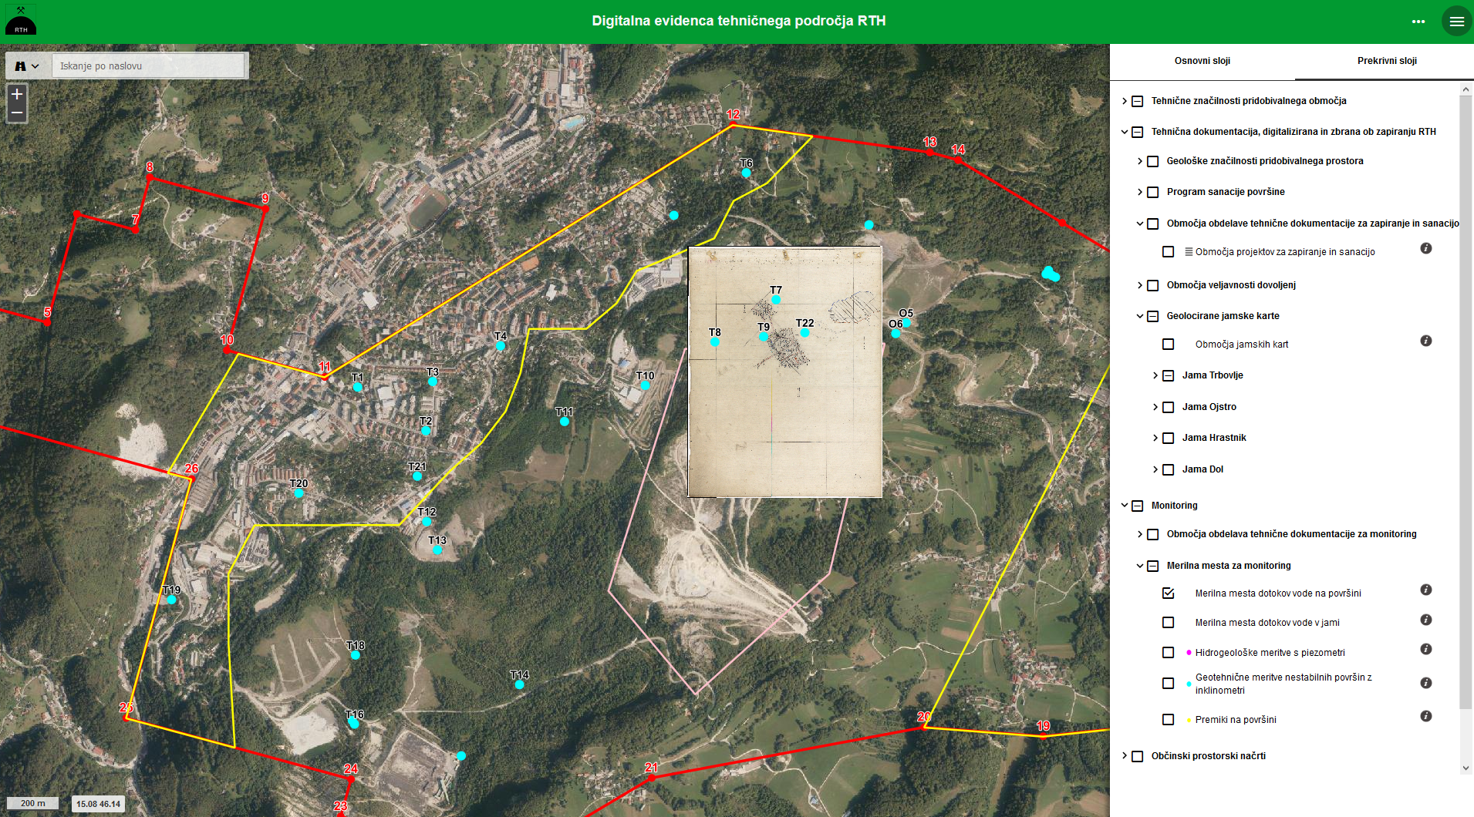
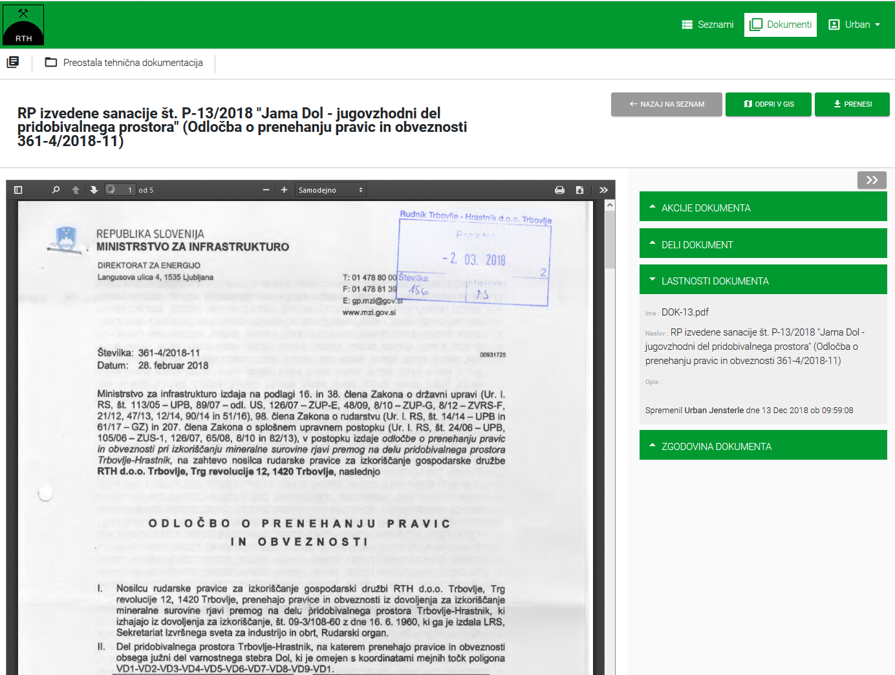
How does the system work?
Notes:
All earlier described procedures and aplication make possible easy and fast transition on different data and documents within the system
Transition from table with document atributes to document, trasition from document table to spatial data viewer, transition from spatial data to metadata, transition from documet to metada etc. ..
The essence of the system is easy searching of the data and documents, especialy searching by location, and transfering the document that was found to apropriate user (emali, printing ….)

Slide 20
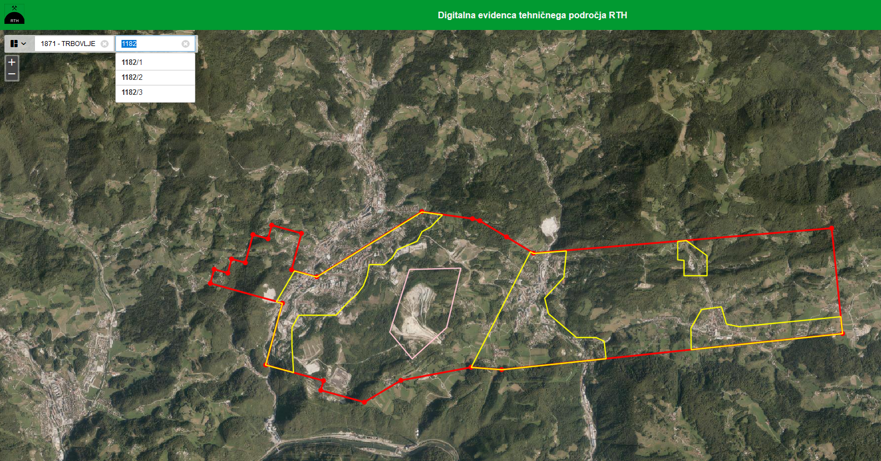
Address / parcel search
Notes:
Let me demonstrate the system funcionality in next few slides:
In most case, the question is, what are the properties of certain land plot or parcel (land use, what is below the surface …)
We can preform search by parcel number

Slide 21
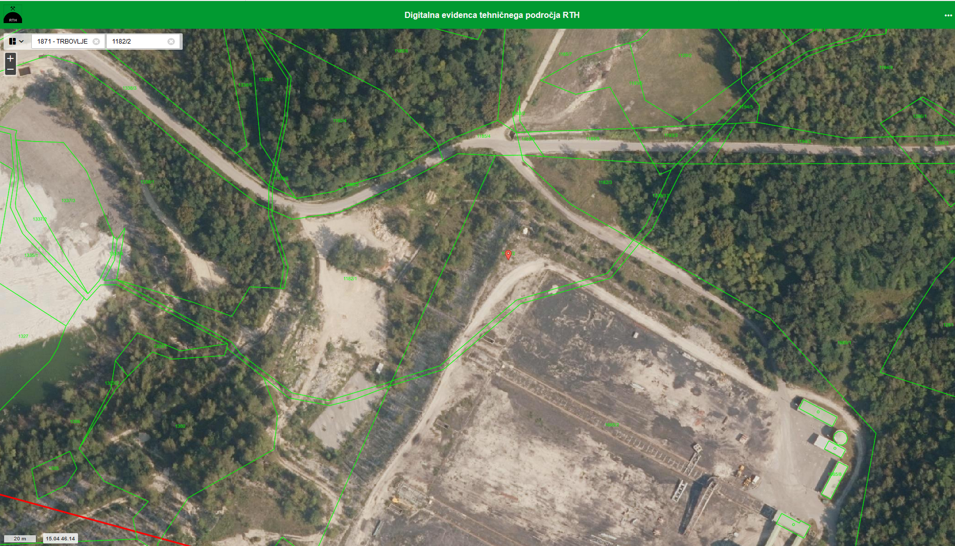
Zoom to location
Notes:
When the parcel is fund we can zoom to the location for beter look

Slide 22
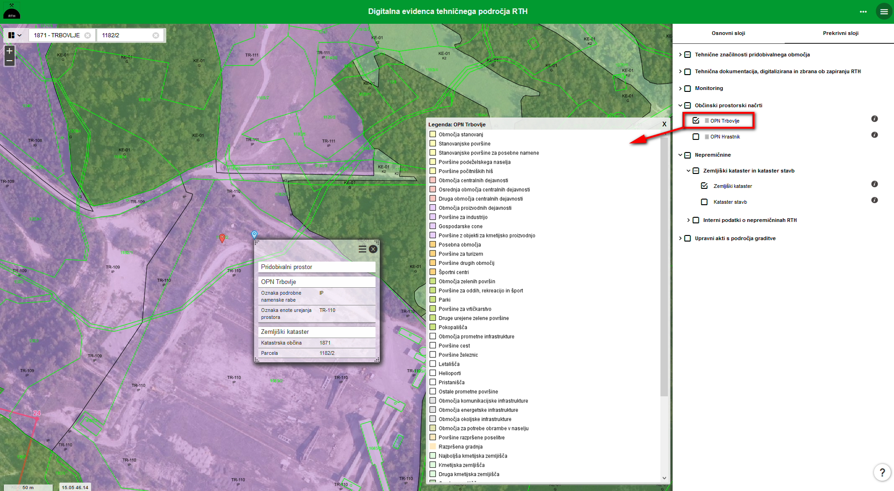
Planned use according to spatial act
Notes:
We can retrive land use map from the municipality land use plan … in this case pland land use is industrial area

Slide 23
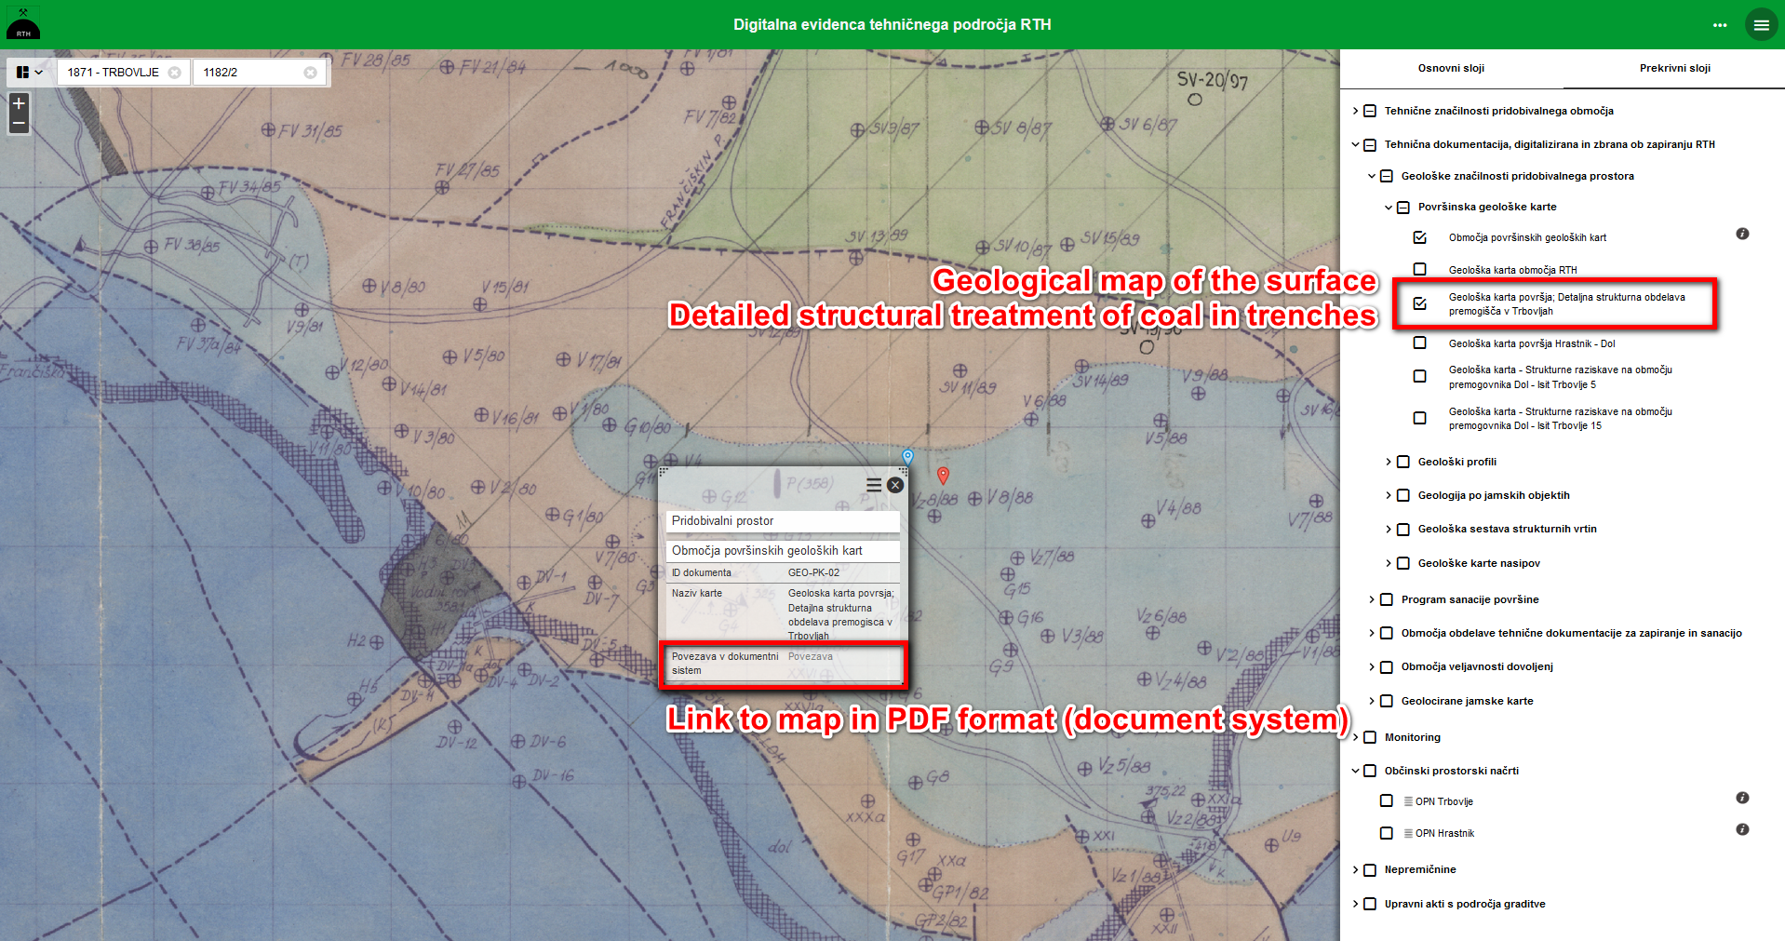
Other relevant spatial data (e.g. geology maps)
Notes:
For same location we can retrive information of geolocial structres

Slide 24
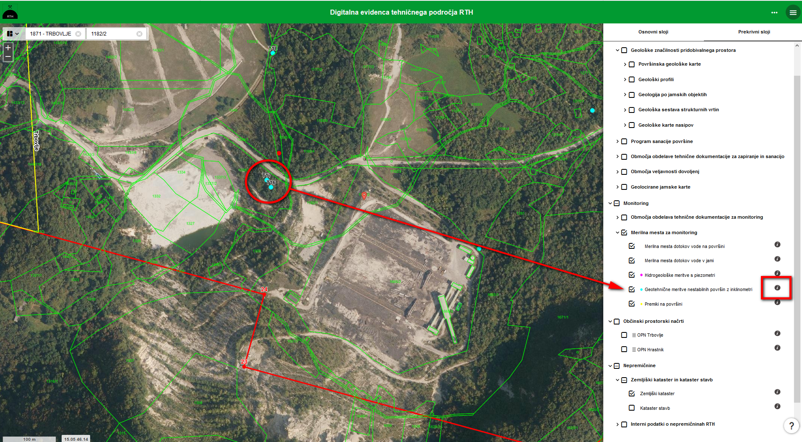
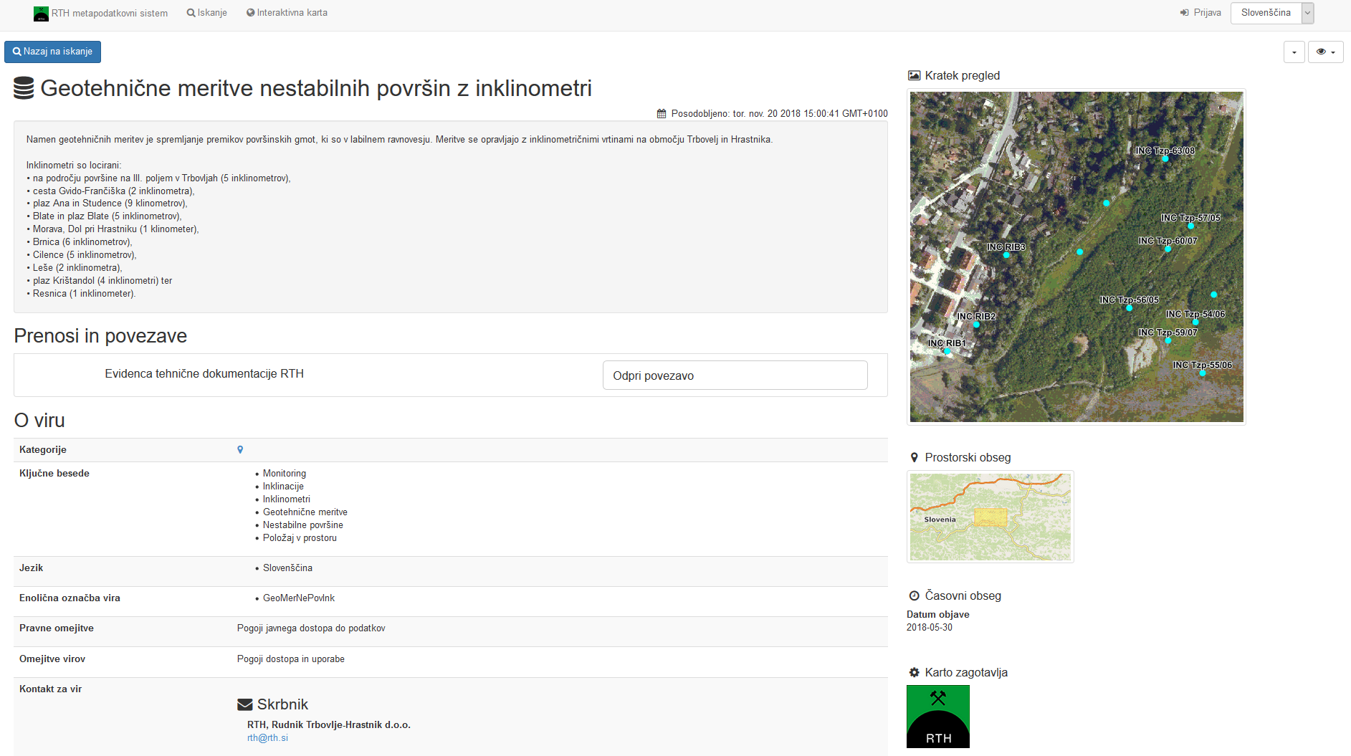
Link to metadata entry
Notes:
For every set of data shown on map we can get their metada … to know what data means, quality and purpuse of data etc.

Slide 25
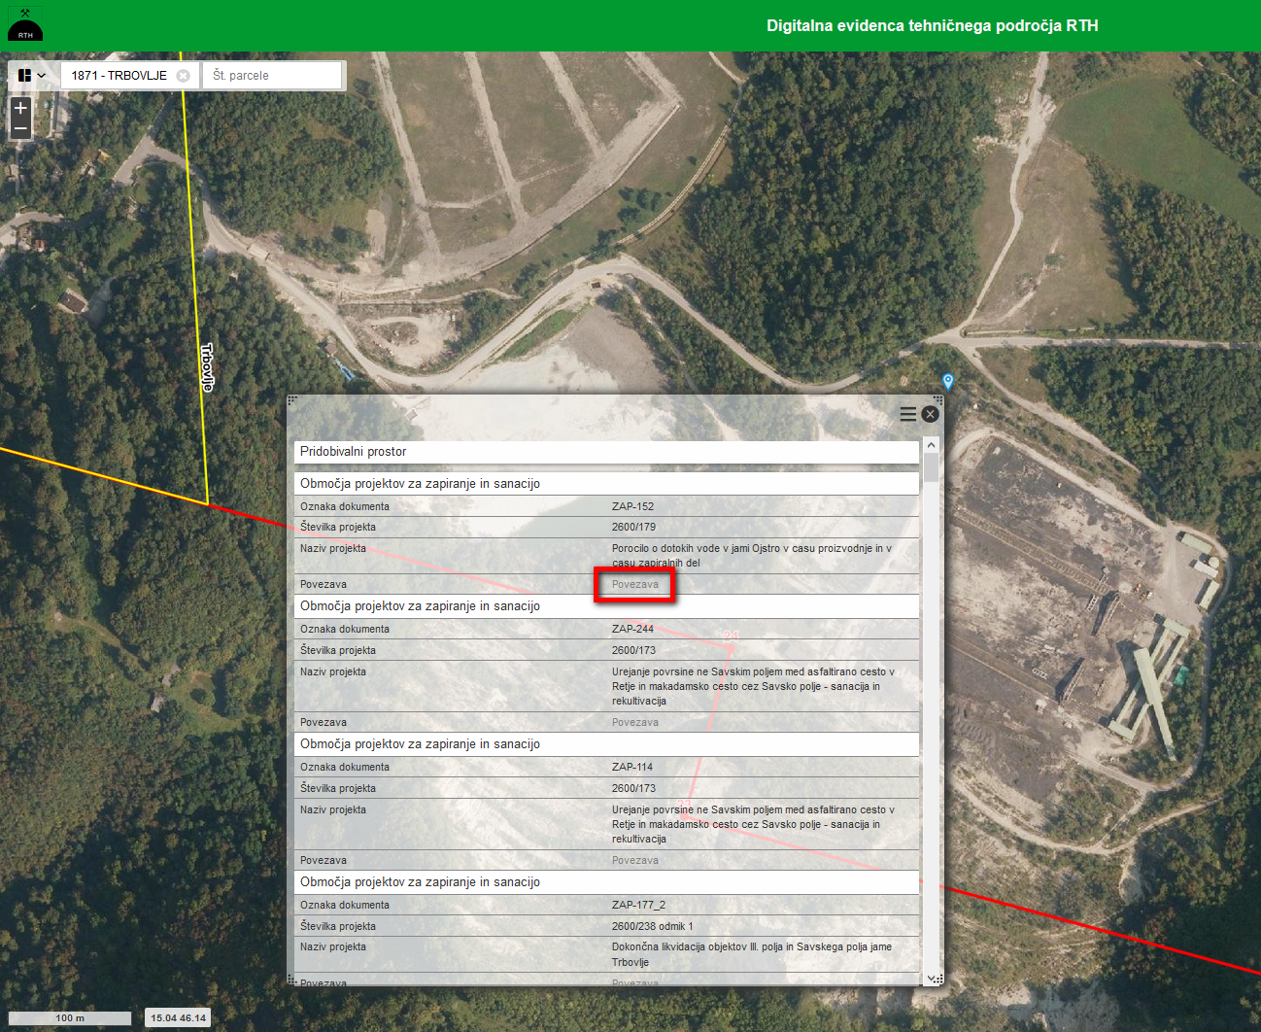
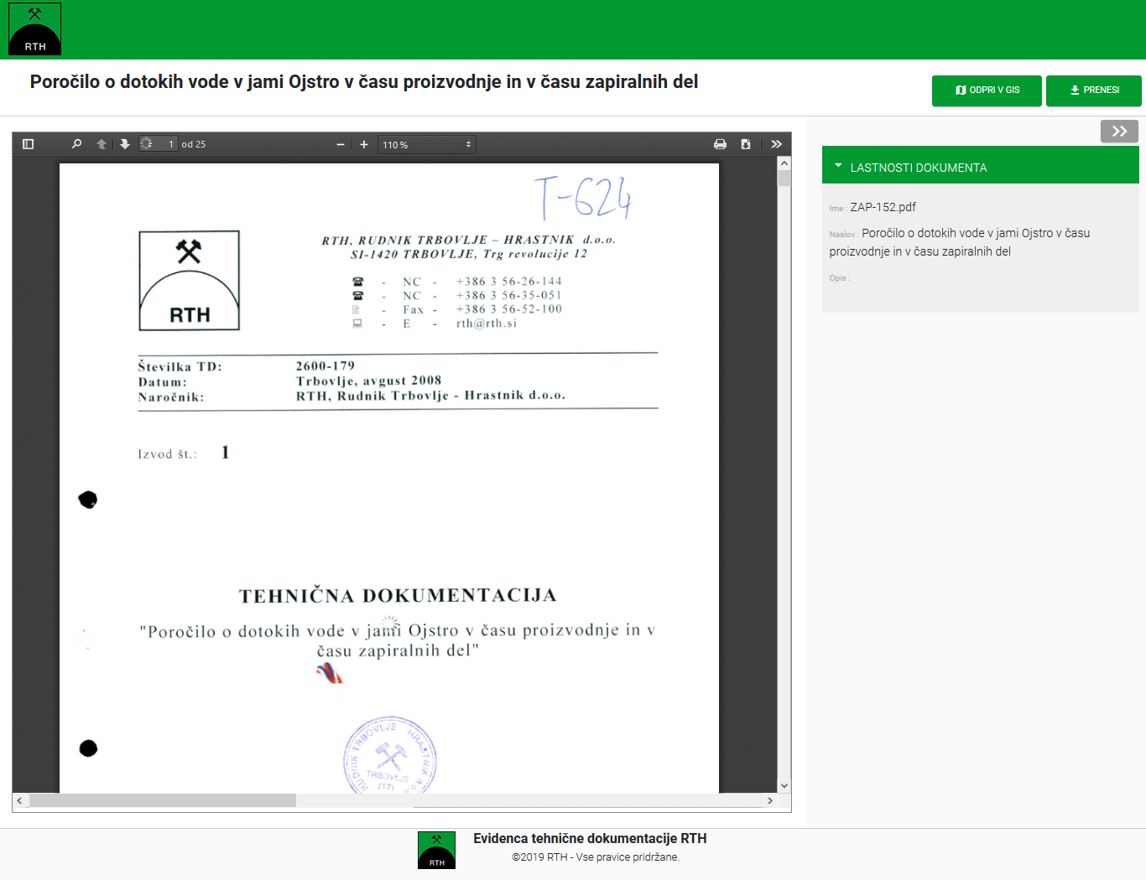
Link to specific document (valid on location)
Notes:
For location we can retrive information of techical documentation that is relevant in the location (rehabilitation projects, infrastructure projects …)

Slide 26
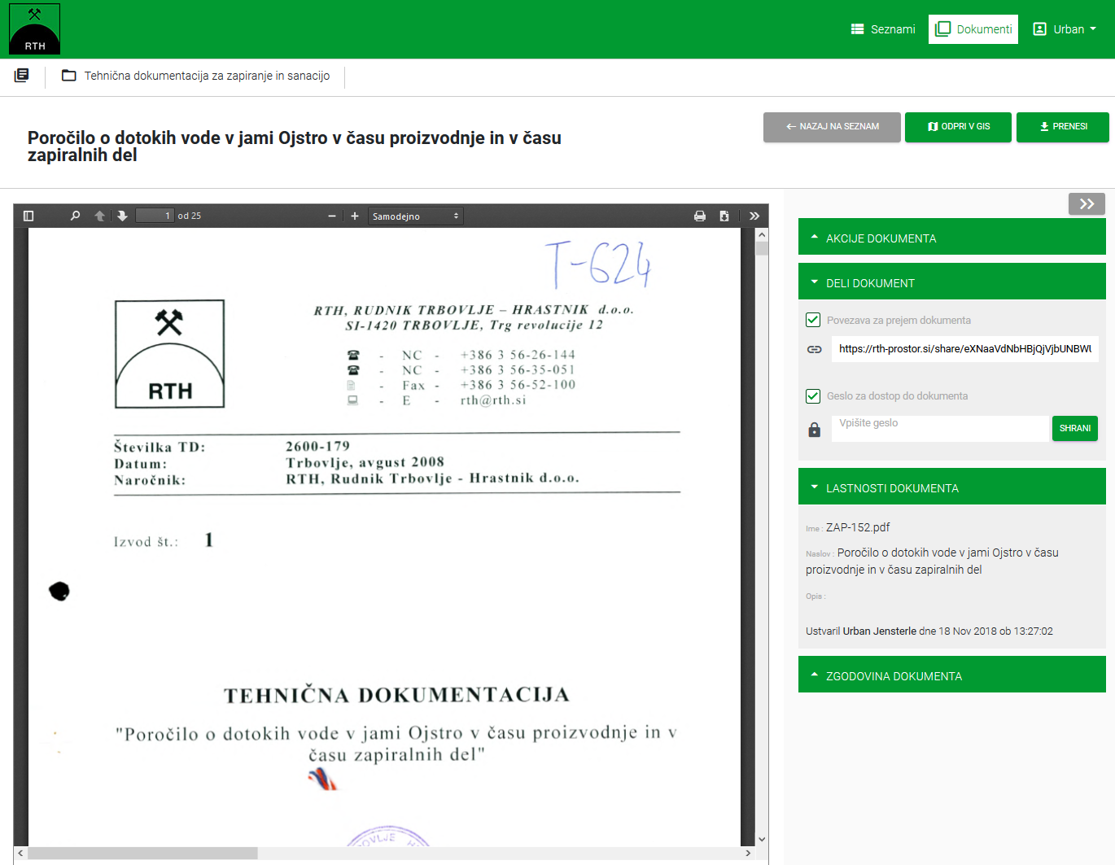
Share document (Link + Password)
Notes:
And finaly we can easly send a link of the documentation to adequate person (civil ingenier, mining inspector, spatial planner …)

Slide 27
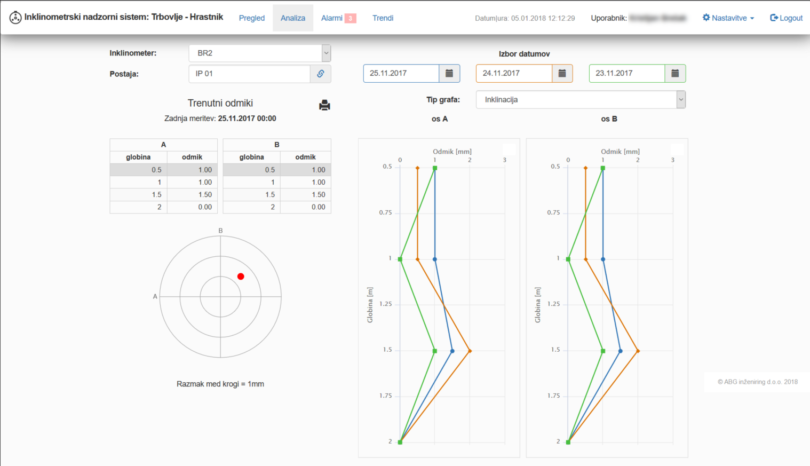
What‘s next?
Integrating digital arcihve of techical data with monitoring system (control system) into easy to use functional unit
Notes:
Plans for the future … we are working on integration of monitiring system with digital archive system described till konw

Slide 28
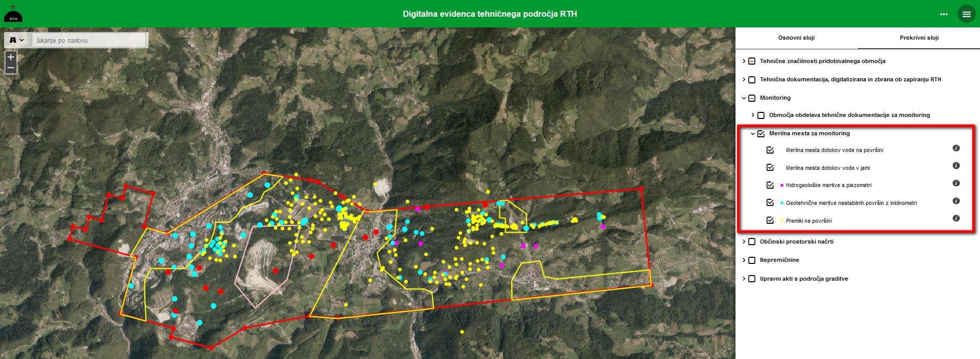
Monitoring: spots of different observation types
Notes:
As i mentoned before, in the geografic information system we have sptial and basic atribute data of monitoring points (different kinds if monitoring)

Slide 29
Monitoring for specific obsevartion spot
Notes:
On the other side, the monitoring observation system is developing. For inclination measurments the system with senzors and remote data trensfering from senzors to control system is already developed.

Slide 30
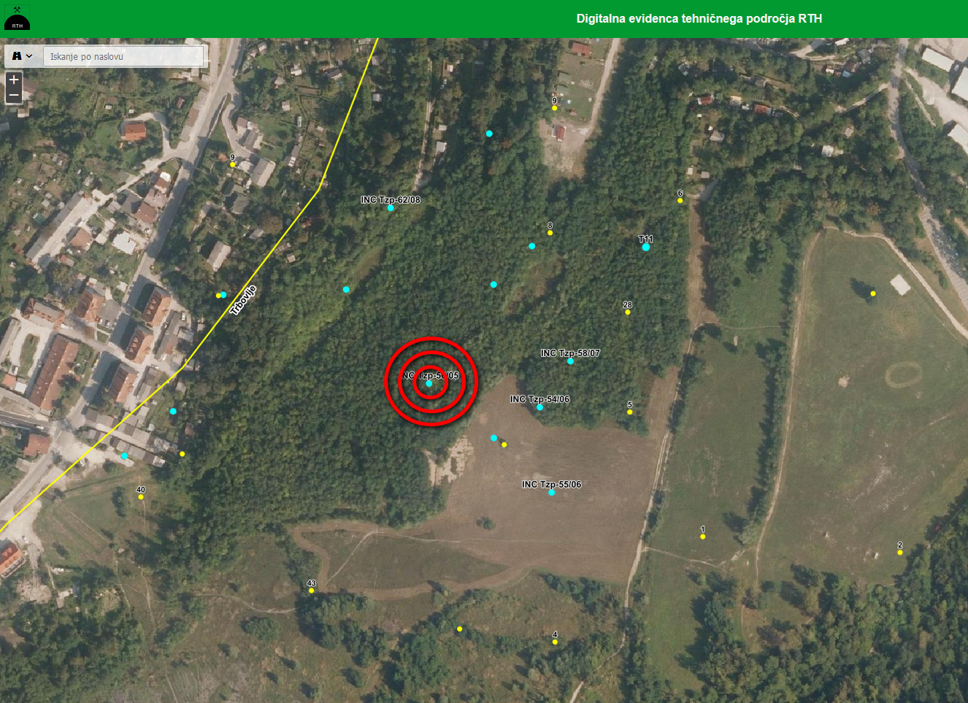
Alarm for spots with exceeded values
Notes:
With the integration of both systems the visualisation of movments of points in GIS will be possible and, with all the funcionality of document system the reasons for movement will be easy determined and proper actions will be taken. So the archive data will be used for solving problems in the present and future.

Slide 31
Conclusion
Effective use of archive data (spatial and non spatial) is possible with presented system (searching, presentation, analysing, interpretation, passing)
The system can be used for managing all the areas that require special caution or treatment
Open source (OGC standard compliant) tools are very corresponded for demanding tasks:
  Compatible with Slovenia spatial data infrastructure and INSPIRE directive
  No licence costs (low starting costs)
  Higher first instalation and seting costs (better be planed and preformed by professionals)
  Further development costs are equal or lower than with commercial GIS tools
It is recommended that professionals are involved early in the system design phase
Notes:
The presented system can be used for efficiant use of archive and non archive data for different pusposes, all related to managing large areas
We found that cpen source (OGC standard compliant) tools are very corresponded for demanding tasks. Advanteges of OGC toolsa are:
Compatible with Slovenia spatial data infrastructure and INSPIRE directive
No licence costs (low starting costs)
Higher first instalation and seting costs (better they are planed and preformed by professionals)
Further development costs are equal or lower than with commercial GIS tools
We recommended that professionals are involved early in the system design phase, so the system aim will be acchived

